Slide 1
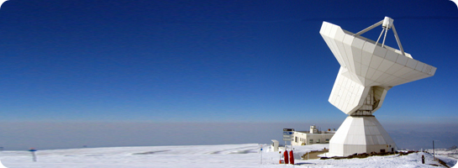
Basics of Radio Astronomy
Dr. James Di Francesco - NRC Herzberg Research Centre
(thanks to Sean Dougherty)

Slide 2
References
Kraus: Radio Astronomy
Wilson, Rohlfs & Huttemeister: Tools of Radio Astronomy*
Stanimirovic, Altschuler, Goldsmith & Salter: Single-dish radio astronomy: techniques & applications
Condon & Ransom: Essential Radio Astronomy✚
*Free e-book available by request
✚Online at http://www.cv.nrao.edu/~sransom/web/xxx.html

Slide 3
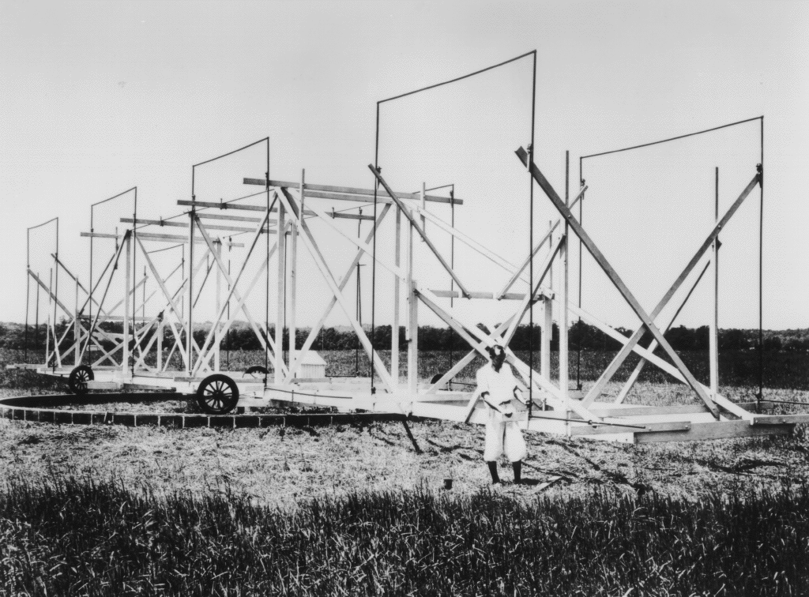
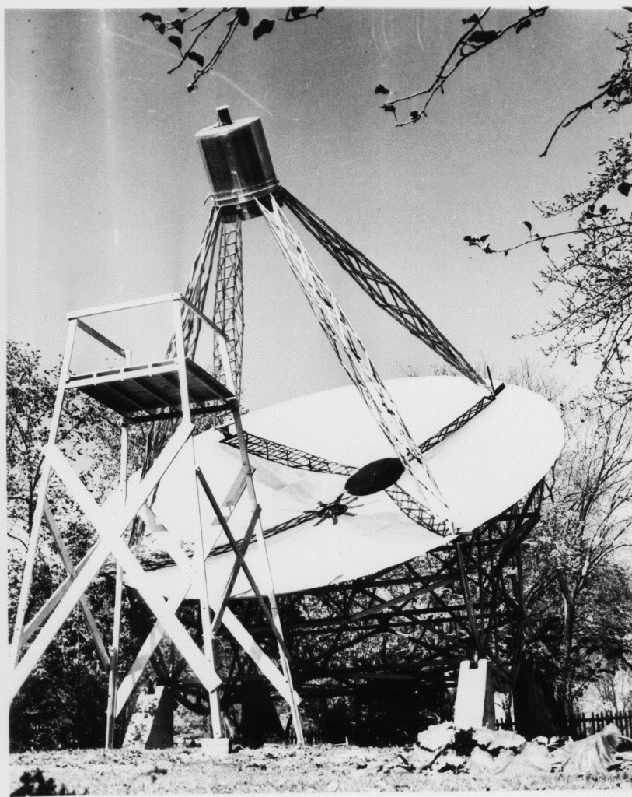
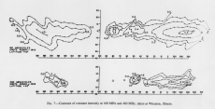
A brief history of wavelength coverage
What we know of the universe is by observation
  Detection and analysis of EM radiation from the universe
Up to 1930 – observations (knowledge) from 0.35 microns → 1 micron
1931 – Jansky observes the sky at 14.6m (20 MHz)
1937 – Reber observes at 1.87m (160 MHz)
Radar research during the war – improved antenna/receiver systems
Since 1945:
  interferometry: VLA, MERLIN, VLBA, DRAO, ATCA etc.
  extend to sub-mm: JCMT, CSO
  mm interferometry: PdB, SMA, CARMA, ALMA
  Balloons, aircraft, satellites for λ where atmospheric opacity is high.
    EINSTEIN, IUE, IRAS, ISO, MSX, CHANDRA, XMM, SPITZER…..
  ~diffraction limited and interferometry in the optical
Experimental techniques are now mature at almost all wavelengths
  Observations at each wavelength range used as astrophysical tools

Slide 4
Radio signals – how much energy?
Telescope of area 10,000 m²
Bandwidth = 50 MHz
Flux = 1 mJy
Total energy received in 1000 yrs = 1 erg = 10⁻⁷ Joules
~ few percent of energy of a falling snowflake !

Slide 5
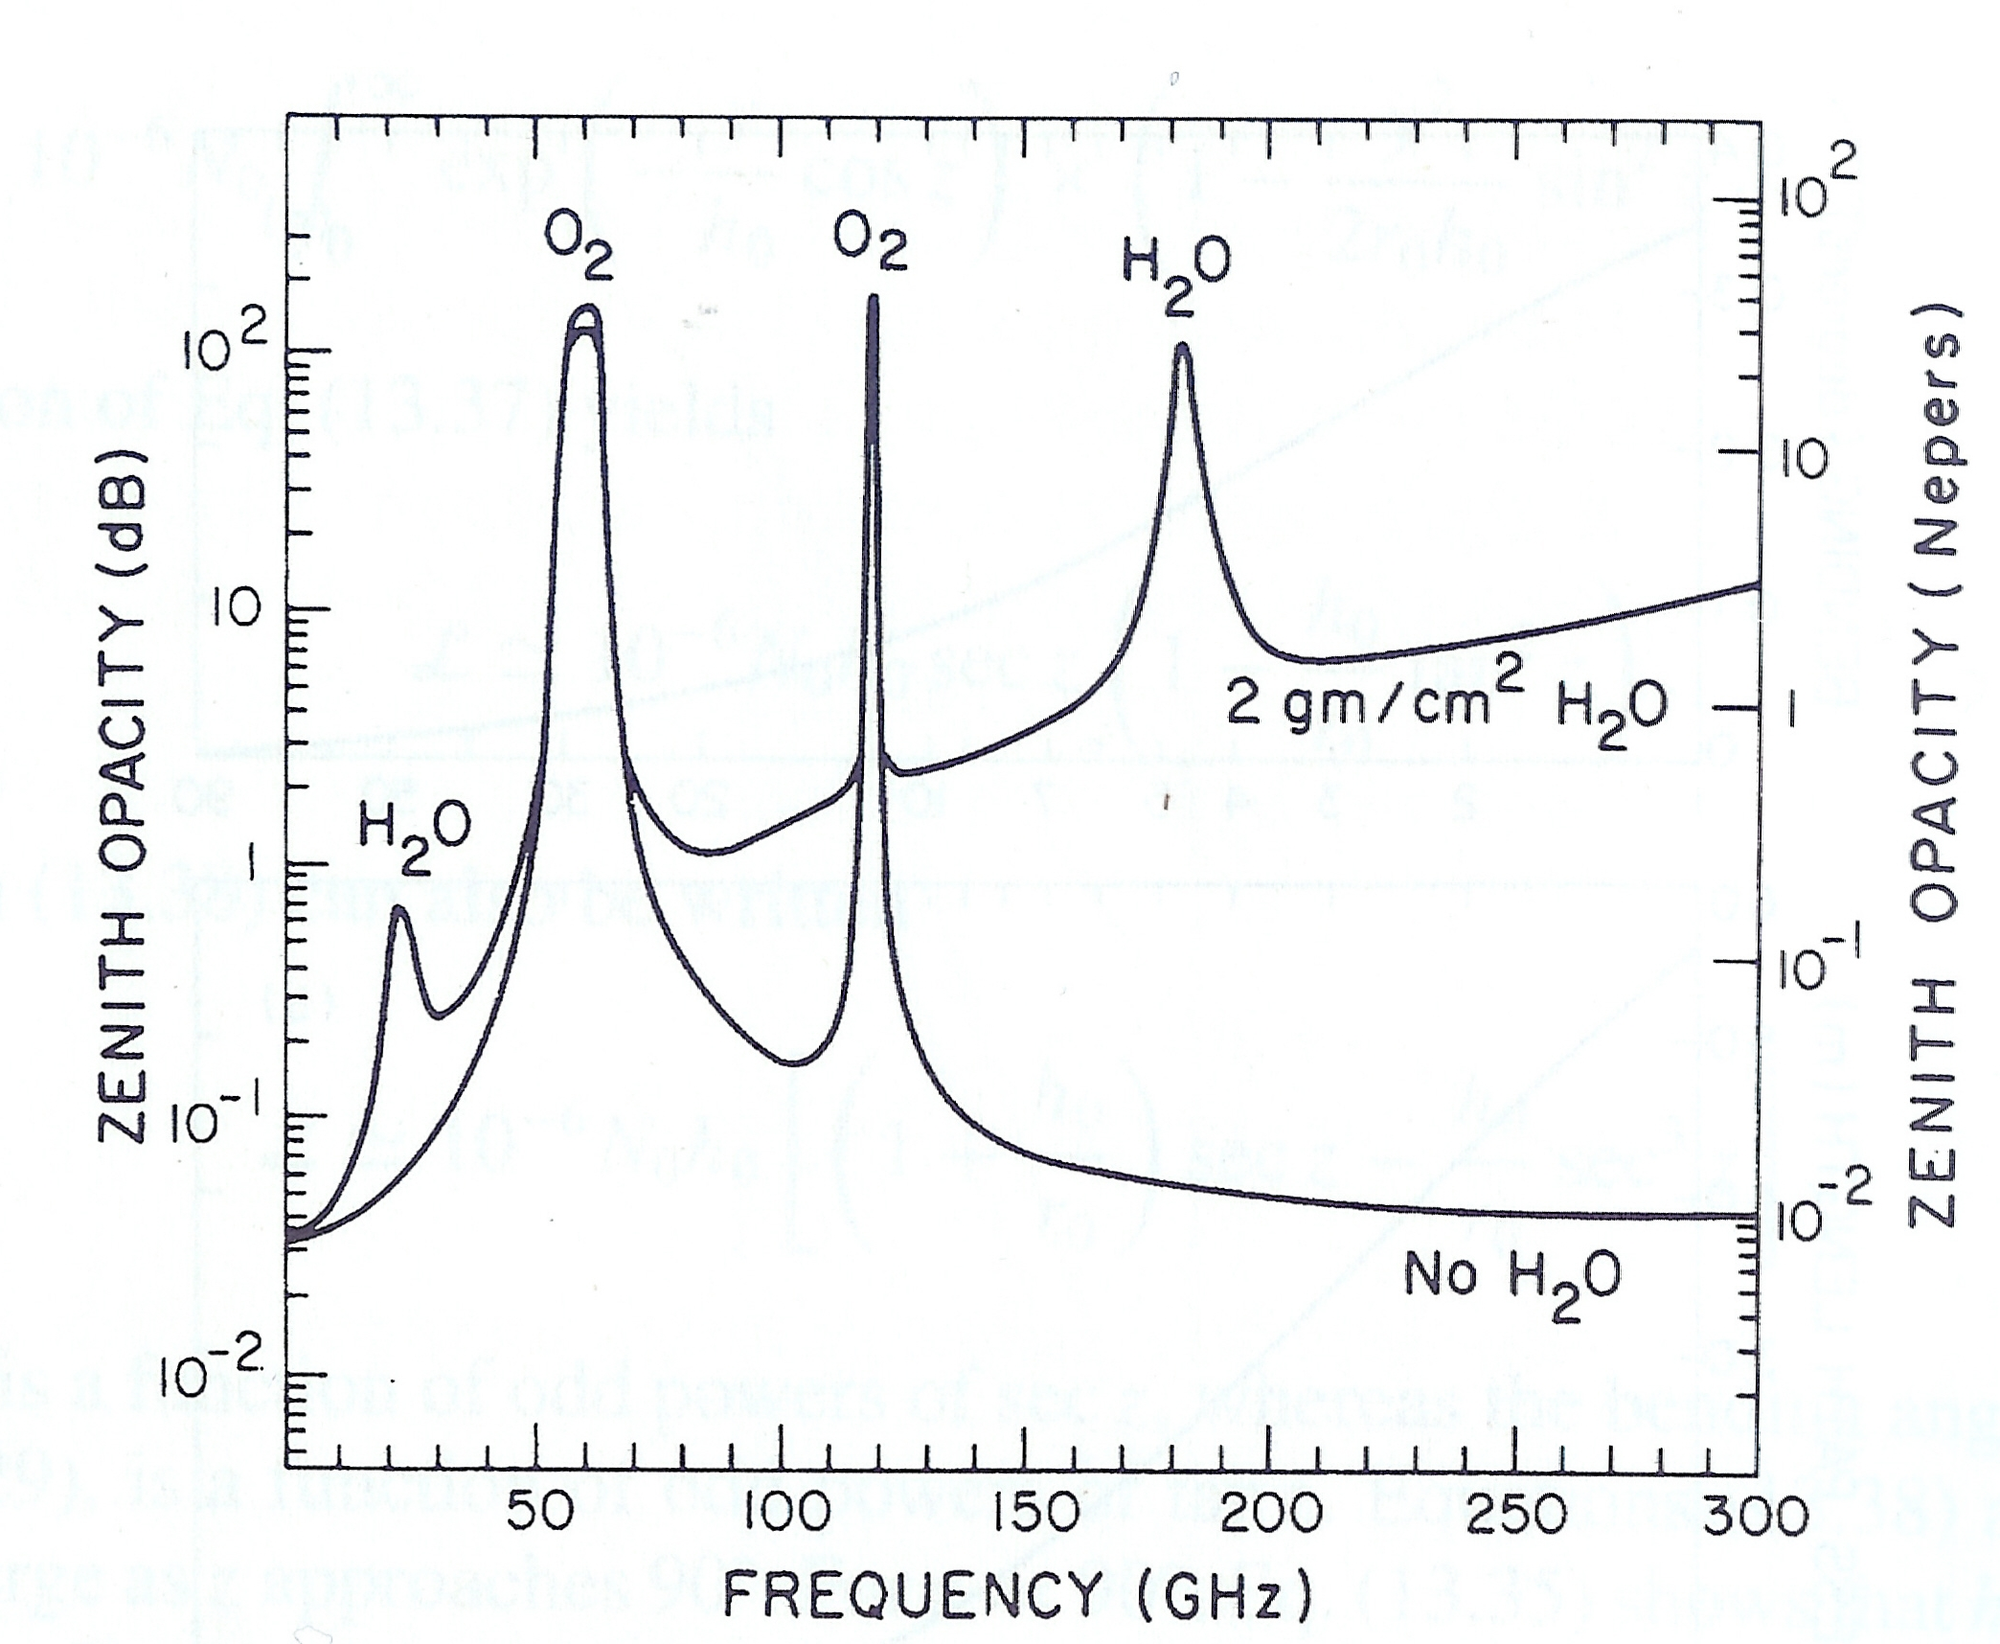
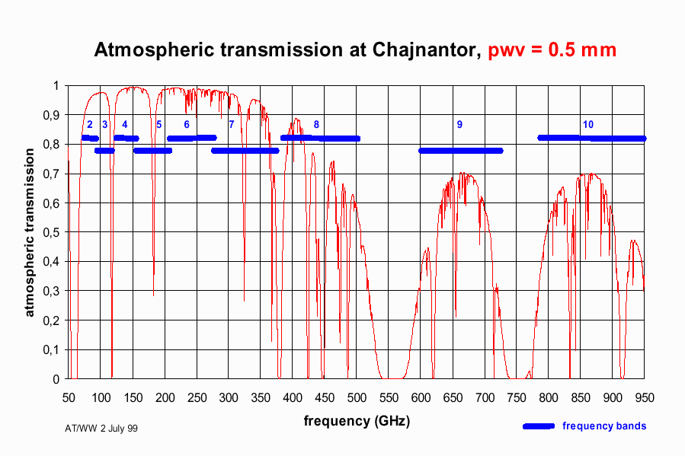
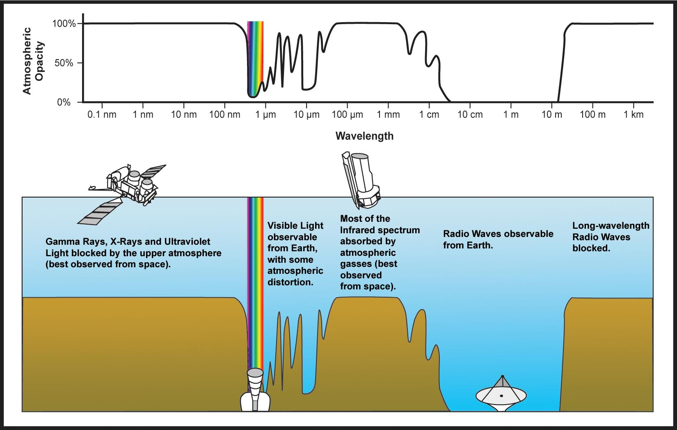
Atmospheric Windows
Radio window --- 5-10 MHz (~30 m) → 1000 GHz (300 microns)
- 5 decades of frequency!
Windows defined by absorption by atmospheric molecules
water
  best to pick telescope sites where water content is lower!
  e.g. Mauna Kea, Chajnantor, South Pole.
oxygen ~ 60 GHz ( 5mm) and 119 GHz (2.52 mm)
nitrogen and carbon dioxide absorption --- infrared region.
at low frequencies – cut-off defined by the plasma frequency of the electrons in the ionosphere.

Slide 6
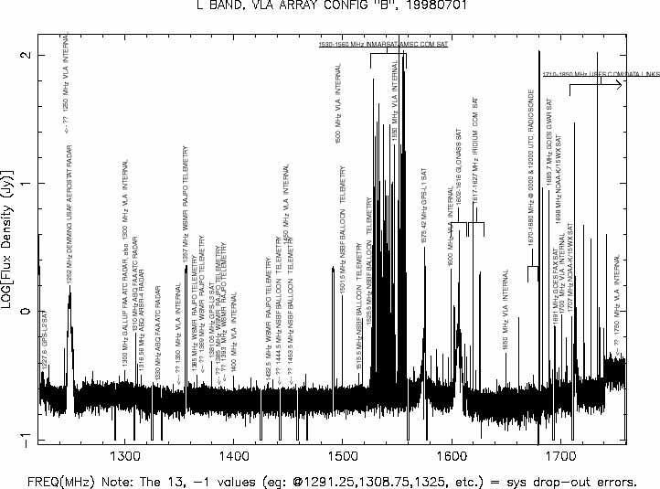
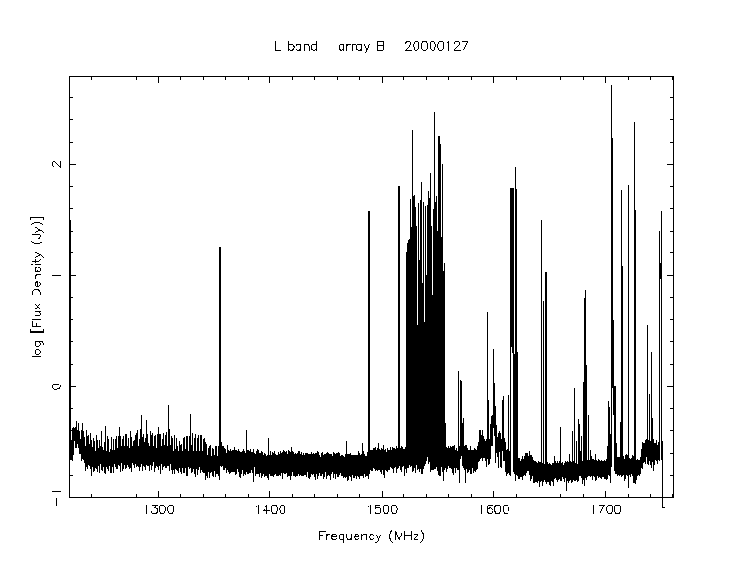
Radio Frequency Interference (RFI)
VLA 1.2-1.8 GHz

Slide 7
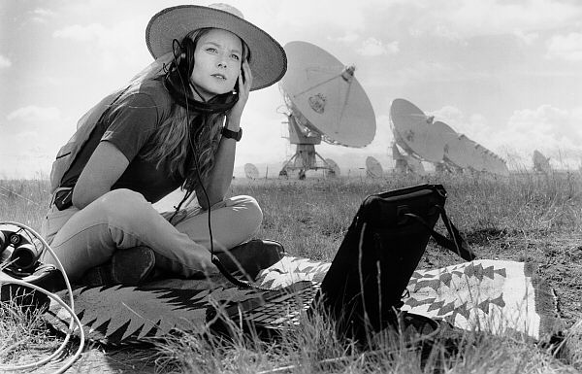
RFI mitigation techniques 101
No digital switching devices in the telescope beam!
No transmitters in the telescope beam!

Slide 8
What is detected at radio frequencies?

Slide 9
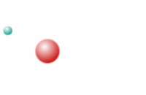
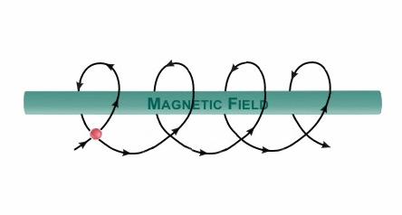
What is detected at radio wavelengths?
Continuum emission
  Thermal emission
    bremsstrahlung (free-free emission)
    Dust emission
  Non-thermal emission
    magneto-bremsstrahlung (gyro emission)
      Cyclotron (non-relativistic)
      Gyro-synchroton (mildly relativistic)
      Synchrotron (highly relativistic)

Slide 10
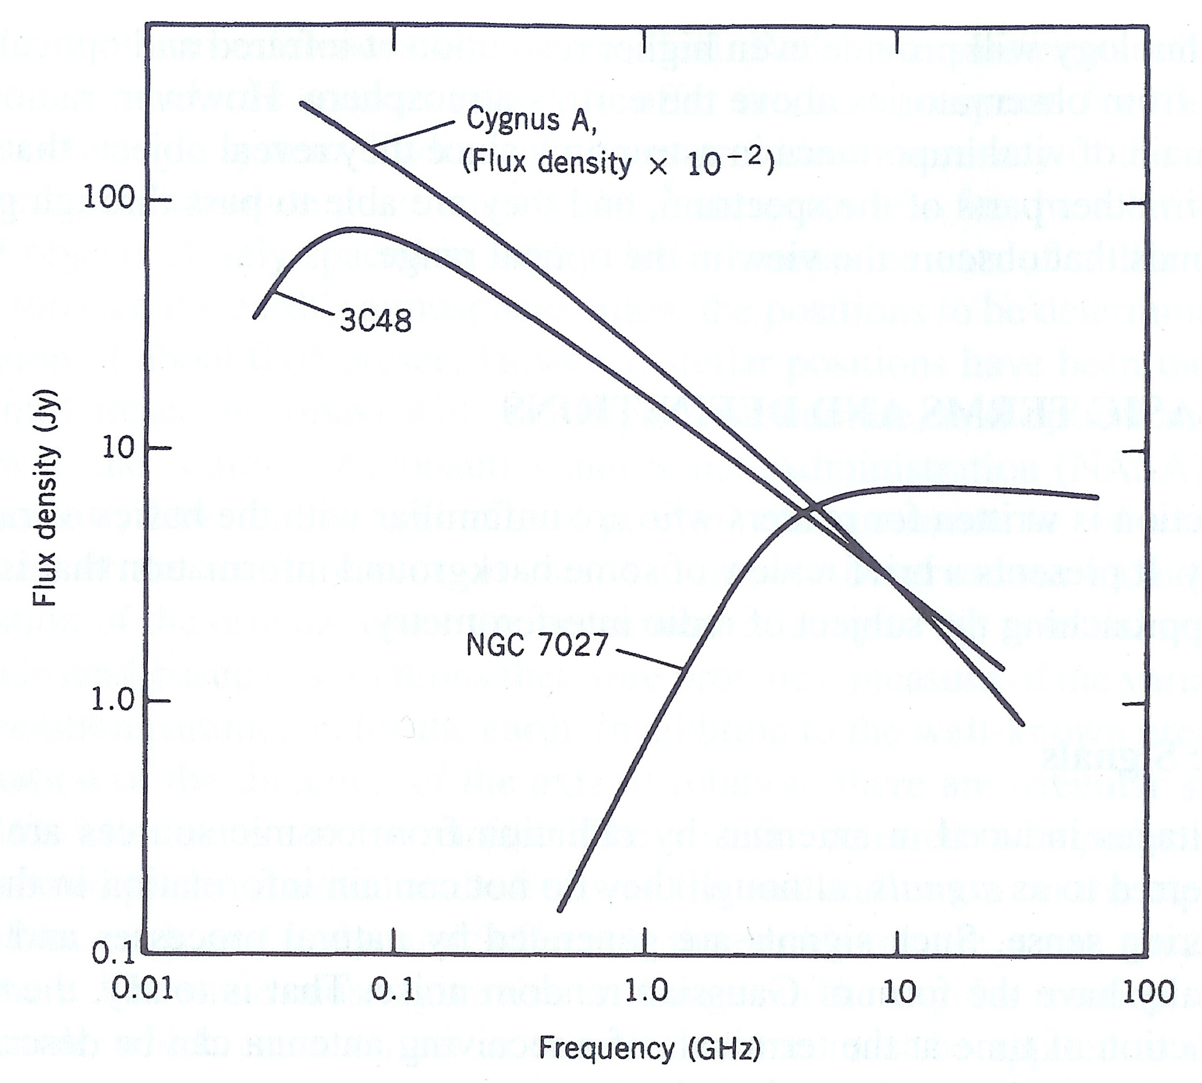
Continuum emission
Characterized by power-law spectra
Thermal spectrum

Slide 11
Continuum emission
Characterized by power-law spectra
Non-thermal spectrum

Slide 12
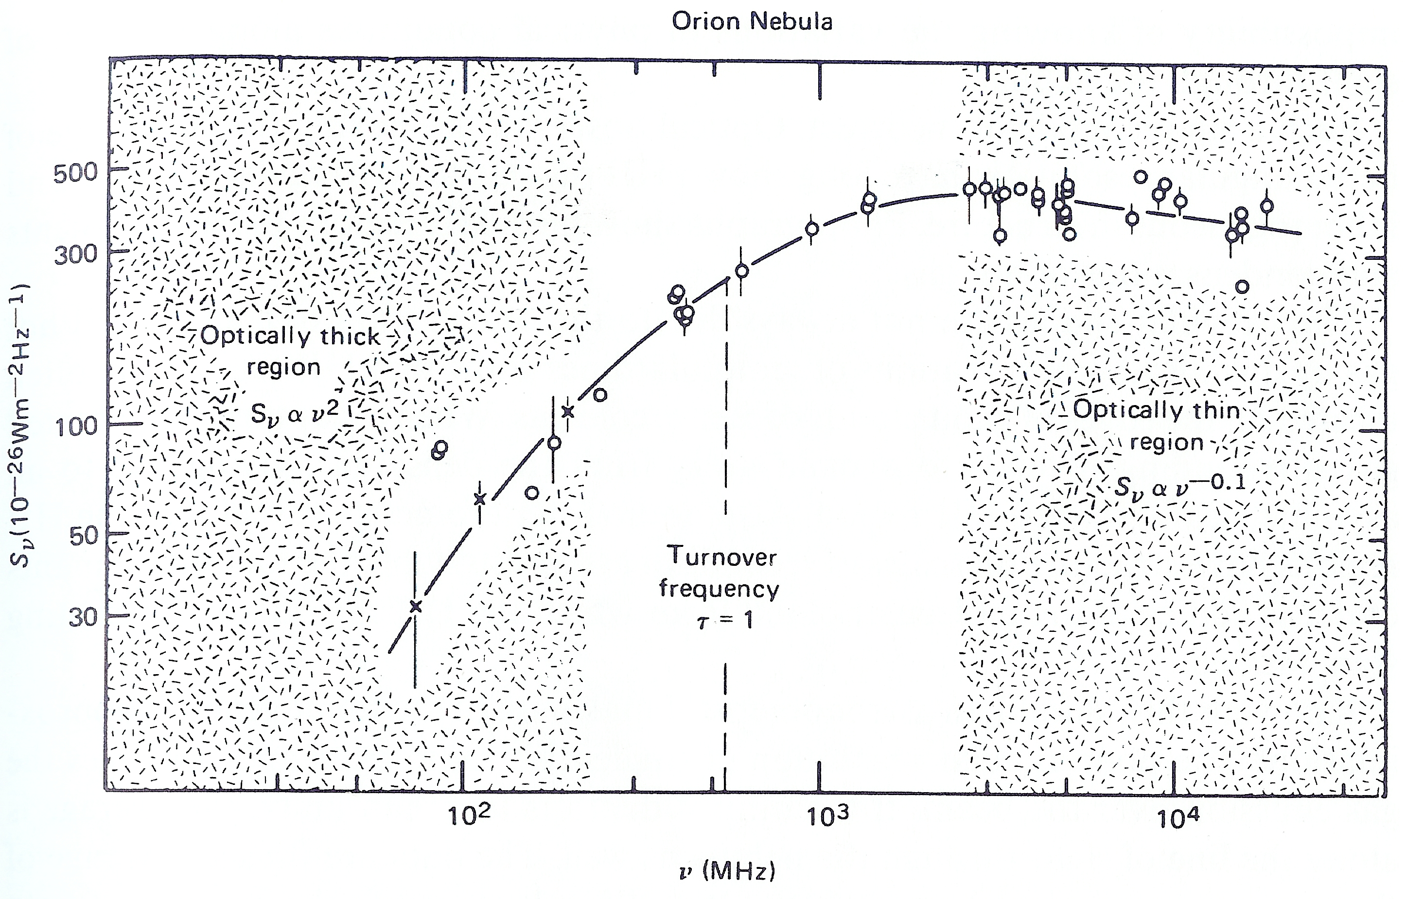
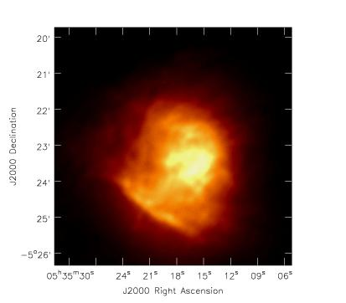
Thermal emission: HII regions

Slide 13
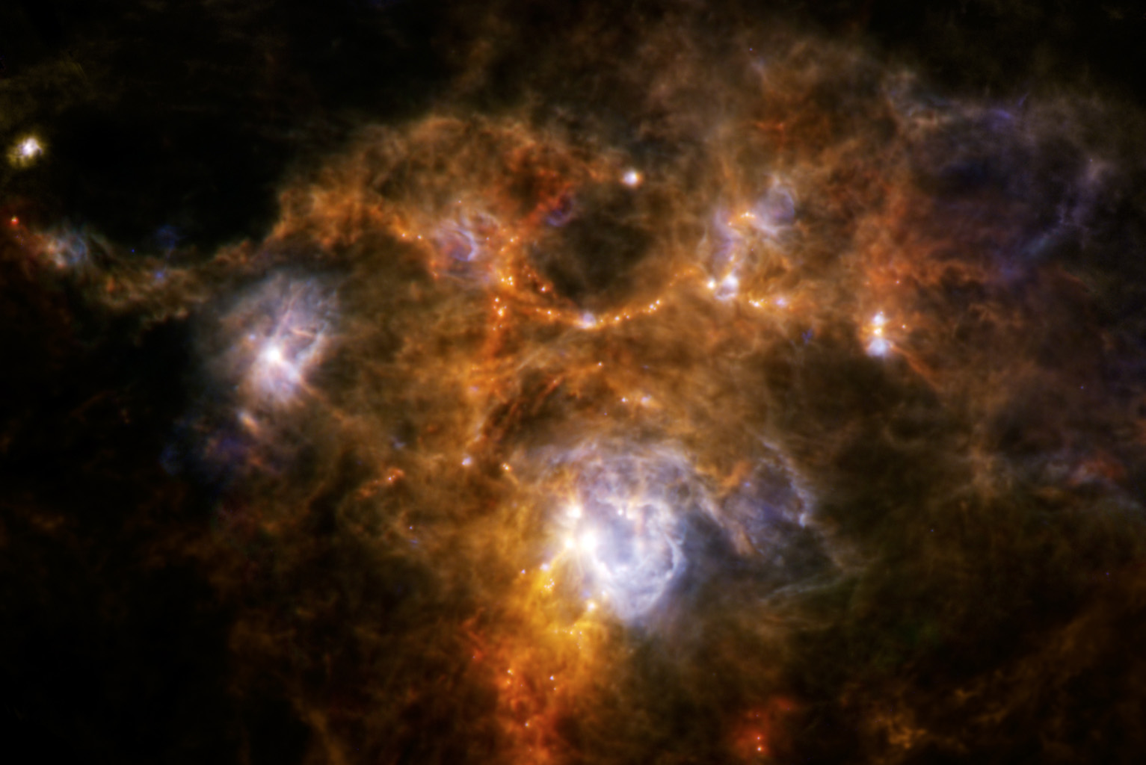
Thermal emission: Dust in molecular clouds
Herschel observations of NGC 7538
Composite of 70 μm, 160 μm & 250 μm

Slide 14
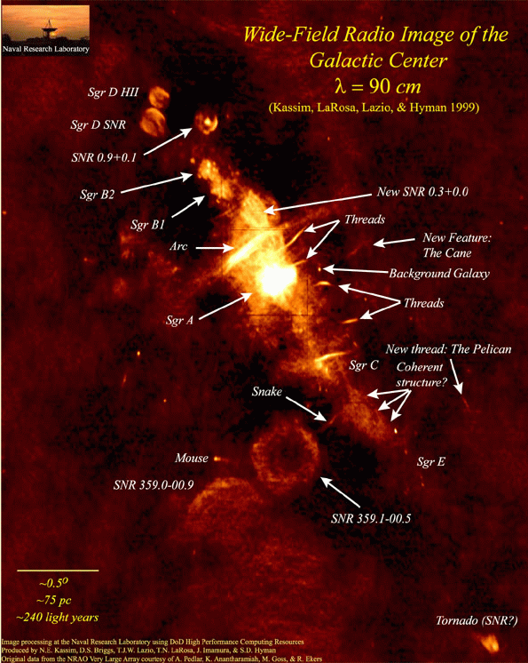
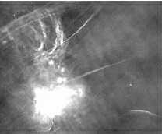
Non-thermal emission: Galactic Centre
Kassim, LaRosa, Lazio & Hyman, 1999

Slide 15
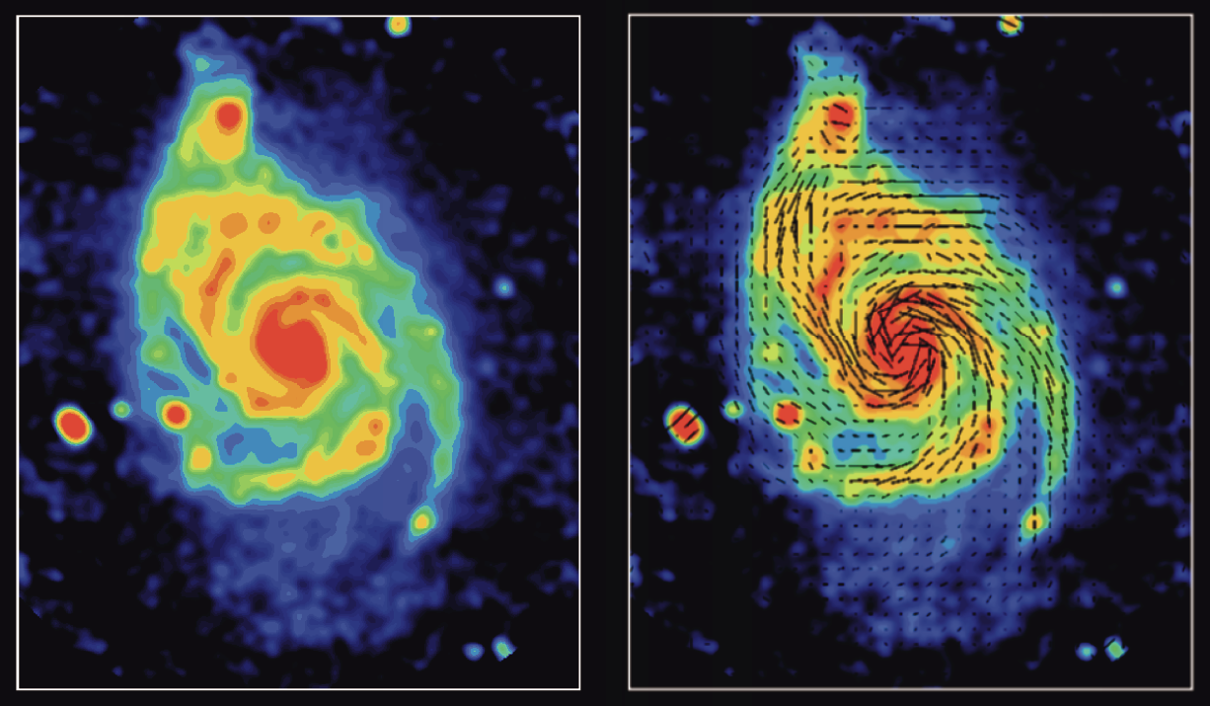
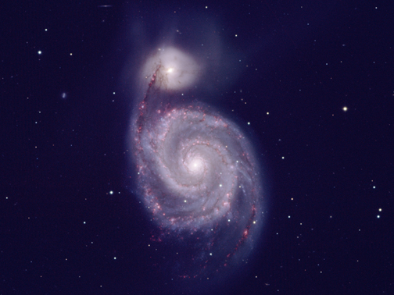
Non-thermal emission: polarization
NOAO Optical+Hα image www.noao.edu
Radio Continuum
Lines=Magnetic Field Orientation
Beck, Horellou, Neininger www.nrao.edu/imagegallery

Slide 16
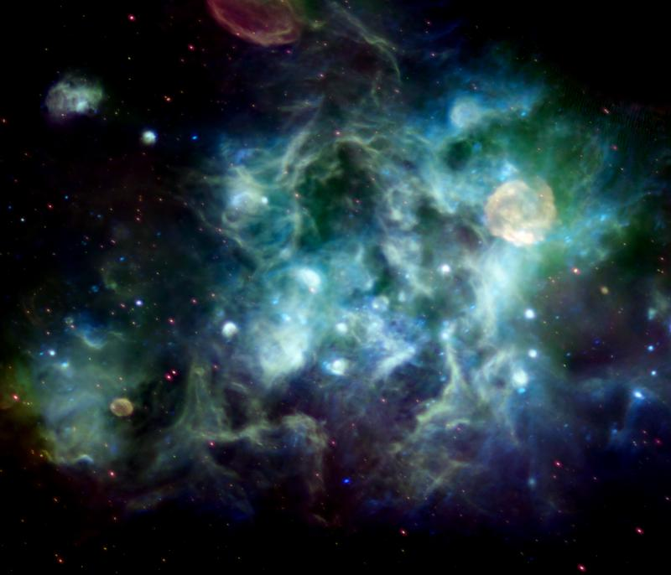
From the wonders of well sampled data….
27-image mosaic of the Cygnus region from DRAO: thermal (blue) non-thermal (red)

Slide 17
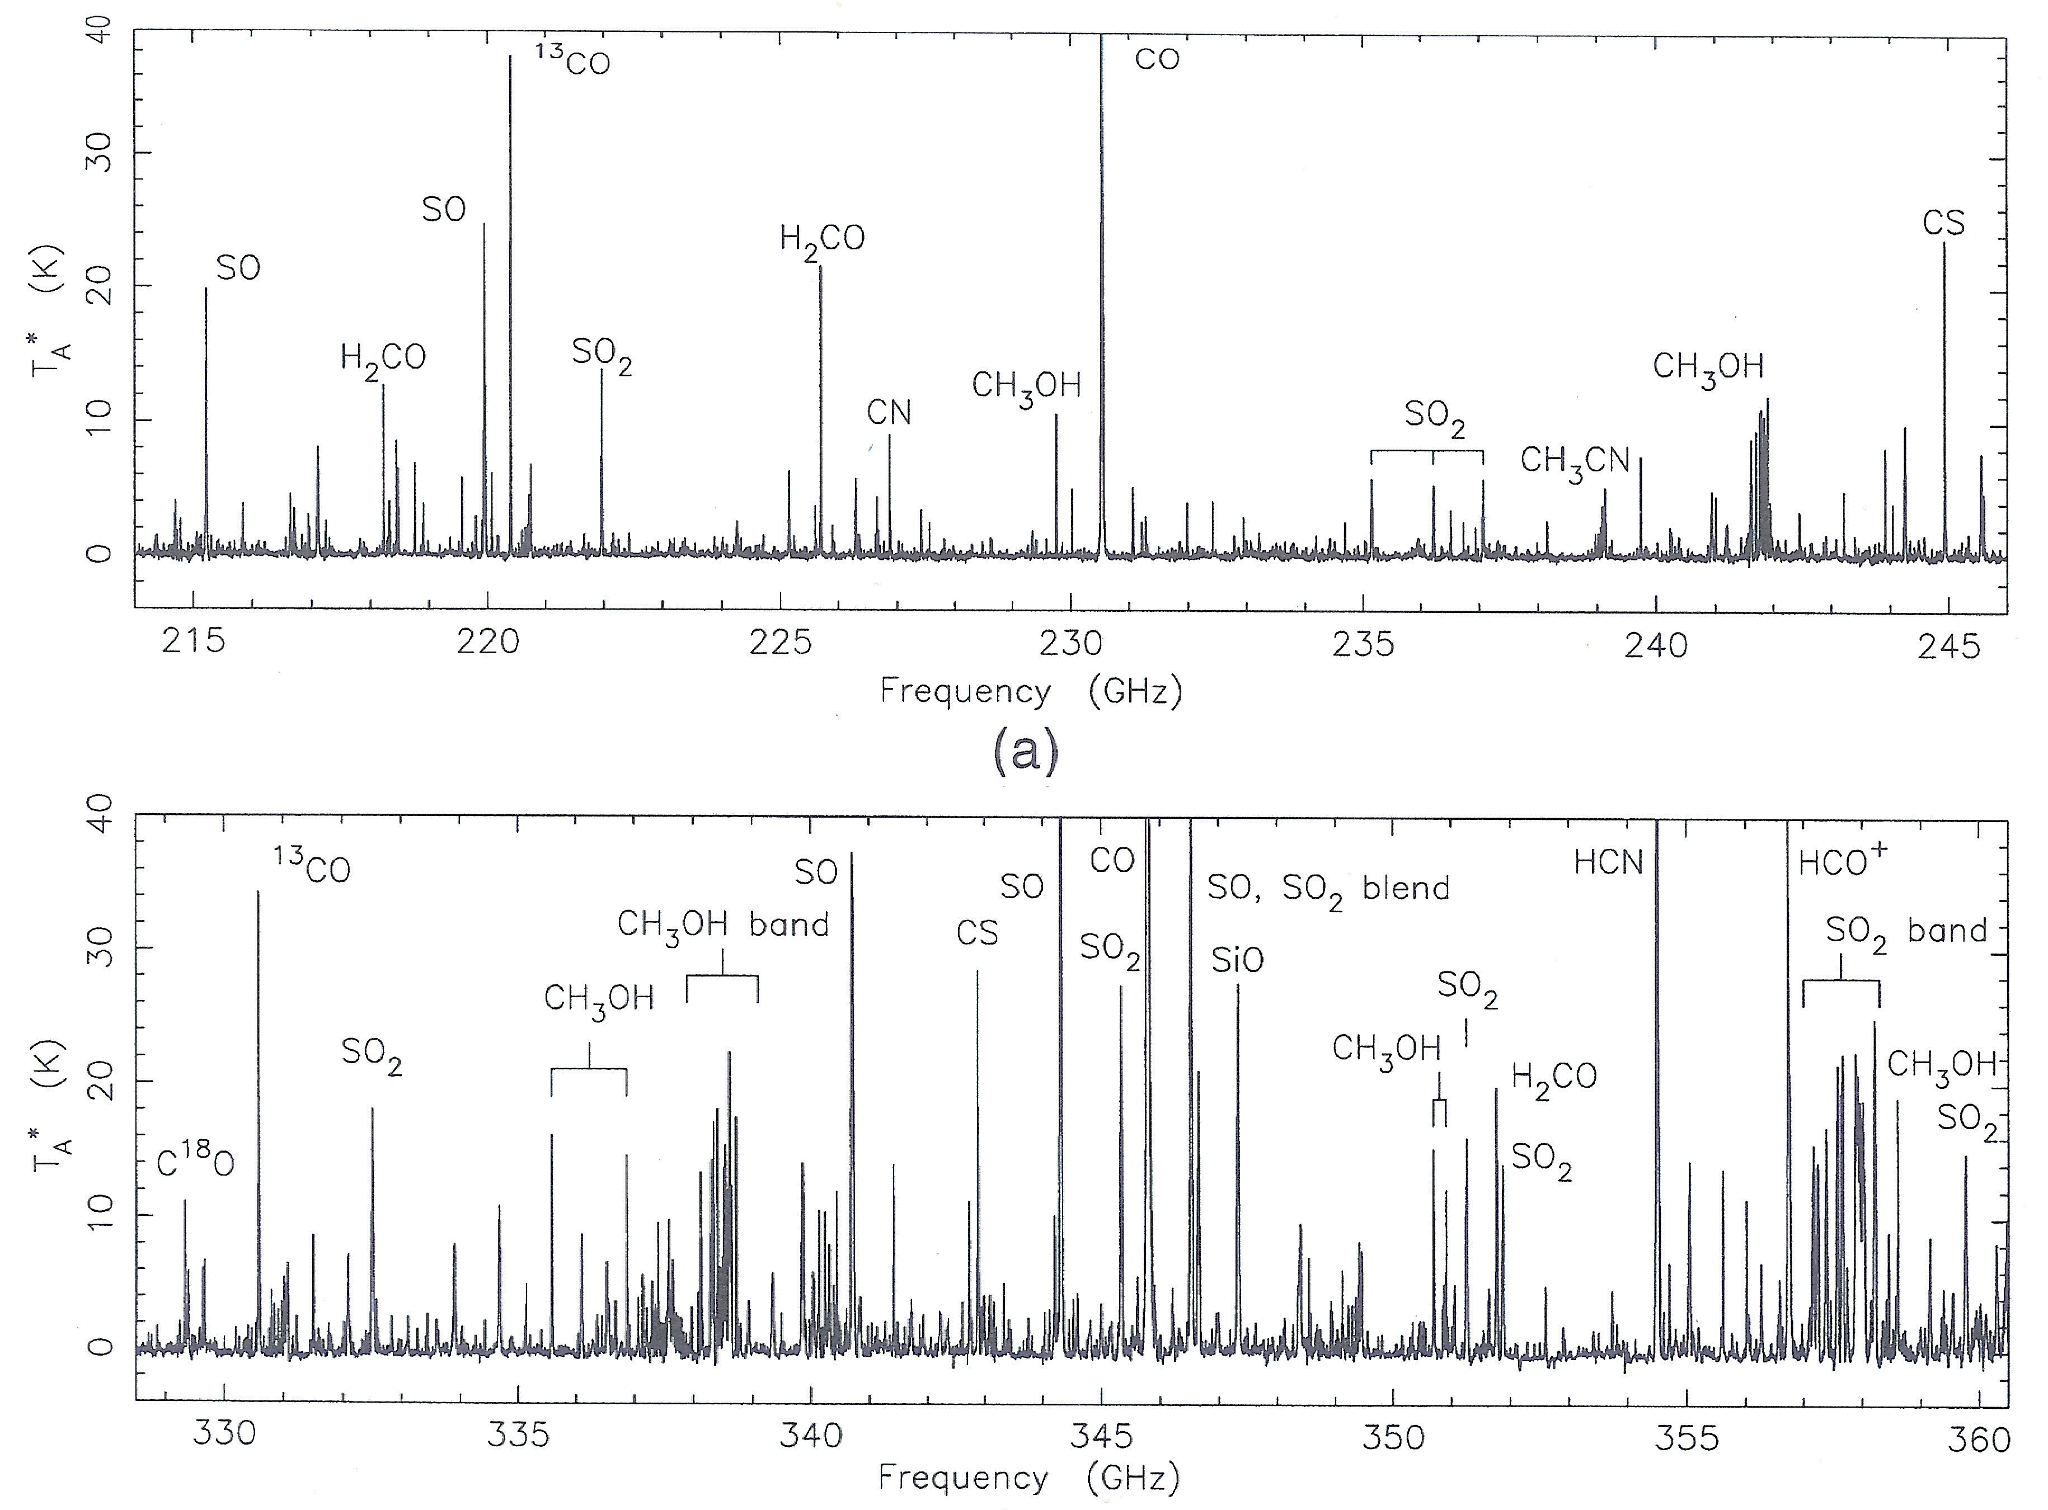
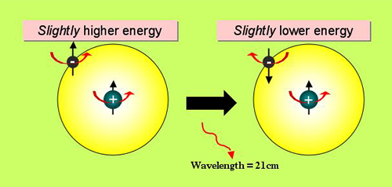
Line Emission
Line Emission -- due to quantum state transitions
  Radio “recombination” lines - high-energy level transitions
  Hyperfine splitting → 21 cm spin-flip of hydrogen
  Molecular transitions – rotation & vibration modes
  Maser emission – population inversion (non-thermal)
Line analysis gives:
  Gas characteristics – density, temperature, column density, opacity, abundances, chemistry
  Dynamics: Line-of-sight velocity via Doppler shift
    Infall, outflow

Slide 18
Molecular Lines
Many molecules discovered in space
  Around 200 detected and counting
Transitions are mainly in the mm/sub-mm
Köln Molecule List – many more than shown here!

Slide 19
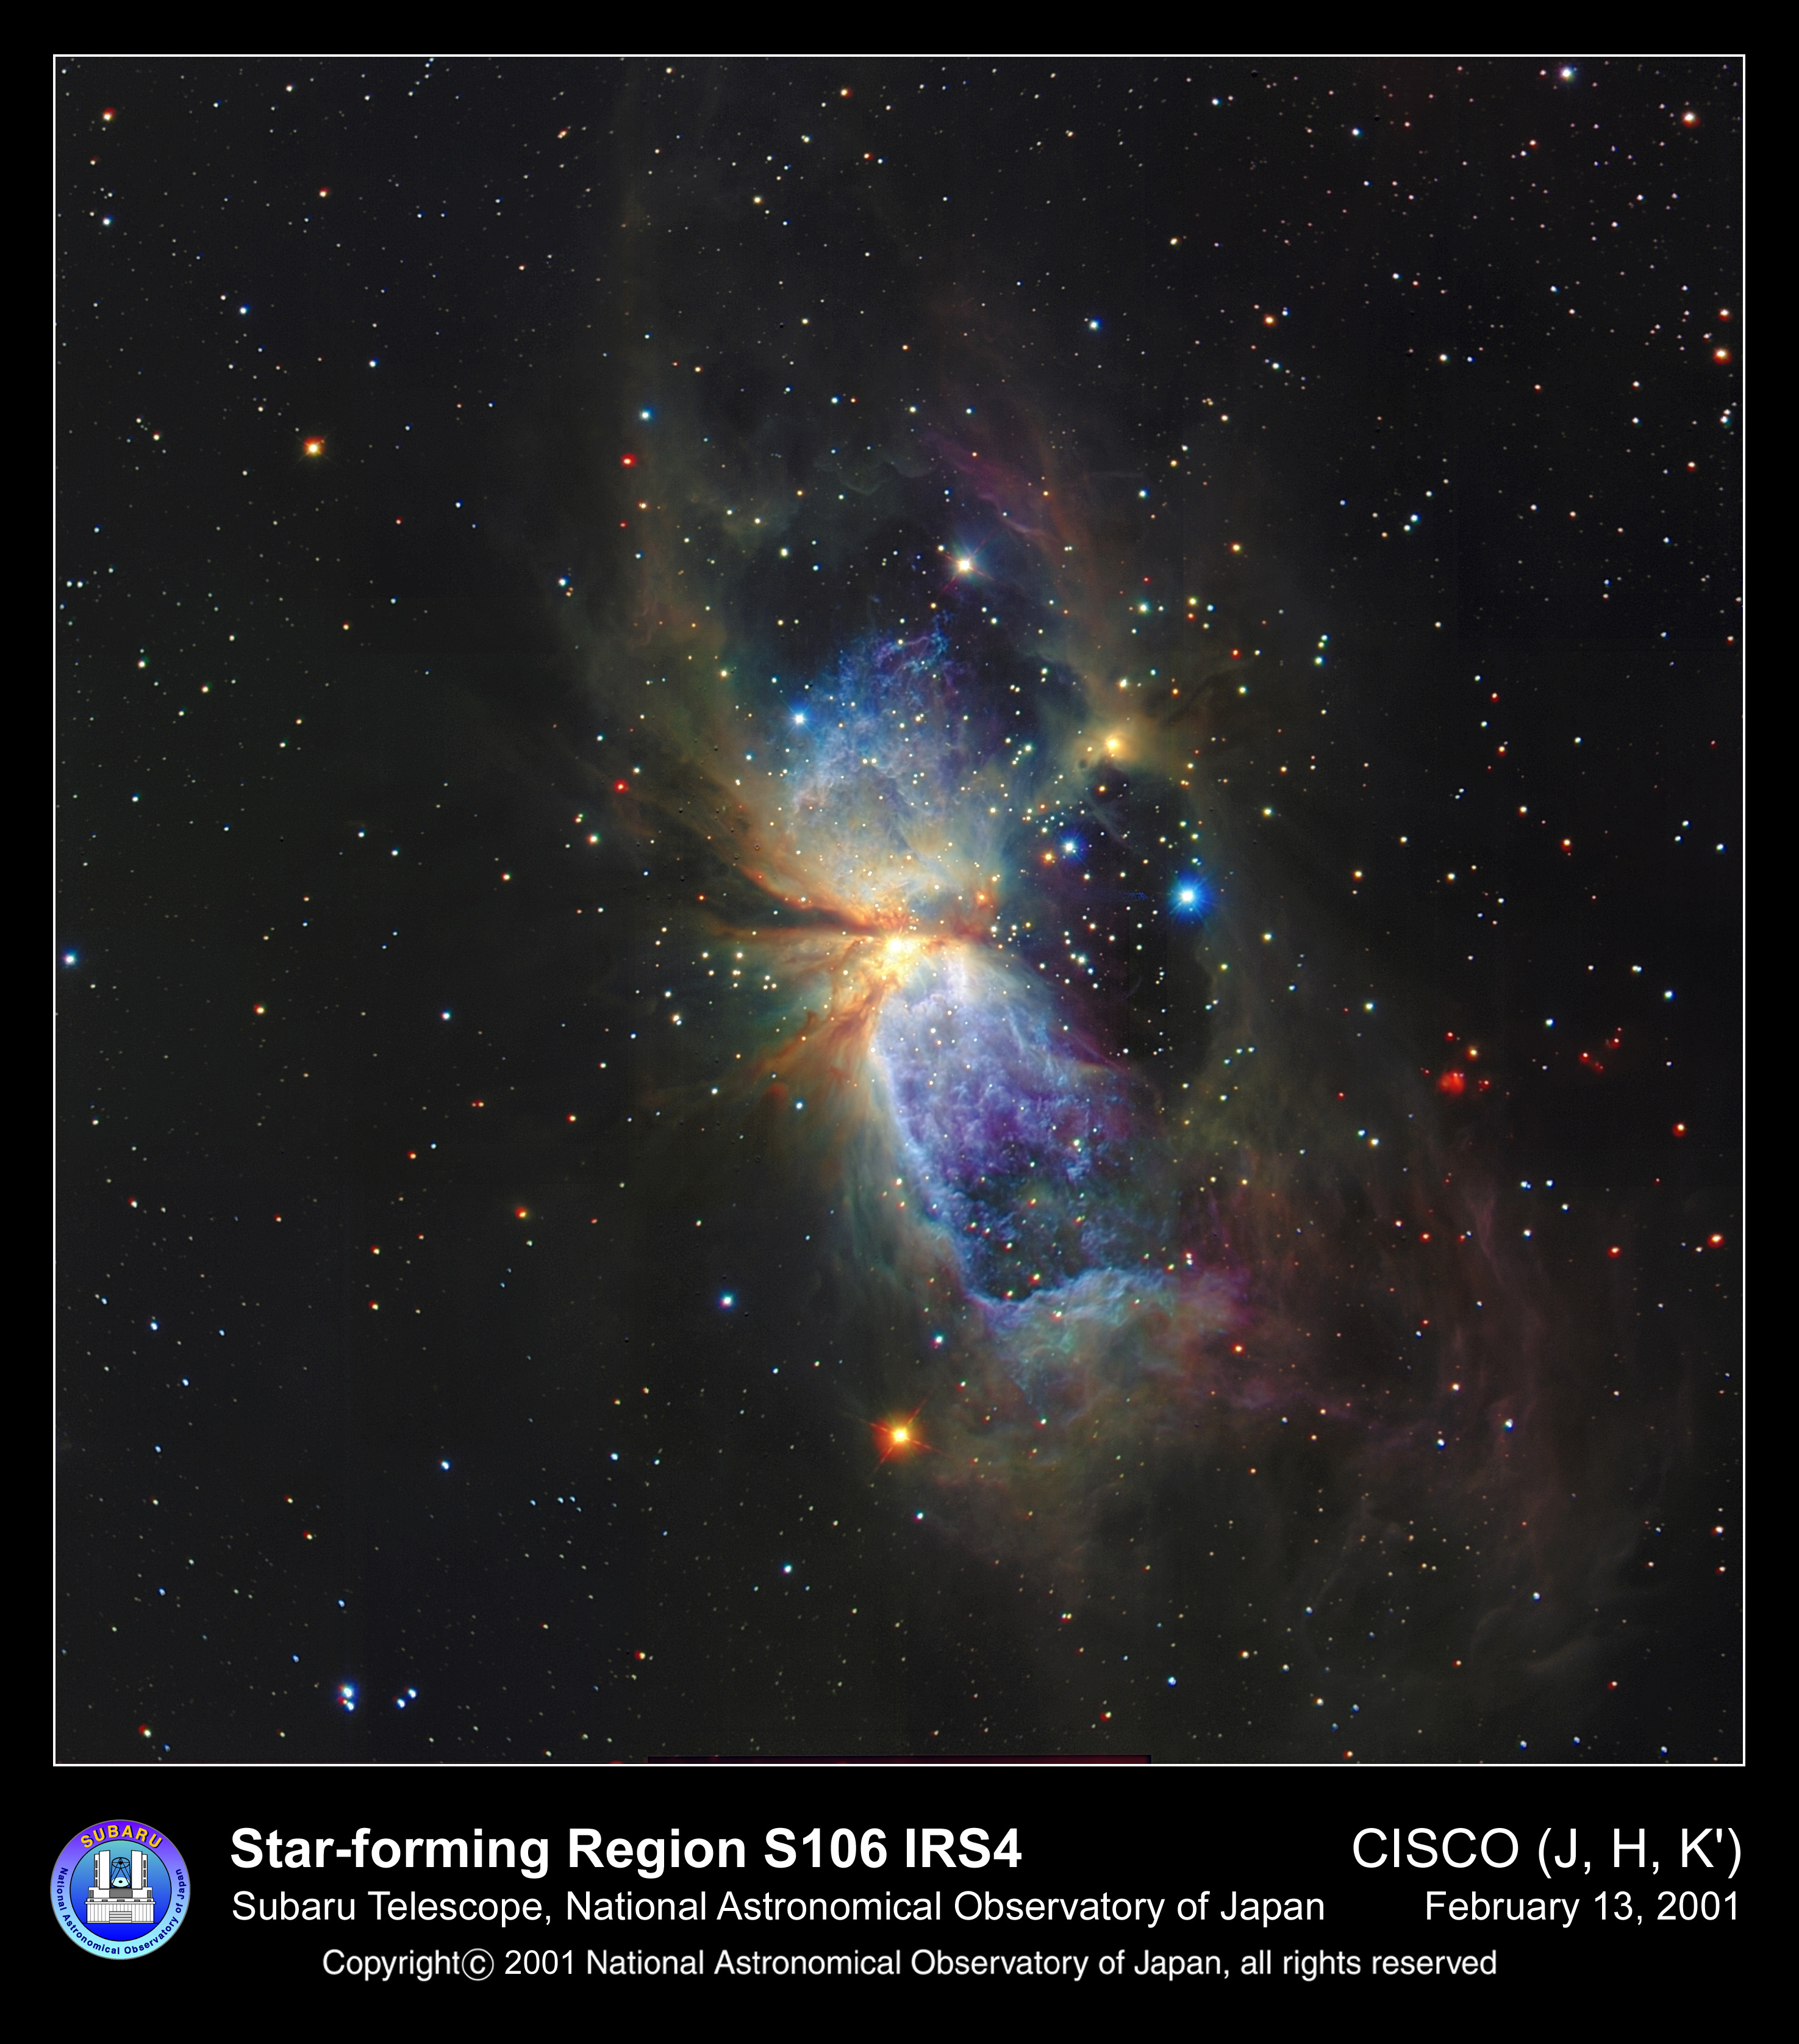
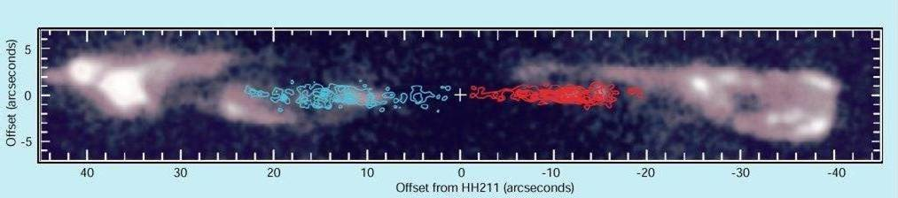
Molecular lines: outflows
Blue=Towards us
Red=Away from us
outflow in S106
Chandler & Richer 2001 (SiO J=1-0 in HH 211)

Slide 20
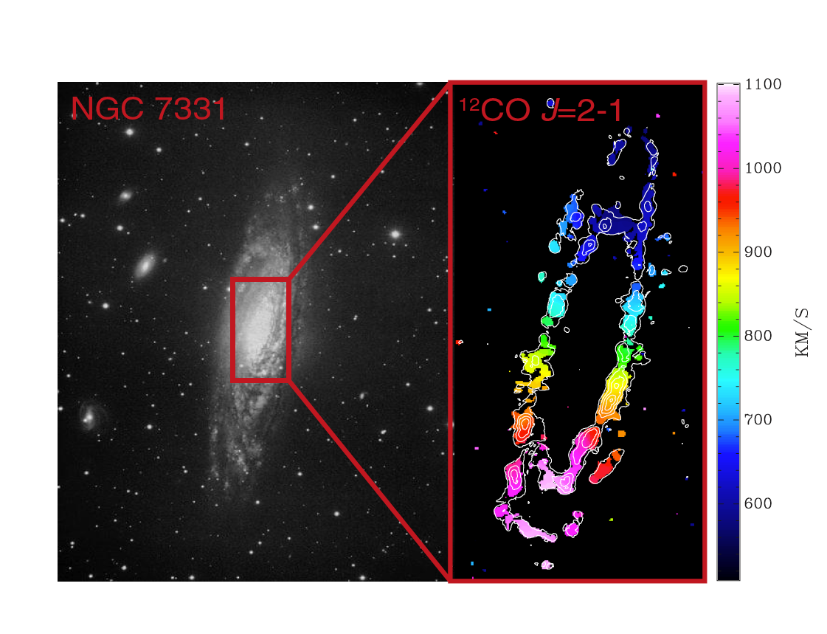
Molecular Lines: dynamics
Text

Slide 21
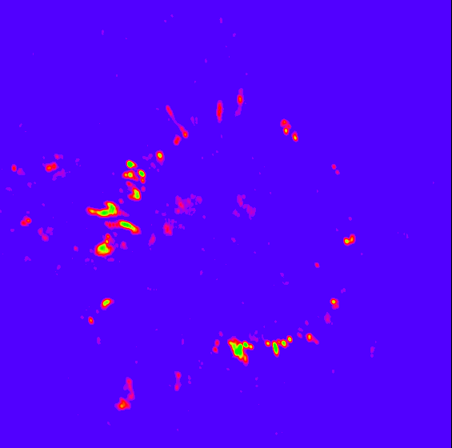
Molecular lines: maser emission
VLBA observations of SiO maser emission in wind of AGB star
Gas motions are evident
The “ring” diameter ~10AU
73-epochs of SiO maser observations of TX Cam (Gonidakis and Diamond)

Slide 22
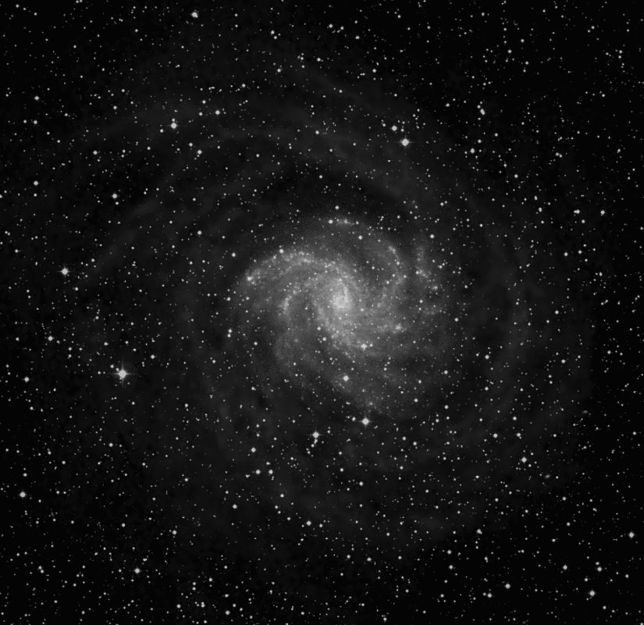
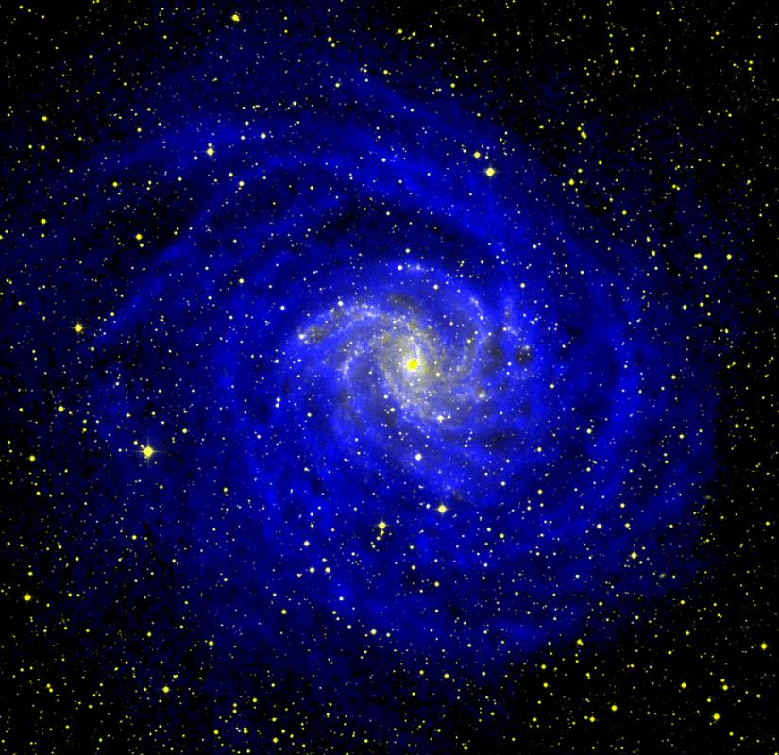
Neutral Hydrogen in Galaxies
NGC 6946

Slide 23
HI: dynamics of our own Galaxy
HI4PI movie
https://www.youtube.com/watch?v=Q2mgpsTFuV8

Slide 24
(just a reminder)
Some basic concepts

Slide 25
Basic Concepts
EM power in bandwidth δν from solid angle δΩ intercepted by surface δΑ is:
Defines surface brightness I_{v} (W m⁻² Hz⁻¹ sr⁻¹) ( aka intensity/specific intensity)
Flux density S_{v} (W m⁻² Hz⁻¹) – integrate brightness over solid angle of source
Convenient unit - the Jansky ➔ 1 Jy = 10⁻²⁶ W m⁻² Hz⁻¹ = 10⁻²³ erg cm⁻² Hz⁻¹
Note:

Slide 26
Surface Brightness of a Black body
Surface brightness of a black body defined by the Planck Function
Radiation emitted at ν depends only on ν and the blackbody temp T
Special case – Rayleigh-Jeans limit
This approximation starts to break down in mm

Slide 27
Surface Brightness
In general surface brightness is position dependent ie. I_{ν}=I_{ν}(θ,φ)
i.e. surface brightness is described by a temperature distribution
Back to flux:
In general, a radio telescope maps the temperature distribution of the sky

Slide 28
Brightness Temperature
Many astronomical sources DO NOT emit as blackbodies!
However….
Brightness temperature (T_{B}) of a source is defined as the temperature of a blackbody with the same surface brightness of a source at a given frequency.
This implies that the flux density

Slide 29
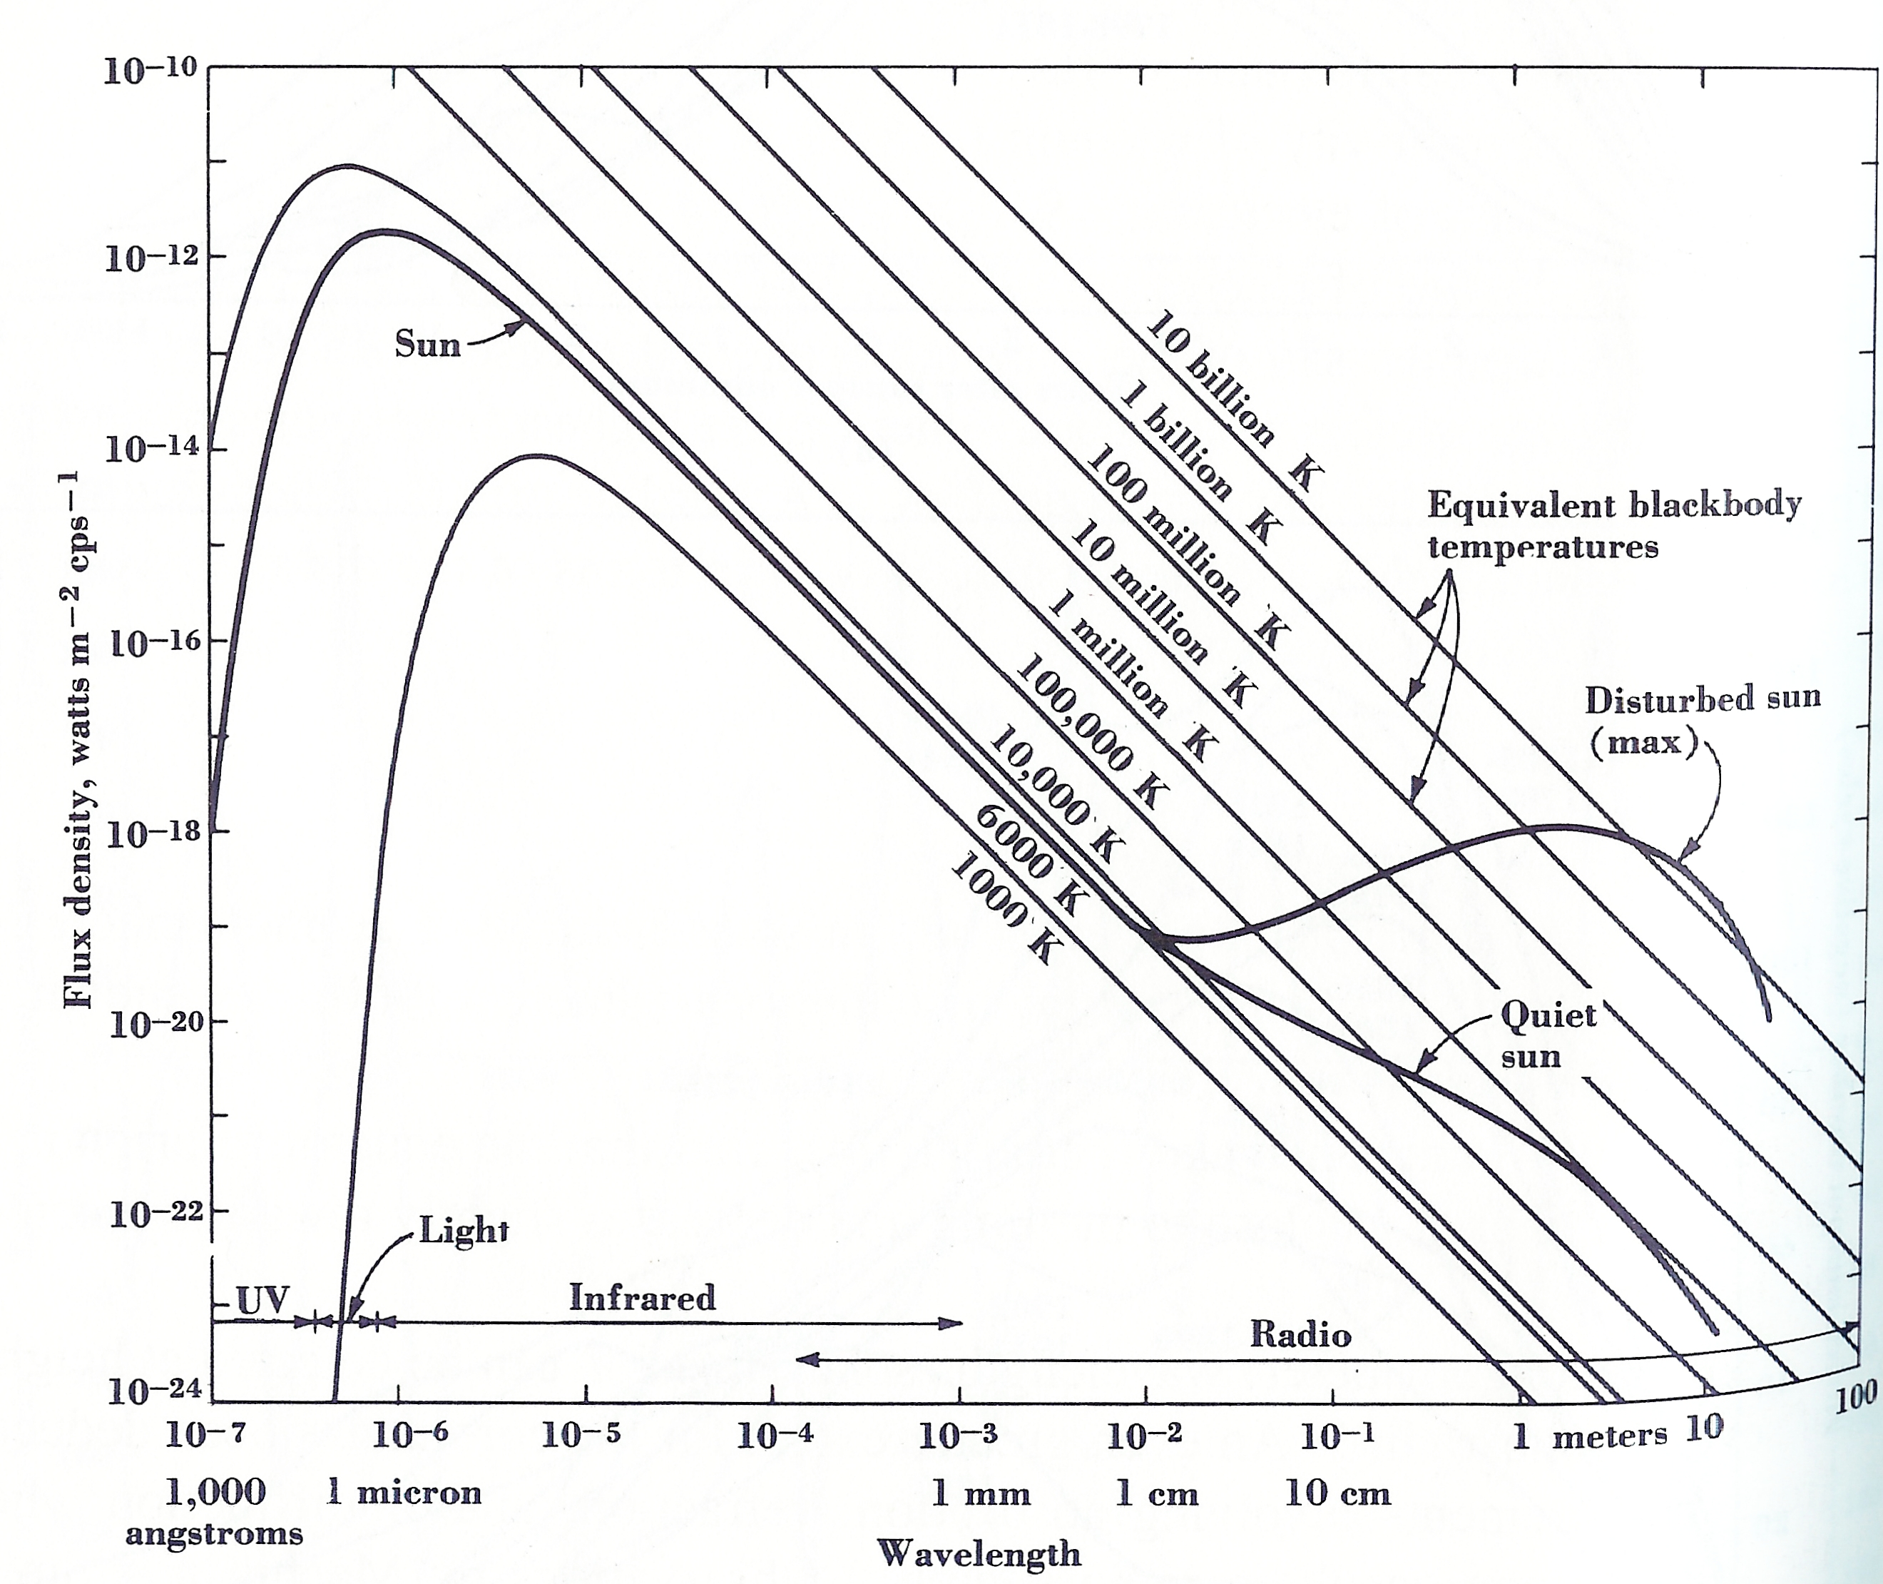
Brightness Temperature
Examples:
‘Blank’ Sky 2.73 K Big Bang
Orion Nebula @ 300 GHz 10-100 K Warm molecular cloud
Orion Nebula @ 1 GHz 10⁴ K Thermal
Quasar 10⁷⁻¹² K Synchrotron
‘Quiet’ Sun @ 300 MHz 5x10⁵ K Synchrotron
Sun @ 30 GHz 5800 K Thermal
@ 30 GHz T~5800 K
=> Thermal emission
@ 300 MHz T~10⁶ K
=> Non-thermal emission

Slide 30
Tools of the trade - telescopes

Slide 31
Telescopes – our eyes on the Universe
Most of what we know of our universe is through detection of electromagnetic radiation.
The purpose of an astronomical telescope is to determine the characteristics of this emission:
  Angular distribution
  Frequency distribution
  Polarization characteristics
  Temporal characteristics
Telescopes
  imperfect devices
  their efficient use requires an understanding of their capabilities and limitations.

Slide 32
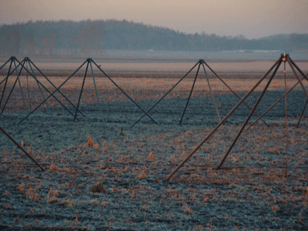
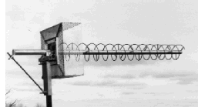
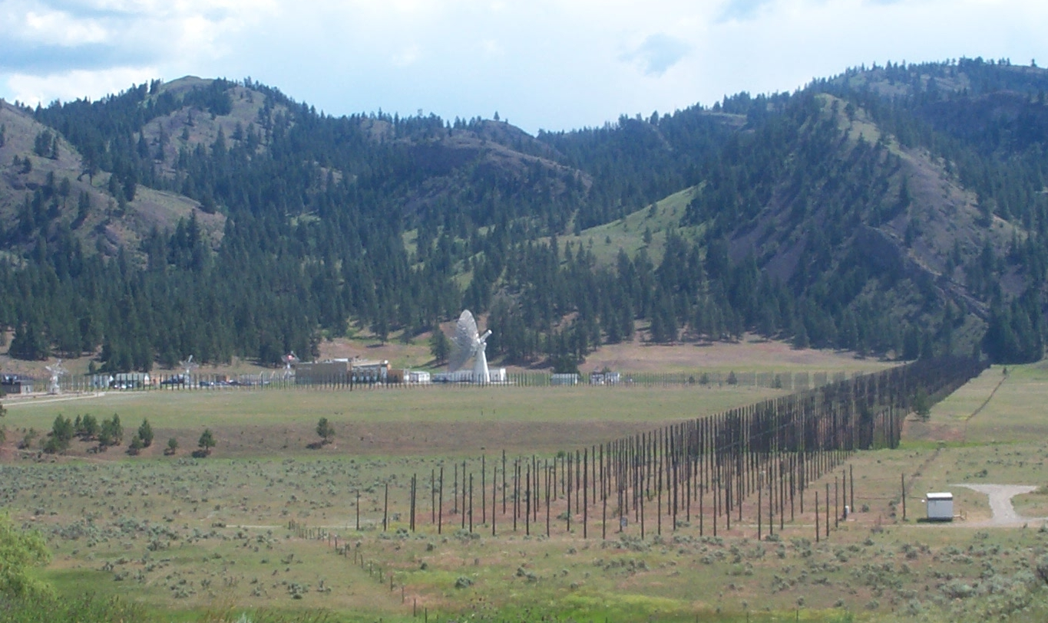

Radio telescopes
Radio regime spans a vast range of wavelength
Very different instruments to span this range
λ > 1 m (=300 MHz) – wire antennas

Slide 33
Radio telescopes
Radio regime spans a vast range of wavelength
Very different instruments to span this range
λ > 1 m (=300 MHz) – wire antennas
λ ~ 1 m -- hybrid antennas (wire reflectors or feeds)
λ < 1 m -- reflector antennas
Single telescopes
Multi-element arrays (interferometers)
- see upcoming lecture by Brenda Matthews

Slide 34
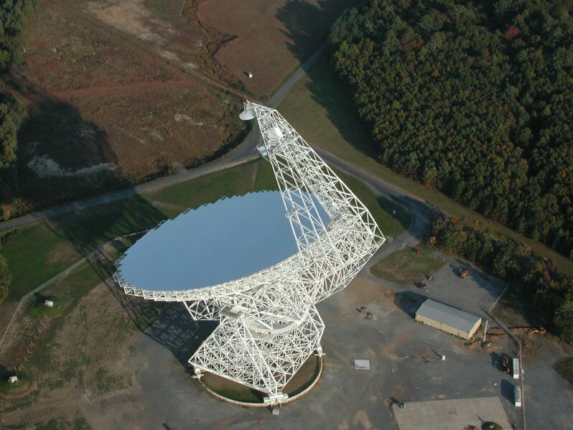
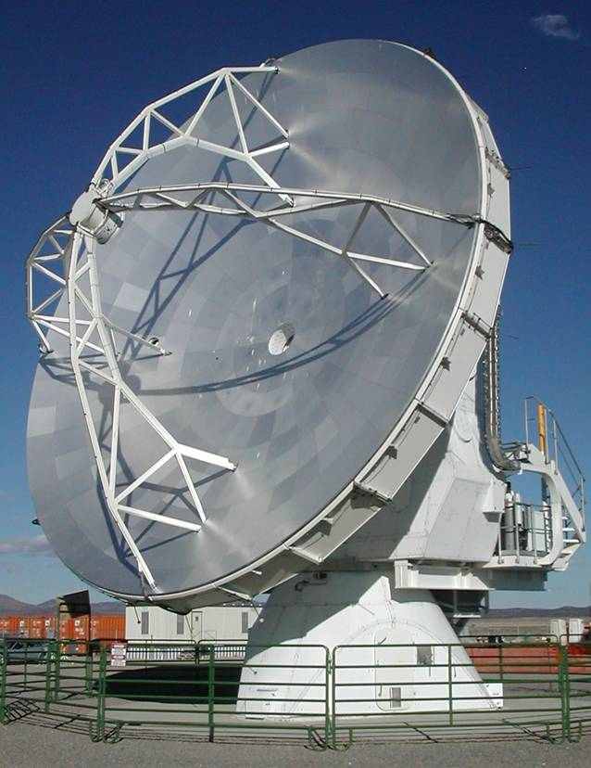
An example of a single dish – the GBT
100m diameter
largest fully steerable telescope in the world
surface rms ~ 360μm
100m
ALMA -12m diameter
surface rms ~ 25μm

Slide 35
Radio telescope systems
Radio telescopes are devices for generating an electrical signal from incoming EM radiation
Astrophysical radio signals are typically weak compared to background “noise”
Radio telescopes have to be:
  highly directional (aka high gain)
    dependent on antenna beam/power pattern
  Extract energy from the incoming wavefront
    Antenna size
    Antenna Efficiency
Receivers - convert EM signal to a voltage - amplify the “noise”
Back end (correlator/power detector) - to detect the signal

Slide 36
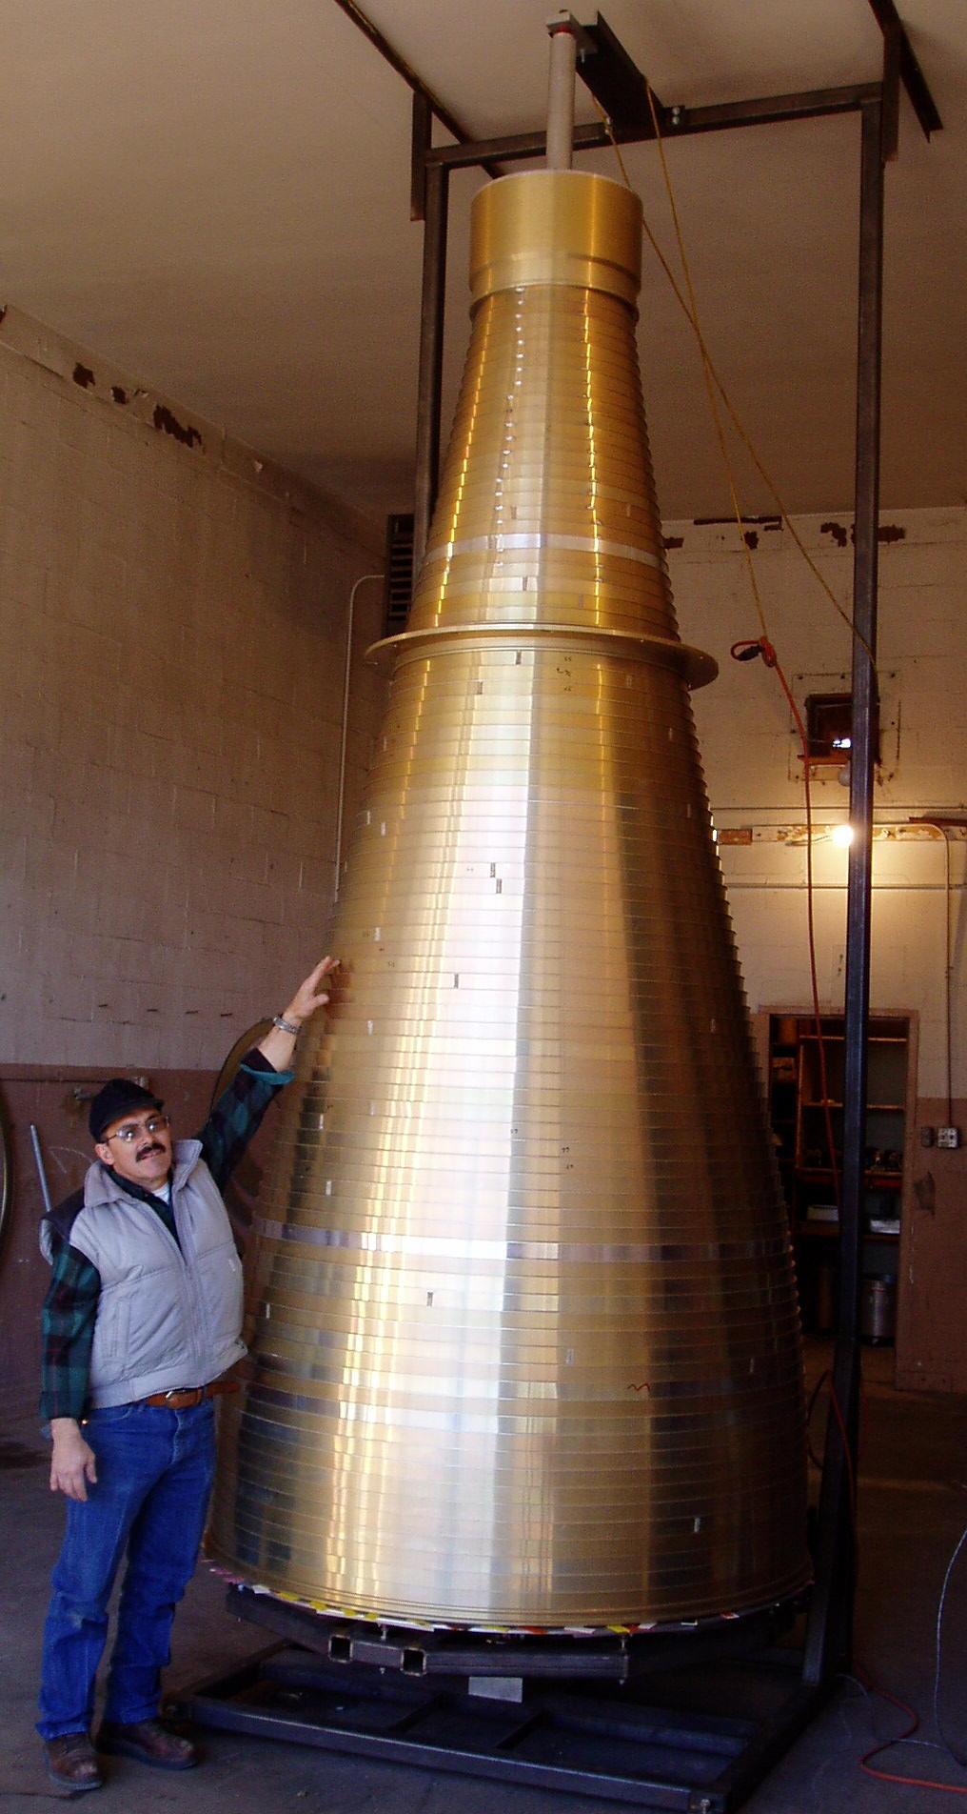
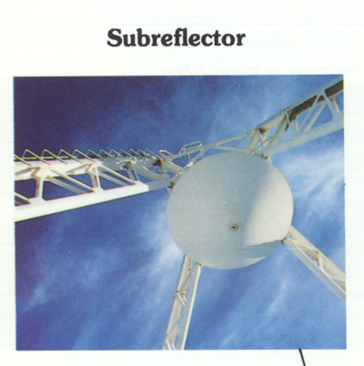
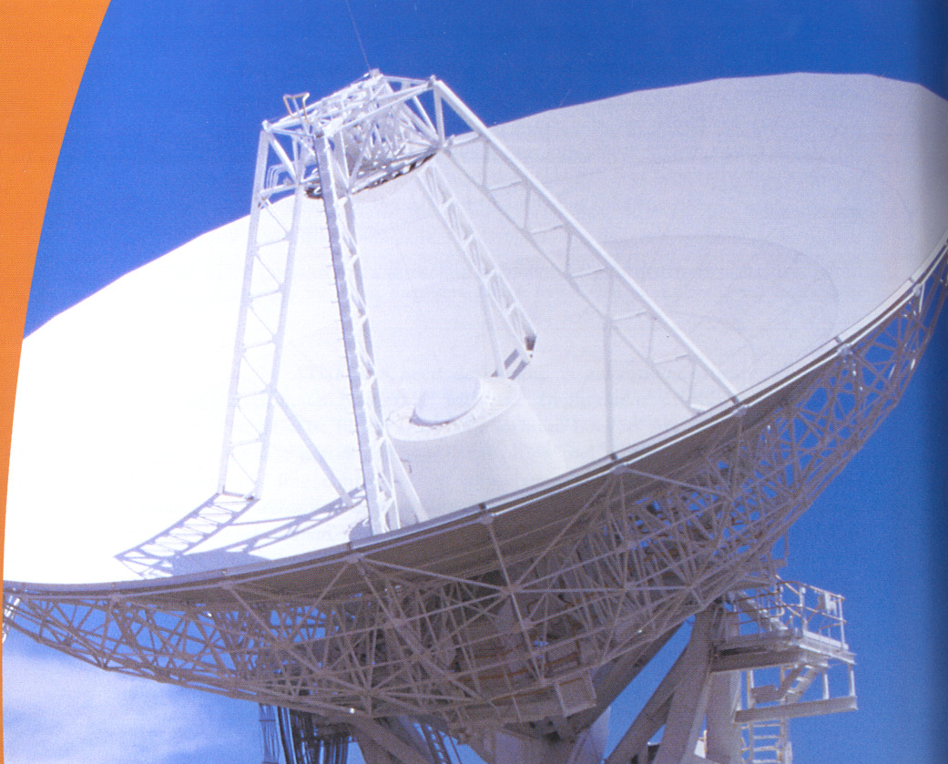
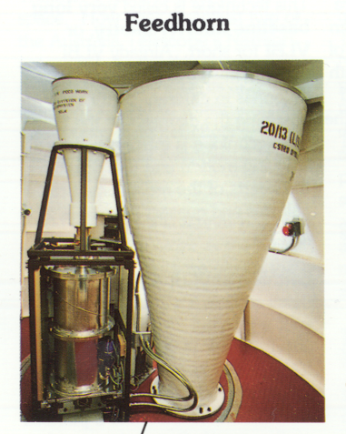
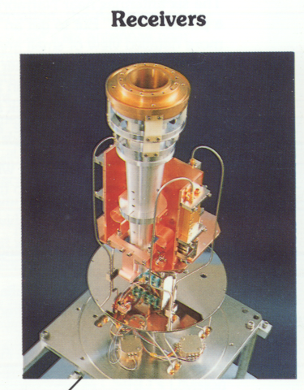
Signal path:

Slide 37
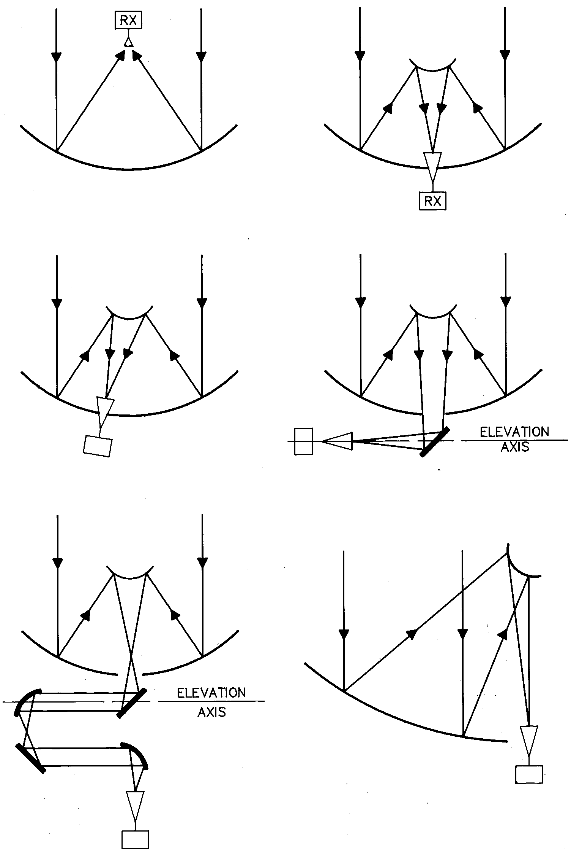
Reflector Types
Prime focus Cassegrain focus
(GMRT) (ATCA,JCMT,ALMA)
Offset Cassegrain Nasmyth
(VLA) (OVRO, JCMT)
Beam Waveguide Dual Offset
(NRO) (ATA)

Slide 38
Newton’s comments on the Cassegrain design:
“….You see therefore, that the advantages of this design are none; but the disadvantages so great and unavoidable that I fear it will never be put in practice with good effect”
Phil. Trans. Royal. Soc. London. 7, 4056 (1672)

Slide 39
Useful telescope characteristics

Slide 40
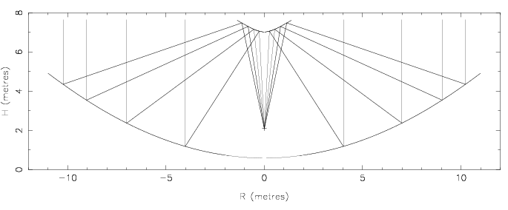
The antenna collects the E-field over the aperture at the focus
The feed horn at the focus adds the fields

Slide 41
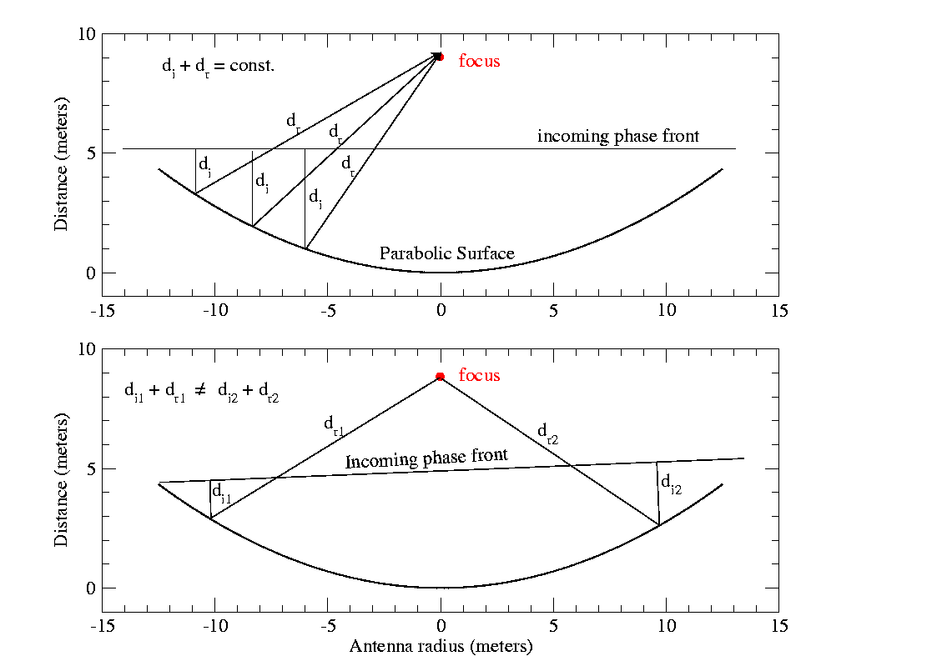
Beam Pattern - origin
An antenna’s response is a result of incoherent phase summation at the focus.
First null occurs at the angle where the extra distance for a wave at center of antenna is in anti-phase with that from edge.
(D/2) sin θ = λ/2
θ ~ λ/D
On-axis
incidence
Off-axis
incidence
For a given wavelength, the larger D, the higher resolution
D ~ 100 m ; e.g., GBT
Larger D => interferometers
(see Brenda’s lecture)

Slide 42
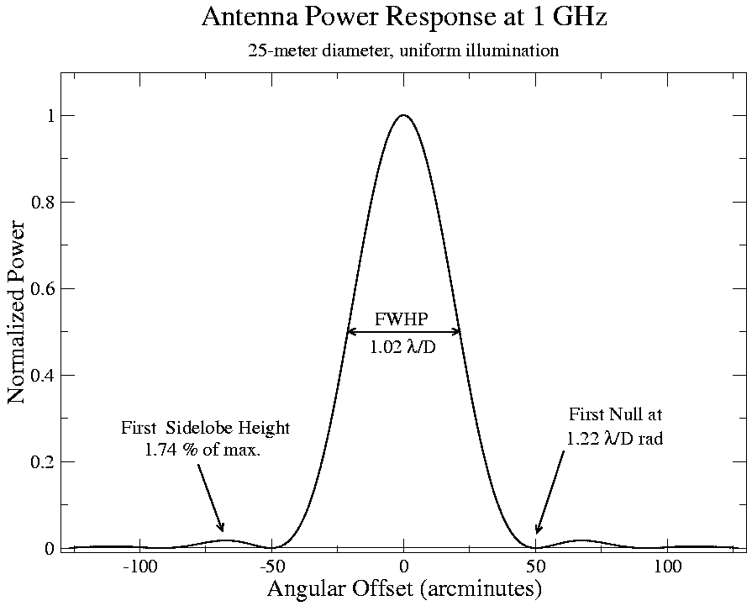
Antenna power pattern
Defines telescope resolution
“Power pattern" P(θ,ϕ) of a telescope is the square of the complex far-field voltage pattern F(l,m) i.e. |F(l,m)|² = F(l,m)F*(l,m).
(diffraction theory -- voltage pattern F(l,m) is the FT of the aperture distribution )

Slide 43
Beam sizes
D
θ
VLA dish
25 m
8’
GBT
100 m
2’
cm telescopes @ 5 GHz
VLA
36 km
0.34”
MERLIN
215 km
0.06”
VLBA
8611 km
0.001”
D
θ (“)
AST/RO
1.7 m
103
mm telescopes @ 345 GHz
JCMT
15 m
15
LMT
50 m
4.5
SMA
508 m
0.35
ALMA
15 km
0.012
Small beams – need good and stable pointing – IMPORTANT @ mm λ

Slide 44
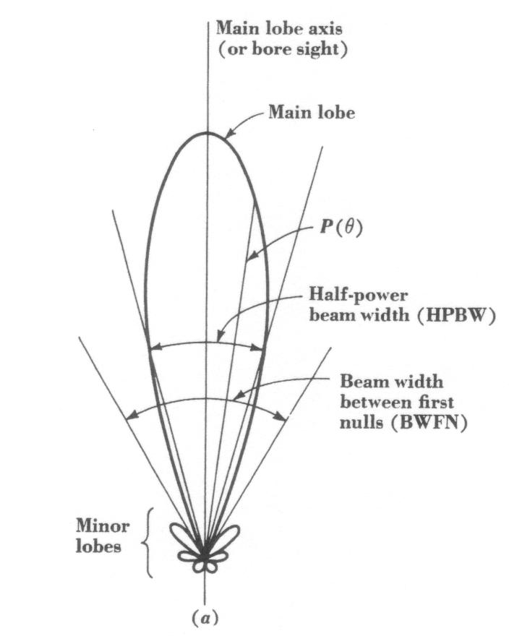
The Beam
The antenna “beam” solid angle on the sky is:
Sidelobes
NB: rear lobes!

Slide 45
The Beam
The antenna “beam” solid angle on the sky is:
Antenna gain (aka directivity) - a measure of how big the beam is on the sky:
Antenna design aims to minimize Ω_{Α} to maximize antenna gain
  e.g., dipole antenna – low gain; parabolic reflector – high gain

Slide 46
Antenna efficiency
Effective aperture A_{e} of an aperture A :
(η = the aperture efficiency)
Antenna theorem relates A_{e} and Ω_{Α} :
As effective area increases, solid angle of beam decreases
  “gain” increases
Increasing A_{e} increases sensitivity - nice to have!
Not possible to have large A_{e} for sensitivity (and gain) with a large beam (to see more sky)

Slide 47
Antenna Efficiency II
Aperture Efficiency η = η_{surface} × η_{blockage} × η_{spill} × η_{taper} × η_{misc}
η_{surface} = reflector surface efficiency ~ exp(−(4πσ/λ)²)
=> if σ = λ/20 , η_{sur} = 0.67
η_{blockage} = blockage efficiency
η_{spill} = feed spillover efficiency
η_{taper} = feed illumination efficiency
η_{misc} = diffraction, phase errors due to feed position etc
ALMA σ = 25 μm
VLA σ = 650 μm
λ mm | η_{sur}
2.6 | 0.79
1.3 | 0.75
0.87 | 0.70
0.65 | 0.63
0.44 | 0.48
λ cm | η_{sur} | η_{bl} | η_{spill} | η_{tap} | η_{diff} | η_{mis} | η_{tot}
20 | 1.0 | 0.85 | 0.82 | 0.98 | 0.86 | 0.94 | 0.55
6 | 0.97 | 0.85 | 0.92 | 0.98 | 0.96 | 0.94 | 0.67
2 | 0.85 | 0.85 | 0.90 | 0.95 | 0.98 | 0.94 | 0.57
1.3 | 0.68 | 0.85 | 0.90 | 0.95 | 0.98 | 0.94 | 0.46

Slide 48
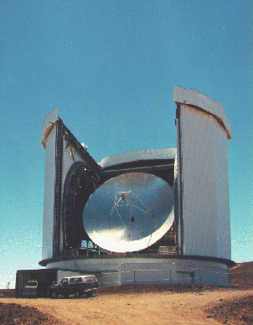
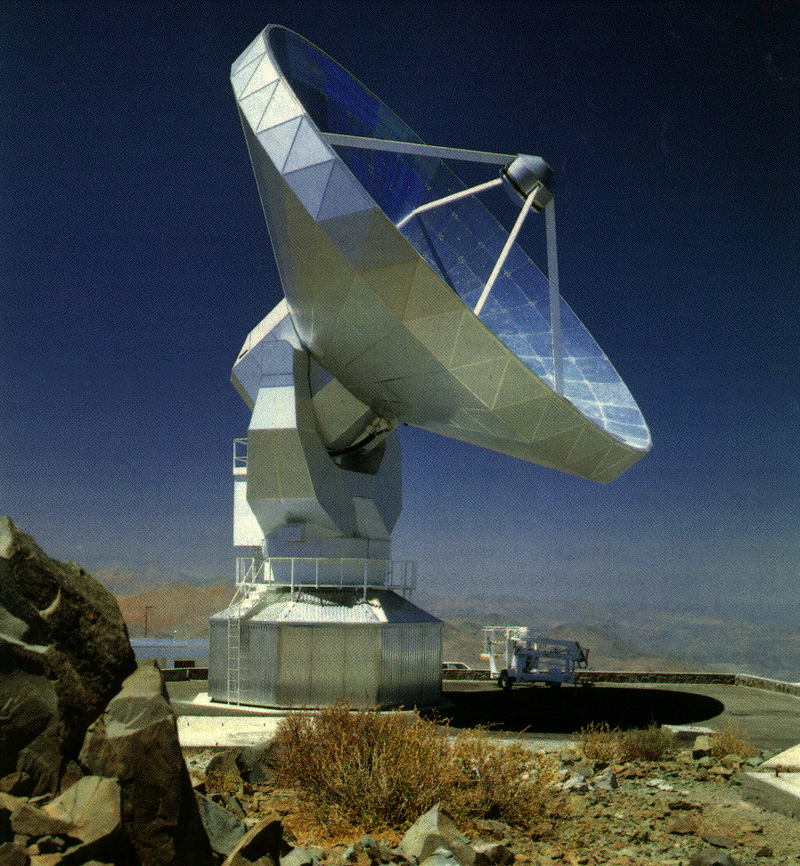
MM telescope – where surface rms rules!
Accurate surface
  Stiff reflector
Enclosed backing structure for thermal stability
  Low surface deformation
Pointing accuracy
very important with small beam
(θ ~ λ/D)
  15 m => 15” @ 345 GHz
  Enclosed yoke
  Enclose the telescope!

Slide 49
What are we detecting and how?

Slide 50
What does a radio telescope detect?
Recall :
Telescope of effective area A_{e} receives power P_{rec} per unit frequency from an unpolarized source (only sensitive to one mode of polarization)
Telescope is sensitive to radiation from more than one direction with relative sensitivity given by the normalized antenna pattern P_{N}(θ,ϕ)

Slide 51
Antenna temperature
Nyquist theorem (1929):
Power received by the antenna:
Antenna temperature is what is observed by the radio telescope
A “convolution” of sky brightness with the beam pattern
It is an inversion problem to determine the source temperature distribution.

Slide 52
Antenna temperature: some special case I
For a point source ie Ω_{beam} >> Ω_{source} : P_{N} (θ, ϕ)=1
=> known point source flux density S_{ν}, measure T_{A} to get A_{e}
Gives a measure of reflector performance
e.g., Arecibo 300 m : 0.07Jy/K
JCMT 15 m : ~25 Jy/K

Slide 53
Antenna temperature: some special case II
For an extended source ie Ω_{beam} ~ Ω_{source}.
Assume T (θ, ϕ)=constant over the beam e.g. the Moon
Main beam filling factor
Need to know the power pattern

Slide 54
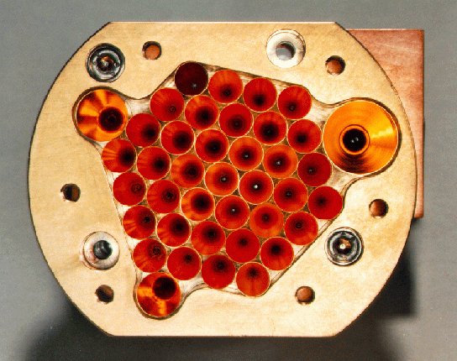
Receiver systems
A radio source produces an antenna temperature T_{A}
How do we detect this (perhaps very small e.g. ~ 10⁻⁴ -10⁻⁷) change in power that appears at the output of the telescope?
The challenge of the receiver (detector) system
Two main types of observation – continuum and spectral line
Continuum – total power is required
  mm/sub-mm -> bolometers – sensitive, wide bandwidths
  SCUBA
  cm – use heterodyne receivers
Spectral line – need narrow frequency bands
  use heterodyne receivers
    preserve phase information
      essential for interferometry
    Typically a correlator (power detector)

Slide 55
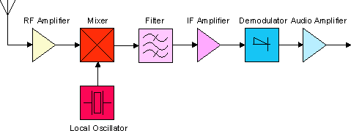
Components of a heterodyne receiver
Back end
Power detector/integrator
Correlator
Amplifier
  Amplify very weak signal
  Needs to be stable and have very low noise
Mixer
  Produces a stable low frequency signal which mixes the higher frequency (RF) signal to a lower, intermediate (IF) frequency.
    Mixer can be tuned to detect a large range of RF
    Cost (samplers, amplifiers, transmission line) and performance (filtering)
    Transmission lines less lossy at lower frequency (optic fibre relief)
Filter – selects a narrow signal band
Backend – either total power detector or more typically today, a correlator

Slide 56
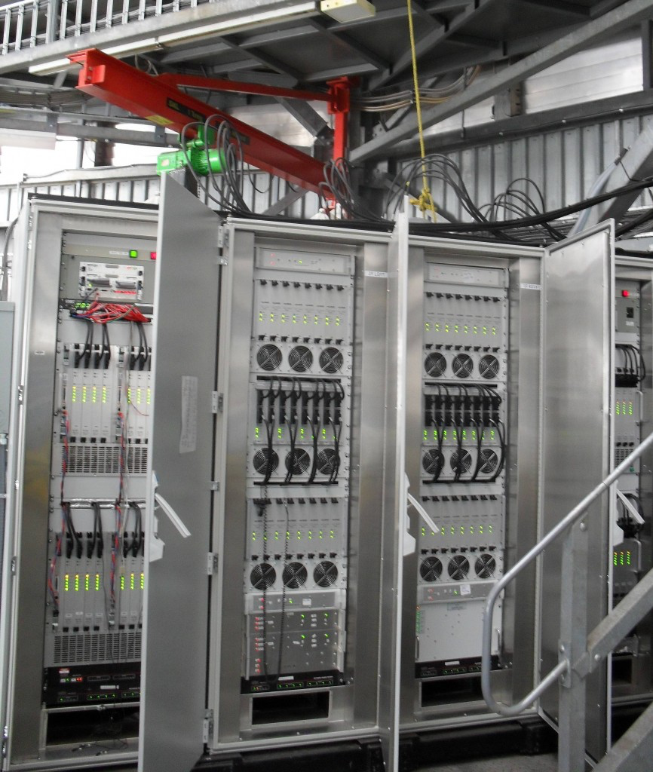
Backend Example: ACSIS on JCMT
ACSIS = AutoCorrelation Spectral Imaging System
Built by NRC Penticton
Used by JCMT heterodyne receivers
Very configurable with up to 2 or 4 spectral windows depending on receiver used
Spectral resolution varies from 30 kHz to 1 MHz, as needed
Data read out at 0.1 s intervals for fast mapping
HARP configurations:
R = Δλ/λ ~ 10⁻⁷ !!

Slide 57
Noise in the machine!
Unfortunately, the telescope system contributes noise to the source signal detected by the telescope
i.e. P_{out} = P_{A} + P_{sys} => T_{out} = T_{A} + T_{sys}
T_{sys} represents the noise added by the system
= T_{bg} [exp(-tau*A)] + T_{sky} [exp(-tau*A) -1] + T_{spill} + T_{loss} + T_{rx} + T_{cal} ;
where A = airmass ~ 1/sin(elevation) for elevation > 15 degrees,
and tau = opacity at the frequency of interest
T_{bg} = microwave and galactic background (3 K, except below 1 GHz)
T_{sky} = atmospheric emission (increases with frequency--dominant in mm)
T_{spill} = ground radiation (via sidelobes) (telescope design)
T_{loss} = losses in the feed and signal transmission system (design)
T_{rx} = receiver system (often dominates at cm — a design challenge)
T_{cal} = injected calibrator signal (usually small)
Note that T_{bg},T_{sky},T_{spill} vary with position on the sky
T_{sky} also is time variable

Slide 58

System Noise – cm regime
T_{rx} is the challenge!
=>T₁ needs to be small
VLA
λcm
T_{bg}
T_{sky}
T_{spill}
T_{loss}
T_{cal}
T_{rx}
T_{sys}
JVLA
92
25
3
15
7
5
70
125
20
3
3
14
8
2
30
60
26
6
3
3
7
5
2
30
50
31
3.6
3
2
5
2
2
16
30
34
2
3
8
6
13
6
80
116
39
1.3
3
17
6
21
7
100
154
54

Slide 59

System Noise – mm regime
T_{sky} is the challenge
T_{rx} < T_{sky}
  T_{rx} is essentially at the quantum limit
ALMA T_{rx}
GHz
T_{rx} K
Band 3
84-116
<37
Band 6
211-275
<83
Band 7
275-370
<83
Band 9
602-720
<175

Slide 60
Radiometry equation
Challenge: How to detect T_{A} (signal) in the presence of T_{sys} (noise)?
The signal is correlated from one sample to the next - the noise is not.
For a bandwidth Δν, samples taken less than Δt=1/Δν are not independent
(another Nyquist theorem!)
Time τ contains independent samples
Gaussian noise : total error for N samples is
that of single sample
Radiometer equation

Slide 61
Flux sensitivity & antenna performance
  For a point source, flux density S_{ν} recall
  Minimum detectable flux
  A_{e}/T_{sys} is the measure of the performance of a radio telescope

Slide 62
Flux sensitivity & antenna performance II
@5 GHz
D (m)
T_{sys}
A_{e} (m²)
SEFD (Jy)
cm telescopes
Arecibo
300
31
22080
3.9
GBT
100
24
7850
13
Bonn
100
27
4162
18
VLBA PT
25
40
360
300
Onsala
26
74
338
600

Slide 63
Flux sensitivity & antenna performance II
NEFD (mJy s^{1/2})
A_{e} (m²)
850 μm
450 μm
350 μm
AST/RO
2
2160
2300
2660
Mm/submm telescopes
SOFIA
5
200
200
FIRST
7
54
54
CSO
79
150
2000
2200
Scuba
Scuba 2
177
80
22
700
107
760
SMA
227
134
1142
1250
ALMA
7000
2
12
15

Slide 64
The essential qualities of a radio telescope
Lots of area!
High antenna efficiency
  Good surface rms
Low system temperature
  Low receiver temperature
    Low noise in the 1st stage (LNA – low noise amplifier)
  At mm, T_{sky} is the challenge
    Low water content above the site
      e.g. Chajnantor, South Pole, Mauna Kea
  All this improves
Receiver bandwidth
  – drives down minimum detected flux
Good pointing – most especially at mm/sub-mm.

Slide 65
Calibration & Observing Techniques

Slide 66
What does the telescope measure?
T_{A} = “antenna temperature”
T_{A}(total) = T_{source} + T_{sys}
T_{sys} represents the noise added by the system
= T_{bg} [exp(-tau*A)] + T_{sky} [exp(-tau*A) -1] + T_{spill} + T_{loss} + T_{rx} ;
where A = airmass ~ 1/sin(elevation) for elevation > 15 degrees,
and tau = opacity at the frequency of interest
Want T_{source}, so carry out ON – OFF
T_{A}(ON) = T_{source} + T_{sys}, T_{A}(OFF) = T_{sys}, so T_{A}(ON) – T_{A}(OFF) = T_{source}
Need to carry out ON – OFF observations, and there are different observing techniques for measuring ON – OFF

Slide 67
Different Observing Modes to get OFFs
Types of “reference observations”:
Frequency Switching
- In- or Out-of-band
Position Switching
Beam Switching
- Move subreflector
- Receiver beam switch
Dual-beam Nodding
- Move telescope
- Move subreflector

Slide 68
In-band Frequency Switching

Slide 69
Out-of-band Frequency Switching

Slide 70
Position Switching

Slide 71
Position Switching: ON – OFF on sky

Slide 72
Beam Switching : Internal (“Dicke”) Switching
Difference spectrum eliminates any contributions to the bandpass from after the switch
Low overhead but ½ time spent off source

Slide 73
Beam Switching : Subreflector or internal tertiary
Removes “fast” gain / bandpass changes
Low overhead but ½ time spent off source

Slide 74
Nodding with dual-beam Rx’s - subreflector, etc
Removes “fast” gain / bandpass changes
Low overhead and all time spent on source

Slide 75
Nodding with dual-beam Rx’s – telescope motion
Removes “fast” gain / bandpass changes
Overhead from moving the telescope but all time spent on source

Slide 76
Mapping Techniques
Point map
- sit, move, sit, move….
On-The-Fly mapping
- slew a column or a row while collecting data
- move to next column / row
- basket weave
- should oversample ~1/3 the resolution along direction of slew (“Nyquist sampling”)
- OFF position taken from either an emission free map position or a separate OFF position observed

Slide 77
Data Calibration
(ON – OFF) / OFF
[ (T_{source} + T_{everything else}) – T_{everything else} ]/ T_{everything else}
= (source temperature) / (“system temperature”)
T_{A} = [(ON – OFF) / OFF] * T_{sys}
OFF obtained from observations of blank sky (or other)
T_{sys} obtained from internal calibration (noise diodes, etc.)

Slide 78
Determining T_{sys} with noise diodes
GBT uses noise diodes for all receivers except 4 mm one and MUSTANG bolometer array
T_{sys} = [OFF / (ON – OFF)] * T_{cal}
T_{sys} = [OFF / (ON – OFF)] * T_{cal} + T_{cal}/2
(Used at GBT for Flicker diode ON/OFF)

Slide 79
Determining T_{sys} with hot / cold loads
GBT uses hot/cold loads for 4 mm receiver
“calibration gain” G = (T_{hot} – T_{cold)} / (V_{hot} – V_{cold}) [K/Volts]
T_{sys} = G * V(OFF) and T_{A} = G * (ON-OFF)
One load “chopper wheel” method also used! See Kutner & Ulich (1974)

Slide 80
Absolute Calibration on known sources
Corrects for errors in adopted diode temps, etc., and corrects for telescope response
S(source) / S(cal) = T(source) / T(cal), where S(cal) is known, e.g., 3C273, planet…
VLA calibration is ~1% accurate at < 20 GHz and ~3% accurate at > 20 GHz
Mars WMAP observations with model in red

Slide 81
Temperature Scales in Radio Astronomy
T_{A} ; observed source antenna temperature
T_{A}’ = T_{A} exp (tau * A) ; antenna temperature corrected for atmospheric opacity tau at airmass A
; η_{r} = radiation efficiency of telescope (ohmic losses due to resistive heating)
T_{A}* = T_{A}’ / η_{r}η_{rss.} ; η_{rss} = rearward scattering/spillover efficiency
; η_{l} = η_{r}η_{rss} = fraction of power in forward direction
T_{R}* = T_{A}’ / η_{l}η_{fss} ; η_{rss} = forward scattering/spillover efficiency
T_{mb} = T_{A}’ / η_{mb} ; main-beam temperature, where η_{mb} = f_{s} η_{c}(main beam) η_{fss} , f_{s} = source filling factor, and η_{c}(main beam) = coupling of source that just fills the main beam (Mangum 1993, 2006)
η_{a} ~ η_{mb .}/ 1.3 for GBT = A_{e} / A ; “aperture efficiency”

Slide 82
And to close….
Some gratuitous images of telescopes

Slide 83

At cm - the VLA
27 “movable” antennas
25 m diameter each
Total area = 130-m diameter dish
Y configuration (“2D” array)
Longest baseline = 36 km
Featured in the movie ‘Contact’.
World’s ‘largest’ array.

Slide 84

In the year 2018……

Slide 85



At mm/sub-mm…
LMT
IRAM

Slide 86



At mm/sub-mm…
CARMA
ALMA

Slide 87


FAST
Arecibo

