Slide 1
The Karl J. Jansky Very Large Array
Dr. James Di Francesco - NRC Herzberg Research Centre
(thanks to Emmanual Momjian & Amy Kimball of NRAO)

Slide 2
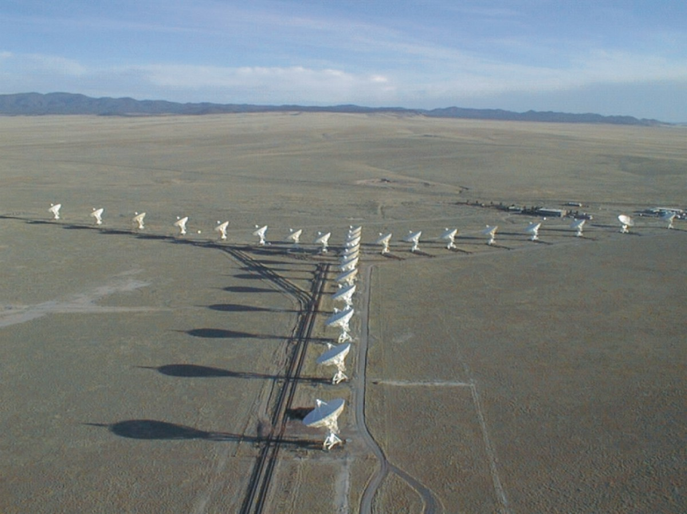
The VLA
27 “movable” antennas
25 m diameter each
Total area = 130-m diameter dish
Y configuration (“2D” array)
Longest baseline = 36 km
Featured in the movie ‘Contact’.
World’s ‘largest’ array.

Slide 3
The Jansky Very Large Array
27 x 25-m antennas (Y-shape) reconfigurable on baselines 35 m to 36 km
Located in New Mexico at 2100 m altitude
Construction from 1973-1980, upgrade 2003-2012 to Jansky VLA
Notes:
Hybrid configurations were for sources outside the range -15 and 75 deg declination. No longer offered.

Slide 4
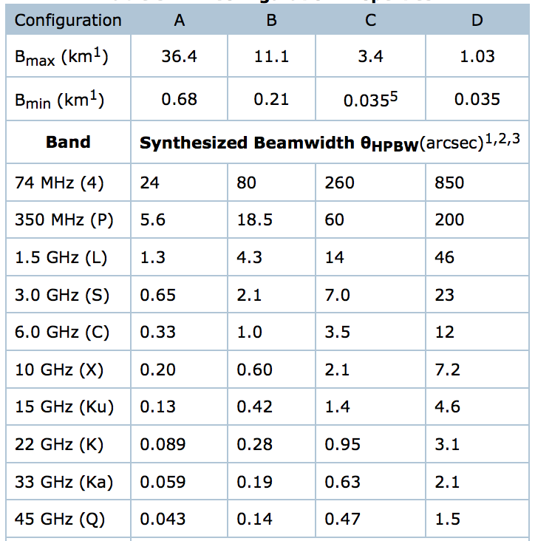
Spatial Resolution
With reconfiguration of the antennas, the array can vary its spatial resolution by a factor of ~40.
Configuration sequence:
D (Bmax~ 1 km) → C → B → A (Bmax~ 36 km)
Reconfiguration about every 4 months
The August 1, 2018 proposal deadline is for both the A and B configurations
Notes:
Hybrid configurations were for sources outside the range -15 and 75 deg declination. No longer offered.

Slide 5
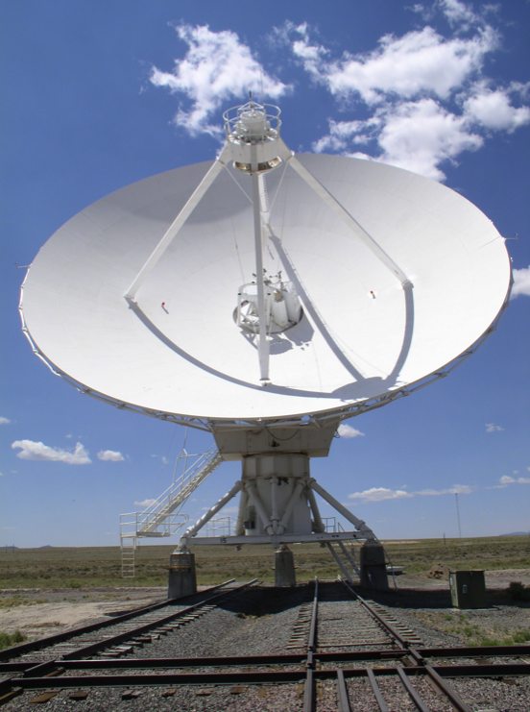
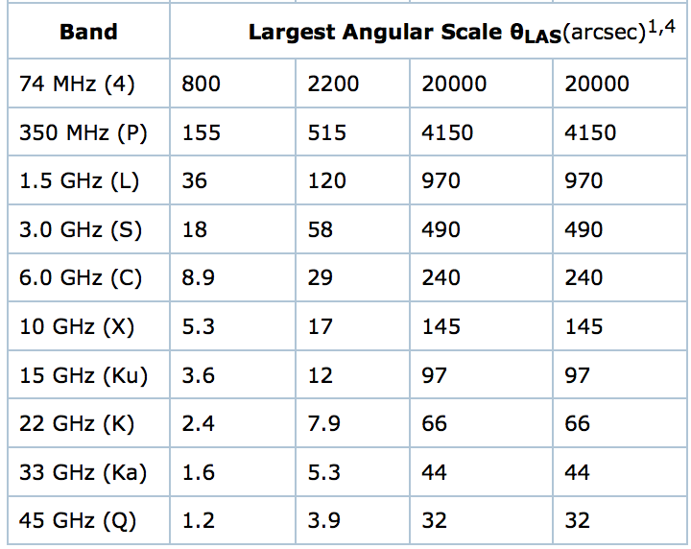
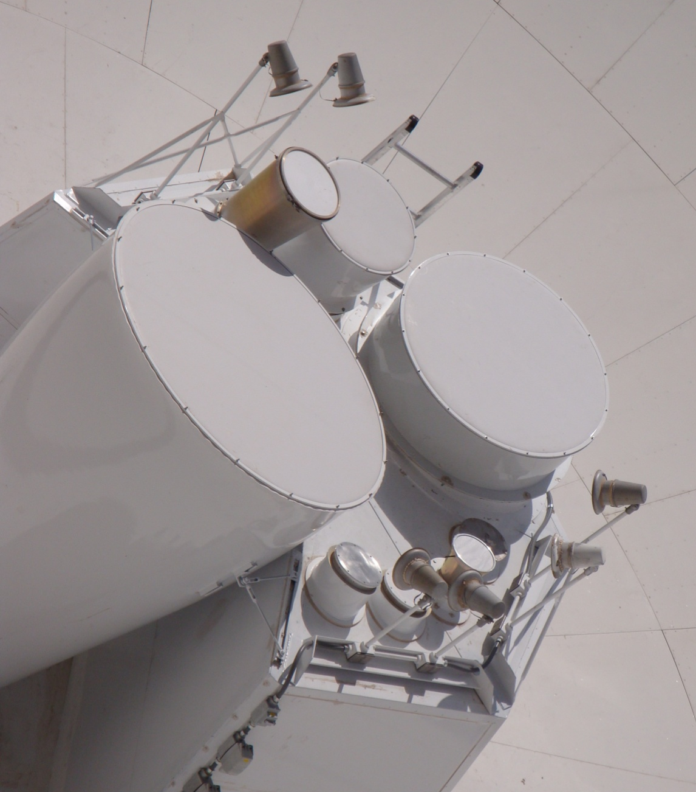
Largest Angular Scale
The shortest baseline sets the largest angular scale to which an interferometer is sensitive
Compact configurations have less spatial resolution but cover larger angular scales and increase surface brightness sensitivity
Field of view
(depends on
diameter of a
single antenna)
608’
129’
30’
15’
7.5’
5.3’
3’
2’
1.4’
1’

Slide 6
The Very Large Array Specs
Nine Frequency Bands
Eight cryogenic bands, covering 1 – 50 GHz. Utilizes Cassegrain subreflector.
One uncooled, prime-focus band, covering 50 – 450 MHz.
Up to 8 GHz instantaneous band width
All digital design to maximize instrumental stability and repeatability
Full polarization correlator with 8 GHz instantaneous band width
Provides 64 independent ‘sub-correlators’, and 16384 spectral channels.
Many specialized operation modes (burst, pulsar binning, phased arrays …)
Notes:
Cassegrain: convex secondary reflector

Slide 7
8-bit and 3-bit paths
VLA has two separate sampler sets:
Two 8-bit sampler pairs, each pair covering 1024 MHz
Total of 2048 MHz BW, per polarization
Four 3-bit sampler pairs,each pair covering 2048 MHz.
Total of 8192 MHz BW, per polarization
8-bit paths primarily for low frequency bands (P, L, S)
90 cm, 20 cm, 10 cm bands
3-bit paths primarily for high frequency bands (C through Q)
5 cm, 3 cm, 2 cm, 1.3 cm, 0.9 cm, 0.7 cm bands
But 3-bit samplers lose ~ 15% sensitivity!
If your science requires < 2 GHz band width, use the 8-bit samplers
Notes:
Cassegrain: convex secondary reflector

Slide 8
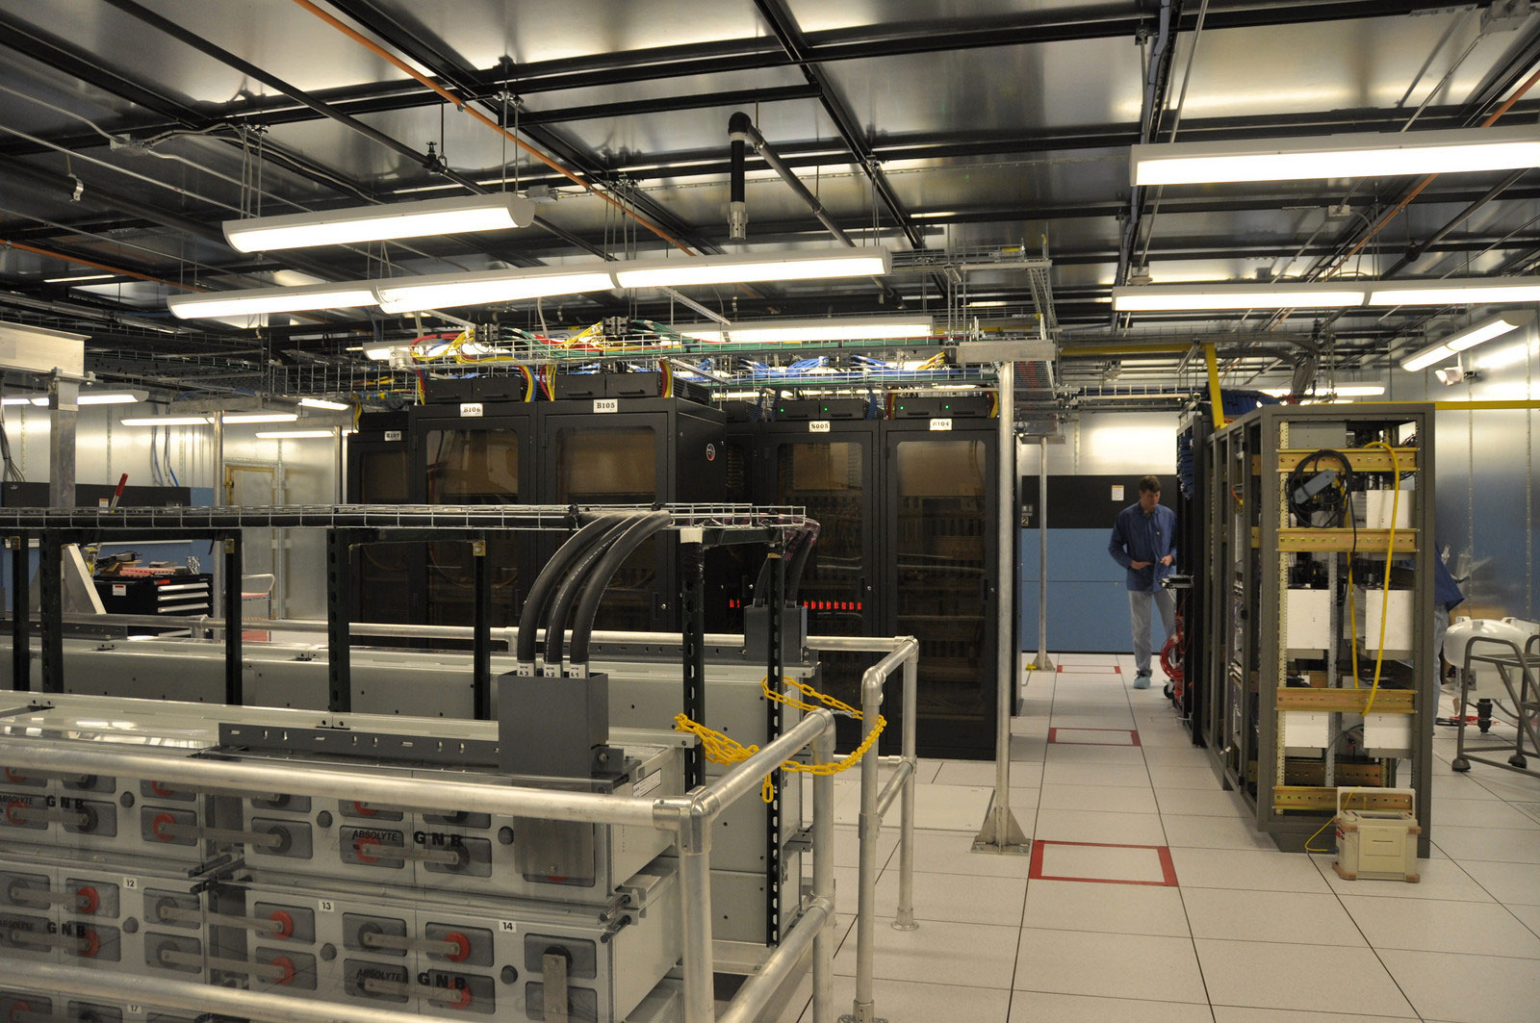
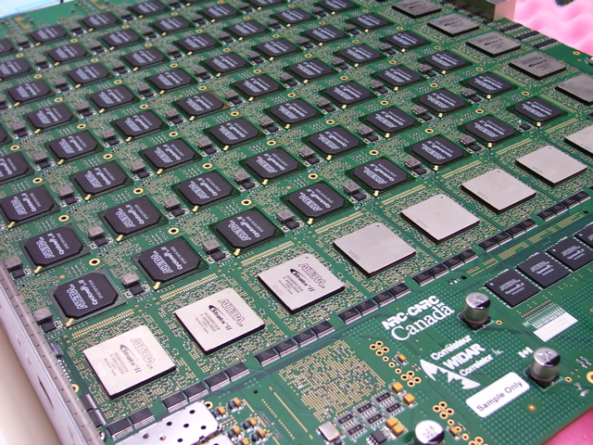
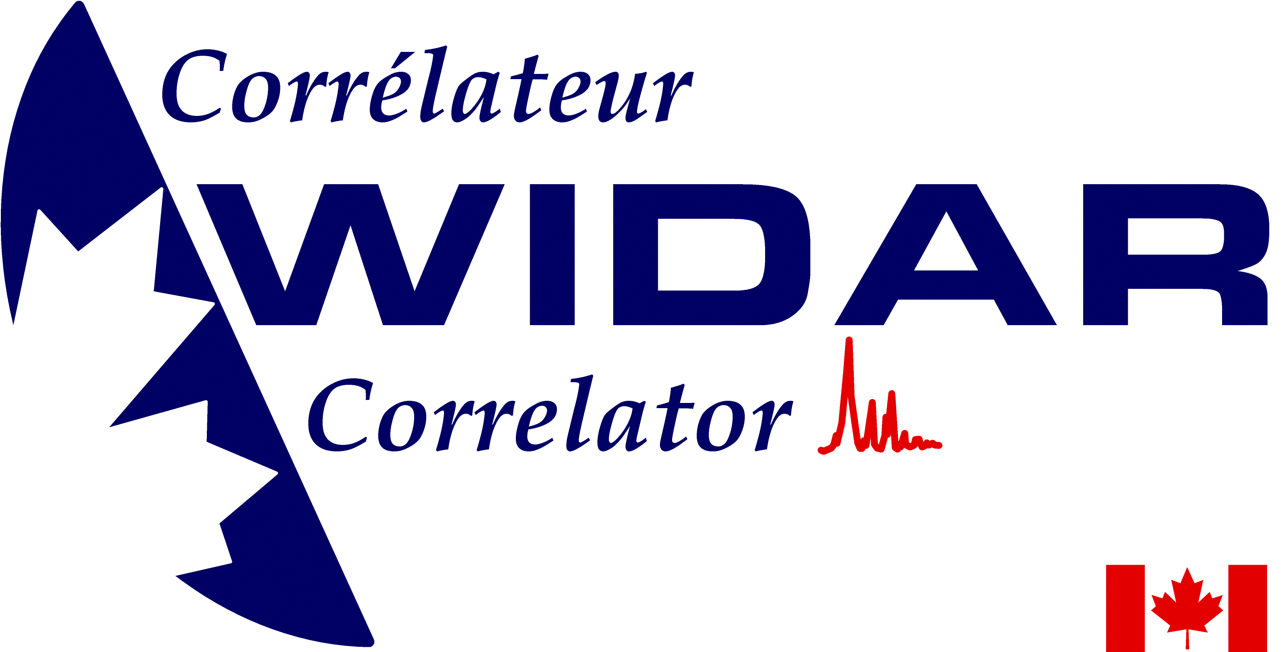
The ‘WIDAR’ Correlator
The correlator by the Dominion Radio Astrophyiscal Observatory’s correlator group, located at the NRC facility near Penticton, BC
This ‘WIDAR=Wideband Interferometric Digital ARchitecture’ correlator was paid for by the Canadian government, as part of a cooperative agreement between NRC and NSF

Slide 9
Basic Features of the ‘WIDAR’ Correlator
64 independent full-polarization subbands:
- Each can be tuned to its own frequency, with its own
band width (128 MHz to 31.25 kHz) and spectral
resolution (from 2 MHz to 0.12 Hz)
100 msec dump times with 16384 channels and full polarization:
- Faster if spectral resolution, band width, or number of
antennas is decreased
Up to 8 sub-arrays:
- Maximum to date is three
Phased array capability:
- with full band width – for pulsar and VLBI applications
Special pulsar modes:
- 2 banks of 1000 time bins, and 200 μsec time resolution (all
spectral channels), or 15 μsec (64 channels/window).
Undergoing testing; see RSRO
Notes:
yuppi modes (fold and search) are implemented and moderately well-tested. WIDAR phase bins are implemented and partially tested.
"yuppi modes" means phased/summed array data processed single dish style (coherent dedispersion, very high time resolution, flexible spectral resolution, but only single beam on the sky). This is still RSRO but is fairly well tested and has been used for real projects. "phase bins" means visibilities averaged modulo a specified pulse period. As Bryan says, it is implemented and testing is ongoing. there are likely still some issues. Also, support for post-processing of this kind of data is currently non-existent in the standard software packages..

Slide 10
General Observing (GO)
Up to 8 GHz bandwidth with 16384 spectral channels – 2 MHz spectral resolution (full polarization)
All 64 sub-band pairs can be separately tuned, and set to any of 128, 64, 32, 16, … , 0.03125 MHz widths
Up to 16384 spectral channels (no recirculation), or up to 1048576 (with recirculation)
Three simultaneous, fully independent subarrays
Mix 3-bit and 8-bit modes
Phased Array (for VLBI)

Slide 11
Shared Risk Observing (SRO)
Access to extra capabilities that have not been as well tested as GO capabilities. These currently are:
On-the Fly mosaicking
Up to 32 sub-bands per baseband with the 8-bit samplers
Solar observing
P-band (224–480 MHz) spectroscopy
Frequency averaging in the correlator (up to a factor of 4): C through Q bands for 3-bit wide-band continuum science projects

Slide 12
Resident Shared Risk Observing (RSRO)
Access to extended capabilities that require more testing - in exchange for a period of residence
Correlator dump times < 50 msec (including as short as 5 msec for transients)
Pulsar observations
Data rates above 60 MB/s
Recirculation beyond a factor of 64
P-band (230-470 MHz) polarimetry
4-band (58-84 MHz) commissioning and testing
More than 3 subarrays with the 8-bit samplers
Subarrays with the 3-bit samplers
Complex phased array observations

Slide 13
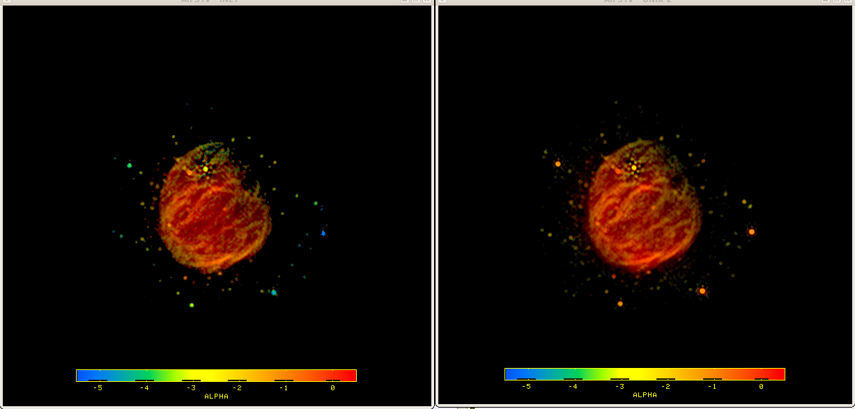
Post processing
Data reduction software: CASA
Handles complex observing set-ups
Task interface to suite of C++ -based reduction tools
Python interface provides access to data for manipulation
Effective platform for algorithm development (e.g., handling effect of wide fractional bandwidths, Δν/ν)
Spectral index of 1–2 GHz emission from SNR G55.7+3.4, before correction for the frequency-dependence of the primary beam (left), and after correction (right)

Slide 14
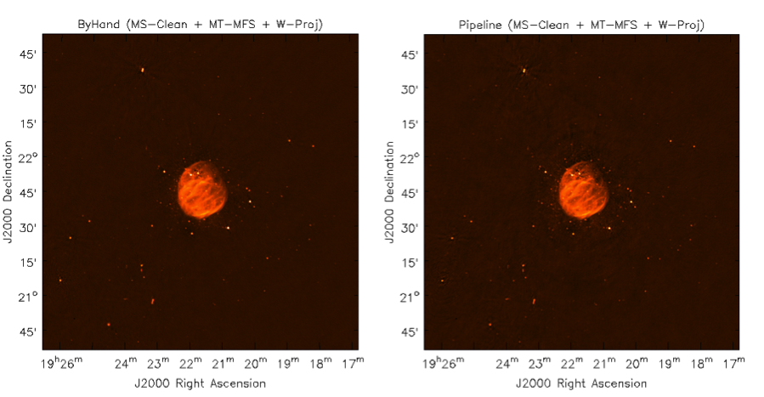
VLA Calibration Pipeline
Designed for Stokes I continuum.
Work is in progress to support spectral line and polarization.
Supernova remnant
G55.7+3.4
hand-flagged and
calibrated
pipeline-calibrated
RMS is within 10%

Slide 15
Some Recent VLA Science Highlights

Slide 16
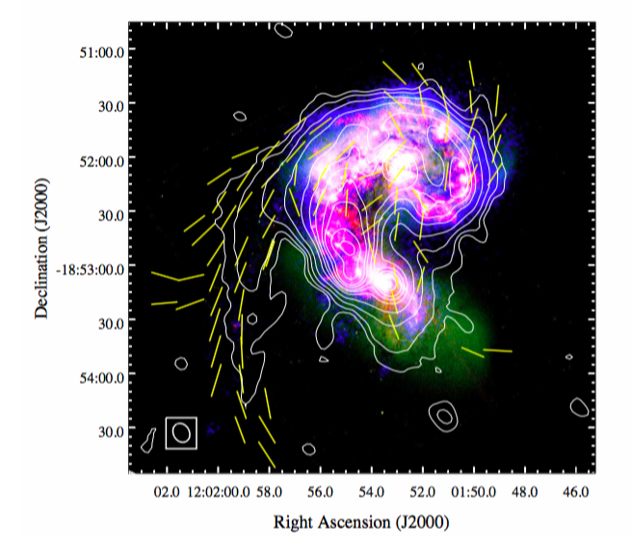
The VLA images the large scale magnetic field in the Antennae Galaxies
The VLA has imaged at 1 kpc resolution, the B field in these merging galaxies.
The tail is 62% polarized, with B fields aligned along the tidal tail on a scale of 20 kpc – the largest detected regular field structure on galactic scales
The regular field in the tail is ∼8.5 μG, which is stronger than the turbulent field. This field must be generated in a few 100 Myr, likely by stretching galactic disk field
Although the B fields within merging bodies are dominated by strong turbulent fields, tidal effects can nevertheless produce large-scale regular field structure in the outskirts.
Antennae with GALEX, HST, JVLA
(3 GHz Contours), plus the Faraday rotation-corrected magnetic field orientations. (Basu et al. 2016).
Notes:
Basu ea. Detection of a ∼20 kpc coherent magnetic field in the outskirt of merging spirals: the Antennae galaxies
MNRAS 2016, in press arXiv:1609.04266v1
DnC and CnB array configurations
S-band: common resolutionof 15 Å~ 12 arcsec2
Our result suggests that the magnetic field along the tidal
tail is highly regular up to a size of ∼ 20 kpc, the largest
known coherent field structure on galactic scales.

Slide 17
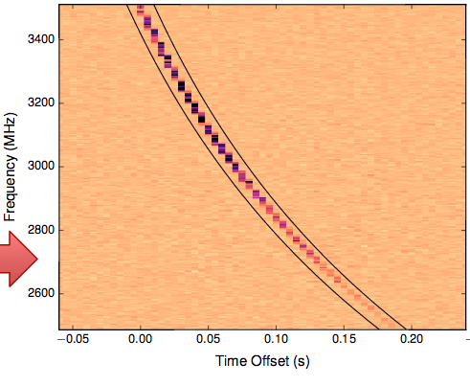
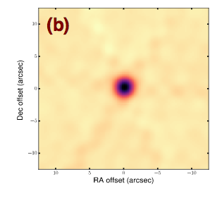
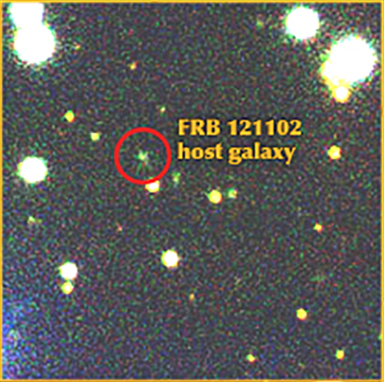
VLA Solves the FRB Puzzle
The VLA has localized, for the first time, a fast (millisec) radio burst. The repeating FRB 121102 is localized to 0.1” accuracy, and is situated at the center of a dwarf galaxy at z ~ 0.1. The galaxy shows a compact (1.7 mas) persistent radio source.
Models for the system include: a neutron star or magnetar enveloped by supernova ejecta, or a new AGN-jet related phenomenon.
The discovery that FRBs are indeed at cosmological distances raises the potential of using FRBs as unique probes of cosmology and physics. This result has already inspired numerous theoretical papers on the physics of the IGM and degenerate stars.
VLA 3GHz observations of the FRB 121102, plus the near-IR image of the host dwarf galaxy (Chatterjee et al. 2017, Nature)
Notes:
Chatterjee et al. 2017 http://adsabs.harvard.edu/abs/2017Natur.541...58C
A direct localization of a fast radio burst and its host

Slide 18
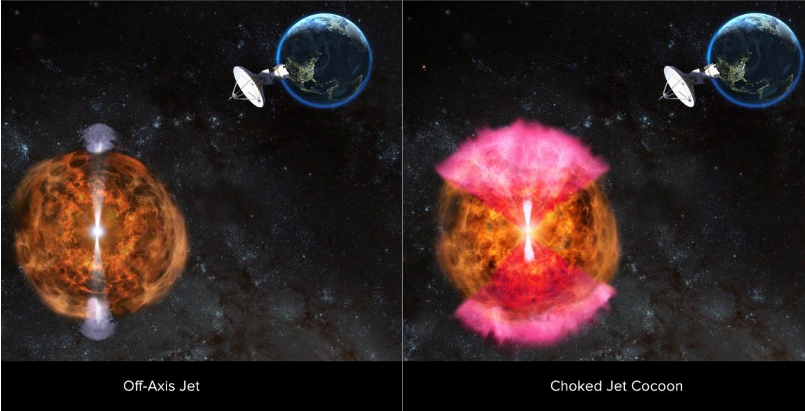
Radio Observations Point to Likely Explanation for Neutron-Star Merger Phenomena
Three months of monitoring observations with the VLA
VLA, ATCA, GMRT observations showed gradual brightening of the radio signal indicative of a wide-angle outflow of material from the neutron star merger
The X-ray emission, measured with Chandra, had also brightened as predicted by the ‘cocoon’ model
Notes:
collision of a pair of neutron stars in a galaxy 130 millionlight-years from Earth. Aug 17.
VLA detection was after 2 weeks.
The astronomers looked to a model published in October by Mansi Kasliwalof Caltech, and colleagues, and further developed by Ore Gottlieb, ofTel Aviv University, and his colleagues. In that model, the jet does not make its way out of the sphere of explosion debris. Instead, it gathers up surrounding material as it moves outward, producing a broad “cocoon” that absorbs the jet’s energy.

Slide 19
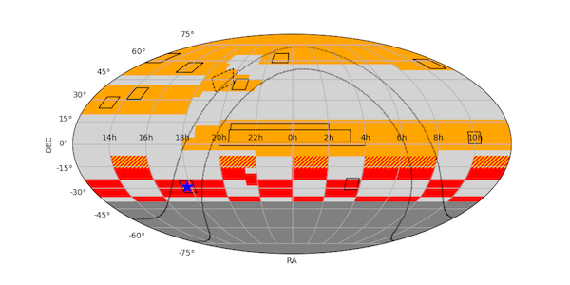
VLA All-Sky Survey (VLASS)
B config
BnA
“hybrid”
Observing status:
First VLASS observing cycle complete, covers half of sky in the first epoch (Sept 2017 to Feb. 2018) in B-configuration
Presently re-calibrating data and producing QuickLook images
~9500 square degrees of sky so far released (over 10,000 images)
Working through software/algorithm obstacles before producing “science quality” single epoch images:
- continuum & polarization & spectral cubes
See http://archive-new.nrao.edu/vlass for more info, also vlass.org
Notes:
collision of a pair of neutron stars in a galaxy 130 millionlight-years from Earth. Aug 17.
VLA detection was after 2 weeks.
The astronomers looked to a model published in October by Mansi Kasliwalof Caltech, and colleagues, and further developed by Ore Gottlieb, ofTel Aviv University, and his colleagues. In that model, the jet does not make its way out of the sphere of explosion debris. Instead, it gathers up surrounding material as it moves outward, producing a broad “cocoon” that absorbs the jet’s energy.

Slide 20
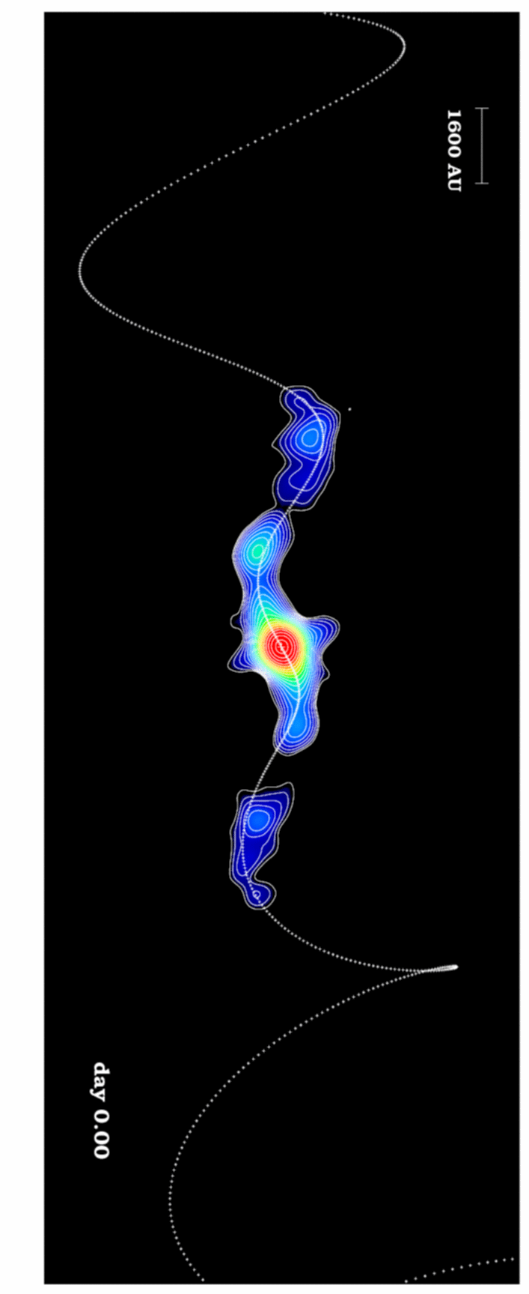
Important Links
NRAO Help Desk:
go.nrao.edu/obshelp
VLA Observational Status Summary:
go.nrao.edu/vla-oss
VLA Exposure Calculator:
go.nrao.edu/ect
Proposal Submission Tool:
my.nrao.edu
CASA (data reduction software):
http://casa.nrao.edu/
VLA Calibration Pipeline:
go.nrao.edu/vla-pipe
The X-ray binary SS433 at 26 GHz (0.095”; 520 au resolution)
Credit: Miodusweski & Miller-Jones, EVLA demo science
Notes:
26 GHz emission from microquasar SS433, 0.095” (520 AU) resolution
VLA A-config, 3 month span. This would not have been possible with the old VLA. The new VLA’s instantaneous bandwidth allows imaging each epoch with high S/N.

