Slide 1
Introducing the
The World’s Largest Radio Telescope
By Tyler Bourke
Project Scientist
Slight Editing by Doug Johnstone
For Astr511

Slide 2
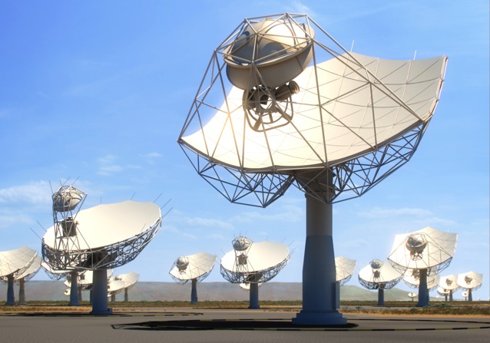
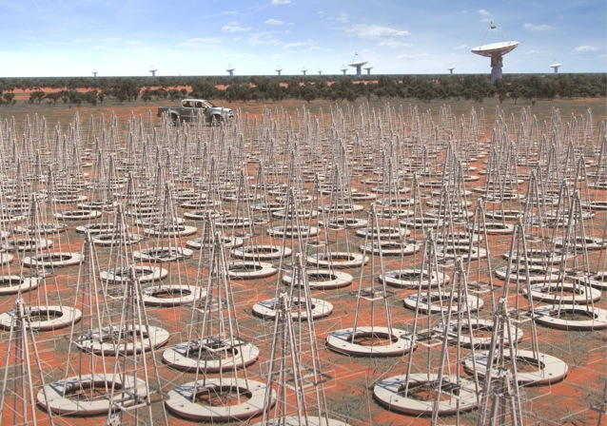
What is the Square Kilometre Array?
What Science is enabled by the SKA?
Progress & How can you be involved

Slide 3
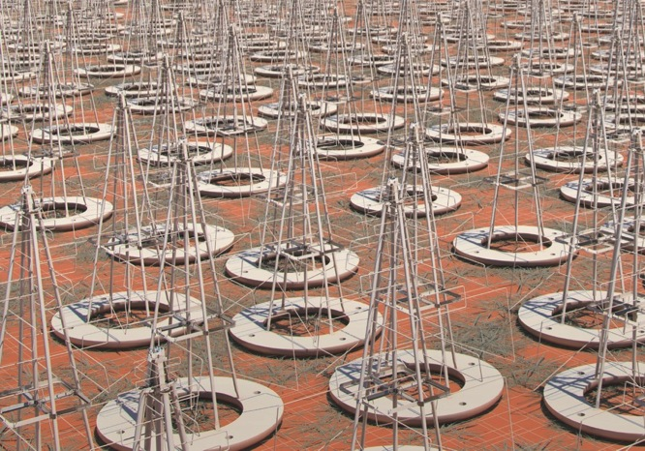


SKA Phase 1
3 sites (AUS, RSA, UK-HQ) 2 telescopes (LOW, MID) one Observatory (SKAO)
Construction Cost-cap: €675M
Construction: 2018 – 2024
SKA1-Low: ~131,000 low-freq dipoles,
50 – 350 MHz
65 km baselines (11” @ 110 MHz)
Murchison, Western Australia
SKA1-Mid: 133 x 15m + 64 x 13.5m dishes,
0.35 – 15 (24) GHz
120 km baselines
(0.22” @ 1.7 GHz; 34 mas @ 15 GHz)
Karoo, South Africa

Slide 4
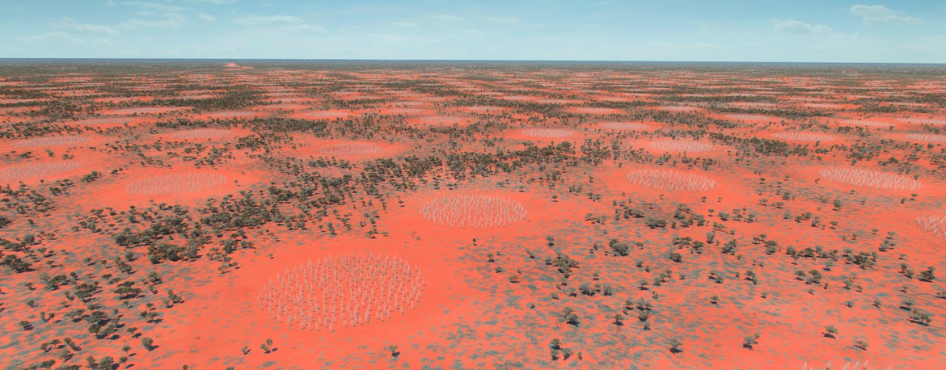
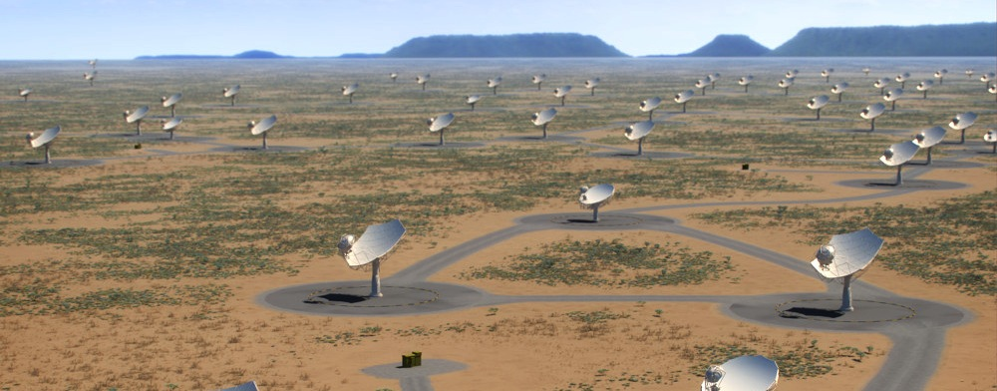
SKA Phase 2
Start Mid-2020s
AUSTRALIA
SKA-Low: ~500,000 low-freq dipoles,
200 km baselines
Murchison, Western Australia
SOUTH AFRICA
SKA-Mid: ~2500 x 15m dishes
3500 km baselines
Karoo, South Africa
+ Mid-Frequency Aperture Array?
+ Phased-Array Feeds?

Slide 5
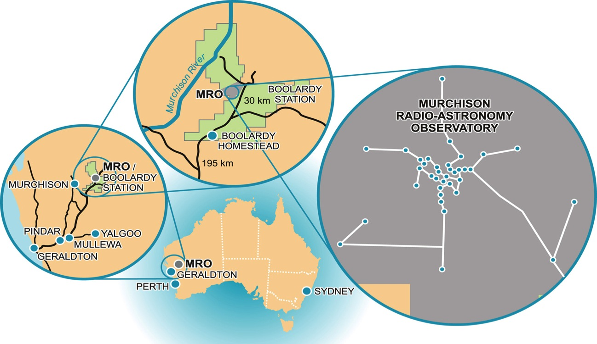
Murchison Radio Astronomy Observatory
Shire of Murchison
50,000 km² (Scotland is ~80,000 km²)
0 gazetted towns
29 sheep/cattle stations
population 110
=> 0.002 km⁻²

Slide 6
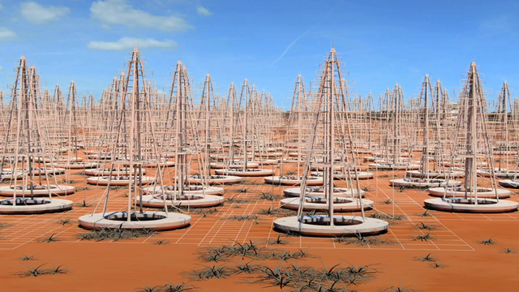
SKA1-LOW
Imaging the Epoch of Reionization Statistical studies of the Cosmic Dawn
Pulsar Studies
Detection and studies of ‘hot jupiter’ exoplanets Solar studies
Notes:
Collecting area 0.4 km^2. Compare HERA 0.04 km^2, so 10x collecting area. HERA fully filled 300-m core, plus outriggers to 1-km (70-220 MHz). See talk by James Aguirre on HERA (2015, available online).

Slide 7
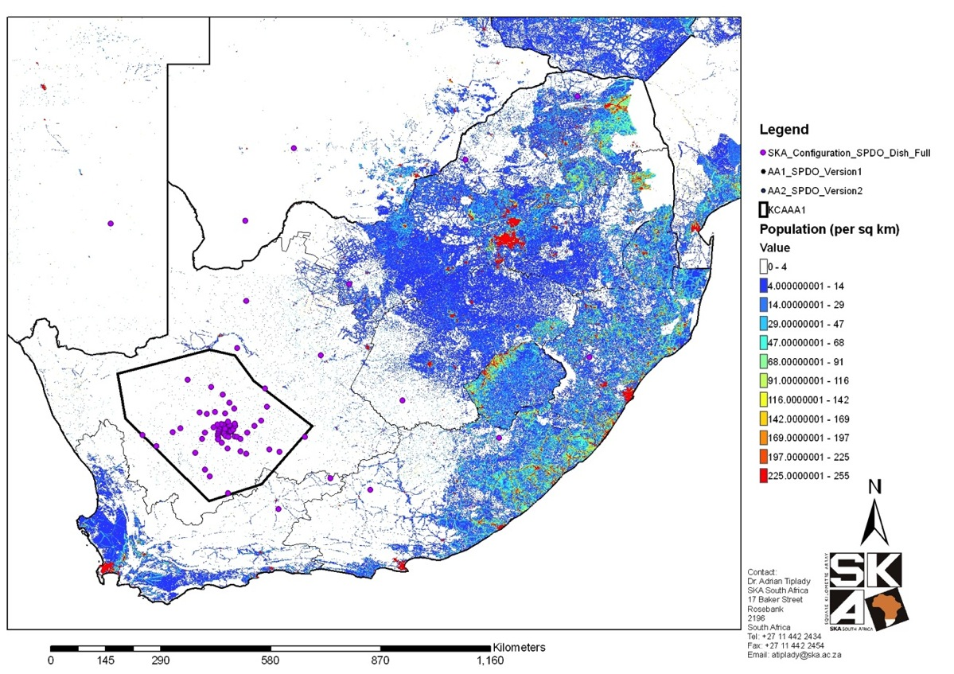
Karoo Radio Astronomy Reserve
500 km

Slide 8
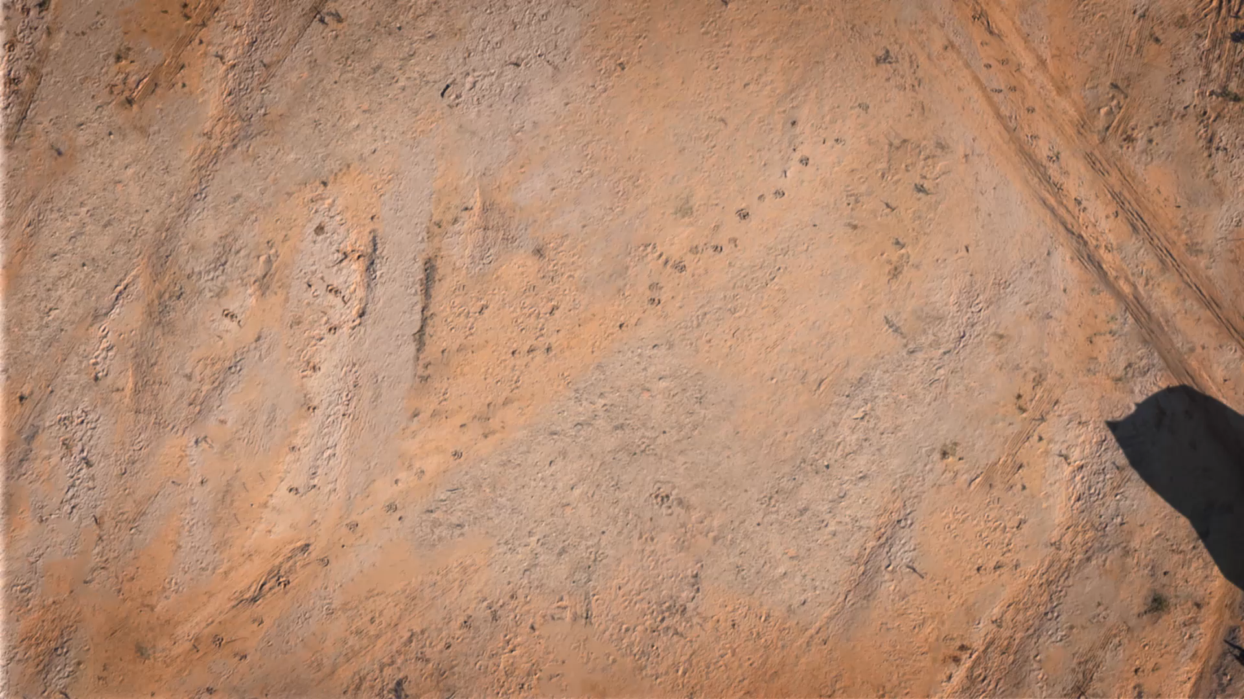
SKA1-MID
Pulsar surveying and timing (Gravitational Wave astronomy; GR in the strong regime)
  Cosmology and Galaxy evolution (through HI, Continuum and OH)
Star formation history; proto-planetary disks; cosmic magnetism; transients (FRBs)

Slide 9
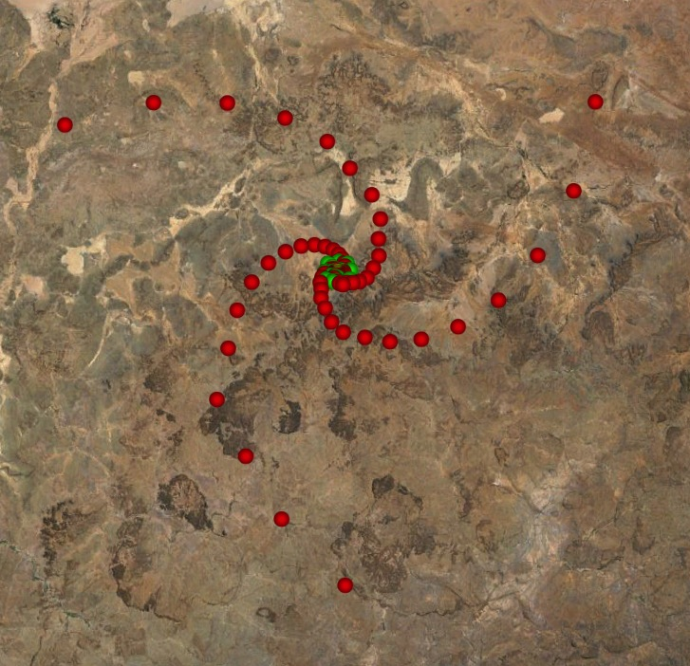
SKA Configurations
Fixed positions
Dense inner-core (~2 km diam.)
➞ Brightness Sensitivity
Logarithmic spiral arms
➞ Imaging a range of angular scales (“scale-free”)
SKA1-MID
~150 km maximum baseline
Red = MID; green = MeerKat
SKA2

Slide 10
SKA1 Bands and Spectral Resolution
Band | Frequency Range | Bandwidth
Low | 50 – 350 MHz | 300 MHz
Mid Band 1 | 0.35 – 1.05 GHz | 1 GHz
Mid Band 2 | 0.95 – 1.76 GHz | 1 GHz
Mid Band 3 | 1.65 – 3.05 GHz | 1 GHz
Mid Band 4 | 2.80 – 5.18 GHz | 2.5 GHz
Mid Band 5a | 4.6 – 8.5 GHz | 2.5 GHz
Mid Band 5b | 8.3 – 15.3 GHz | 2 x 2.5 GHz
65,536 channels maximum across any band, zoom windows possible
Possible Wide-Band and/or High Frequency upgrade paths
Band | Frequency Range | Bandwidth
Mid Band A | 1.6 – 5.2 GHz | 2.5 GHz
Mid Band B | 4.6 – 24 GHz | 2 x 2.5 GHz
Mid Band 5c | 15 – 24 GHz | 2 x 2.5 GHz

Slide 11
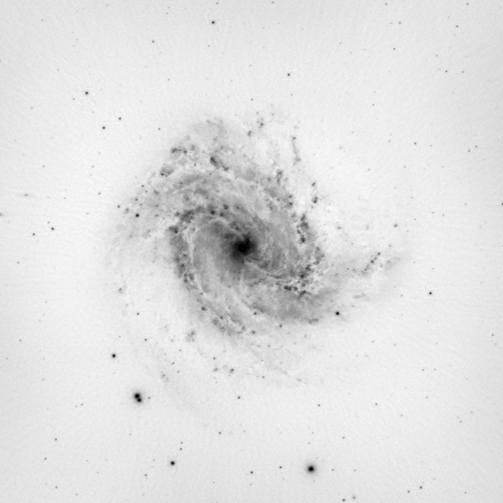
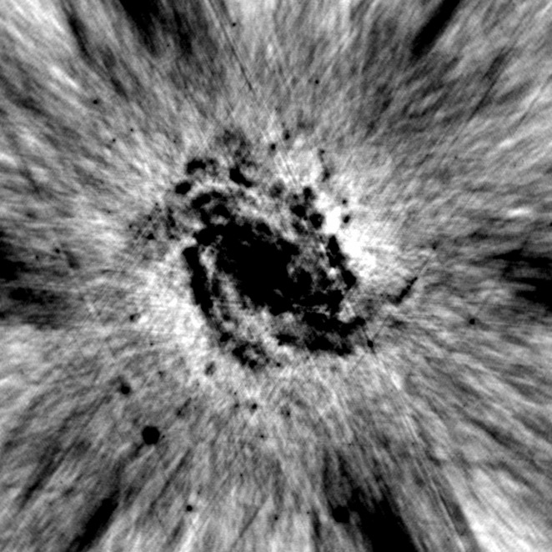
Imaging Performance*
SKA1-MID Snapshot observation
VLA Combination Snapshot
A+B+C+D array configuations
*Noiseless
VLA Produces Amazing Science

Slide 12
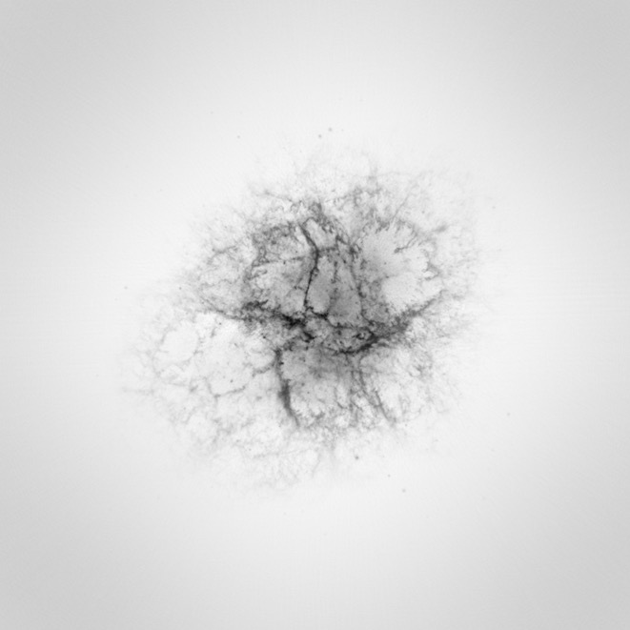
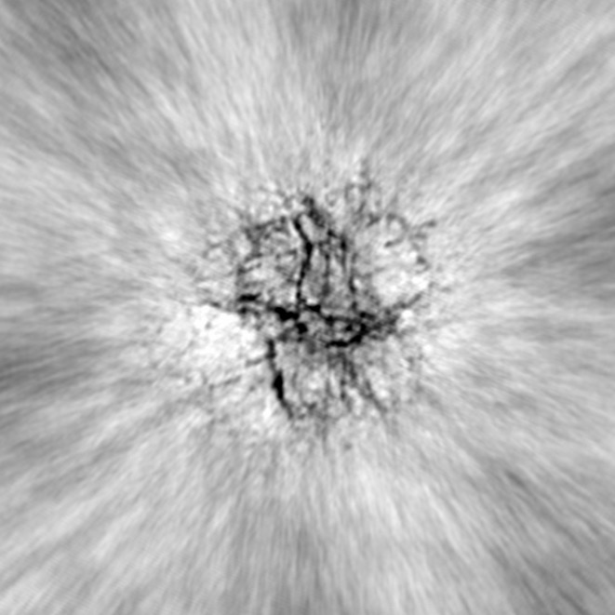
Imaging Performance*
SKA1-LOW Snapshot observation
LOFAR Snapshot observation
*Noiseless
LOFAR Produces Amazing Science

Slide 13

Computing Challenges (SKA1)
Global Traffic in 2020 ~500 Tb/s
Conservative Analysis
~300 PB/yr
AWS, IBM, Google, Nvidia
SGI, Intel, …
Tera 10¹²
Peta 10¹⁵
Exa 10¹⁸
Zetta 10²¹
Notes:
Global Traffic number from a Cisco projection.

Slide 14
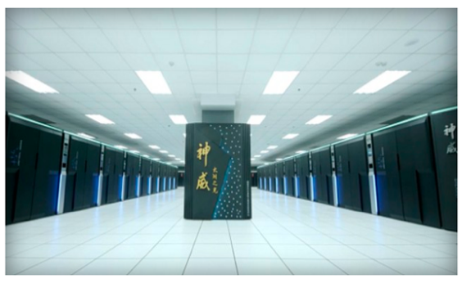
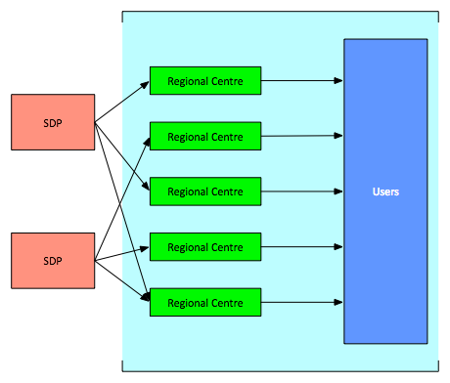
SKA Regional Centres –
outside SKAO scope
Sunway TaihuLight – 93 PFlops
Required
capacity for reprocessing data and their analysis
storage for a long-term archive
local user support
Intent
SKA partner countries planning SKA regional Centres
National super-computing centres
Provide local support to scientists
Development of new techniques, new algorithms
Deliver SKA science
AUS
RSA

Slide 15
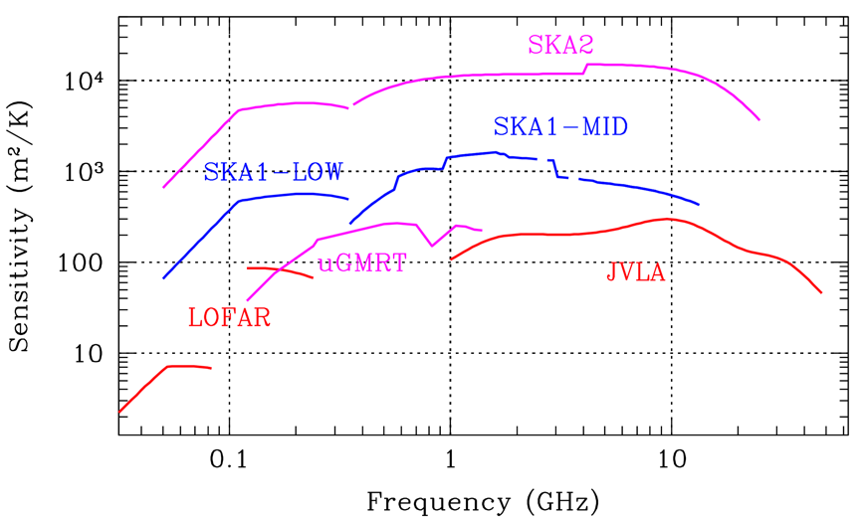
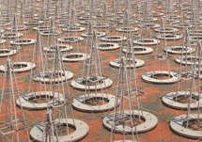
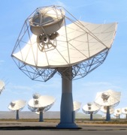
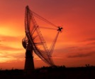
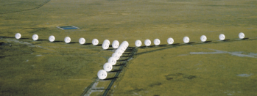

Sensitivity Comparison

Slide 16
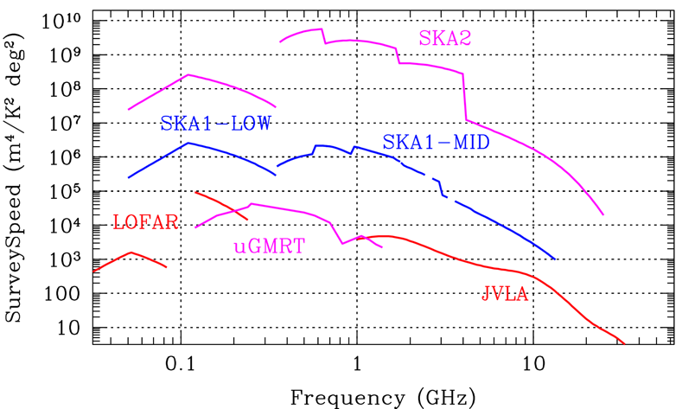
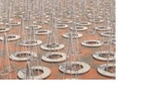

Survey Speed Comparison

Slide 17
What is the Square Kilometre Array?
What Science is enabled by the SKA?
Progress & How can you be involved

Slide 18
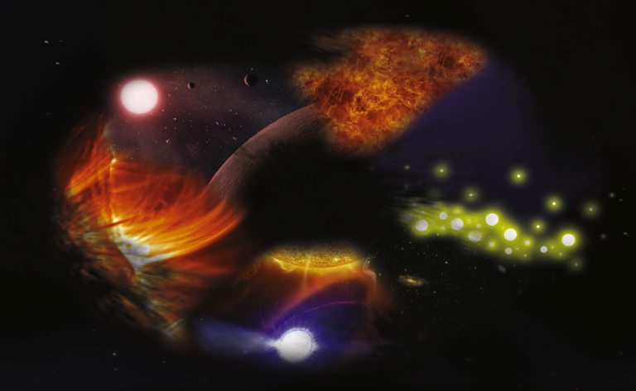
SKA– Key Science Drivers:
The history of the Universe
Cosmic Dawn
(First Stars and Galaxies)
Testing General Relativity
(Strong Regime, Gravitational Waves)
Galaxy Evolution
(Normal Galaxies z~2-3)
Cradle of Life
(Planets, Molecules, SETI)
Cosmology
(Dark Matter, Large Scale Structure)
Cosmic Magnetism
(Origin, Evolution)
Exploration of the Unknown
Broadest range of science of any facility, worldwide

Slide 19
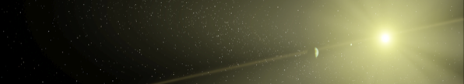
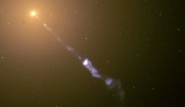
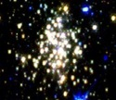
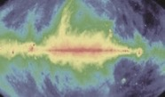

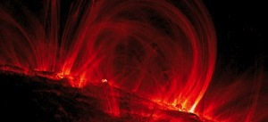



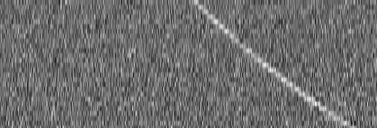
SKA Big Questions
The Cradle of Life & Astrobiology
  How do planets form? Are we alone?
Strong-field Tests of Gravity with Pulsars and Black Holes
  Was Einstein right with General Relativity?
The Origin and Evolution of Cosmic Magnetism
  What is the role of magnetism in galaxy evolution and the structure of the cosmic web?
Galaxy Evolution probed by Neutral Hydrogen
  How do normal galaxies form and grow?
The Transient Radio Sky
  What are Fast Radio Bursts? What haven’t we discovered?
Galaxy Evolution probed in the Radio Continuum
  What is the star-formation history of normal galaxies?
Cosmology & Dark Energy
  What is dark matter? What is the large-scale structure of the Universe?
Cosmic Dawn and the Epoch of Reionization
  How and when did the first stars and galaxies form?

Slide 20
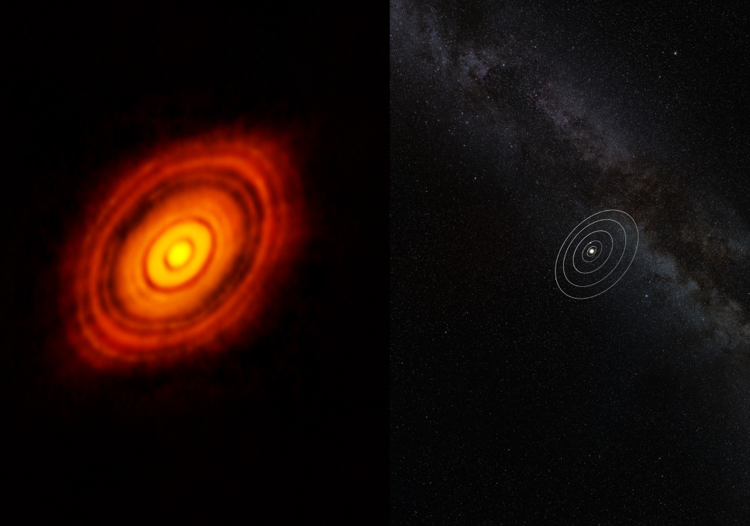
How do planets form?
Are we alone?

Slide 21
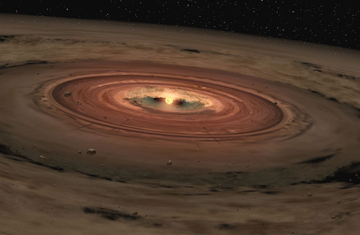
Grain Growth in Protoplanetary Disks
Study the formation of planets
When/where do grains grow beyond pebbles to rocks?
Resolved disk observations allow for separation of free-free and thermal dust emission
SKA1 at 15 GHz will have 34 mas resolution, so 4-5 AU at 140 pc
Probing very large grains trapped in the terrestrial planet regime
→ SKA resolution and sensitivity at longer wavelengths sensitive to larger grain sizes
Hoare+ 2015, Testi+ 2015
Notes:
Opacity curves showing flattening at cm wavelengths. (log kappa in cm2 g-1)
Matched resolution indicated.

Slide 22
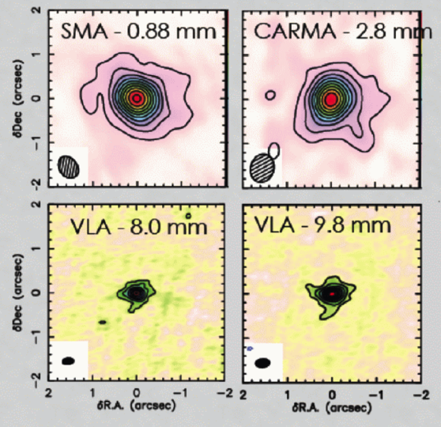
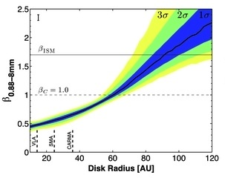
Grain Growth in Protoplanetary Disks
Resolved observations at cm wavelengths
constrains dust opacity slope
sensitive to larger grains
small grains
➜
➜
large grains
Perez+ 2012
SKA1 at 15 GHz will have 34 mas resolution, so 4-5 AU at 140 pc
Probing very large grains trapped in the terrestrial planet regime

Slide 23
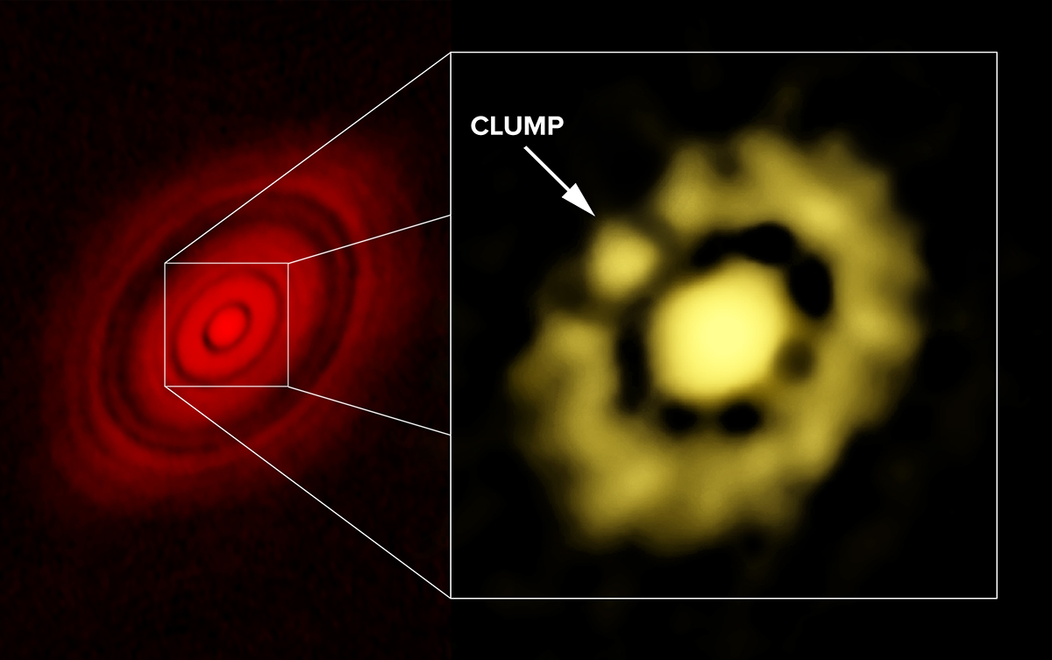
ALMA 1-mm image of HL Tau at left; VLA 7-mm image (70 mas), showing clump of dust, at right.
CREDIT: Carrasco-Gonzalez, et al.; Bill Saxton, NRAO/AUI/NSF.

Slide 24
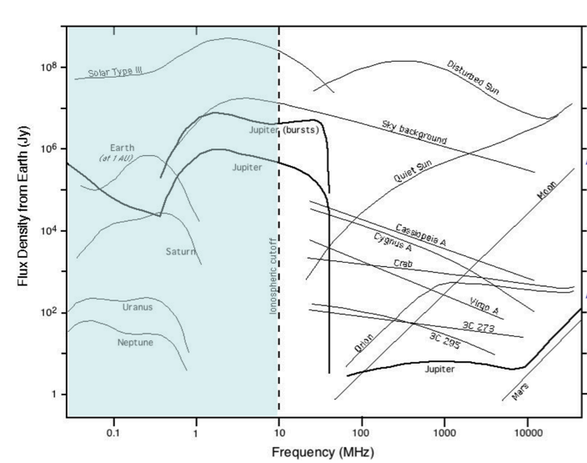
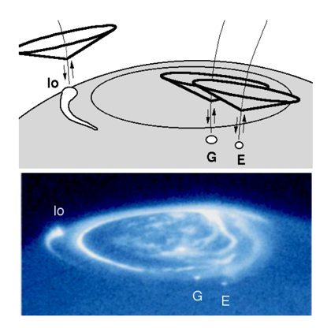

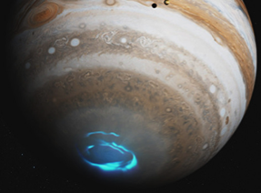

Characterisation of Exoplanets
• Magnetospheric auroral radio emissions due to coherent Plasma processes
Emission is extremely bright (up to 1020 K), highly polarized & beamed
• Direct detection method for exoplanets:
• measurement of rotation rate
• measurement of magnetic field strengths
• leads to constraints on scaling laws
• probes internal structure
Zarka+ 2015
SKA1-LOW at ~50 MHz will detect polarised bursts of emission!
SKA1-LOW able to detect hot-Jupiters out to 10 pc (~200 stars, ~35 known exoplanets)

Slide 25
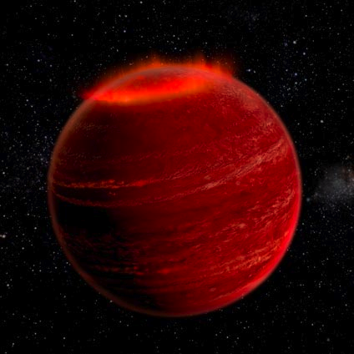
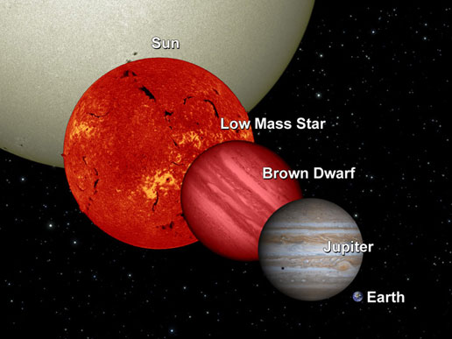
Aurora detection on a Brown Dwarf
a few GHz
LSR J1835+3259
Power 10,000 x Jupiter
Distance 6 pc
Link between stars and gas planets
Hallinan+ 2015

Slide 26

SETI – are we alone?
Detectable stars with airport radar power ~ 10⁴ with SKA1
Detectable stars with TV transmitter power ~10 with SKA2
Siemion+ 2015

Slide 27
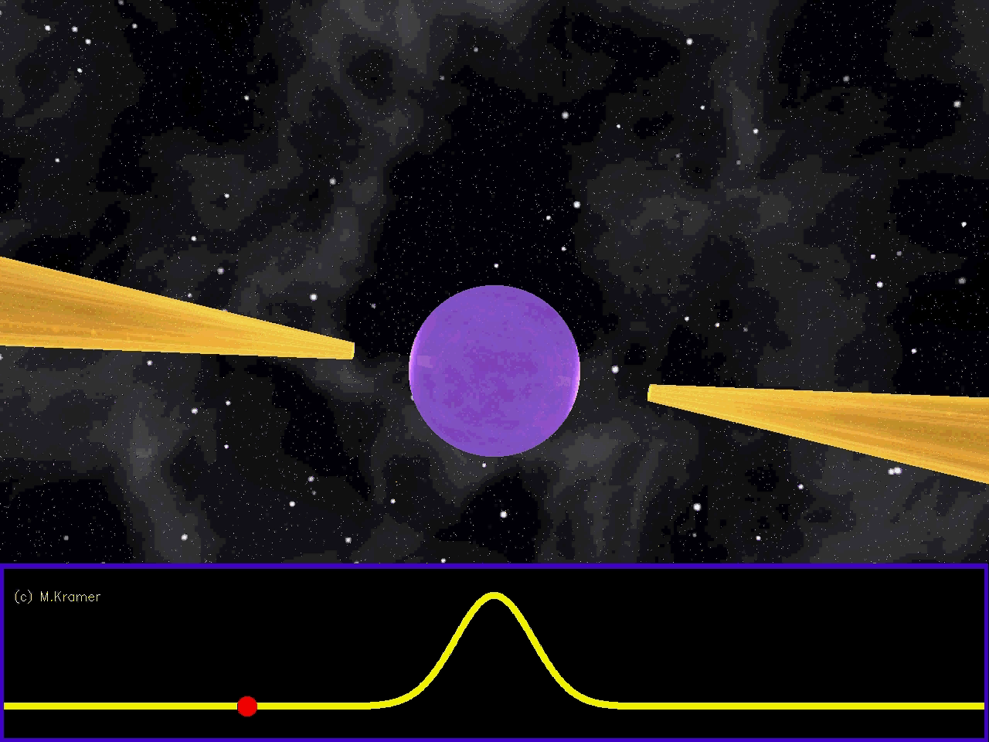
Pulsars
Testing General Relativity
in extreme environments
5.757451924362137(2) ms (Verbiest et al. 2008) = 2 atto (10⁻¹⁸) seconds uncertainty!

Slide 28
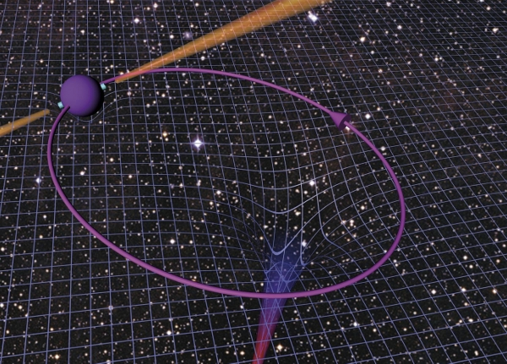
Test GR in strong field regime
No Hair Theorem
Tests of GR in strong field regime via:
Neutron Star – White Dwarf binaries
Neutron Star – Neutron Star binaries
Pulsars around Galactic Centre
Neutron Star – Black Hole binaries
Black Holes can be described by 3 classical parameters:
  Mass
  Electric Charge
  Angular Momentum (Spin)
Cosmic Censorship
BHs have an event horizon which hides the singularity, i.e.., there are
no naked singularities
M.Kramer
Kramer & Stappers 2015

Slide 29
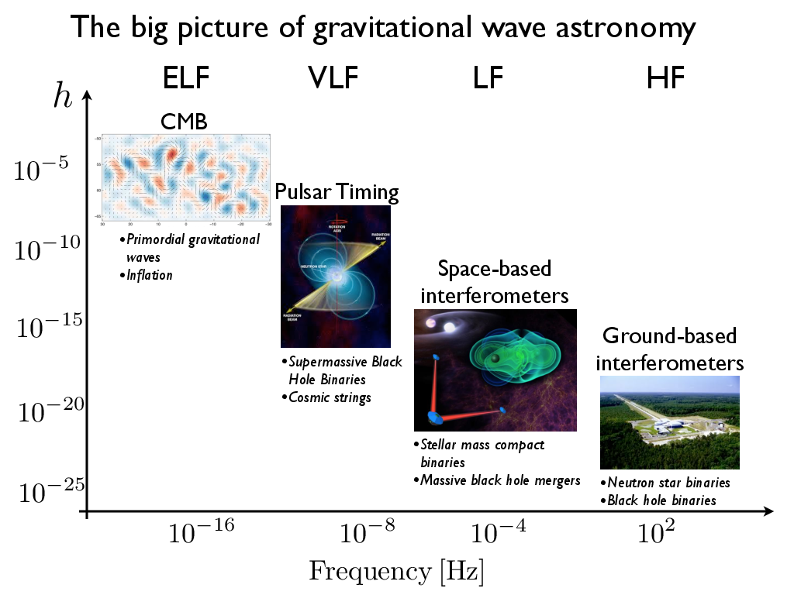
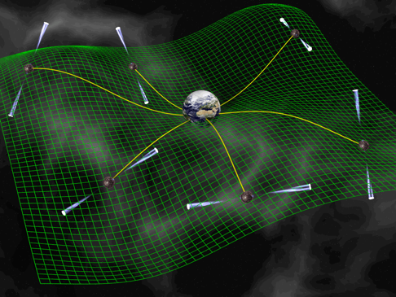
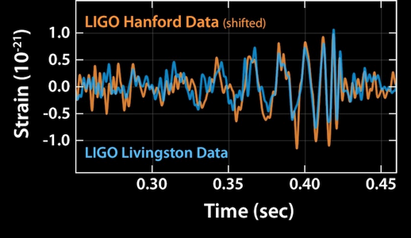
Gravitational Waves with Pulsars
Pulsar Timing Array
D.Champion
SKA
Discoveries with SKA1 (SMBH mergers, Primordial GWs)
“GW astronomy” with SKA2 (discrete sources)
Notes:
Advanced LIGO: NS-NS to 350 Mpc, NS-BH to 650 Mpc (z=0.15), BH-BH to z=0.4 (1500 Mpc)
SMBH (PTAs) – mergers in early galaxy evolution

Slide 30
What is the origin of B fields? How do they evolve?
What is their role in galaxy and structure evolution?

Slide 31
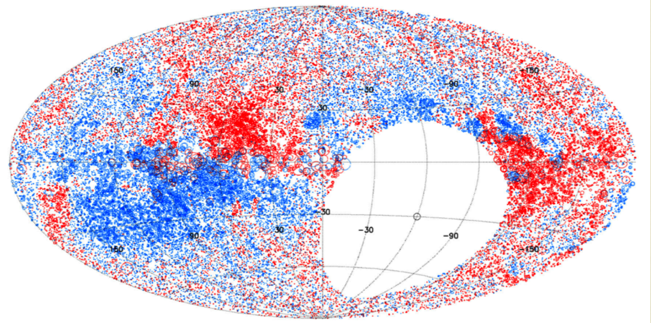
What is the origin of B fields? How do they evolve?
What is their role in galaxy and structure evolution?
Measure the magnetic field structure in:
Our Galaxy
Nearby Galaxies
Galaxy Clusters/Cosmic Web
Reveal:
Turbulent component of Galactic field and small-scale structure ➜ 3D structure
Structure of fields in nearby galaxies (along with direct imaging) ➜ Field Origin
Structure of fields in and around galaxy clusters ➜ their role in cluster dynamics
Rotation Measure Grid
NVSS 1 source/deg². SKA1 ~300x denser; SKA2 ~5000
Johnston-Hollitt+ 2015

Slide 32
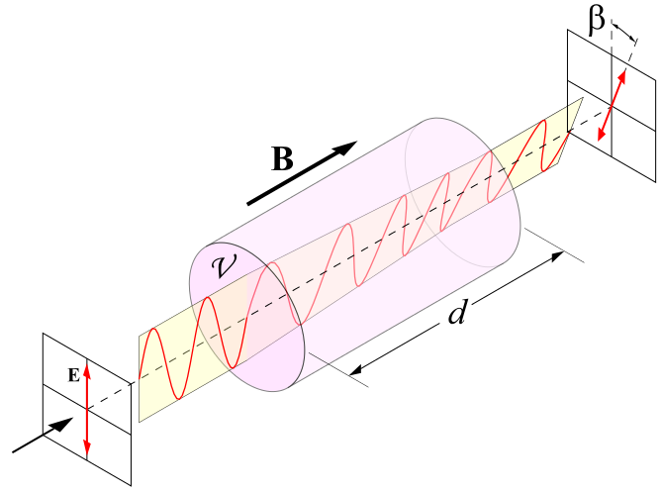
From Wikipedia!

Slide 33
Rotation Measure Grid

Slide 34
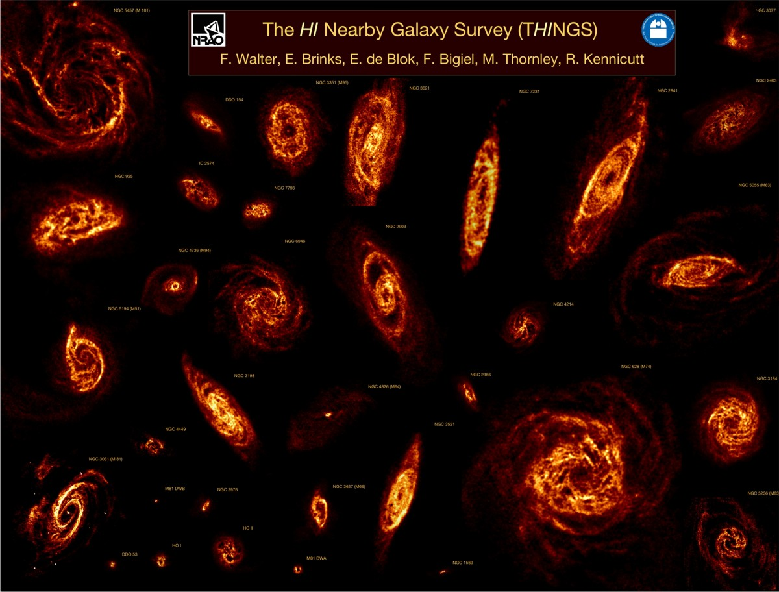
How do galaxies form
and evolve?
HI Nearby Galaxy Survey (THINGS)
Notes:
IMAGE: HI Nearby Galaxy Survey (THINGS), Walter et al.

Slide 35
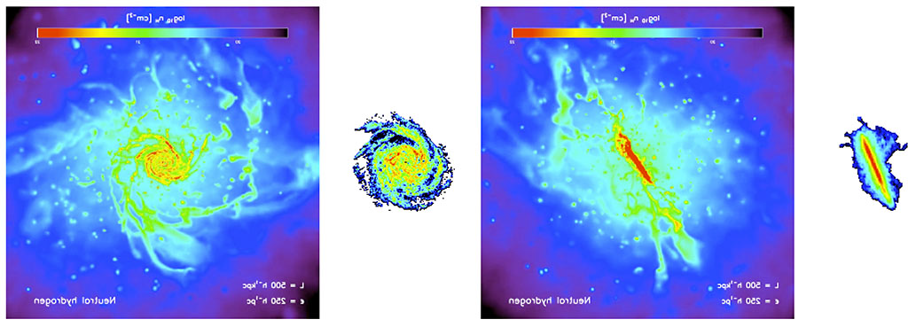
How do galaxies form and evolve?
observed HI simulated HI observed HI simulated HI
Images courtesy of Tom Oosterloo (SKA HI science working group)
How do galaxies accrete and grow from the `Cosmic Web’ (feeding and feedback)?
Observations miss the low-density IGM
SKA1 will provide resolved observations out to z ~ 0.8
Measure angular momentum build-up (rotation curves out to large radius)
SKA1 will probe low column density HI in nearby Universe (N_{HI} < 10¹⁸ cm⁻²)

Slide 36
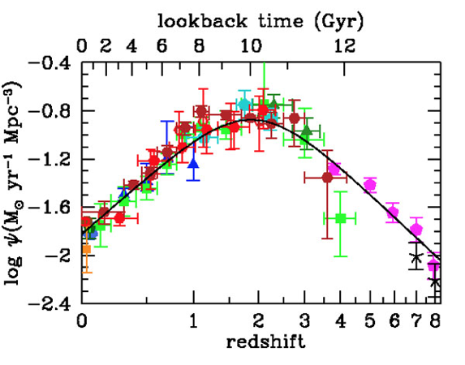

Galaxy Evolution & Star Formation
Evolution of HI mass function and galaxy kinematics
SF rate peaked z~2, but hydrogen density flat – WHY?
? Replenishment
Star Formation Rate Density PEAKED
Hydrogen mass density evolution FLAT
FUV and IR, many assumptions
Madau & Dickinson 2007
Zafar+ 2013
SKA1 - Detect 10⁷ galaxies <z> ≈ 0.3, 10⁵ galaxies <z> ≈ 1
Compare to SDSS: 10^{6.2} galaxies, <z> ≈ 0.1; WiggleZ: 10^{5.2} galaxies, <z> ≈ 0.6

Slide 37

Galaxy Evolution & Star Formation
Evolution of HI mass function and galaxy kinematics
SKA1:
Resolved Emission to z~0.8
Intensity Mapping to z~3
Full SKA z~5
Intensity Mapping
Hydrogen mass density evolution
Zafar+ 2013

Slide 38

How do galaxies form and evolve?
What is the Star Formation History of the Universe (SFHU)?
Star Formation Rate Density
SFHU uncertain due to many reasons, e.g.,:
dust attenuation corrections
conversion to SFR
lack of IR measures at z>2
poor angular resolution
Want to:
understand the evolution of the star-formation main sequence
resolve SF within galaxies at peak (central v distributed SF)
FUV and IR, many assumptions
Madau & Dickinson 2007

Slide 39
How do galaxies form and evolve?
What is the Star Formation History of the Universe (SFHU)?
~1 GHz non-thermal – SNR
➞ FIR-radio correlation
➞ indirect SFR tracer
➞ massive stars, well-sampled IMF
~10 GHz+ thermal
➞ redshifted from 30-40 GHz
➞ z ~ 2-3, peak of SF
➞ direct tracer of current SFR of massive stars
Multi-frequency to separate non-thermal and thermal
Star Formation Rate Density
FUV and IR, many assumptions
Madau & Dickinson 2007

Slide 40

Radio Transients

Slide 41


Radio Transients
Fender+ 2015
Incoherent synchrotron emission
Relatively slow variability
Brightness temperature limited
Associated with all explosive events
Find these (mostly) in images
Coherent emission
Relatively fast variability
High brightness temperature
Often highly polarised
Sometimes very steep spectra
Find these (mostly) in time series
Mark A. Garlick
Dan Thornton

Slide 42


Fast Radio Bursts (FRBs)
Bright, short period bursts at cosmological (?) distances
>20 celestial “FRB” events now detected
Bright: S = 0.5 – 1.3 Jy,
Short period: Δt = 1 – 6 msec
Extragalactic: DM = 375 – 1500 cm⁻³ pc
Estimated event rate: 1x10⁴ sky⁻¹ day⁻¹
Completely unknown origin*, possibly at cosmological distances
DM = 944 pc cm⁻³ ➜ z ~ 0.8
Thornton+ 2013
Probe Baryon content along line-of-sight
Missing Baryon Question

Slide 43

Cosmology with SKA
What is Dark Energy?
Does GR hold on large scales?
Virgo consortium - http://www.virgo.dur.ac.uk/
Notes:
1 pc = 30 trillion kilometres (30 x 10^12)

Slide 44



What is Dark Energy?
Baryon Acoustic Oscillations (BAO)
Standard ruler to map expansion history of the Universe
Test cosmological models incl. Dark Matter
HI Intensity mapping with SKA
Does GR hold on large scales?
Constraining non-Gaussianity of primordial fluctuations
Uniquely probes the largest scales
  ➞ tests of inflation models
Cross-correlation of large-scale structure and CMB
  Integrated Sachs-Wolf effect
Notes:
In early ionised universe (< 380,000 yrs) sound waves propagated (characteristic scale).
● This scale is left imprinted on the matter distribution after the baryons decoupled from the photons (dark ages) ➜ Standard Ruler (~ 150 Mpc)
● Measurements of the galaxy clustering pattern allow us to recover it ➜ expansion history of the Universe via large scale structure as function of redshift

Slide 45



Revealing the Epoch of Reionisation
CMB displays a single moment
of the Universe. Its initial
conditions at ~400,000 yrs
HI emission from the Dark Ages, Cosmic Dawn & EoR traces an evolving “movie” of baryonic
and DM structure formation at tuniv<10⁹ years.

Slide 46
The Unknowns (cf. HST)
Project | Key project | Planned? | Nat. Geo. top ten? | Highly cited? | Nobel prize?
Use Cepheids to improve value of H0 | ✔ | ✔ | ✔ | ✔
Study intergalactic medium with uv spectroscopy | ✔ | ✔
Medium-deep survey | ✔ | ✔
Image quasar host galaxies |  | ✔ | ✔
Measure SMBH masses |  | ✔ | ✔
Exoplanet atmospheres |  | ✔ | ✔
Planetary Nebulae |  | ✔ | ✔
Discover Dark Energy |  |  | ✔ | ✔ | ✔
Comet Shoemaker-Levy |  |  | ✔
Deep fields (HDF, HDFS, UDF, FF, etc) |  |  | ✔ | ✔
Proplyds in Orion |  |  | ✔
GRB Hosts |  |  | ✔
(Lallo: arXiv:1203.0002; Norris AASKA14)

Slide 47
What is the Square Kilometre Array?
What Science is enabled by the SKA?
Progress & How can you be involved

Slide 48

Member Countries
Australia (DoI&S)
Canada (NRC-HAA)
China (MOST)
India (NCRA/DAE)
Italy (INAF)
Netherlands (NWO)
New Zealand (MED)
South Africa (DST)
Sweden (Chalmers)
UK (STFC)
Interested: France, Germany, Japan, Korea, Portugal, Spain, Switzerland
Contacts: Brasil, Ireland, Malta, Mexico, Russia, USA.

Slide 49




















Detailed Design Phase
Project Management and System Engineering Teams based at Jodrell Bank Observatory
Design >75% complete – Prototypes under construction for deployment on site
~600 scientists & engineers in institutes and industry in Member + other countries
€200M design effort – fully funded

Slide 50

International Organisation
SKA Member governments are negotiating the establishment of an intergovernmental organisation (IGO), similar to ESO/CERN/ITER/ESA.
Will provide:
  Long-term government commitment and funding stability
  Availability of Privileges and Immunities for members
  ‘Freedom to operate’, specifically through procurement process
Critical step to allow SKA Observatory to operate as an international scientific facility
SKA Headquarters @ Jodrell Bank
€20M project, primarily funded by UK Govt.
Completion early 2018
HQ staff ~150
Observatory staff >400

Slide 51



MeerKAT Radio Telescope – South Africa
ASKAP - Australia
MWA - Australia
Notes:
Why Build interferometers? 1. Mechanical limit. 2. Resolution limit to single dishes?

Slide 52



Technical Progress
Surface RMS 350 micron
66 x M1 moulds, each 12 tonnes, with average surface accuarcy of ~50µm RMS.
Subreflector Moulds

Slide 53


Technical Progress
SKA-LOW prototype antenna station deployed
2.6 MWhr lithium ion battery

Slide 54

SKA Science Case
http://astronomers.skatelescope.org/meetings-2/aaska14/
www.skatelescope.org/books/
135 chapters,
2000 pages,
31 countries
2015

Slide 55




SKA Science Advisory Groups
Science Working Groups (SWGs)
Astrobiology (“The Cradle of Life”)
Cosmic Magnetism
Cosmology
Epoch of Reionisation & the Cosmic Dawn
Extragalactic Continuum (+ Surveys)
Extragalactic Spectral Line
HI Galaxies
Our Galaxy
Pulsars (“Strong field tests of gravity”)
Solar and Heliospheric Physics
Transients (Exploration of the Unknown)
Focus Groups
High Energy Cosmic Particles
VLBI

Slide 56

Key Science Projects (‘KSPs’)
Notional package of Key Science Projects developed:
  Based on highest priority science objectives (HPSOs)
  Consistent with capabilities of the SKA1 design
  Consistent with a realistic observing schedule filled at approximately 50-70% for the first 5 years of scientific operations
Adopted KSP policy (agreed by SKA Board, but details still under discussion)
  Only scientists from SKA member countries may lead a KSP
  KSP Leadership is guaranteed to be distributed amongst SKA members in proportion to their financial contribution
  KSP participation (at the non-Leader level) is guaranteed to be distributed amongst SKA members in proportion to their financial contribution
  KSP participation (at the non-Leader level) of SKA non-members is capped at the value defined in the Access Policy
Limited Open Skies – most time will go to astronomers from member countries

Slide 57


