Slide 1
ALMA:
The Atacama Large Millimetre/submillimetre Array

Slide 2
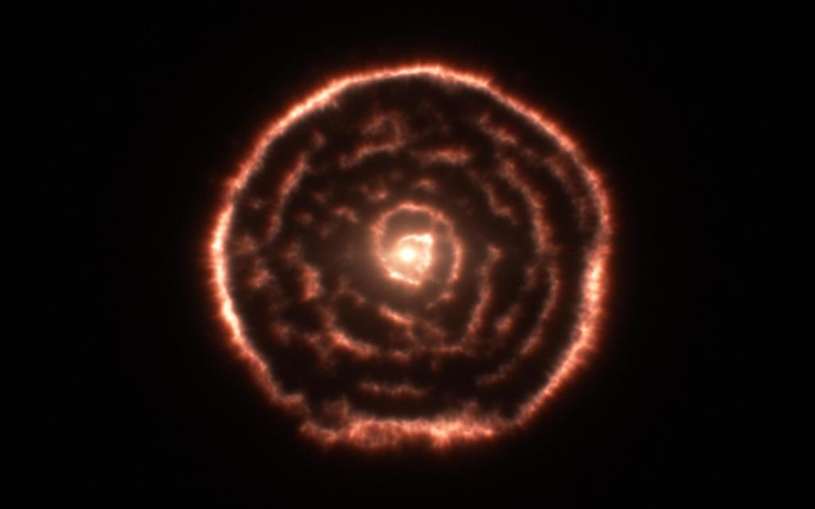
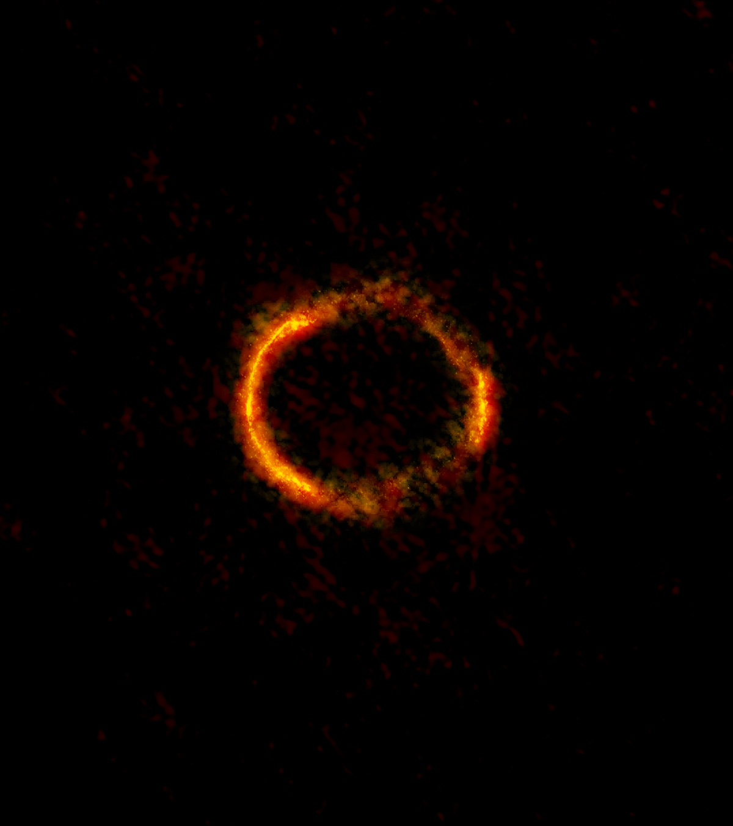
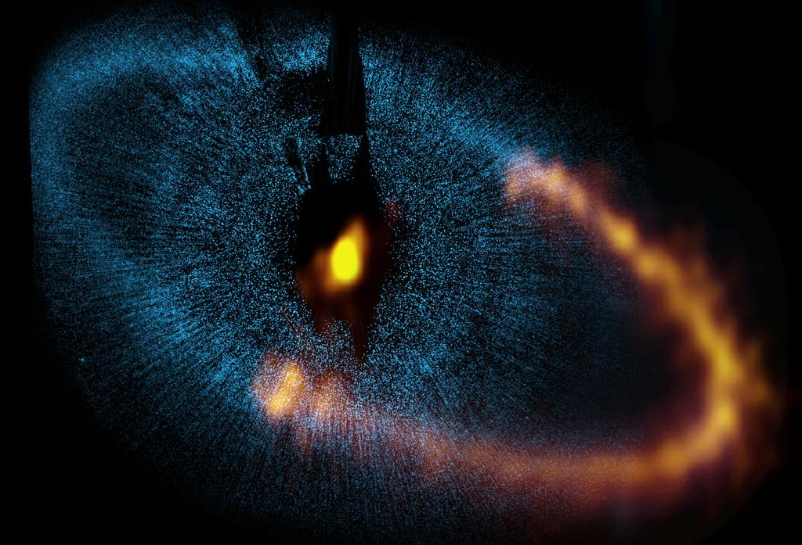
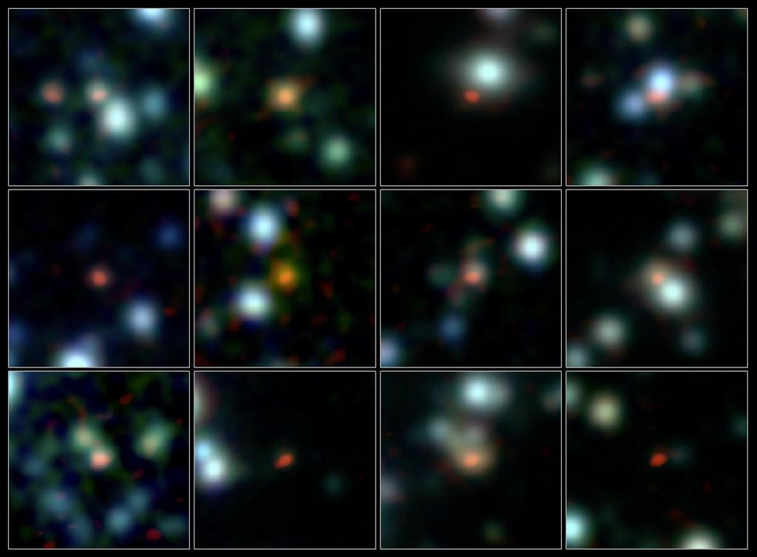
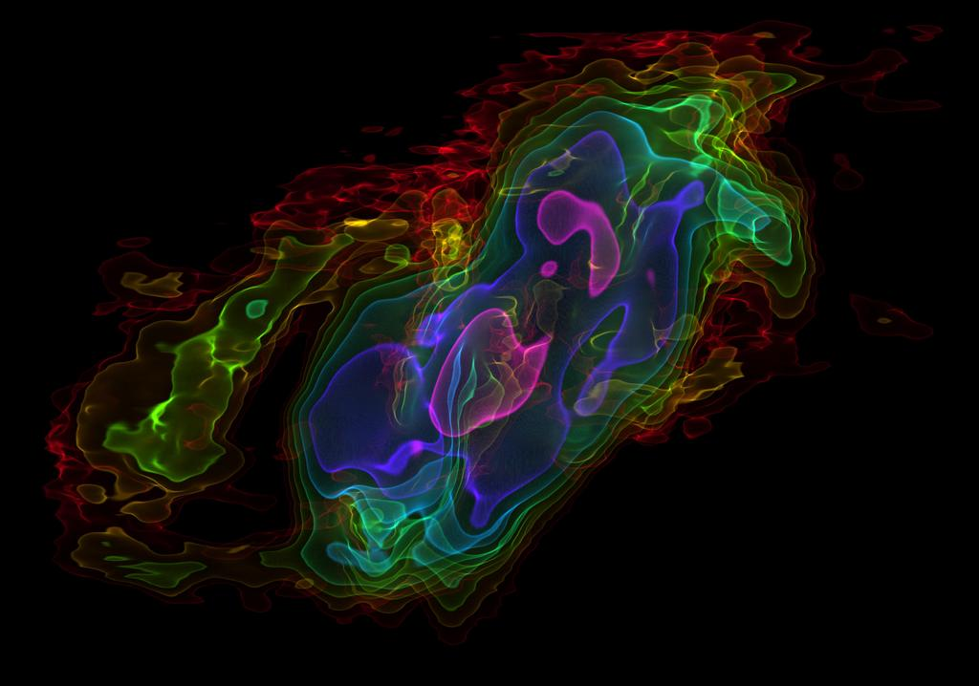
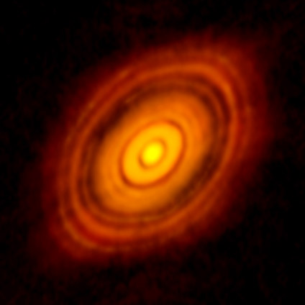
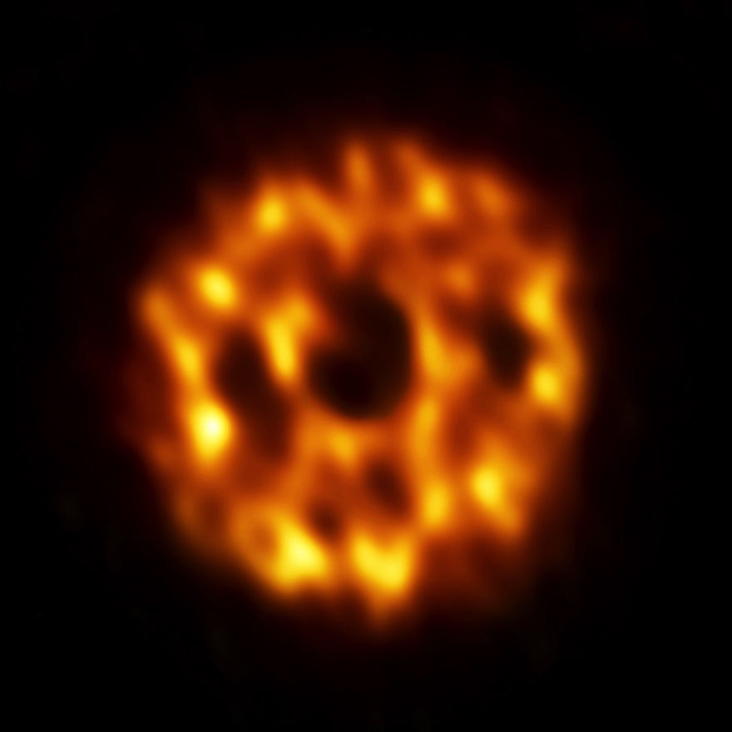
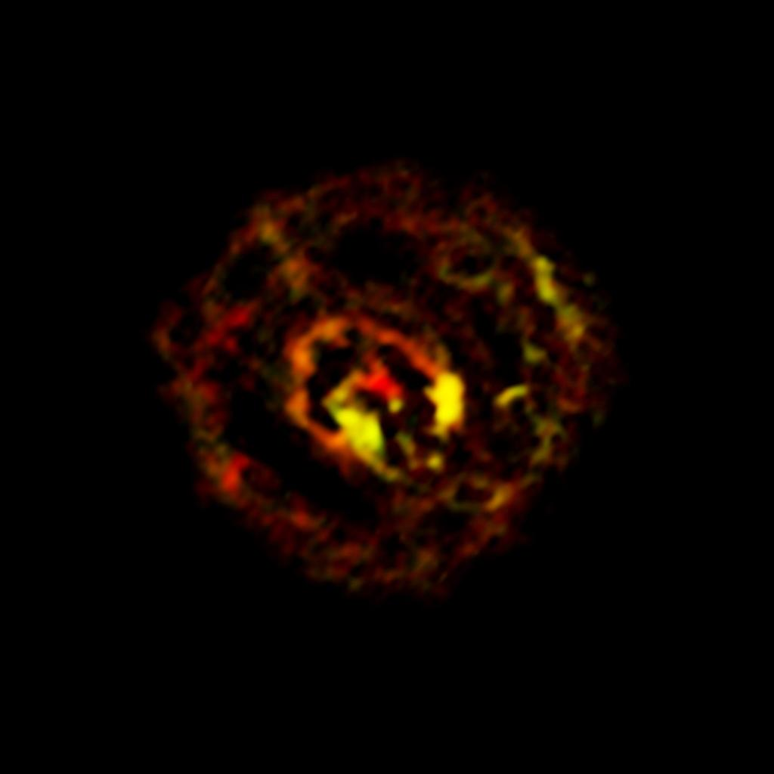
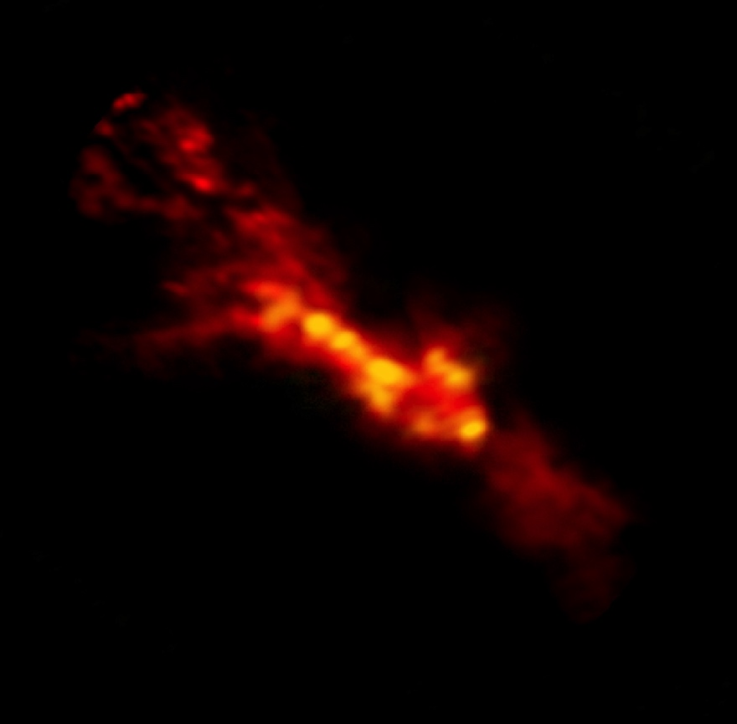
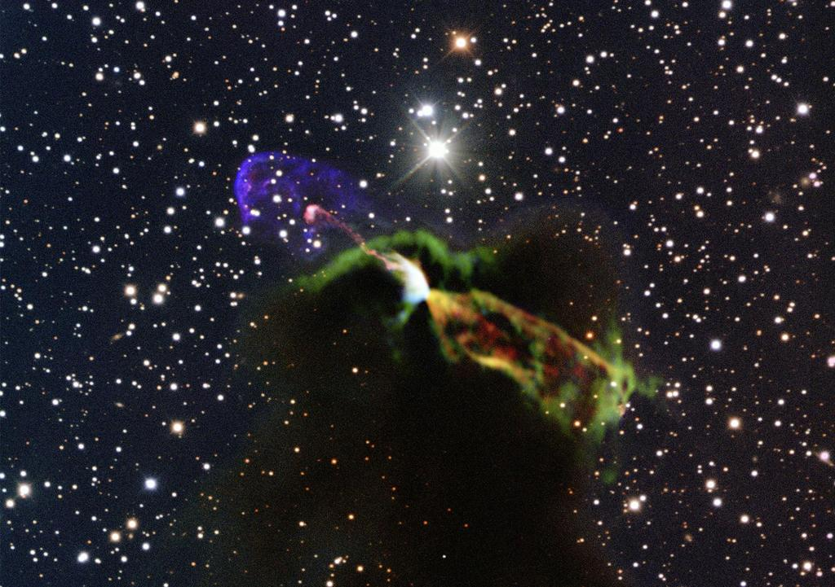
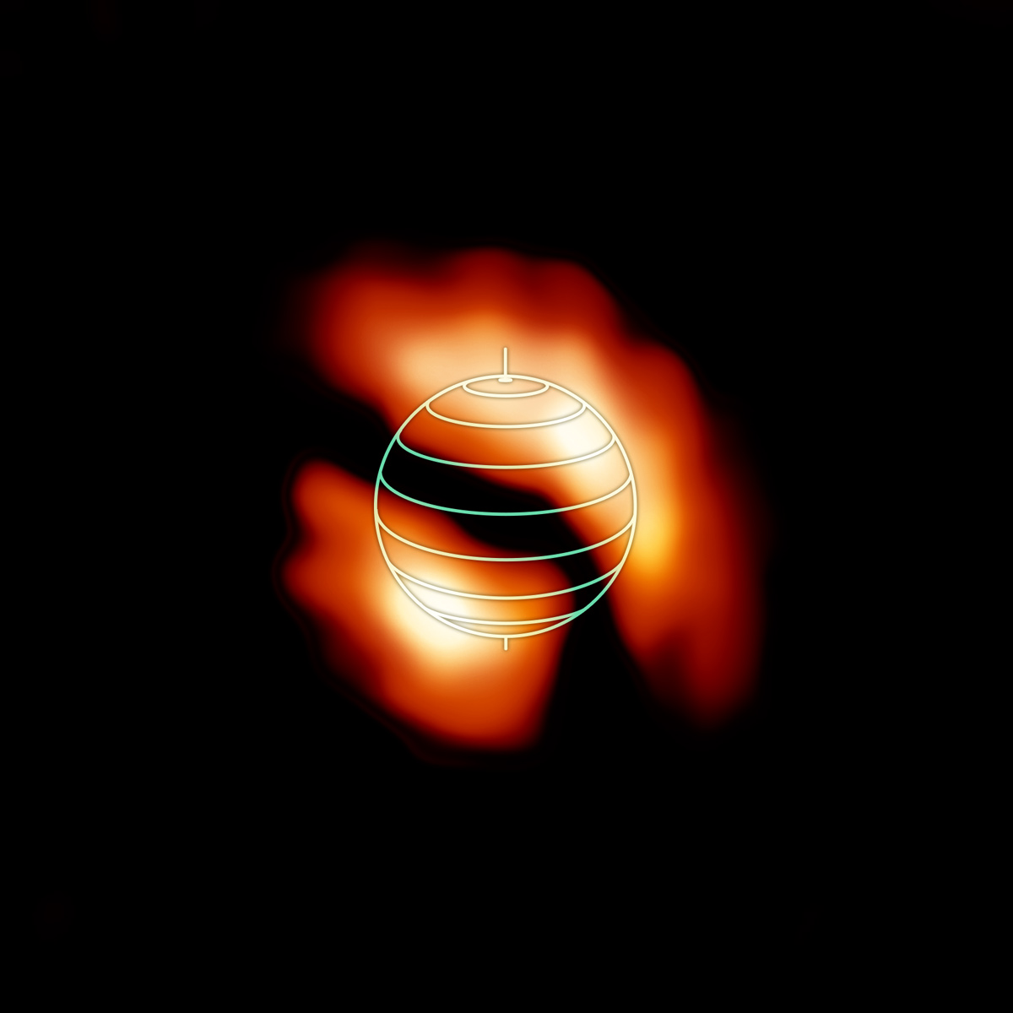
945+ publications since start of operations in 2011!

Slide 3
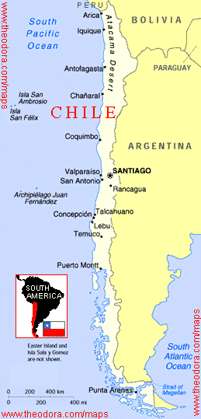
ALMA Overview
A global partnership to deliver a revolutionary millimeter/submillimeter telescope array
  North America (US, Canada, Taiwan)
  Europe (ESO)
  East Asia (Japan,Taiwan)
  In collaboration with Chile
5000 m (16,500 ft) site in Chilean Atacama desert
66 telescopes in full operation
  Main Array: 50 x 12m antennas
  Total Power Array: 4 x 12m antennas
  Atacama Compact Array (ACA): 12 x 7m antennas
April 2013
3

Slide 4
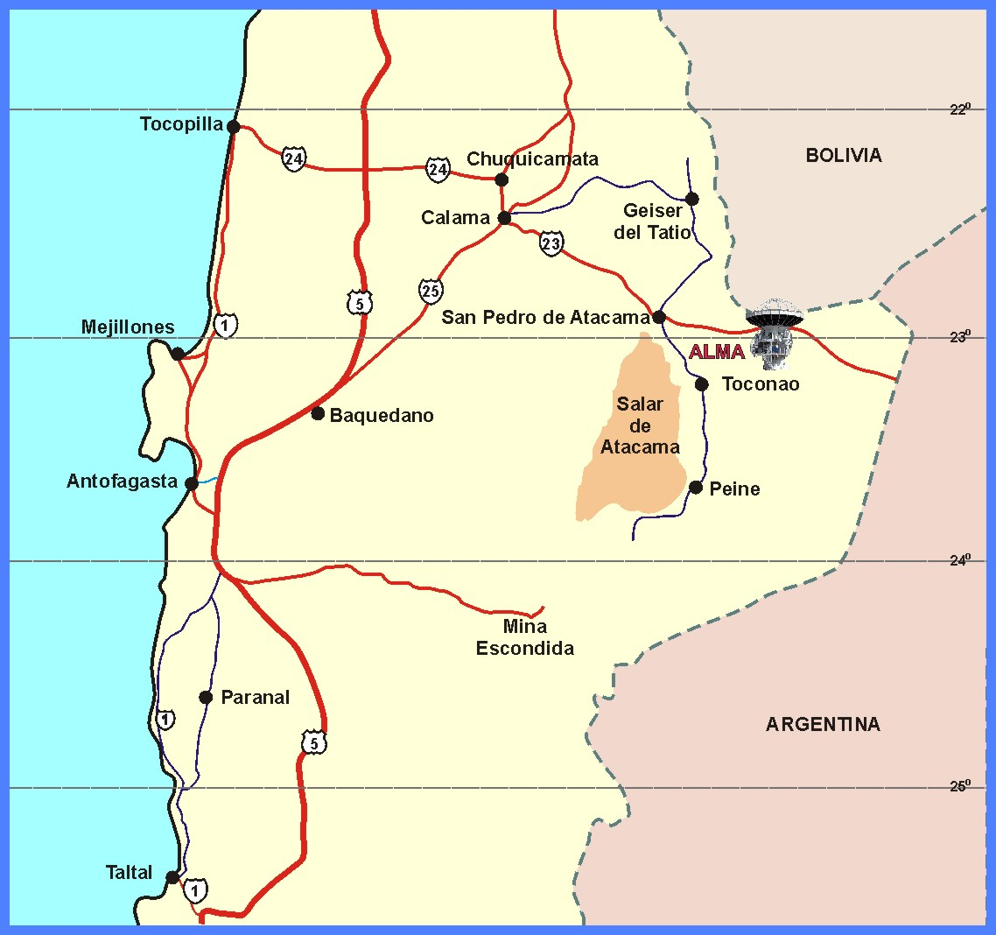
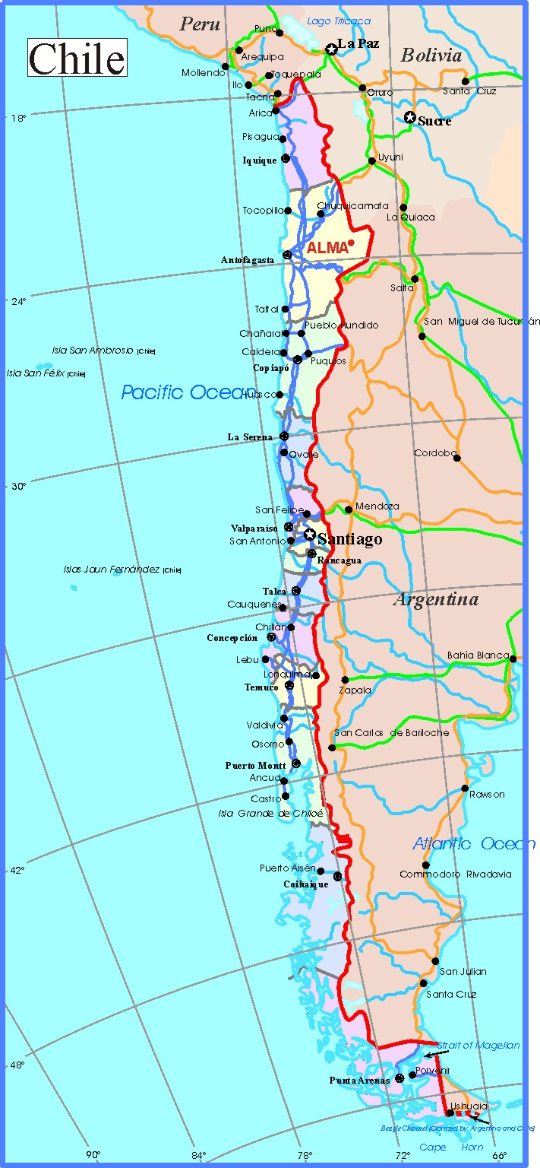
Where is ALMA?
Paranal
La Serena
Santiago
Atacama Desert,
Northern Chile

Slide 5
Where is ALMA?

Slide 6





















Who is ALMA?
An international partnership between:
North America
Europe
Asia
Chile
to build the best possible submillimetre telescope

Slide 7
Who is ALMA?
Standard ALMA acknowledgement:
“ALMA is a partnership of the European Southern Observatory (ESO; representing its member states), the National Science Foundation (NSF; USA) and the National Institutes of Natural Sciences (NINS; Japan), together with the National Research Council (NRC; Canada), the National Science Council (NSC; Taiwan) and the Academia Sinica Institute for Astronomy and Astrophysics (ASIAA; Taiwan), and the Korean Astronomy and Space Science Institute (KASI; Republic of Korea), in cooperation with the Republic of Chile. The Joint ALMA Observatory (JAO) is operated by ESO, the Associated Universities, Incorporated / the National Radio Astronomy Observatory (AUI/NRAO) and the National Astronomical Observatory of Japan (NAOJ)."

Slide 8
ALMA Organization (Array Operations Site)
Llano de Chajnantor, Chile (elev. 5000 m)
latitude = −23.029°, longitude = −67.755°; elevation ~ 5000 m
ALMA Technical Building (ATB)
Correlator
8

Slide 9
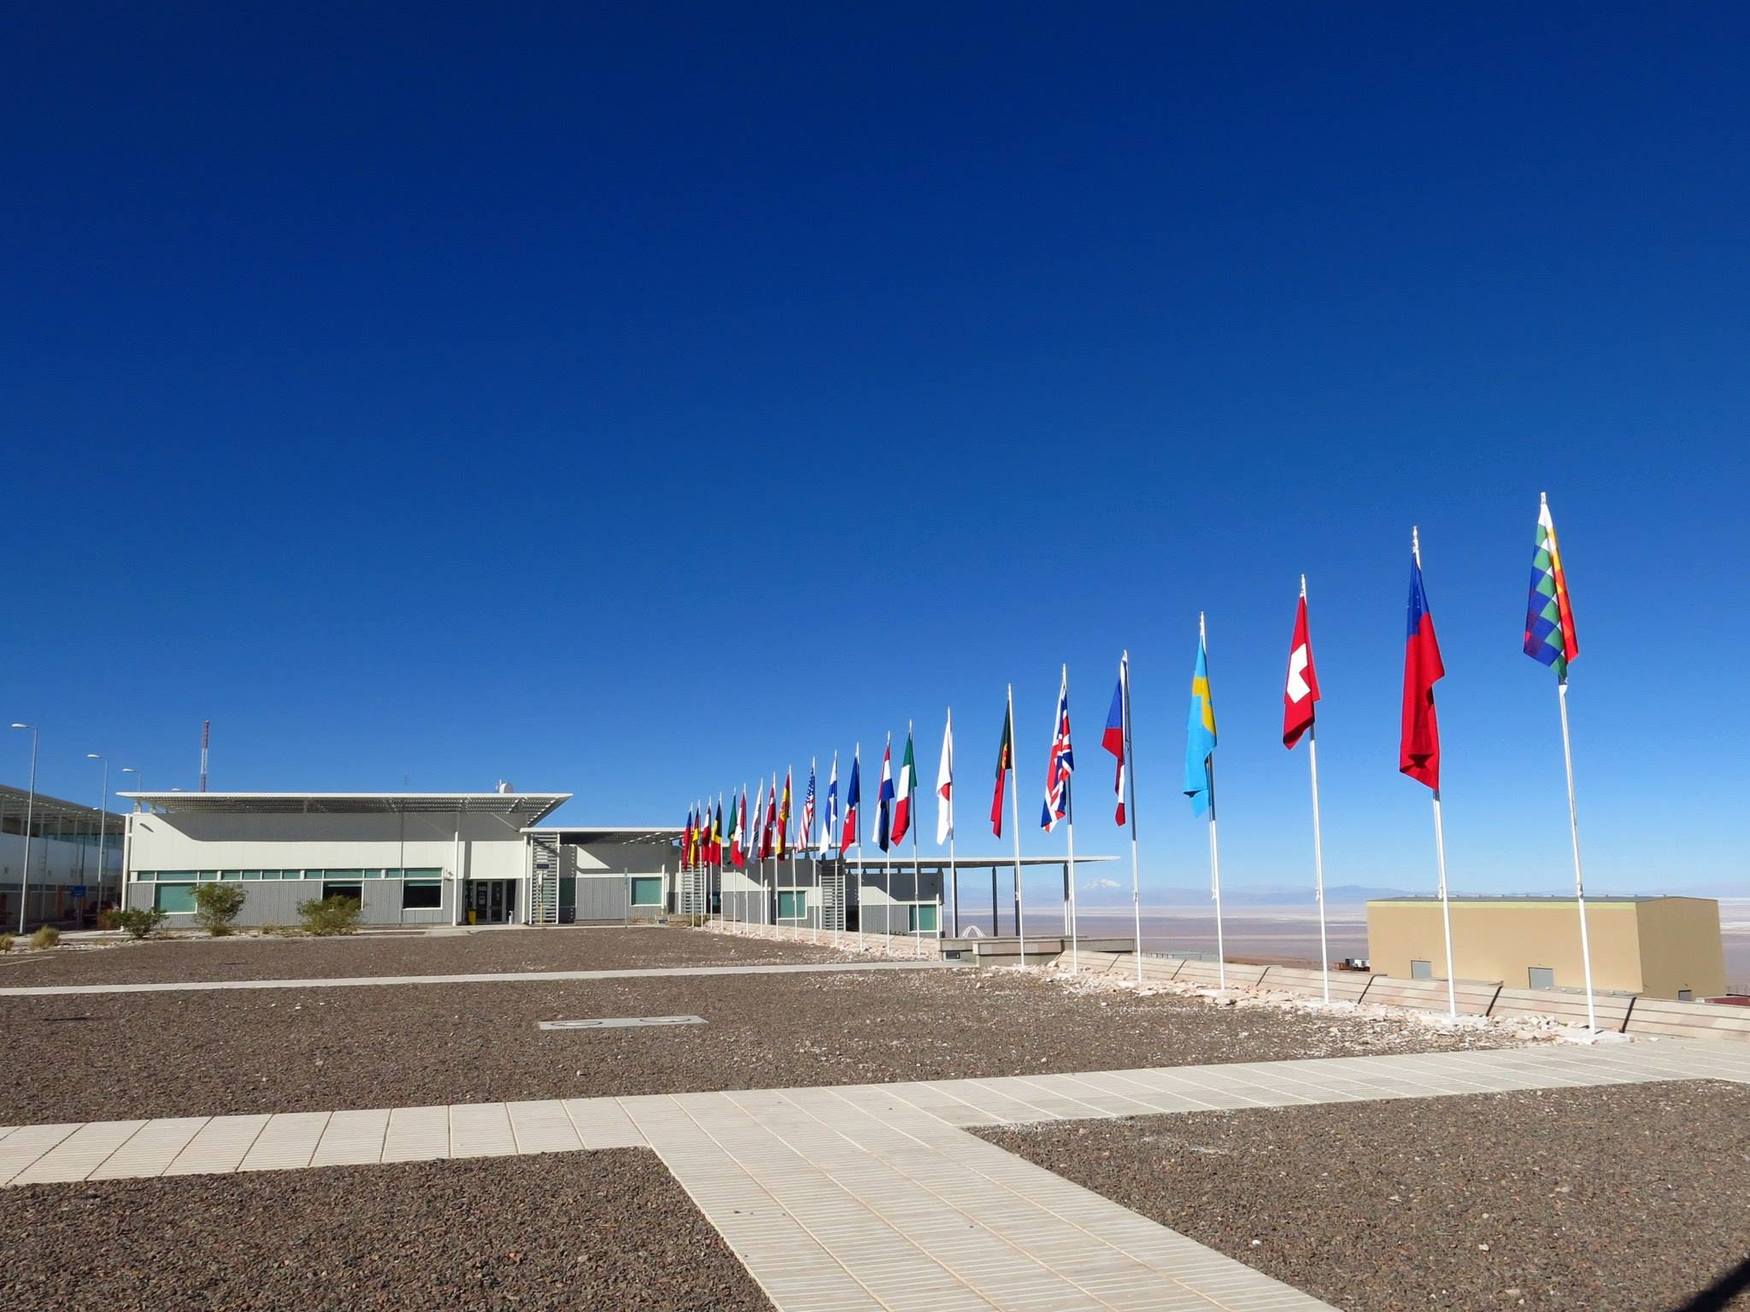
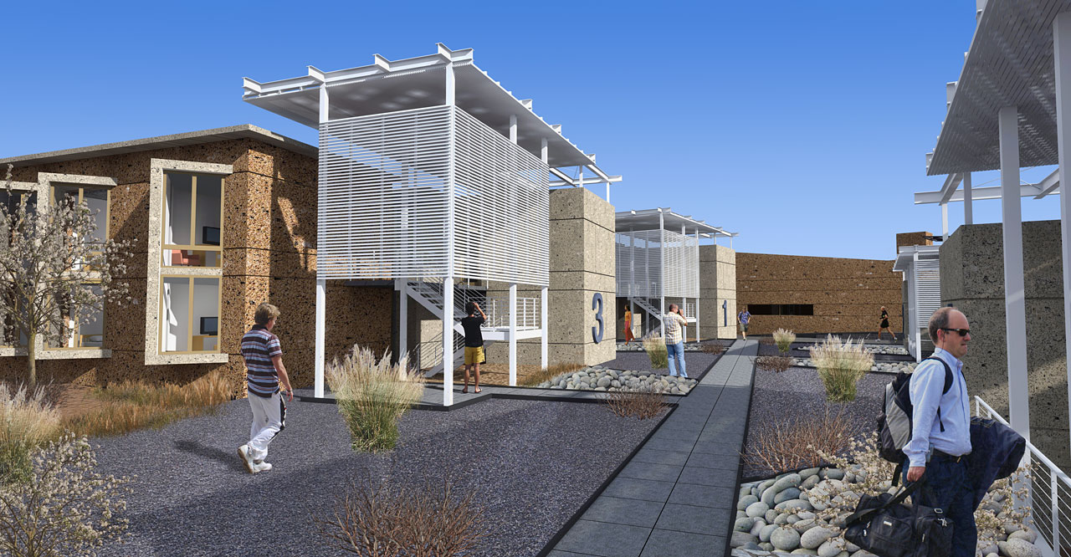
ALMA Organization (the Operations Support Facility)
Dorms (facing west)
Control Building (elev. 2900 m)
c. Chat Hull
Casino
Control Room
9

Slide 10
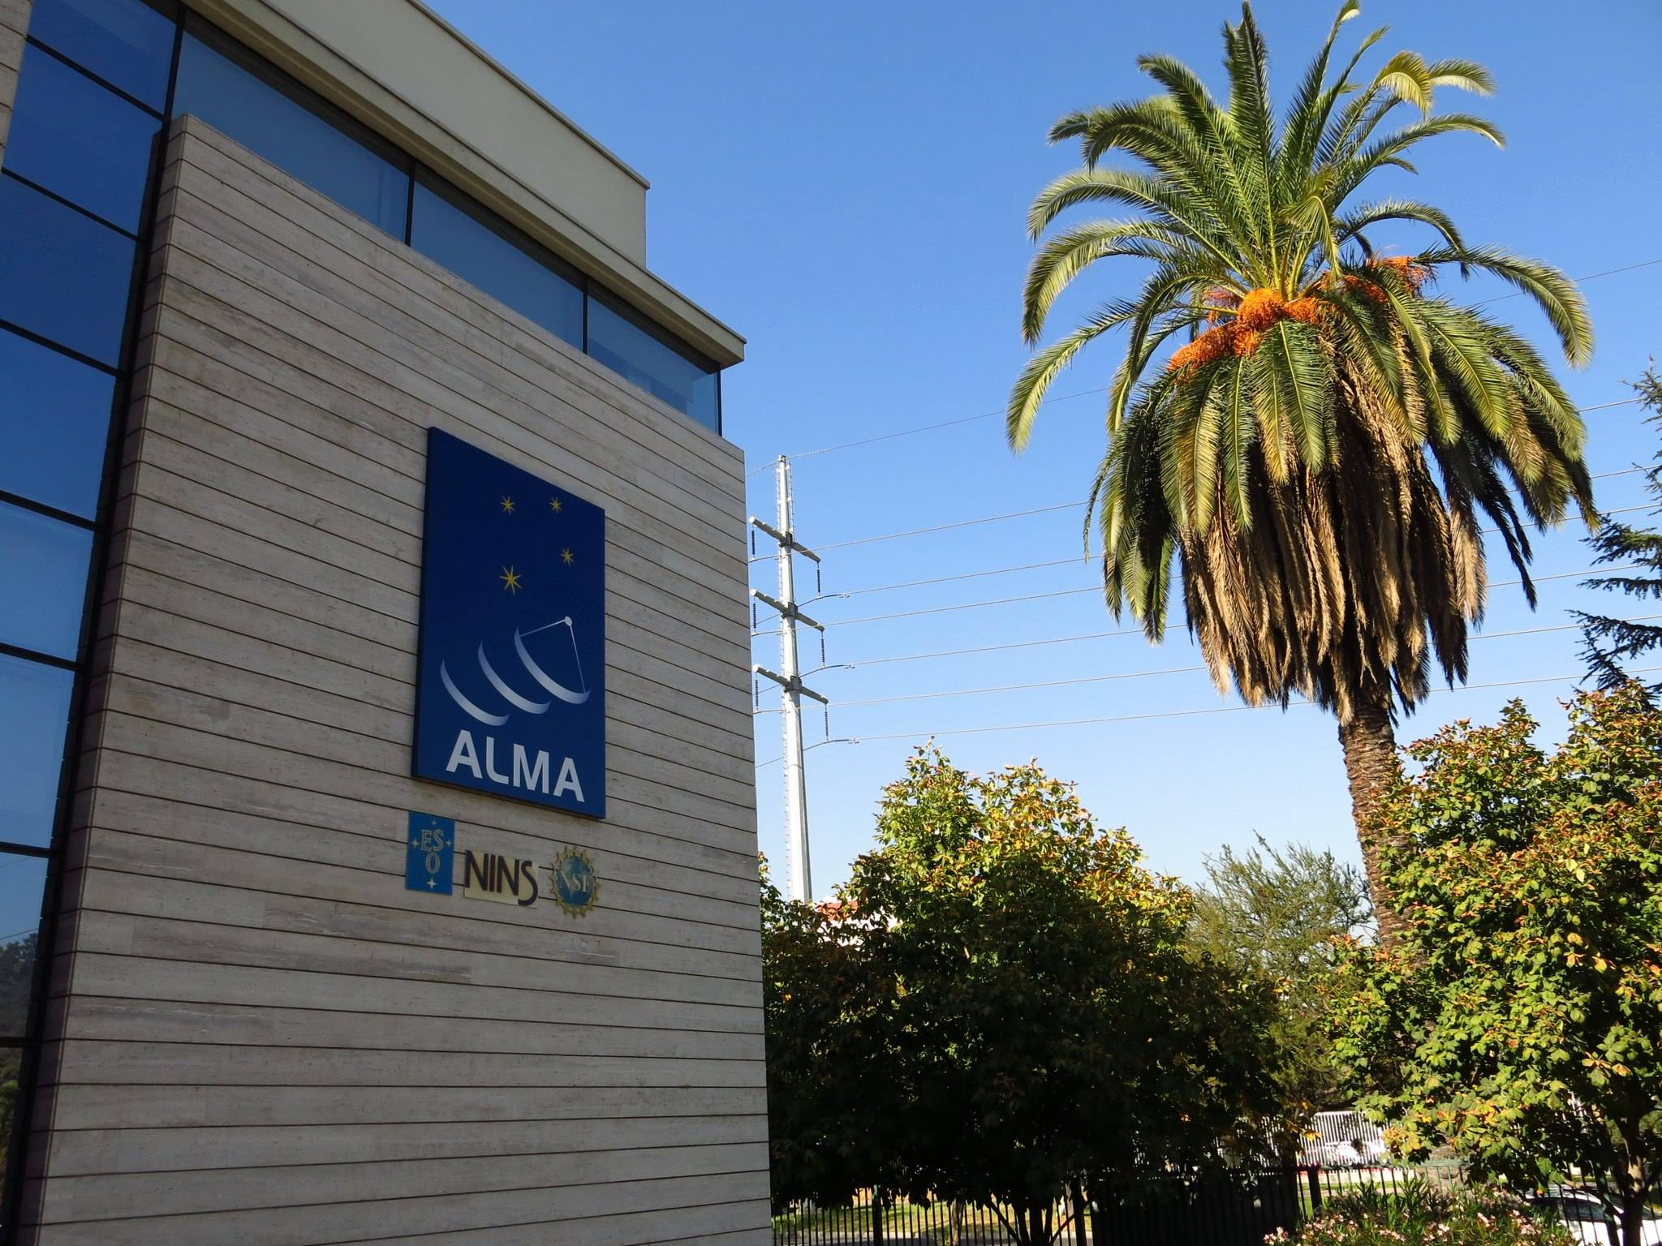
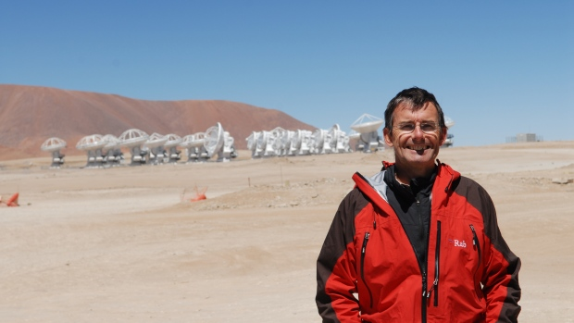
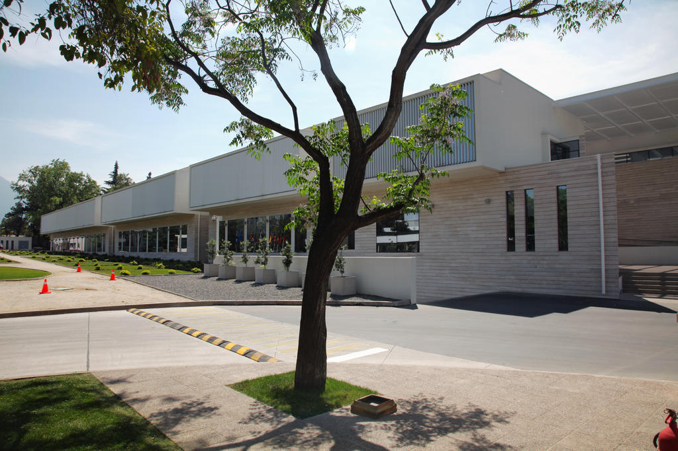
ALMA Organization (Santiago Central Offices)
Sean Dougherty, ALMA Director
c. Chat Hull
Elev. ~520 m
c. ALMA

Slide 11
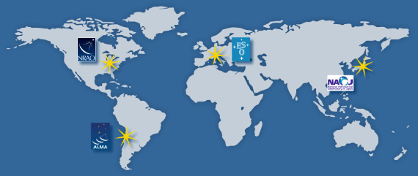
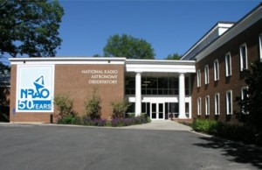
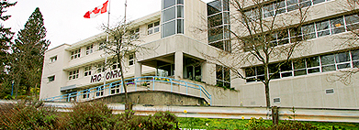
ALMA Organization (ALMA Regional Centers)
EU
NA
EA
+
NRAO Headquarters,
Charlottesville, VA, USA
NRC Herzberg
Victoria, BC, Canada
c. NRAO
c. NRC
c. ALMA

Slide 12
ALMA Data Flow
1. Array Operations Site (AOS)
– Antennas + Receivers + Correlator
2. Operations Support Facility (OSF)
– Quality Assurance Level 0 (“QA0”)
3. Santiago Central Offices (SCO)
– Quality Assurance Level 1 (“QA1”)
4. ALMA Regional Center (ARC)
– Quality Assurance Level 2 (“QA2”)
5. User (YOU)

Slide 13
ALMA Level One Science Goals
The ability to detect spectral line emission from CO or C+ in a normal galaxy like the Milky Way at a redshift of z = 3, in less than 24 hours of observation.
The ability to image the gas kinematics in a solar-mass protostellar/ protoplanetary disk at a distance of 150 pc (roughly, the distance of the star-forming clouds in Ophiuchus or Corona Australis), enabling one to study the physical, chemical, and magnetic field structure of the disk and to detect the tidal gaps created by planets undergoing formation.
The ability to provide precise images at an angular resolution of 0.1″. Here the term "precise image" means an accurate representation of the sky brightness at all points where the brightness is greater than 0.1% of the peak image brightness. This requirement applies to all sources visible to ALMA that transit at an elevation greater than 20 degrees.

Slide 14
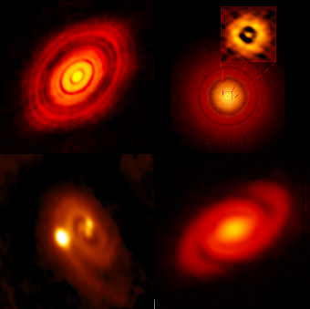
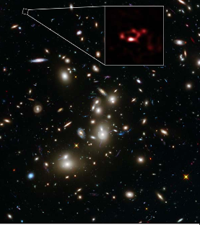
Some cool ALMA images
ALMA image of a z=8.38 galaxy
Protoplanetary disks
Notes:
Galaxy rich in dust based on imaged of lensed 600 million year old galaxy Abell 2744_YD4.
Bottom left disk is L1448 IRS3B, with a second star forming in a fragmented disk

Slide 15
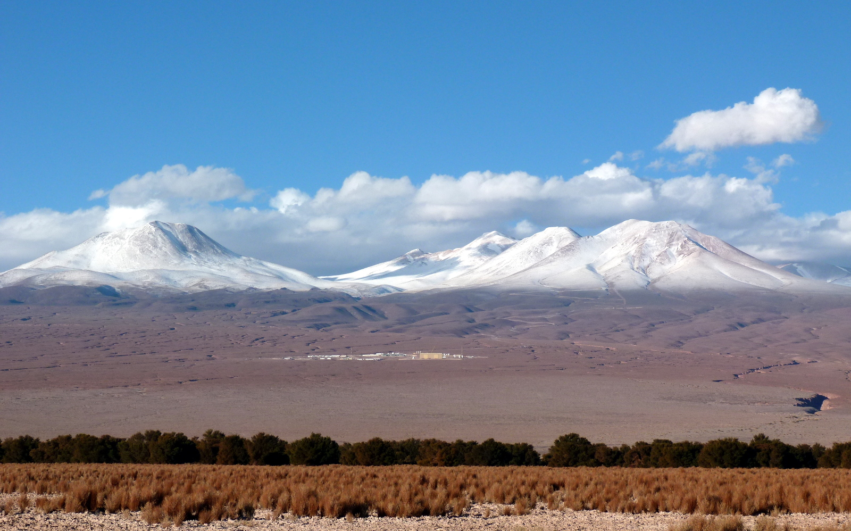
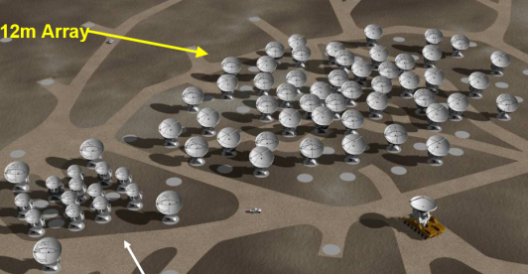
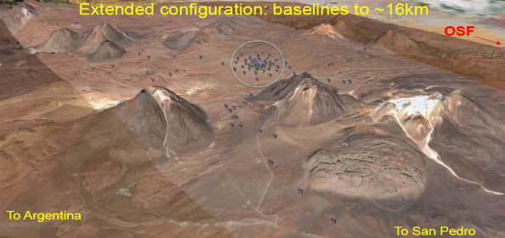
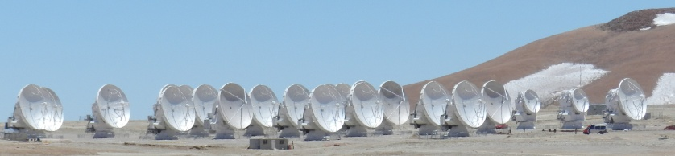
ALMA
An array of 66 antennas,
using aperture synthesis as a “zoom lens”
over the entire accessible mm/submm wavelength range up to 1 THz
Built to operate
>30 years
compact
Extended – up to 15 km
At 5000m
Remotely operated from
OSF Control room
Notes:
If you’re here at this splinter session, I imagine I don’t need to tell you this, but ALMA is a mm/submm telescope accessible at frequencies up to a THz
Operates in a variety of configurations: compact for excellent recovery of low surface brightness emission,
particularly when combined with the Morita array (ACA, the 7m and total power antennas), and extended for very high resolution imaging, with many steps in between.
In fact, I’m sure most of you are aware of the recent observations of HL Tau, but I’d be remiss if I didn’t mention the most exciting image to come from our recent successful Long Baseline Campaign, the high resolution imaging of the proto-planetary disk around HL Tau…

Slide 16
Basic Capabilities of ALMA
At least fifty 12-meter antennas for sensitive, high resolution imaging
Four additional 12-meter antennas, providing total power, and twelve 7-meter antennas comprising the ALMA Compact Array (ACA), enhancing the fidelity of wide field imaging
Imaging ability in all atmospheric windows from 3.6 mm to 0.3 mm (84 GHz to 950 GHz), with coverage down to 10 mm (30 GHz) possible through future receiver development
Array configurations with maximum baselines from approximately 150 meters to 15 km
Ability to image sources many arcminutes across at arcsecond resolution
Top spatial resolution of 5 milli-arcseconds (better than the VLA and HST)
Top velocity resolution better than 0.05 km/s

Slide 17
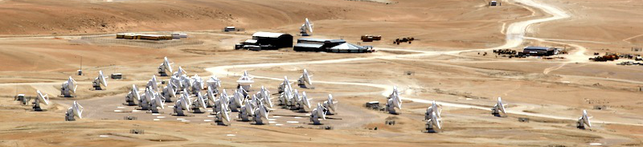
ALMA in a Nutshell...
Angular resolution down to 0.015” (at 300 GHz)
Sensitive, precision imaging 84 to 950 GHz (3 mm to 315 µm)
State-of-the-art low-noise, wide-band receivers (8 GHz bandwidth)
Flexible correlator with high spectral resolution at wide bandwidth
Full polarization capabilities
Estimated 1 TB/day data rate
All science data archived
Pipeline processing
ALMA is10-100 times more sensitive and has 10-100 times better angular resolution than the previous generation of mm interferometers
ALMA is a telescope for all astronomers
17

Slide 18
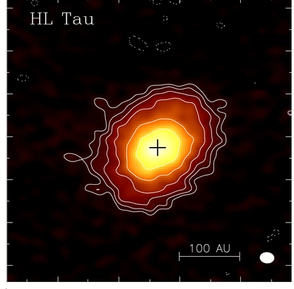
ALMA Long Baseline Campaign
CARMA Observation of HL Tau, resolution of ~25AU
Notes:
Young Star ~1 Million Years, one of the nearest star forming regions to Earth (~450 light yr)
The best image of HL Tau previously is from CARMA with a resolution of ~25AU… the power of ALMA in its extended configuration is apparent here with a resolution of 5 AU
Able to see several gaps in the disk almost certainly reflect young planets, which is “disturbing” to planet formation theories
Going by the number of hits, the press release of HL Tau image was seen by almost 10% of the Earth’s population
But go and hear Al’s talk for more details on the science.

Slide 19
ALMA Current Status
Construction Project ended in September 2014
Routine science observing now extends to the full 15 km baselines
All 66 antennas accepted
  Currently 64 antennas are at the high site (AOS), of which ~47 on average (up to max ~54) are being used for Cycle 3-5 observations
  Some construction and verification items remain to be finished (e.g., Bands 4, 8, 10; various observing modes)
The ACA (Atacama Compact Array) or Morita-san Array – up to 12x7m antennas and 4x12m antennas for TP observations – has been accepted and has been used from Cycle 2 onward
Notes:
LBC (and other commissioning campaigns) – come to Stuartt’s talk tonight at the town hall to hear more
The number of antennas included in Cycle 2 observations includes some combination of 2-3 TP, 8-10 7m antennas, and 37-41 12m elements
Construction + commissioning still being finished – in addition to observing at Bands 4, 8, 10:
spectral line polarization; OTF interferometry; mosaicking of ephemeris observations; routine solar obs

Slide 20
ALMA Receivers: Current Status
Receiver bands currently installed on all antennas
  Band 3, 3mm (84-116 GHz)
  Band 4, 2mm (125-163 GHz)
  Band 6, 1mm (211-275 GHz)
  Band 7, 850 μm (275-370 GHz)
  Band 9, 450 μm (602-720 GHz)
  Band 8, 650 μm (385-500 GHz)
  Band 10, 350 μm (787-950 GHz)
  + Band 5 on some antennas
Notes:
Again, Stuartt will discuss ongoing verifications of new capabilities tonight at the town hall

Slide 21
Comparisons with other mm interferometers
PdBI
Number of baselines N_{B}: N(N-1)/2 = 1225, much better instantaneous sampling of the uv plane, better overall image fidelity
N_{B} (PdBI) = 45
N_{B} (CARMA) = 253
N_{B} (NMA) = 15
N_{B} (SMA) = 27
N_{B} (VLA) = 351
CARMA
7069 m²
3129 m²
NMA
ALMA
22,619 m²
1885 m²
SMA
905 m²
(VLA surface area of 53,014 m² not shown)

Slide 22
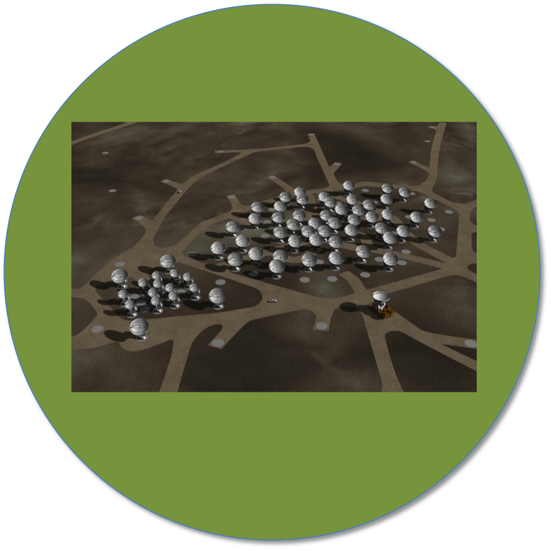
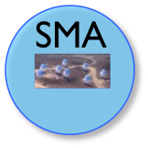


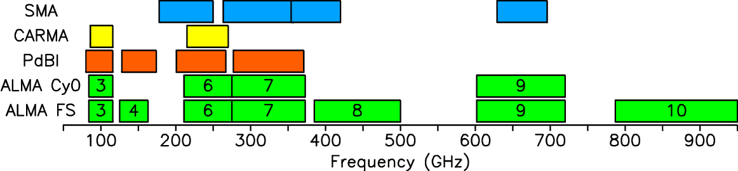
ALMA, Full Science
50(+12+4)
8
CARMA
Cycle 3
36+ (+10+2)
Collecting Area
~ sensitivity
23
Cycle 0
16(+0+0)
6
Spectral Coverage
22

Slide 23
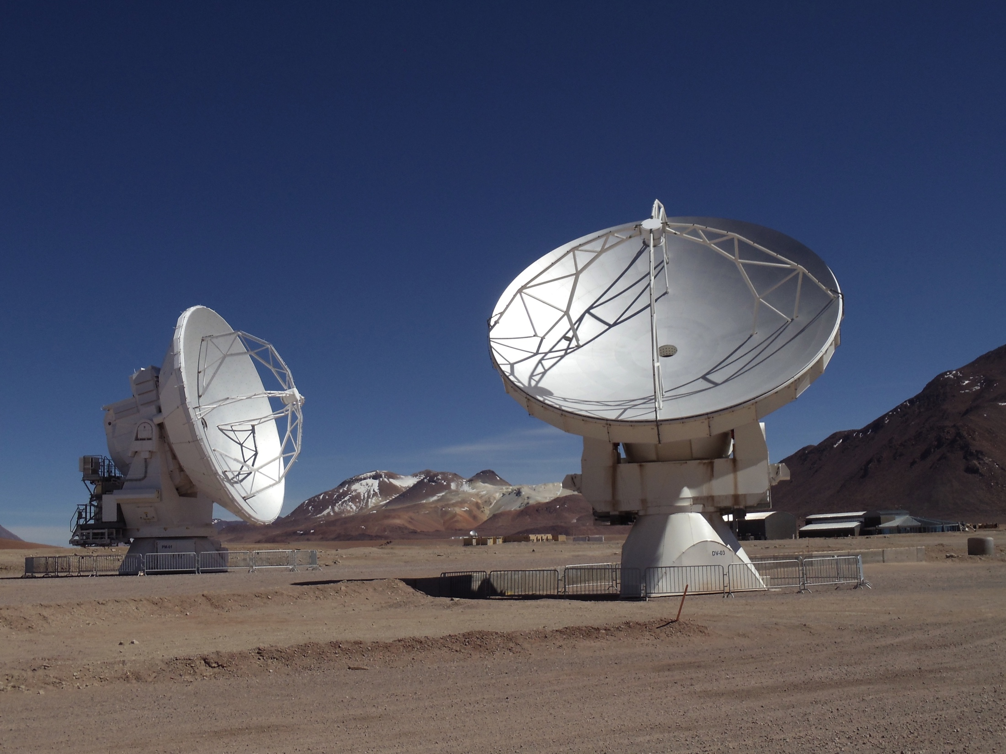
ALMA arrays: the 12-m Array
Number: 50 × 12-m antennas
Composition: steel, CFRP, aluminum, and Invar
Weight: >100 tons
Max slew rate: 0.5° s⁻¹
Pointing: <2” (absolute) all sky; <0.6” in 2° rad (offset)
VertexRSI antennas:
“ DV## ”
AEM antennas:
“ DA## ”
× 25
× 25
Parabolic surface accuracies of <25 μm rms
Minimum 40 antennas available for Cycle 4
Notes:
AEM = Alcatel Alenia Space European Industrial Engineering MT Aerospace

Slide 24
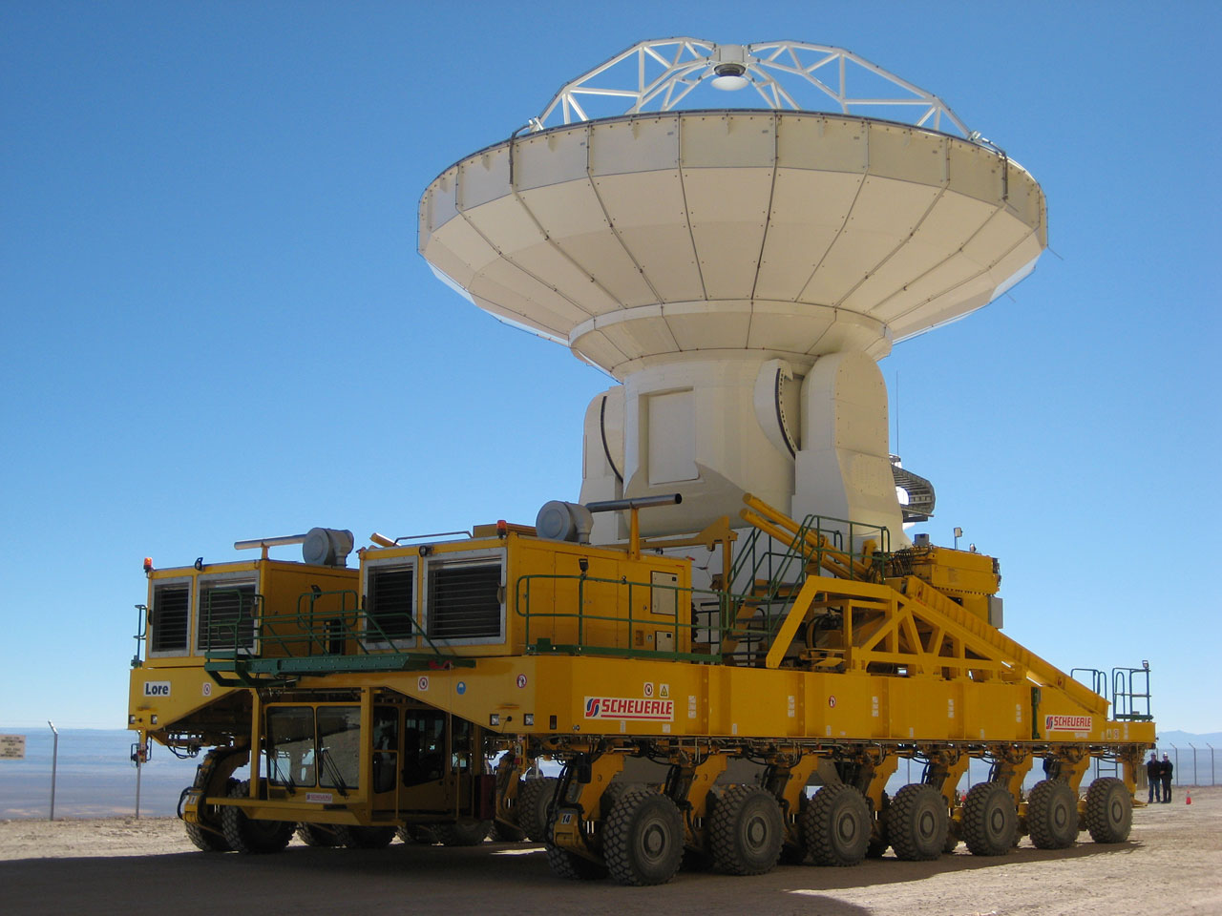
ALMA arrays: the 12-m Array
12-m antennas are movable to various stations across the Chajnantor plateau
Specialized trans-porters (named “Otto” and “Lore”) are used to move antennas around (also return them to the OSF for maintenance visits)
“Lore”
Credit: ESO/P. Martinez

Slide 25
ALMA arrays: the 12-m Array
Cycle 3 configurations: min baseline = 14.7 m, max baseline = 9.743 km
2 km
2 km
2 km
12 km
2 km
12 km
C36-2
C36-4
C36-6
C36-8
C36-1
C36-3
C36-5
C36-7
2 km
12 km
“summer”
2 km
2 km
2 km
12 km
“winter”

Slide 26
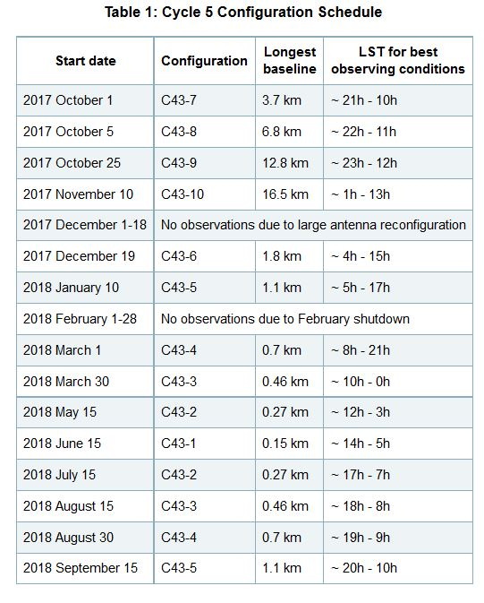
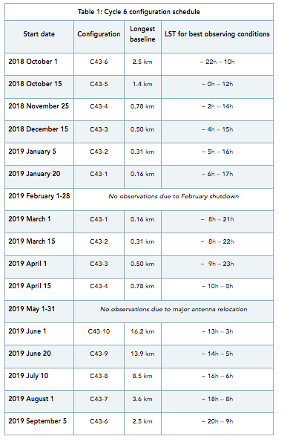
Configurations

Slide 27
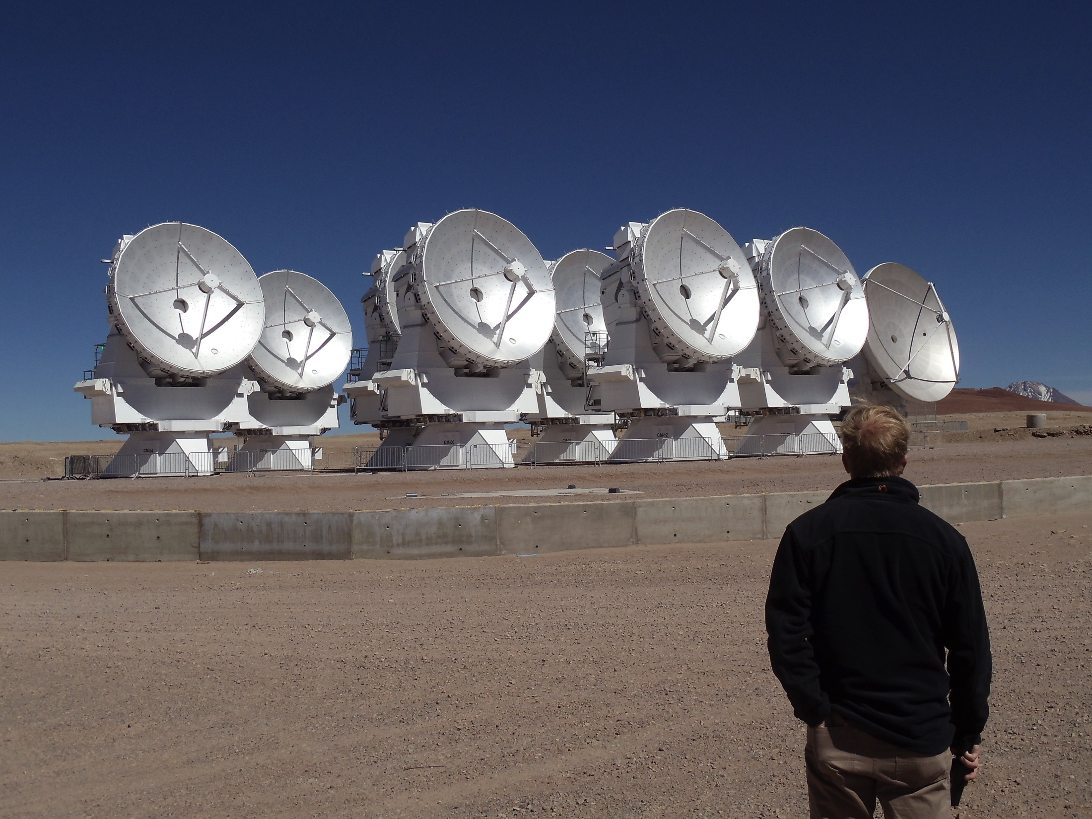
ALMA arrays: the ALMA Compact Array (ACA)
Number: 12 × 7-m antennas
Antennas are fixed in position
Min / Max baselines: 8.7 m / 32 m
Surface accuracy: <20 μm rms
Used for low spatial frequency data
MELCO antennas:
“ PM## ”
Random Swede
Minimum 10 antennas available for Cycle 4
Notes:
ACA only intended to complement 12-m array observations…for now.

Slide 28
ALMA arrays: the Total Power “Array” (TPA)
MELCO antennas:
“ CM## ”
Number: 4 × 12-m antennas
Antennas are also fixed in position
Nutating secondaries available for sky subtraction
Signals not necessarily correlated but signals can be combined with those from the ACA if needed
Used to obtain zero-spacing spatial frequency data by acting as single-dish telescopes that observe simultaneously
Minimum 3 antennas available for Cycle 4

Slide 29
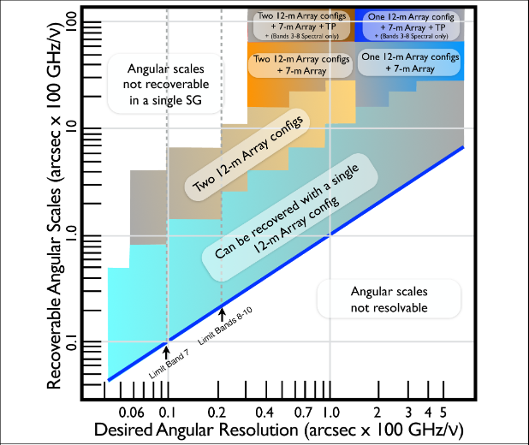
Trade offs of resolution and MRS

Slide 30
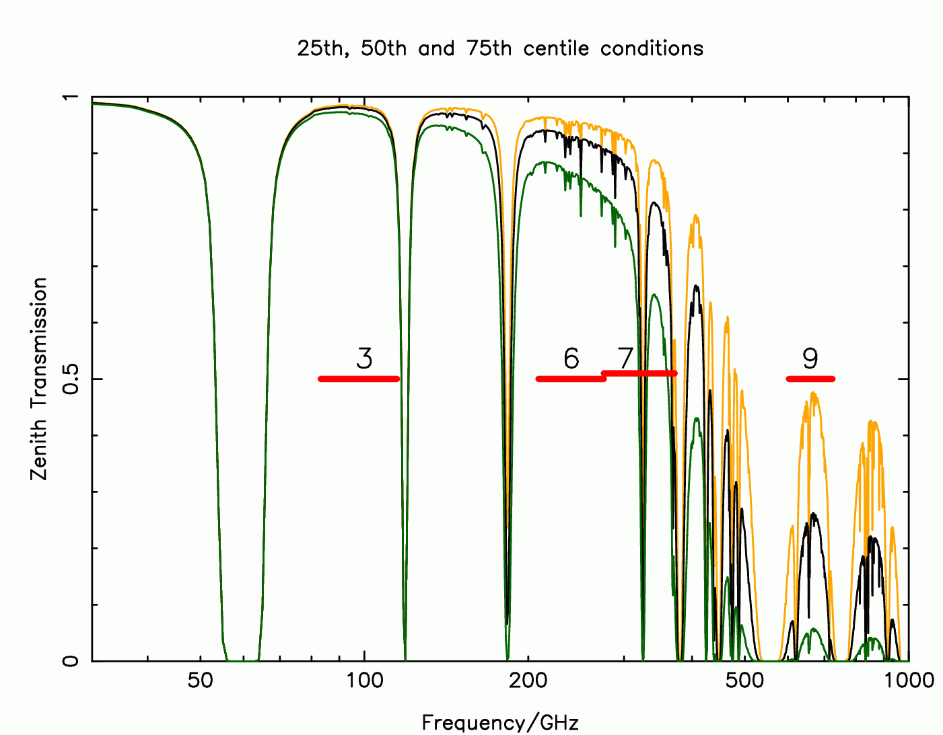
Receiver Bands
submillimetre wavelengths
transparent
350 μm
1
2
5
1
2
5
10
4
4
8
opaque
9 mm
longer wavelength
shorter wavelength
ALMA will have receivers over all submm bands

Slide 31
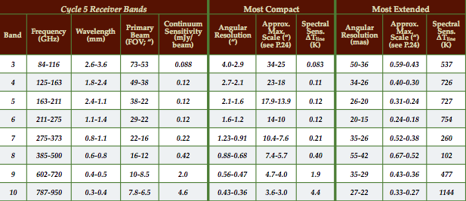
Receiver Bands + Sensitivities
Also “in the works”:
- Band 1: 35-52 GHz
- Band 2: 67-90 GHz
- Band 5: 163-211 GHz
- Band 11? : 1.0-1.6 THz
Continuum sensitivities estimated from a total of 7.5 GHz dual polarization band width in 60 seconds

Slide 32
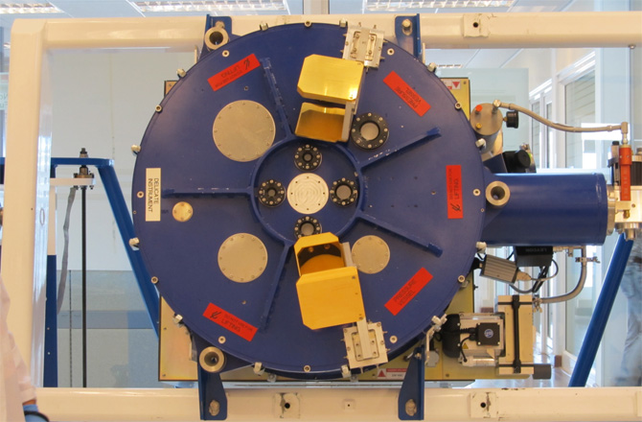
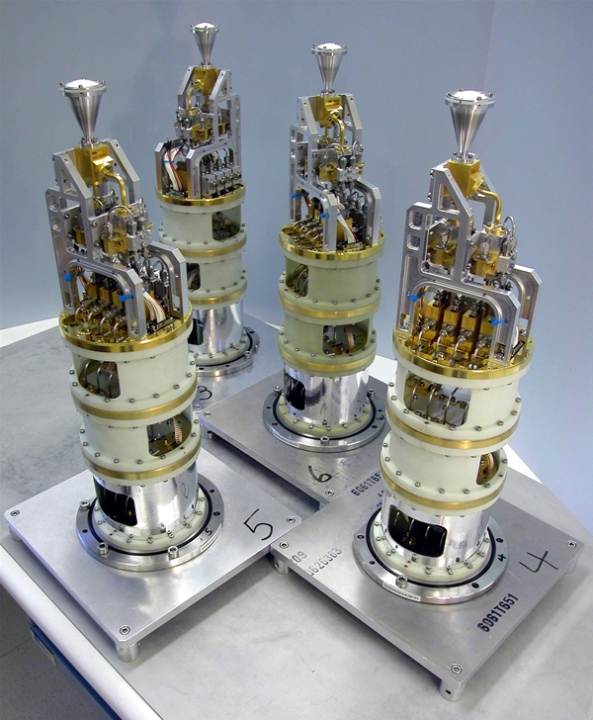
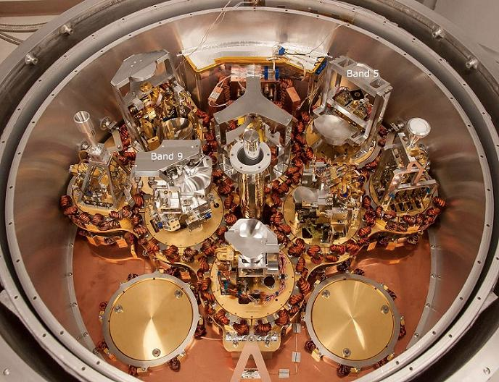

Receiver Bands
Cryostat
(exterior)
Band 3 receiver
cartridges
Cryostat
(interior)

Slide 33
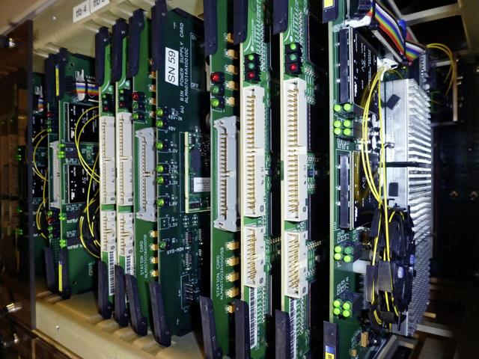
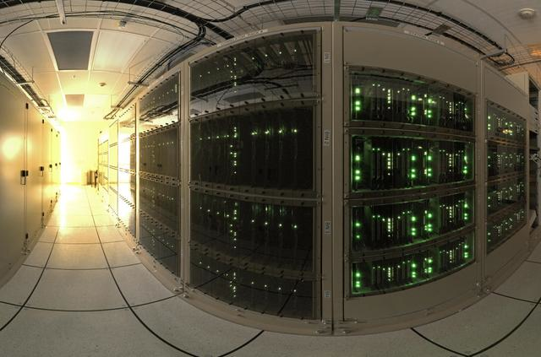
Correlators: the 64-input Correlator
Digital Filter Circuit Boards (ALMA)
Correlator Exterior (ALMA)
A state-of-the-art FXF “correlator” (signal combiner) with 134 million processors capable of performing 17 quadrillion operations per second ➔ produces “visibilities”
Notes:
FXF – Filtering, correlation, and Fourier transform

Slide 34
Correlators: the 64-input Correlator
ALMA Baseband Options (Cycle 5)
Up to 4 basebands can be placed with a given receiver band (with restrictions)
Time Division Mode (TDM): low spectral resolution (continuum) data at a low data rate; fast operations; ~1.875 GHz per baseband
Frequency Division Mode (FDM): higher spectral resolutions (lines); higher data rates; smaller band widths per baseband; 1, 2, or 4 spectral windows per baseband possible
1875
(due to filtering)

Slide 35
Correlators: the 64-input Correlator
ALMA Baseband Options (Cycle 5)
Actual spectral resolution is 2× channel spacing due to the correlator performing Hanning smoothing on the data
Single pol’n modes also available, yield double the channel number and half the channel spacing
4 x “2 GHz” basebands = 8 GHz dual-pol band width
More baseband options to be commissioned later
1875
(due to filtering)

Slide 36
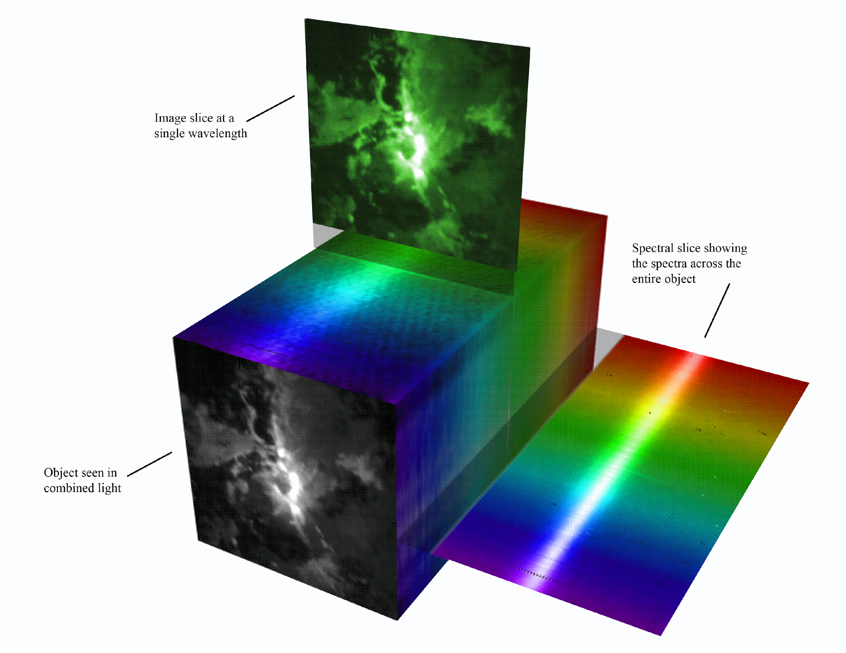
Output of interferometric observation is in the form of a “cube” of data – the third dimension is frequency.
Notes:
So weve been talking a lot about the 2d image, With ALMA, you can make a 2D image (a continuum image). Sometimes you are only interested in an image in the x,y plane, and you can average all of these channels together to get a 2 dimensional image. Other times you are only interested in a spectrum, to determine molecular abundances in a region, for example, so you can integrate over an area in the x,y plane, and just plot the intensity as a function of frequency. But you always have the option to do both, or to keep the whole cube, after the observations are made.

Slide 37
Correlators: the ACA Correlator
c. ALMA/S. Okumura
The ACA (and TPA) have an separate correlator that can have up to 16 inputs
Can run simultaneously with the 12-m Array + 64-input correlator
An “FX” design, different architecture from 64-input correlator
Same baseband modes and spectral window options as 64-input correlator
Two quadrants of ACA Correlator

Slide 38
Other ALMA Capabilities
Some of these are now offered, but note some are considered “non-standard” and access just 20% of the available time:
High dynamic range imaging
Multi-band observations
Multiple spectral window observations
Polarization
TPA+ACA+12-m Array combination
Capabilities are improving with time and continued effort!
38
What is ALMA?

Slide 39
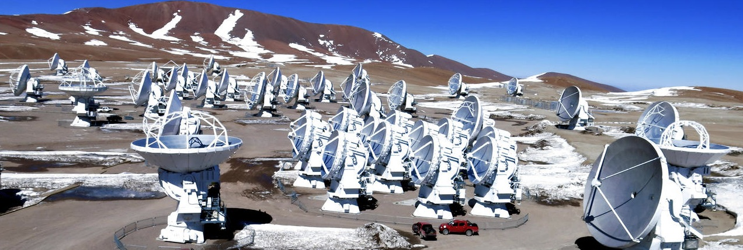

The ALMA Proposal Preparation Process
How to get started and what to expect

Slide 40
Proposal Checklist
Read relevant documentation (CfP Guide, Primer, etc.)
Create an ALMA account by registering at the Science Portal (almascience.org)
Download the Observing Tool (OT) & related guides
Prepare the Science Case
Prepare Science Goals (sources, frequency & correlator setup, integration times) within the OT
Make use of the Helpdesk & the Knowledgebase

Slide 41
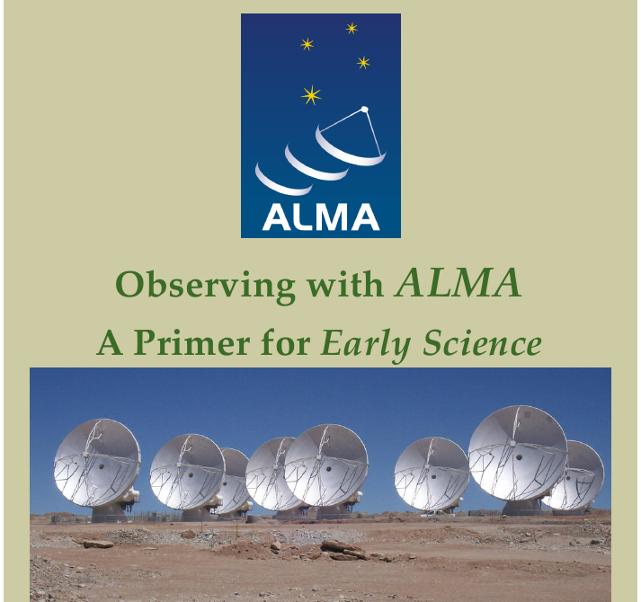
Cycle 6 Documentation & Timeline
Call for Proposals
Proposer’s Guide
ALMA Primer
OT Guide
ALMA Tech Handbook
Timeline for Cycle 6
  Mar. 21 – Call for Proposals
  Apr. 19 – Proposal Deadline
  Aug 2018 – Results to PIs
  Sept 2018 – PIs submit SBs
  Oct. 2018 – Start of Cycle 6
  Duration – 11-12 months

Slide 42
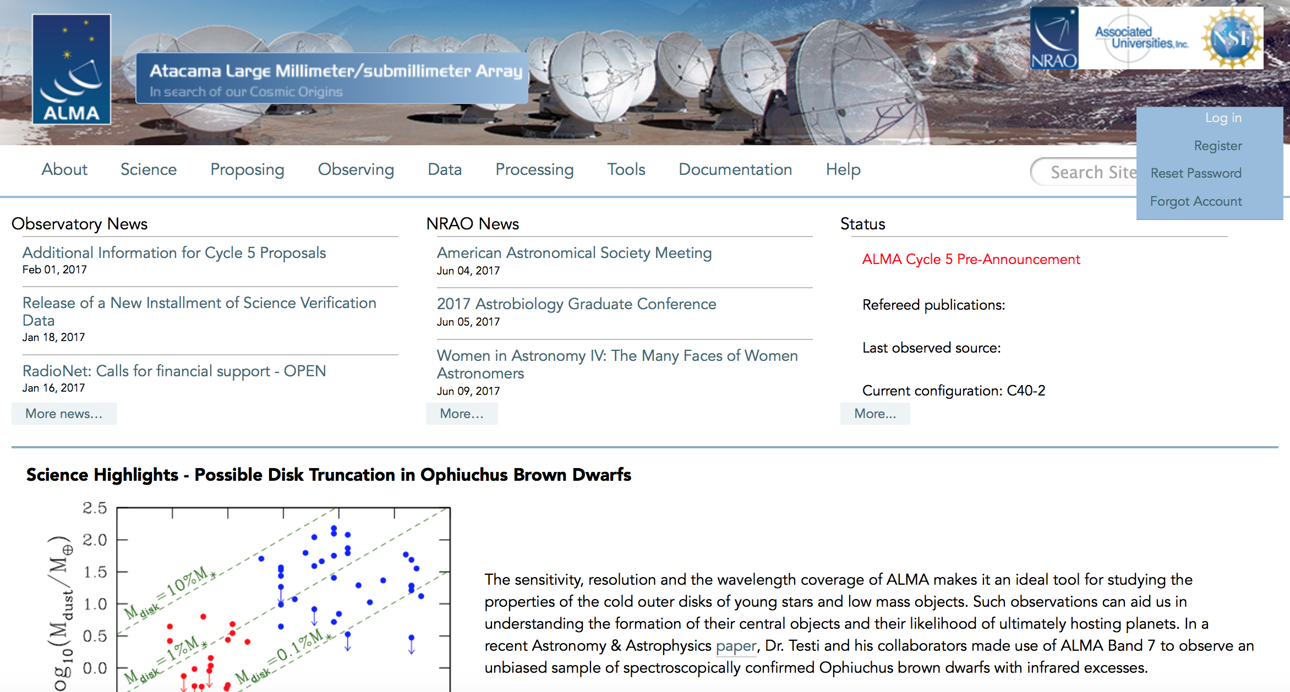
www.almascience.org
ALMA Science Portal @ NRAO
Notes:
Call for Proposals, Helpdesk, NRAO User Support, and Account access.

Slide 43

Downloading the ALMA OT
Java 9

Slide 44


Slide 45
Science Case
Must include:
  Astronomical Importance
  Estimated intensity, S/N
May include:
  Figures
  Tables
  References
Free-form PDF document
  12+ font, English only
  20 MB file size
  4 pages (6 for Large Projects)
Notes:
Check what LST ranges are available for what configurations!
From the Proposer’s Guide: “Additionally, [the science case] should explain how the expected intensity of the target source(s) was estimated and justify the Signal-to-Noise (S/N) ratio required to achieve the scientific objectives of the project as well as, when appropriate, the size of the target sample.”

Slide 46

Different bands require very different conditions

Slide 47

ALMA Observing Strategies (Cycle 5)
Histograms of the anticipated amount of observing time available versus LST for the antenna configurations in Cycle 5. Also shown are histograms of the time available for Large Programs, as well as high frequency observations (Bands 8, 9, and 10) based on historical PWV data

Slide 48
Helpful Tools
Sensitivity Calculator:
Enter in declination, angular resolution, band width, desired sensitivities, etc. to see how long your project will take with the 12-m Array, the ACA, and the TPA
No overheads are taken into account
Even though you do not request a set “time” with ALMA, having a sense of how much time you are requesting is a good idea

Slide 49
Splatalogue
www.splatalogue.net

Slide 50

Using the OT

Slide 51


Slide 52


Slide 53


Slide 54



Slide 55

When possible, use the spectral averaging options.
Most people try this only when confronted with a data rate that sets off a flag
In practice, this will help you immensely; the data rate and data volume will be reduced
Final data set will be smaller and easier to deal with.

Slide 56


Slide 57


Slide 58


Slide 59

Spectral resolution selected to achieve velocity resolution across a line; ensure the rms PER CHANNEL is deep enough for your science, not the entire bandwidth

Slide 60

Click here to make sure that your project can be validated by the OT. If it won’t, you will not be able to submit it.
When you are satisfied that your proposal is complete, click here to submit your project to the ALMA Archive

Slide 61
Observing Strategy
Choose your array by largest angular scale of target
  Interferometers act as spatial filters - shorter baselines are sensitive to larger targets, so remember:
    Spatial scales larger than the smallest baseline cannot be imaged
    Spatial scales smaller than the largest baseline cannot be resolved
Calibration Requirements (Handled by ALMA):
  Gain calibrator: solves for atmospheric and instrumental variations with time.
    Usually a bright quasar near science target
  Bandpass calibrator: fixes instrumental effects and variations vs frequency
    Usually a bright quasar
  Absolute flux calibrator: used to scale relative amplitudes to absolute value
    Usually a solar system object or quasar
Notes:
As far as calibrators go, note that to plan observations, you don’t need to pick these! ALMA does it for you!

Slide 62
Calibration Process
Calibration is the effort to measure and remove the time-dependent and frequency-dependent atmospheric and instrumental variations.
Steps in calibrating interferometric data:
(Note: You don’t have to worry about these in your observational set up!)
Bandpass calibration (correct frequency-dependent telescope response)
Phase and amplitude gain calibration (remove effects of atmospheric water vapor and correct time-varying phases/amplitudes)
Set absolute flux scale
Notes:
Also point/focus/delay calibration step and system temperature step and step for flagging bad data

Slide 63


Bandpass Calibration: Phase
* Analogous to optical “flat fielding” + bias subtraction for each antenna.
* Primarily correcting for frequency dependent telescope response (i.e. in the correlator/spectral windows)
* Done once in an Scheduling Block, uses bright point sources like quasars
* Typically, baseline responses are inverted to antenna-based correction
Baselines to one antenna
Antenna-based Bandpass Solutions
Notes:
Typically, baseline responses are inverted to antenna-based correction
Imperfections = channel to channel variation in the phase
Goal is to get flat spectra

Slide 64

Bandpass Phase vs. Frequency (Before)

Slide 65

Bandpass Phase vs. Frequency (After)

Slide 66


Bandpass Calibration: Amplitude
Baselines to one antenna
Amplitude Before Bandpass Calibration
Bandpass solutions for individual antennas

Slide 67

Atmospheric Phase Correction
Variations in the amount of precipitable water vapor cause phase fluctuations that result in:
  Low coherence (loss of sensitivity)
  Radio “seeing” of 1arcsec at 1mm
  Anomalous pointing offsets
  Anomalous delay offsets
Patches of air with different water vapor content (and hence index of refraction) affect the incoming wave front differently.

Slide 68
Phase & Amplitude Gain Calibration
Determines the variations of phase and amplitude over time
First pass is atmospheric correction from Water Vapor Radiometers readings
Final correction from gain calibrator (point source near to target) that is observed every few minutes throughout the observation (analogous to repeat trips to a standard star)

Slide 69

Water Vapor Correction on ALMA
Phase vs. Time
One 600m Baseline
~600 GHz
Before WVR, After WVR

Slide 70


Phase Calibration
The phase calibrator must be a point source close to the science target and must be observed frequently. This provides a model of atmospheric phase change along the line of sight to the science target that can be compensated for in the data.
Phase
Time
Corrected using point source model
Notes:
Assume phase calibrator is a quasar which has zero phase and constant amplitude

Slide 71

Flux (or Amplitude) Calibration
Two Steps:
1. Use calibration devices with known temperatures (hotload and ambient load) to measure System Temperature frequently.
2. Use a source of known flux to convert the signal measured at the antenna to common unit (Janskys). If the source is resolved, or has spectral lines, it must be modeled very well.
The derived amplitude vs. time corrections for the flux calibrator are then applied to the science target.
Notes:
These are somewhat analagous to standard stars in the optical

Slide 72

Amp-Calibrators Amp vs. uv-distance (Before)

Slide 73

Amp-Calibrators Amp vs. uv-distance (Model)

Slide 74

Amp-Calibrators Amp vs. uv-distance (After)

Slide 75
Simulating ALMA data
You may want to determine if an idea you have for ALMA is feasible, or refine the observations with a simulation
  Can show the impact of using different configurations
  Different bands
  Varying integration times

Slide 76
Trade offs of resolution and MRS

Slide 77


Slide 78


Slide 79


Slide 80


Slide 81


Slide 82


Slide 83


Slide 84


Slide 85


Simulating ALMA data in CASA
Simobserve output
Simanalyze output
See CASAguides
For more info on
Simulating ALMA data
Example of an M51-like galaxy observed at z=0.1

Slide 86
almascience.org
is the place to go for additional ALMA information
Assignment help: Brenda.Matthews@nrc-cnrc.gc.ca

