Slide 1
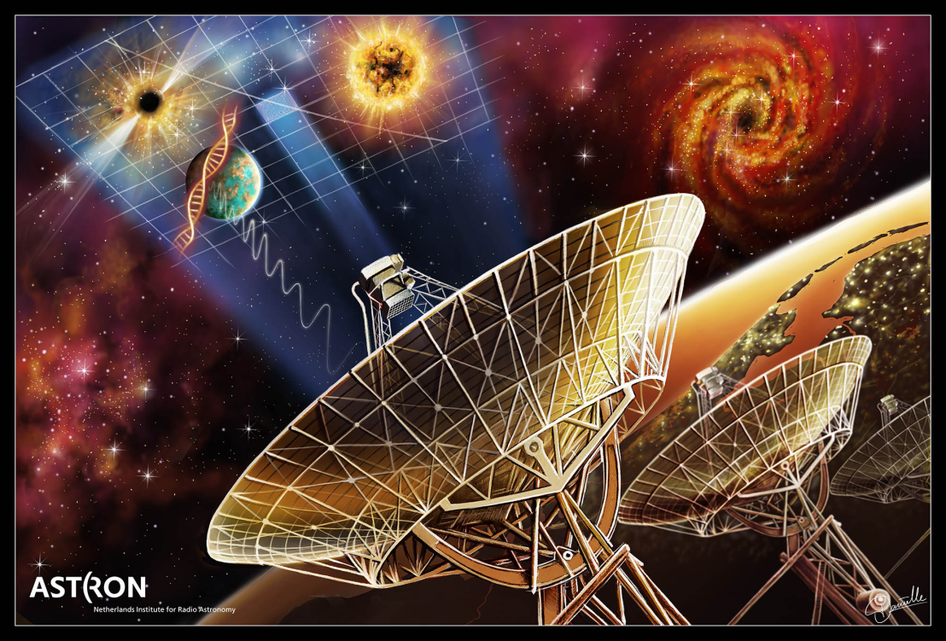
Radio & Microwave Receivers
Lisa Locke, Engineer
Millimetre Astronomy Group
Herzberg Astronomy Research Centre
National Research Council

Slide 2
Contents
Radio astronomy history
Atmospheric windows
Radiometer equation and some physics
The typical receiver
Details of receiver components

Slide 3

Radio Astronomy (Instrumentation)
Engineering (Electrical)
Astronomy
Donna Skelley, skellyward7.ca

Slide 4

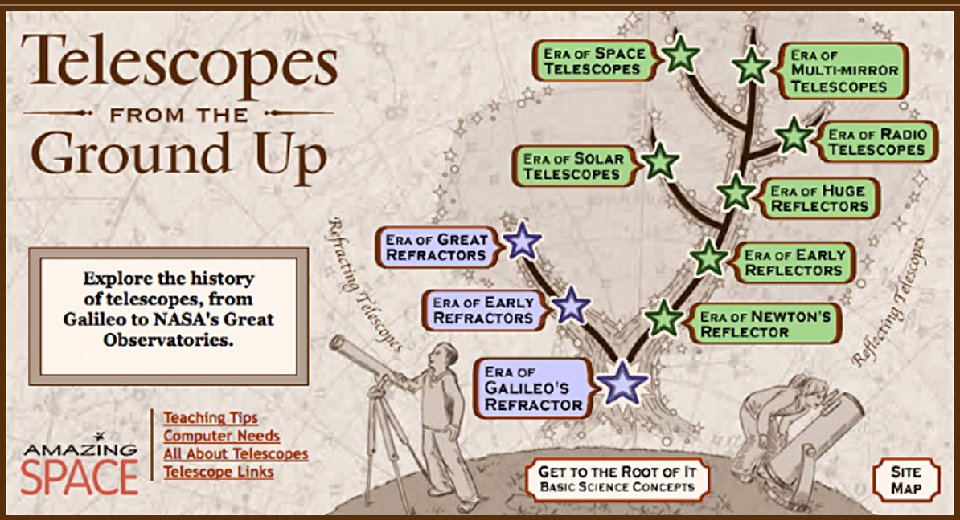

Slide 5
RADIO ASTRONOMY HISTORY

Slide 6
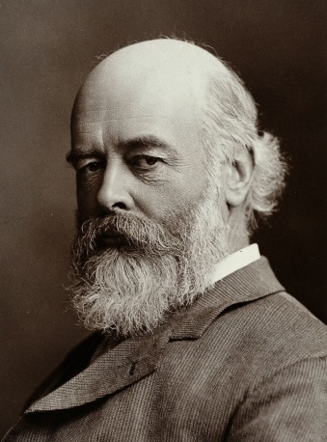
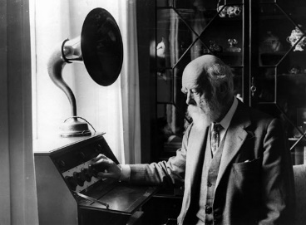
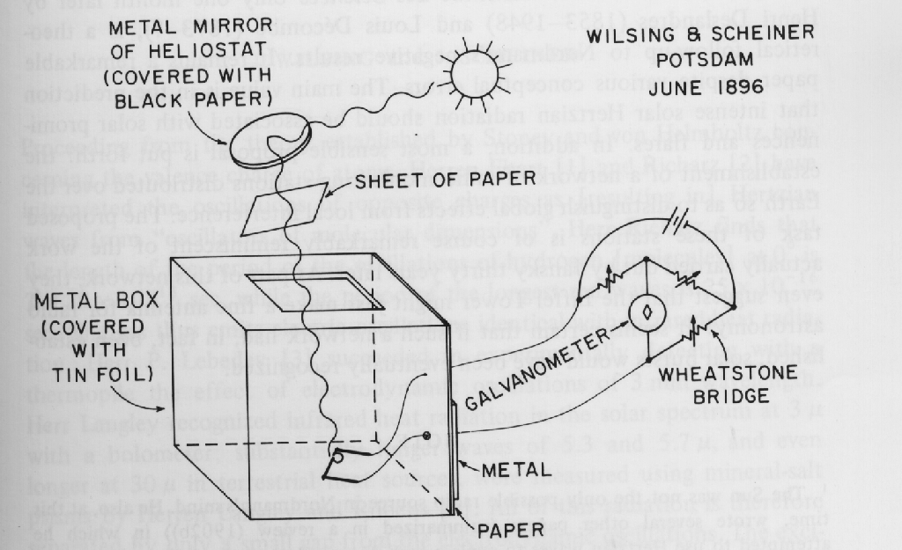
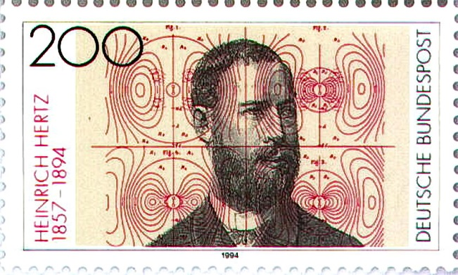
History – Pre 1920
Sir Oliver Lodge (1851-1940)
Pottery trade at 14? No, thank you. Science please.
Studied Maxwell’s 1873 Treatise on E & M, became the “great interpreter of Maxwell’s views.”
Early innovations in radio: invented a better radio detector, invented radio tuner (1898), improved the loud speaker (1898).
His friend George Fitzgerald (incorrectly) advised that “ether waves could not be generated electromagnetically.”¹
Lodge attempted to detect radiation from the sun.
http://www.aes.org/aeshc/docs/recording.technology.history/images3/oliver-lodge.jpg
By Lafayette Ltd. - [1], CC BY 4.0, https://commons.wikimedia.org/w/index.php?curid=33263972
Johannes Wilsing (1856 – 1943) & Julius Scheiner (1858 – 1913)
At Astrophysical Observatory of Potsdam, attempted to measure solar radio emission, and wrote up their attempts - (Ann.Phys.Chem.59,782, 1896, in German).
Heinrich Hertz (1857-1894)
First to demonstrate transmission and reception of EM waves.
"Classics in Radio Astronomy" by W.T. Sullivan, Reidel, 1982
1. Hunt, Bruce J. (2005) The Maxwellians, Cornell University Press, page 37, ISBN 0801482348. Fitzgerald is known for his work in EM theory and for the Lorenz-Fitzgerald contraction which became an integral part of Einstein’s Special Theory of Relativity.
By Deutsche Bundespost - Deutsche Bundespost, Public Domain, https://commons.wikimedia.org/w/index.php?curid=9680498
Notes:
Wilsing: Physicist, Scheiner: Astronomer.
8 day experiment unable to detect any signals associated with the sun.

Slide 7
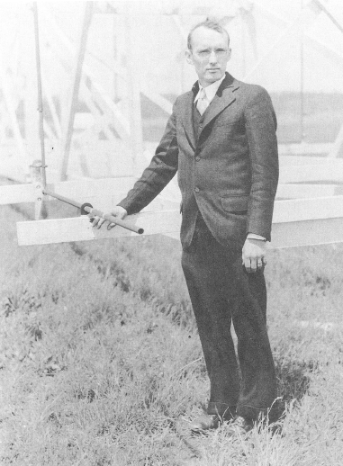
1932
Karl Jansky – the Father of Radio Astronomy
On Jan 7, 1927, AT&T opened the first trans-Atlantic radio telephone link with London. Calls were allotted three minutes and cost $75 (equivalent to $330 per minute today).
There were an average of 7 calls/day, increasing to 31/day in 1928 when the price was cut to $45.
Undersea cables could only be used for telegraphy until the first coaxial cable was laid in 1956 (which could handle 48 voice channels).
In 1928, a the age of 23, Karl Jansky joined the Bell Telephone Laboratories where he worked at the Radio Research Lab in Holmdel, NJ,
He was assigned to investigate sources of atmospheric static that might cause interference with the short-wave (3-30 MHz) radio links.
While listening for the noise coming from thunderstorms, he discovered…
“noise of extraterrestrial origin”
…which he called “star static” in his published papers.
His famous - albeit serendipitous - discovery was made in 1932.
After suffering a stroke, he died in 1950 at the young age of 44.
Karl Jansky with his famous antenna
Classics in Radio Astronomy,
W.T. Sullivan, D. Reildel Publishing Company, 1982, p. Frontispiece

Slide 8
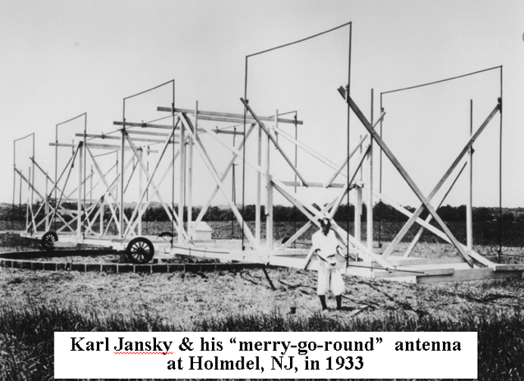
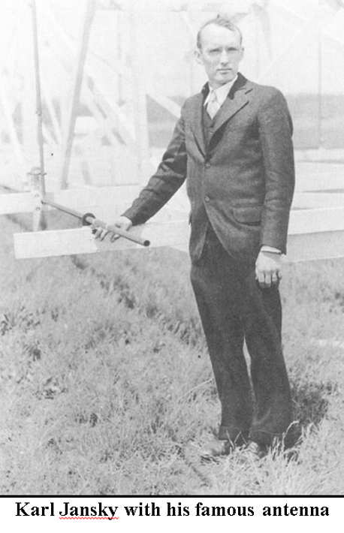

Birth of Radio Astronomy The Sky Emits Radio Noise !
Karl Jansky, physicist
1931:
Problem: static on transatlantic phone lines
Solution: build 20 MHz rotating antenna
Found: Static was due to nearby and far away thunderstorms… and
Something unknown
Monitoring over time showed the source to be sidereal, and from the direction of the centre of our galaxy
You can see a replica of this cool antenna at NRAO in Green Bank, West Virginia.
Nerdy guest observers and summer students still use it to replicate Jansky’s experiments.
In Green Bank,
Pocahontas County,
deer outnumber
people 16 : 1.
8
Notes:
* Back in the early 30s, some of the world was getting used to the luxury of transatlantic telephone communication, but it was not without its problems
* Working for Bell Labs in New Jersey, this young physicist was given the task of investigating some phone noise that was making some customers mad.
* This extra static had to come from somewhere... but where?
* Built a rotating antenna, so he could pinpoint the location of the noise. This antenna is made up of folded dipoles and as you can see here, is quite large, it is tuned to a frequency of 20 MHz, about the same frequency as modern day CB radios (10-4 good buddy people). Its azimuth can be controlled by a motor moving the antenna on a track using Ford tires. It cannot point in elevation, but is a transit instrument, letting the sky pass through its beam. At the time, Jansky probably didn’t think this was important, as he was looking for interference along the horizon, from man-made sources.
* Initial results showed that thunderstorms were mostly responsible for this extra static, and Bell Labs was happy, as they could build their transatlantic relay antennas to avoid these thunderstorm prone areas. But Jansky kept working, and took data over many months, as a diligent scientist would, and found something interesting. There was another source of the static. But its location changed over time, and seemed to follow a 23hr and 56 minute clock, hmmm... More maps made showed that this static indeed came from something outside our solar system, and in fact from the center of the galaxy.
* Now although no-one knew that the center of the galaxy radiates at 20 MHz, and it seems preposterous, Jansky published his paper anyway, in a electrical engineering journal, and went on with other projects that his boss wanted him to do.
* This “discovery” lay dormant for a few years...

Slide 9
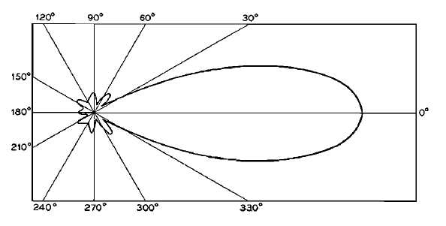



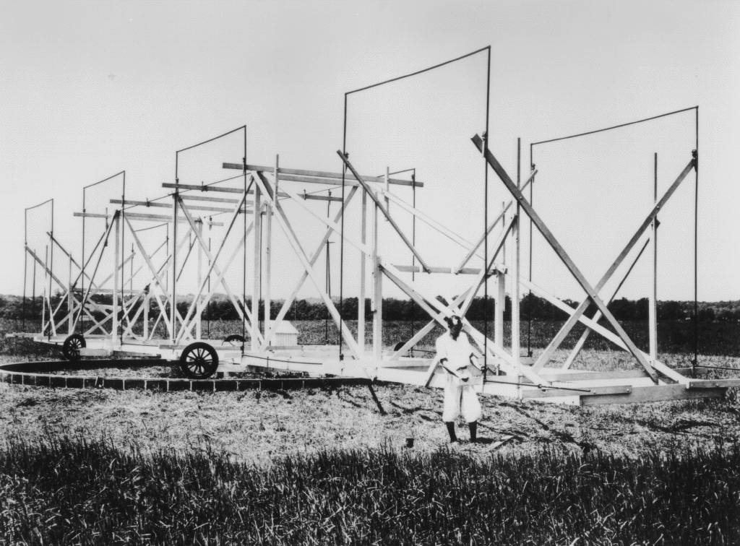
Jansky’s Antenna
BW ~40°
For its time, Jansky’s rotating aerial was a state-of-the-art direction finding instrument.
Frequency = 20.5 MHz (14.6m).
It had a beamwidth of about 40º in azimuth & elevation.
Known as a Bruce Array, it was developed at Bell Labs by Edmond Bruce in the 1920s.
At 95-ft long, it was a mass of wooden beams supporting a series of metal tubes.
The antenna was mounted on 4 Ford truck wheels and made a full rotation every 20 minutes.
Azimuth
Directional Studies of Atmospherics at High Frequencies, K.G. Jansky, Proc. of the IRE, Vol. 20, No. 12, Dec. 32, p. 1920
http://www.nrao.edu/whatisra/images/jansky1.gif
Karl Jansky & his “merry-go-round” antenna
at Holmdel, NJ, in 1933

Slide 10
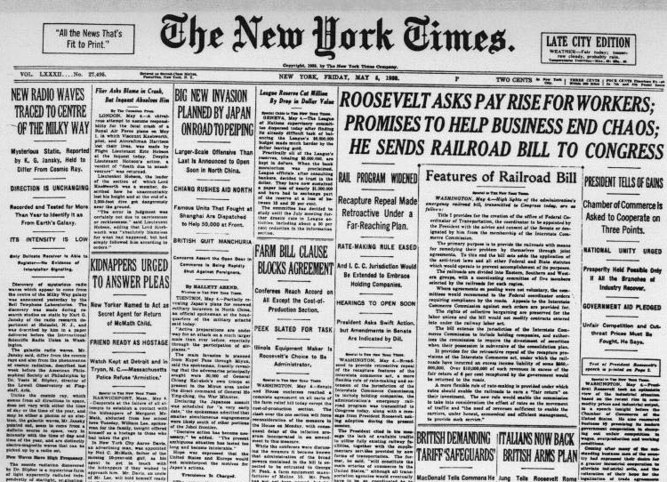
May 5, 1933
NEW RADIO WAVES TRACED TO CENTRE OF THE MILKY WAY
Mysterious Static, Reported by K. G. Jansky, Held to Differ From Cosmic Ray.
DIRECTION IS UNCHANGING
Recorded and Tested for More Than Year to Identify
It as From Earth's Galaxy.
No Evidence of Interstellar Signalling.
LGM?
ITS INTENSITY IS LOW
3σ ?
http://www.gb.nrao.edu/sd03/talks/SDSS_history_talk1.pdf

Slide 11
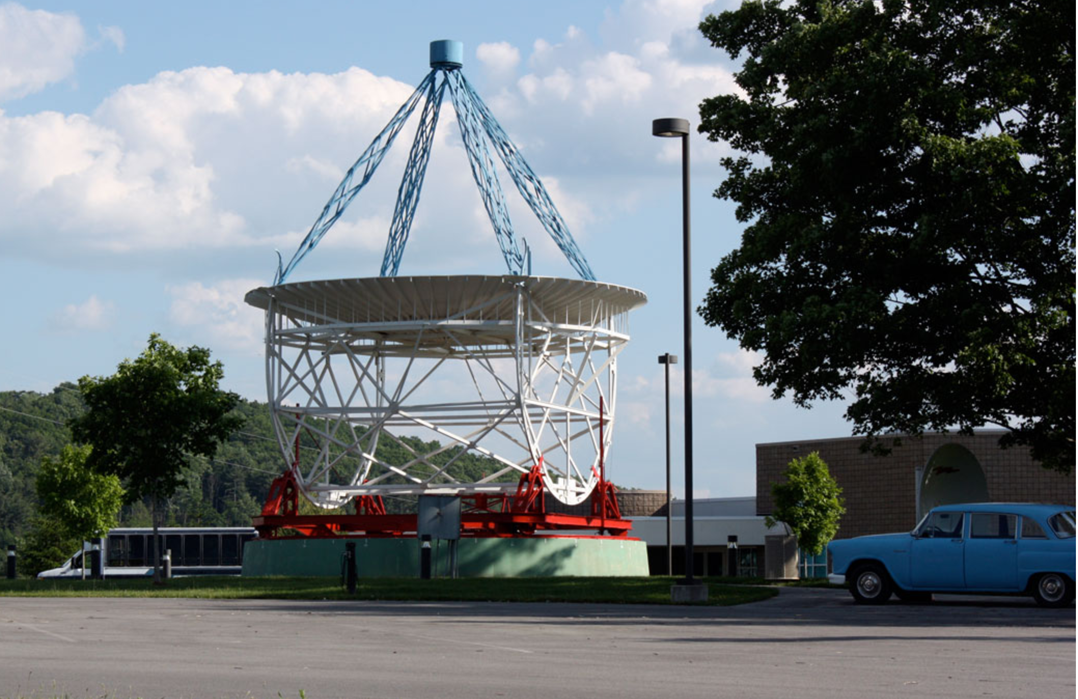
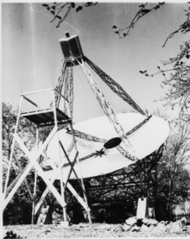
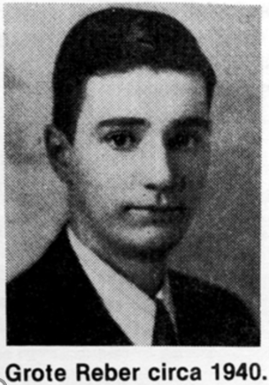
Grote Reber, radio engineer, W9GFZ
* Built a 30 foot parabolic dish in his backyard, inadvertently scaring his neighbours
* After a few years of trying different frequency bands, detected radio emission at 160 MHz around 1940.
* Recognized antenna-receiver combination can measure equivalent temperature of space
* Published findings in Astrophysical Journal, 1944, first ever article on non-optical astronomy
receiver is here
My original telescope
and receivers can also
be found at Green
Bank, WV
Grote’s Backyard, Wheaton, IL
Notes:
... until the 40’s. During this time, almost no mention of Jansky’s discovery was made to the astronomers of the day. Those astronomers were optical astronomers, they were fighting over who gets to use the giant 200” telescope at Palomar, Einstein was at Princeton, the war was on, and things were scarce.
* an enterprising and brilliant ham radio operator was looking for something cool to work on, when he came across Jansky’s papers and decided to revisit his experiment. He collected a large surplus dish reflector, and made his own receivers. He put up this alien looking contraption in his back yard in Wheaton, ILHe tried unusuccessfully at a higher frequency (3 GHz) first, then moved down to around 900 MHz. Still no luck. Third attempt was a 160 MHz receiver, which was successful, and he started to collect strip chart recordings of the data, and make them into maps revealing some structure to the galactic center’s emission.
* While his findings were readily accepted to electronic journals, he tried to publish also in astronomy journals, namely the Astrophysical Journal. Otto Struve was the editor then, and while he had doubts, he took an important step and allowed it to be published. Thus introducing the first non-optical article ever to be published in an astronomical journal. This was big news, astronomy had previously been exclusively optical. And to have a go-getter, home-built instrument be used for professional astronomy was a little bit more than some ivy leagers could handle. But eventually, they let their institution be opened up to other frequencies. and when they did...

Slide 12
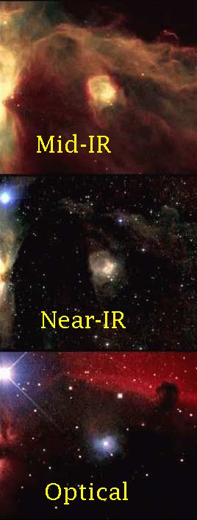
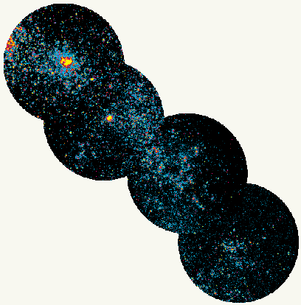
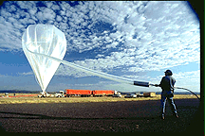
What? Astronomy can be done with Radio? Yes It Is Really Astronomy, Step Aside Alan Sandage…
Prior to 1930’s, most (all?) astronomy was optical.
Jansky and Reber set off a storm of non-optical astronomical theorizing and observing, including:
1949: Aerobee 150 rocket launched from White Sands, detecting X-ray emission from the sun
~1960: balloons carrying Infra Red detectors launched
1961: satellite Explorer XI detects gamma ray photons from universe
Small Magellanic Cloud seen in UV by Ultraviolet Imaging Telescope, GSFC/NASA
Horsehead nebula in various wavelengths, note cooler gas showing in IR images
Filling the GRIP balloon, to launch a Gamma Ray detector, Caltech
Notes:
Hoooolleeee... when scientists/engineers/astronomers realised that astronomical sources could be studied at every wavelength from ultra-low frequency radio to gamma rays, the possibilities seemed endless. The emission that couldn’t be seen from the ground, due to the atmosphere blocking it, is studied with rockets, balloons and satellites. There are ground based radio telescopes like here, millimeter wave (microwave) observatories on mountain tops and at the south pole, infra-red telescopes like IRAS in orbit, UV satellites (which one?), X ray detectors sent up regularly on rockets and orbiting telescopes, the orbitting Compton Gamma Ray observatory... there are many more... they give us a GREAT multiwavelength view of the radio sky...

Slide 13
Post WWII
Many groups spawned after war
Surplus radar equipment – amateur radio
Amateurs and professional radio astronomy groups
UK – Manchester
Canada (Queens, UT, DRAO)
Australia – CSIRO’s Radio Physics
Germany – Max Planck Insitute for Radio Astronomy
USA: National Radio Astronomy Observatory

Slide 14
ATMOSPHERIC WINDOWS, Radio vs optical

Slide 15
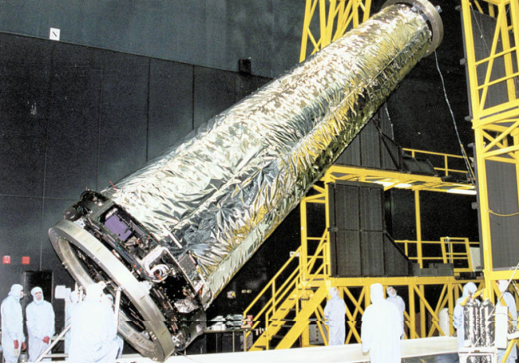
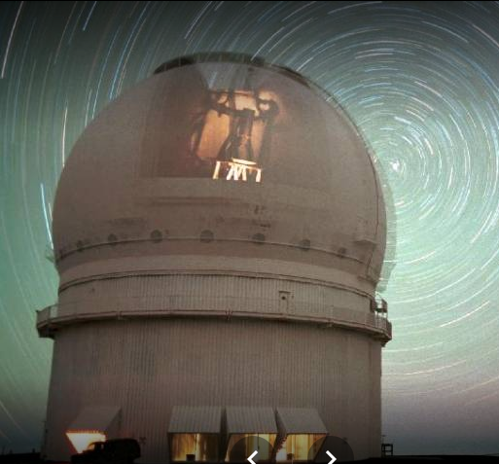
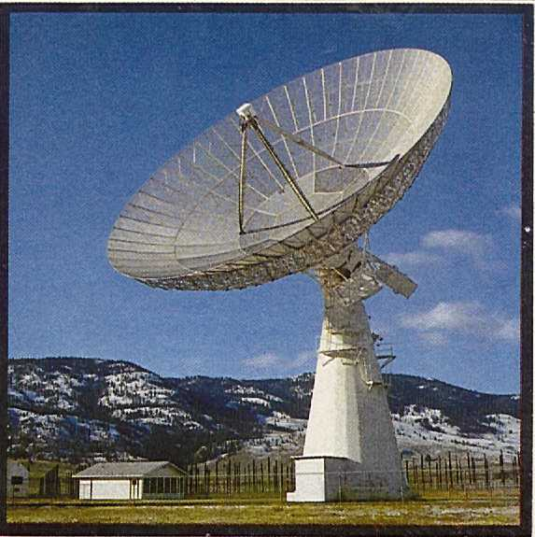
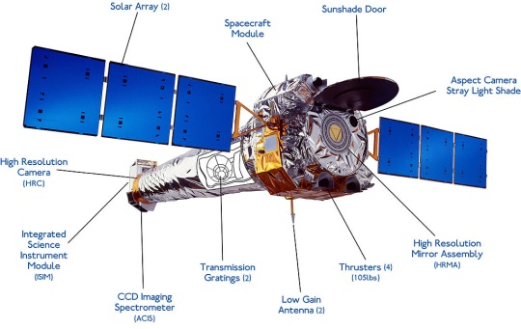
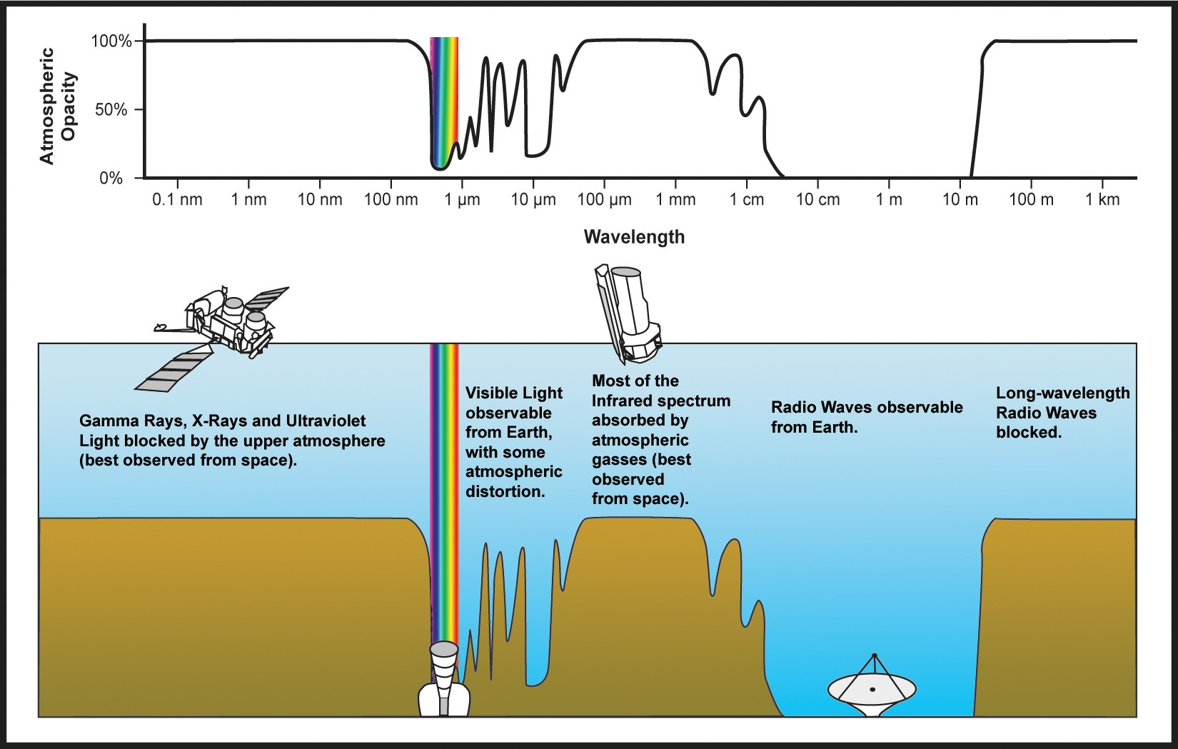
Frequency/Wavelength Definitions
By NASA - http://chandra.harvard.edu/resources/chandraMission.html, Public Domain, https://commons.wikimedia.org/w/index.php?curid=23137247
CFHT
Vis, IR
DRAO
uwave, radio
Chandra
X-ray
Image: http:// lalyreduquebec.com
Image: http://ieee.ca/millennium/drao/
http://gsp.humboldt.edu/OLM/Courses/GSP_216_Online/lesson2-1/atmosphere.html

Slide 16
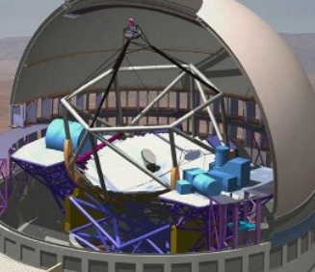
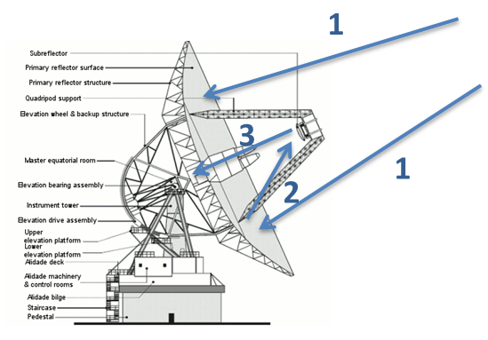
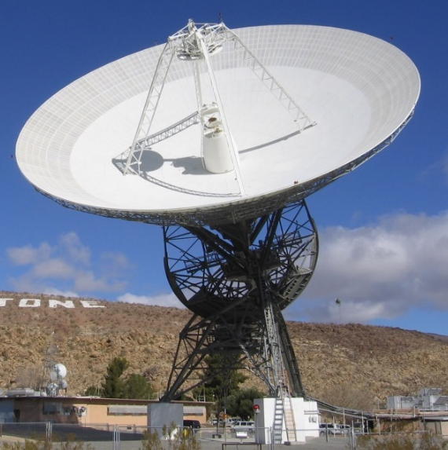
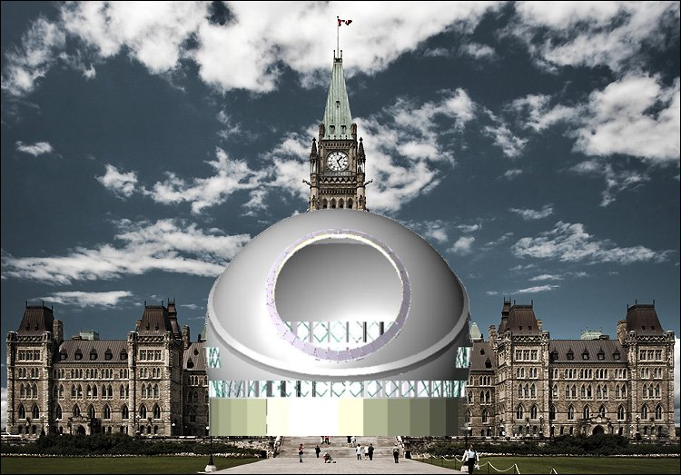
Radio vs Optical - Instruments
Radio vs
Optical
By NASA - http://chandra.harvard.edu/resources/chandraMission.html, Public Domain, https://commons.wikimedia.org/w/index.php?curid=23137247
Image: http://exoplanet.as.arizona.edu
Image: www.nasa.gov
Notes:
Both radio and optical have similar physical optics. Both usually have a large reflector, a few reflections in the path, and then a receiver or detector.
Goldstone: 70-m Cassegrain antenna, used by NASA’s Deep Space Network for comm with spacecraft in our solar system.
TMT: 30-m reflector. ~700 segmented mirrors. Uses adapative optics to de-blur the images. Optical and near IR

Slide 17
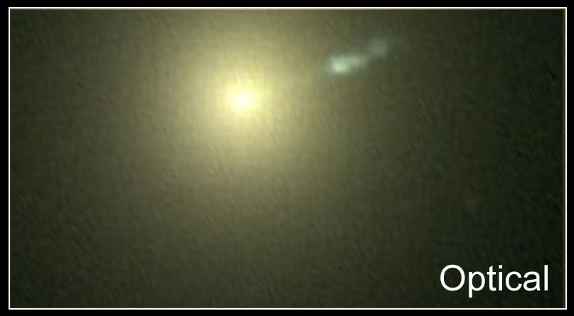
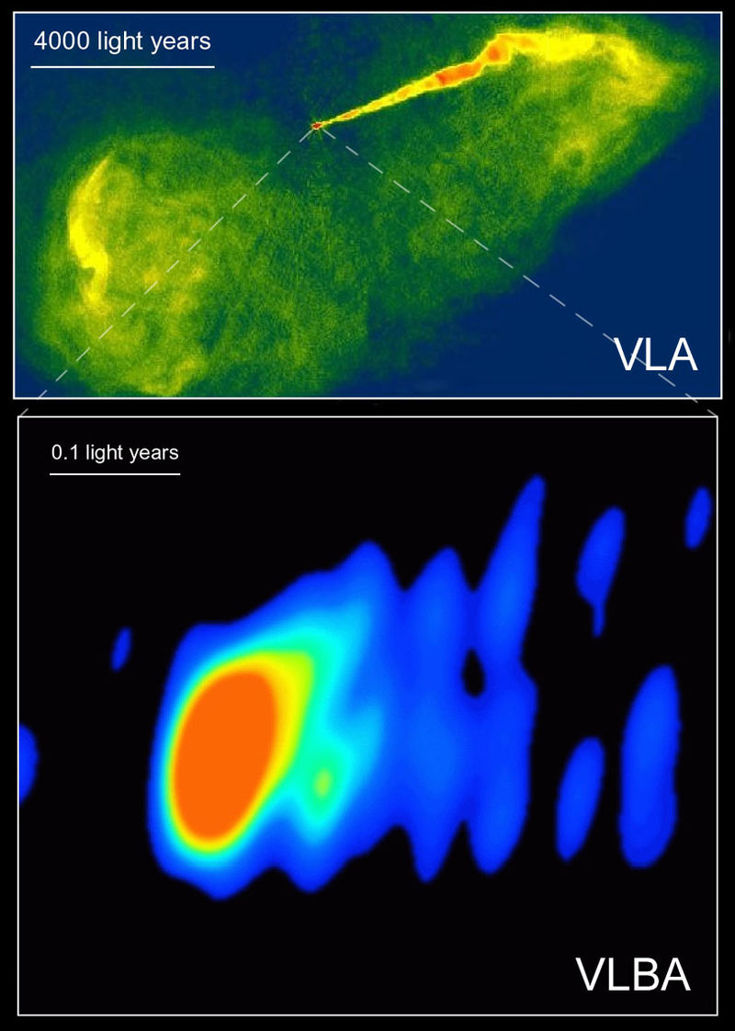
Optical vs Radio
Radio:
Can see through dust…
Can determine the velocity
☹ Need larger reflectors for fine resolution
Optical:
☹ Can’t see through dust.
☺ V. fine resolution due to small wavelength
An optical image of the galaxy M87 (HST), a radio image of same galaxy using Interferometry (Very Large Array-VLA), and an image of the center section (VLBA) using a Very Long Baseline Array (Global VLBI) consisting of antennas in the US, Germany, Italy, Finland, Sweden and Spain.
The jet of particles is suspected to be powered by a black hole in the center of the galaxy.
By Emesee - gov, Public Domain, https://commons.wikimedia.org/w/index.php?curid=4665539

Slide 18
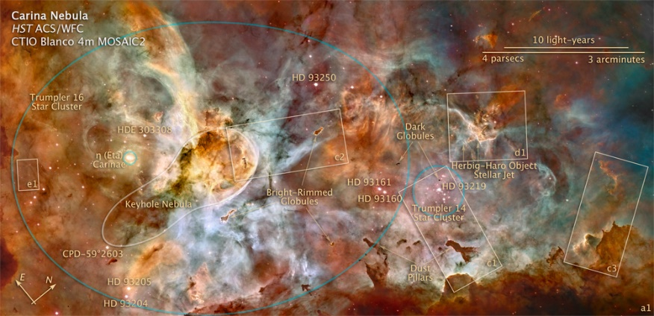
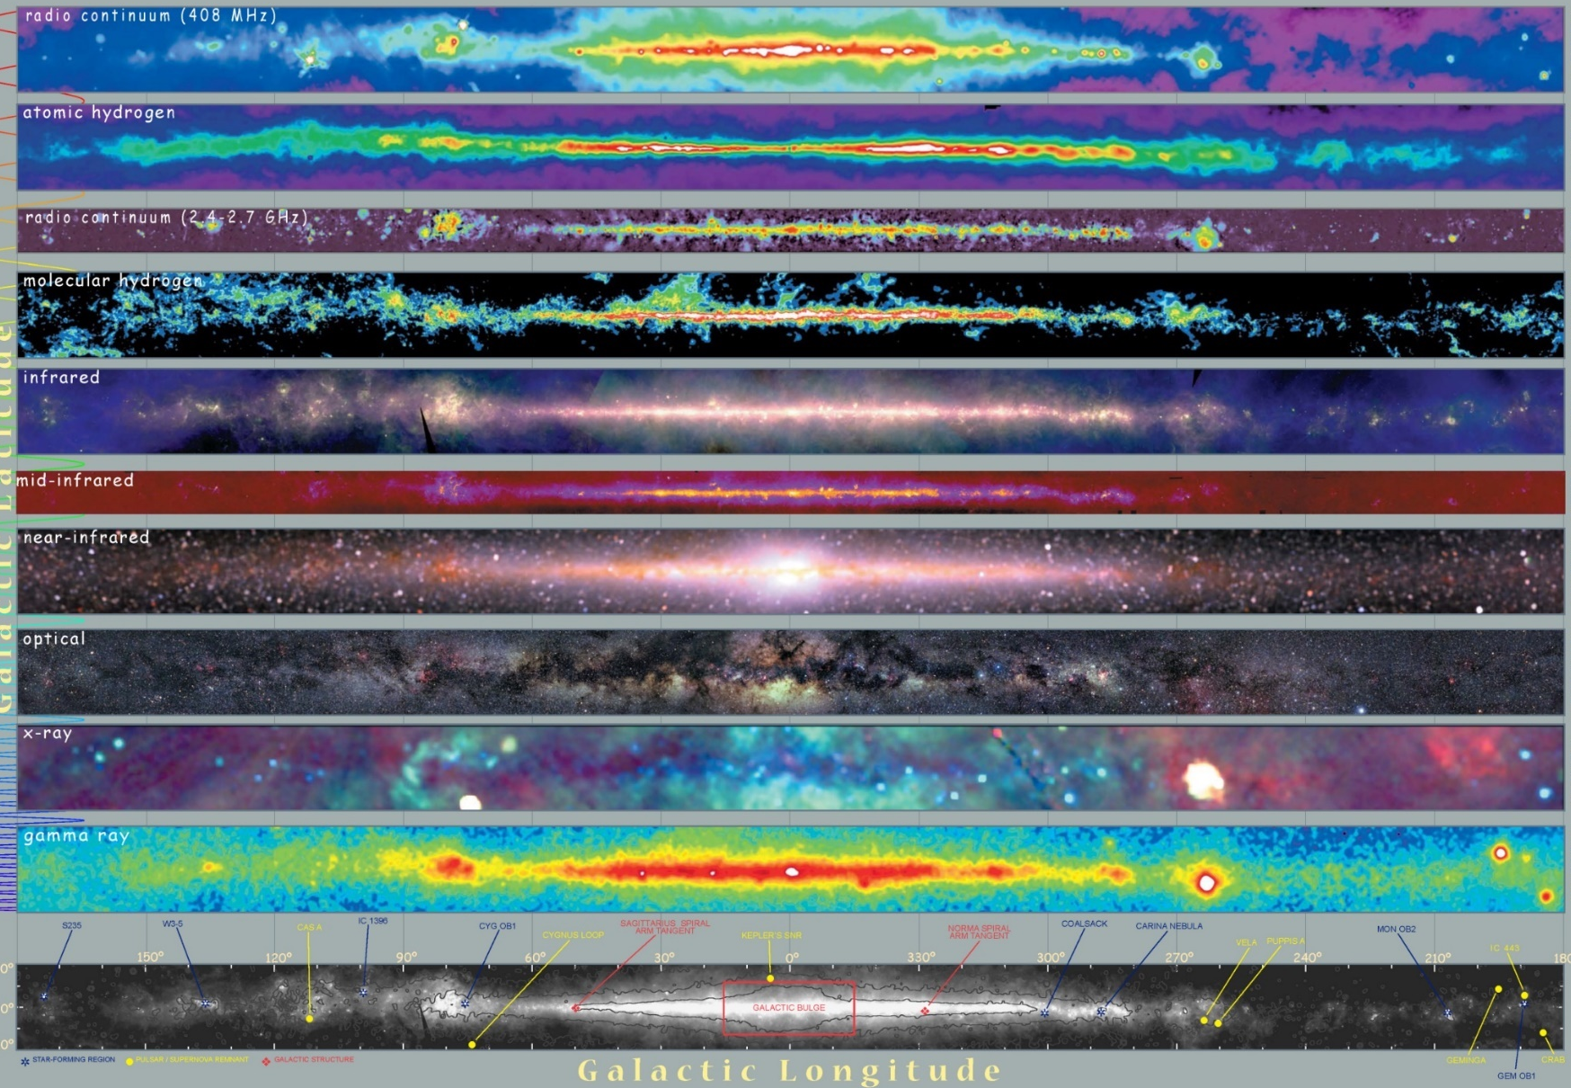
80 Years of Multiwavelength Astronomy
By NASA, ESA, Z. Levay (STScI) - http://heritage.stsci.edu/2007/16/supplemental.html; see also http://hubblesite.org/newscenter/archive/releases/2007/16/image/k/, Public Domain, https://commons.wikimedia.org/w/index.php?curid=2097892
Cool dust
Increasing Wavelength
H₂
Warm dust
Increasing Temperature
Increasing Frequency
Cool stars
Hot stars
Cygnus OB1
VELA Pulsar (supernova remant)
Notes:
* I had to put this slide in, to show you how opening up the spectrum to astronomy can show so much information.
* Originally, we only had the optical view of our galaxy, these are the same strip of our galaxy, showing the center, in different wavelengths/frequenices.
* What Jansky and Reber saw was something close to the top plot, but with much less resolution. At Arecibo, we can image the first three plots, but as the freqency increases, you will have to go to different observatories for this data. Notice that at the top, the emission seems to come from the cooler dust and hydrogen. Infra-red regions tell you where the warm dust is, and further down the picture, comes the cooler stars then the hotter stars.
* ok, now that the scene is set, you know that
a. any EM wavelength can be used to study astronomy
Now we will investigate more about radio astronomy... and introduce you to how it is all possible.

Slide 19
Receiver structure

Slide 20
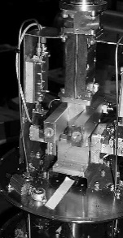

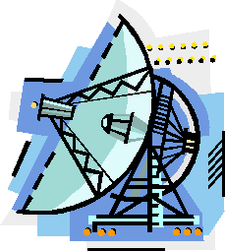
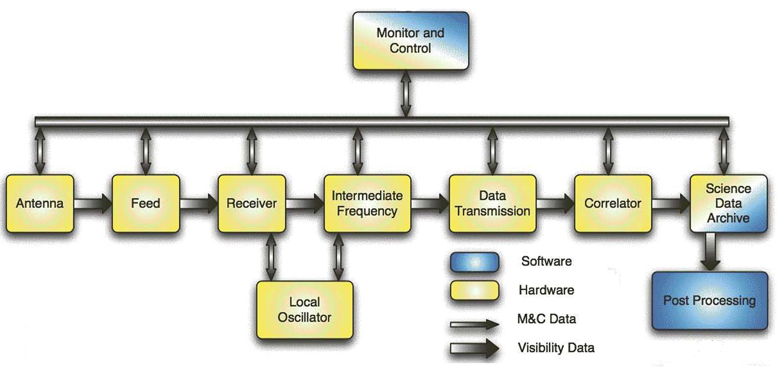

Stepping back a bit… How Does the Information Get From the Star/object to a Signal on a Computer?
Celestial Object – how does it emit?
Thermal emission
due to physical temperatures
Planck’s law: P a f, t
Non-thermal (synchrotron) emission
- electrons spiraling along B-field lines
Spectral line emission
- transitions between energy levels in atoms and molecules
Antenna / Telescope
Reflectors focus and
amplify signal.
Feed: Transducer
changing EM waves in
free space to EM
waves on a transmission
line, i.e. coaxial cable or
waveguide
Optical analog of entire telescope is an
eyeball or a CCD or
photographic plate
Radiative Transfer
Received brightness
changes:
- due to distance travelled
- Due to medium travelled
through
- = optical depth of cloud
- B_{i} = brightness of cloud
- B_{s} = brightness of source
Receiver
Takes transmission line signal and:
- Amplifies
- Changes frequency “down-/up-converting”
- Filters
- Detects
Preserves the Phase (Coherent)
Backends and Storage
- Sample in time or frequency
- store information on computer
Notes:
* OK, now we’re getting somewhere. This is a physical diagram tracking the progress of the astronomical source’s emission to your stored tape drive.
* First, we have the source itself. How does it emit? Briefly, there are some major classes of emission types. One is due to its physical temperature, called appropriately, “thermal emission”. Anything that has a physical temperature above absolute zero, emits some radio emission. That is neat! Everything you could possibly think of or look at will radiate, and our telescope can pick this up. The power that we receive here is dependent on frequency and temperature, as explained by the Planck blackbody curve.
* The source can emit “synchrotron radiation” which happens when an electron encounters a magnetic field, and is accelerated. Emission is given off.
* The source can also emit because of specific molecules/atoms which may be present. Transitions between energy levels will produce radiation at certain frequencies which we can also pick up.
* Now, assuming the object has emitted and now this radiation must traverse galactic and extra-galactic distances, what happens to this original signal? Radiative Transfer theory tells us that there will be some changes... one is the pure attenuation of the signal due to the distance it is travelling. For a distance R, the power will decrease by the root of P. The amplitude also gets altered depending on the material it travels through. It may be amplified if travelling through an hotter region and attenuated if travelling through a colder region (or is it the spectral features that change, picking up signatures from these intervening clouds?). The phase of the signal may also change if travelling near magnetic fields. but remember, most of space is just that, empty, so by the time the signal gets to our telescope, hopefully we can decode what it originally was.
* Finally after traversing across space for what could be zillions of years, it approaches the primary reflector. The three reflectors will serve to focus this incoming radiation to a single point. In the process adding a LOT of gain (a factor of a million) due to the size of the main reflector. I am also including the feed horn in this section, which takes the EM wave focused at a point and channels it onto a transmission line. This is useful, otherwise we couldn’t harness the energy into our electronic system. This is the transducer.
* The optical analog is your eyeball. It takes in visual EM waves, and focuses them onto the back of your retina, where it is changed into an electrical signal by those neat photoreceptors, rods and cones. This is the same thing. It’s a giant radio eyeball.
* Ah... venturing into unknown territory, the receiver... this and the feed horn are where the magic happens. The signal at this point has been amplified by the gain of the optics, but is still very weak. Too weak to work with or to pick up on cool headphones and listen to out in the desert while sitting on the hood of our baby blue thunderbird convertible (contact movie), so it has to be changed a bit more. The receiver takes in this baby-weak signal and amplifies the begeezes out of it. It also selects in frequency which region we’re interested in. Receivers usually take this signal and shift it in frequency, while still preserving the information, and eventually ....
* Record it to disk or other storage media so astronomer dudes can take it home with them and give it to their students to work with.

Slide 21
Radio Telescope Receivers
The purpose of a receiver
To collect efficiently the astronomical signal that has been concentrated by the antenna (optics) near its focal point,
select a frequency subset,
amplify it with a minimum of extra noise,
frequency shift (optional, though recommended),
and digitally collect and process
Spectral line emission (Spectrometers)
Discrete energy jumps produce precise wavelength emission
Features are narrowband (few to 100 kHz), need very high resolution
Thermal emission (Continuum Detectors)
Constant spectral density over wide bandwidths (few MHz or more).
Signals are noise-like and cannot be distinguished from noise from the receiver
Switching receiver (switches between calibrated load and sky) can help
Key factors
Accurately reproduce the amplitude, phase and spectral characteristics
Add a minimum of noise to the system
Receiver must be linear even when it operates over a high dynamic range
Dynamic Range:
Very large and very small power signals get accurately replicated, with minimal distortion
Notes:
Receivers: main goal is to take the incoming signal and amplify it, because it’s way too weak!
we want to frequency select, because the radiation coming in is very broad band, so we need to choose a range that we’re interested in.
while doing this, we have to make sure that we don’t add a lot of extra noise to the system, and also that our receiver is linear. This means there is no distortion in the signals, as what may happen to your stereo if you turn up the volume too loud....
What kinds of signals are coming into these receivers?

Slide 22
Antenna / Telescope Optics
Reflectors focus and amplify signal.
Backends and Storage
Sample in time or frequency
Store information on computer
Receiver + Feed
Feed: a transducer.
EM waves in free space -> EM waves on a transmission line
Receiver: Amplifiies, Changes frequency “down-/up-converting”, Filters, Detects
Receiver Block Diagram

Slide 23
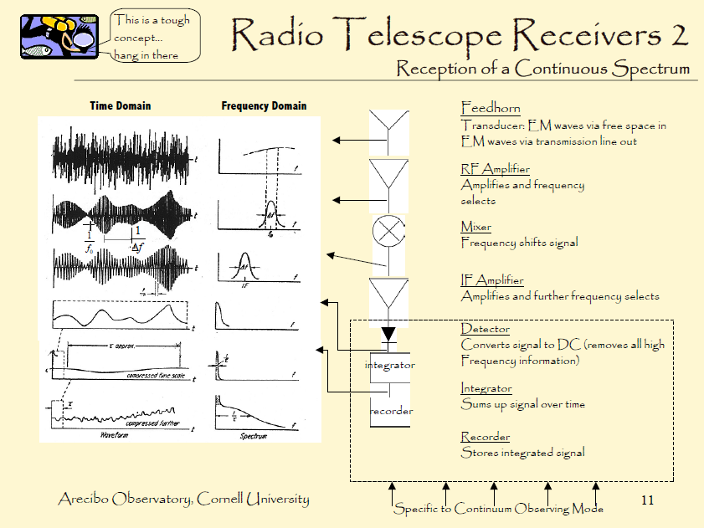

Slide 24
Critical Components in Cryogenic Receiver
Feed
Cryostat
15 & 50ºK
LCP
Circular
Polarizer
RCP
LNA
LNA
Room Temperature
Electronics
Signal
Out
LCP
RCP

Slide 25
NOISE, Radiometer equation

Slide 26
Noise Temperature of a Receiver System
A Receiver System consisting of an antenna with a lossy line
in front of the LNA, followed by more lossy cable between the LNA and a Postamp:
T_{In}
G
G
T_{Out}
T_{Line}
L_{Line}
T_{LNA}
G_{LNA}
T_{Cable}
L_{Cable}
T_{Postamp}
G_{Postamp}
T_{Sys}
“Double whammy” from resistive losses in front of the LNA.
T_{Rx}
Each stage contributes thermal noise to the signal being received.

Slide 27
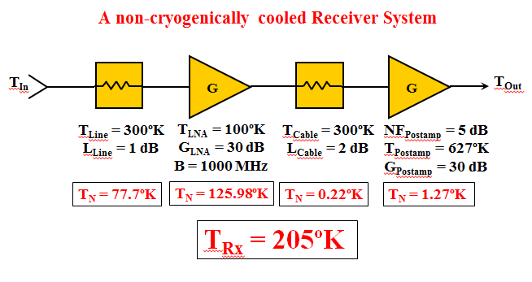
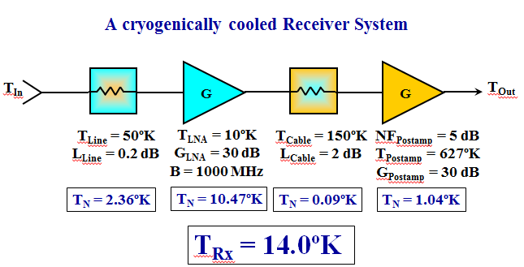
Noise Temperature of Warm/Cooled Receiver Systems
This why it is necessary not just to use a cryogenic low noise amp but to cool everything in front of it.

Slide 28
Noise Model for EVLA Ka-Band Receiver

Slide 29
The Radiometer Equation
Unlike the signal from a communications satellite or a deep space probe, most astronomical sources emit a constant flux (or are slowly varying).
This means radio astronomers can have their telescopes “sit on a source” and average the signal so that the unwanted thermal (Johnson) noise integrates down
while the wanted signal rises up like a Phoenix from the noise.
Where…
∆T = sensitivity of the receiver (minimum detectable signal)
T_{Source} = astronomical noise from the source of interest
T_{Ant} = noise contribution from the sky, antenna spillover, etc.
T_{Rx} = noise contribution from the receiver
B = detection bandwidth
τ = integration time

Slide 30
The Radiometer Equation Consequences
If T_{Sys} is reduced by a factor of 2, the amount of integration time required
to achieve the same sensitivity level takes only 1/4th as much time.
In other words, you could now observe 4 times
as many astronomical objects in the same amount of time.
Perspective:
Astronomical sources contribute a very, very, very small amount to the overall noise power coming out of the antenna/receiver system.
For the EVLA at C-Band, which has a T_{Sys} of ~25ºK, a relatively strong astronomical source with a flux of 1 Jy (= 10⁻²⁶ W m⁻² Hz⁻¹) would cause about a 0.2ºK increase in the system temperature, or less than 1%.
Most sources that astronomers look at are 10s or 100s times weaker.

Slide 31
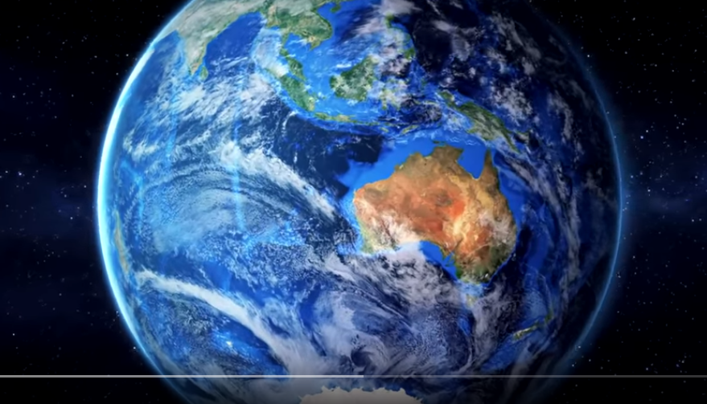
Video: Square Kilometer Array - Australia

Slide 32
RECEIVER DETAILS & components

Slide 33
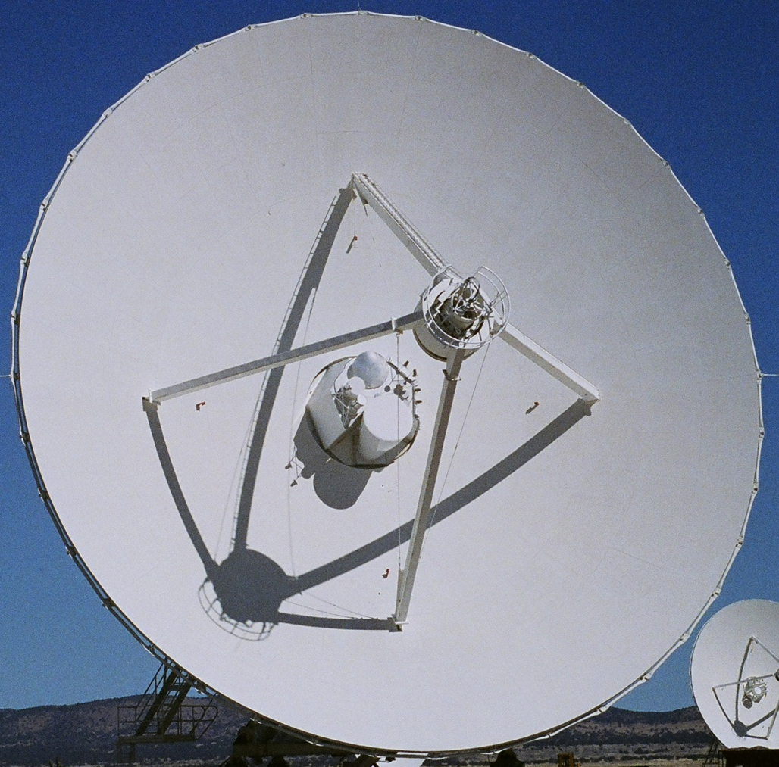
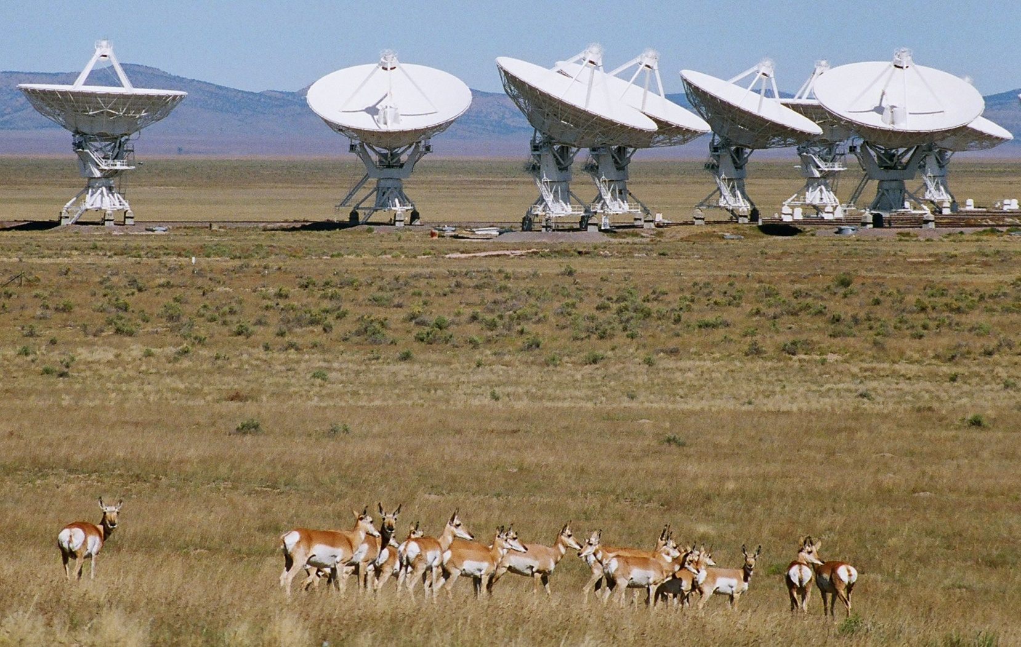
Optics
Cassegrain
Focus Cabin
The Feeds stick out above while the Receivers are located below inside the Vertex Room.
Photos
R. Hayward (2009)

Slide 34
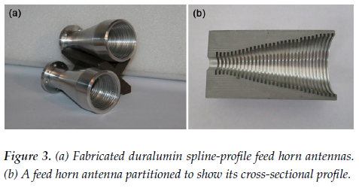
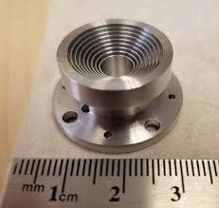
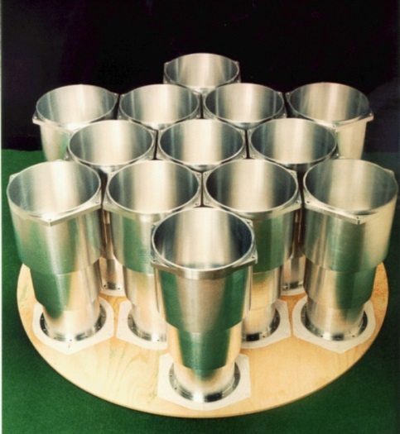
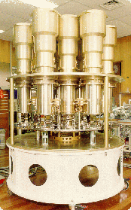
Antennas: feedhorns +
ALMA Band 1 (35-50) GHz feedhorn
Purpose: Antenna is defined as a transducer between free space and a guided transmission line
Key Issues:
keep loss low, as this is a component before the first amplifier
Preserve signal integrity – amplitude, phase, polarization characteristics.
Characteristics
Is a wideband frequency filtering device due to physical dimensions and modal characteristics of waveguide
Usually element is a horn (dual pol), but … sometimes can be dipoles or planar elements
N. Reyes, V. Tapia, D. Henke, M. Sanchez-Carrasco, P. Mena, S. Claude, L, Bronfman, “An Optical system design for the Atacama Large Millimeter Array,” SPIE 2014
NRC’s Q-band (35-50 GHz) feedhorn
CSIRO’s 13-element feedhorn array
atnf.csiro.au

Slide 35
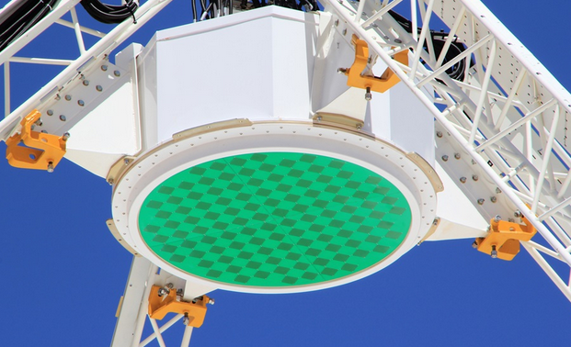
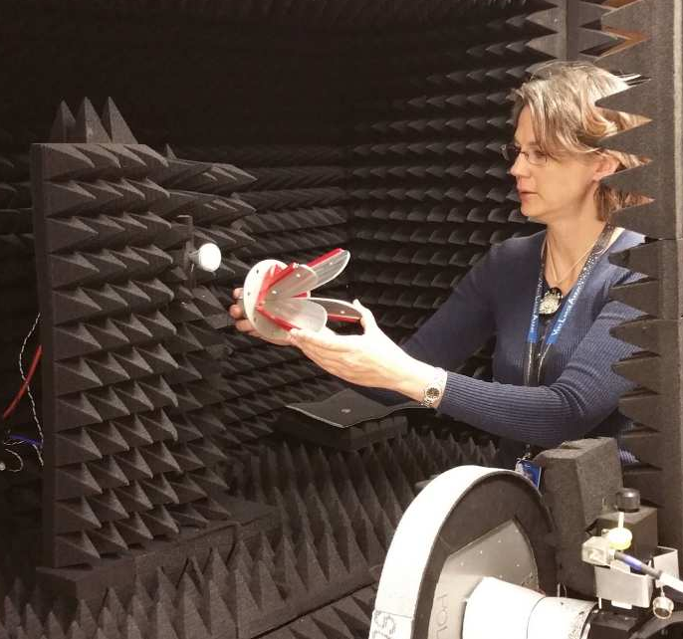
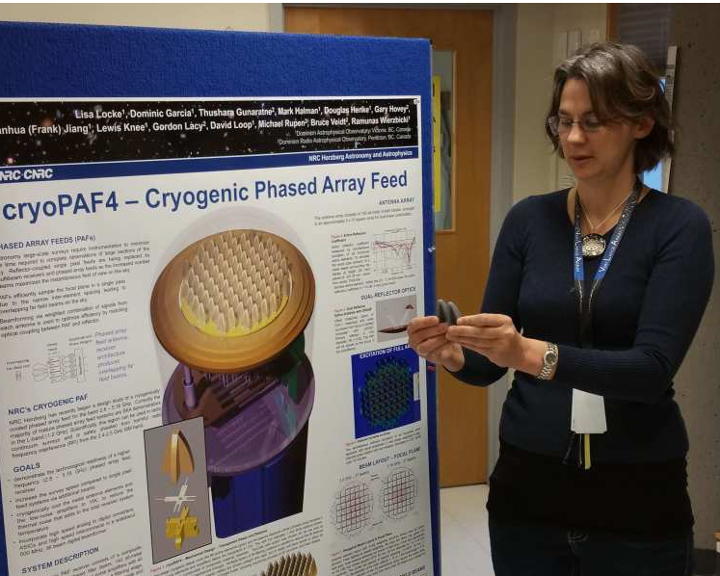
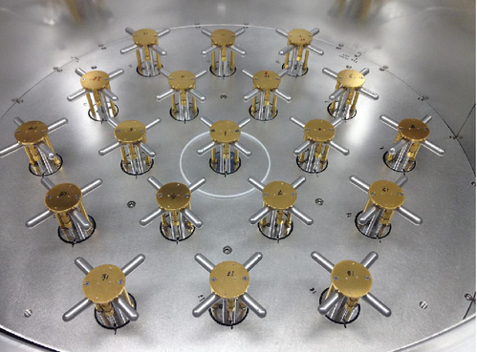
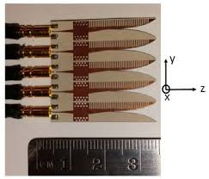
Antennas: other non-horn types of elements
Planar
Vivaldi
Dipole
NRC’s 35-50 GHz ALMA Band 1 feedhorn
UVic’s 2-20 GHz dual-pol Vivaldi – ETS Lingren
CSIRO’s L-band 188 elem PAF
Cornell’s L-band n-elem cryogenic dipole PAF
NRC’s 18-26 GHz planar Vivaldis
NRC’s 2.8 – 5.2 GHz cryogenic bullet-style Vivaldi PAF
G. Cortes et al, SPIE 2014

Slide 36
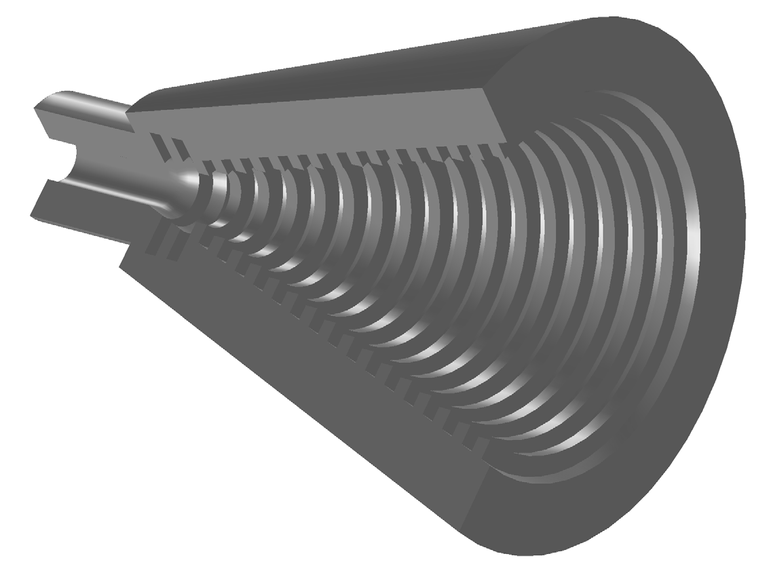


How Feedhorns Work
Corrugated Horns
It is easier to understand a corrugated feed by thinking of it as a transmitter, rather than a receiver.
Corugated horns provide:
low sidelobe levels
low cross-polarization
excellent beam symmetry and
exhibits high efficiency with low noise contribution.
They are an iteration on smooth walled horns in that the sidelobes are reduced at the expense of complexity.
A corrugated horn has concentric parallel grooves covering the inner surface, placed close together and ~1/4 λ deep.
The signal in the throat section passes through a smooth circular waveguide, where the dominate mode is TE₁₁. Since this mode has a poor radiation pattern, it is necessary to transform it into a waveguide mode which is better suited for illuminating the subreflector with a symmetric beam.
The best mode to use is the balanced hybrid HE₁₁ mode which has very good radiation properties. HE₁₁ is the fundamental mode in circular corrugated waveguide.
HE₁₁ can be made up of a combination of ~85% TE₁₁ and ~15% TM₁₁.
When the TE₁₁ mode exits the circular w/g and passes along the corrugated portion, the TM₁₁ mode will be excited. As both modes propagate, they become mixed.
http://www.radio.feec.vutbr.cz/kosy/soubory/bocia/High_performance_horn_antenna_design_I.pdf

Slide 37








How Vivaldis Work
NRC CryoPAF antenna element
Shown in transmit mode, although antennas are reciprocal, so the receiving process is just the reverse.
In transmit mode, the field is fed by a coaxial TE11 mode
The magic happens at the junction at the apex of the metal arcs (Blades) where the field is launched from coaxial feed to between the blades.
The wave travels up the blades and is launched into free space.
Surface currents on metal element are informative as they show :
Clear physical picture
radiation process
travelling waves
mutual coupling
Unwanted reflections
Surface current plots (dB), normalized to max.
2.8 GHz
4.0 GHz
5.18 GHz
37

Slide 38
Circular vs. Linear Polarization
A coherent microwave detector can only capture one polarization. To collect all the EM energy being intercepted by a radio telescope, the receiver must have two separate channels designed to detect two orthogonal polarizations.
Either Linear (i.e., Horizontal & Vertical) or Circular (i.e., Left & Right)

Slide 39







A device called an Orthomode Transducer (OMT)
can be used to separate both linear
polarizations simultaneously.
Linear & Circular Polarized Waves
Y
Left Circular
Vertical
Right Circular
(Radio Astronomy Definition)
A circularly polarized wave as a sum of two linearly polarized components 90° out of phase
Z
To convert linear to circular, a 90 degree phase-shifter is needed to retard one of the linear polarizations wrt the other.
Horizontal
X
http://en.wikipedia.org/wiki/Polarization_%28waves%29#mediaviewer/File:Rising_circular.gif

Slide 40

Some Linear Polarizers
P. Lilie, aoc.nrao.edu

Slide 41




Quadruple-Ridge Waveguide to Coax Transition
SMA Connector
Coaxial Probe
(x2)
Semi-rigid Cable
Outer Conductor
Teflon Insulator
Y-oriented Coaxial Probe
Inner Conductor
X-oriented Shorting Pins
Absorber
X-oriented Coaxial Probe
…
TE₁₀
Mode
TE₁₁ Mode
.
…
Unwanted
Desired
Open-circuited Coax Matching Stub
Y-oriented Shorting Pins
The inner conductor of the Coaxial Probe extends into the hole of the fin on the far side and acts like a capacitor. The more conductor, the more capacitance. Trim for best Return Loss.
Octave-band Orthomode Transducers for the Expanded Very Large Array, G.Coutts, H.Dinwiddie & P.Lilie, URSI Conference, 2009

Slide 42



How to make Linear Polarization
- Quad Ridge assembly
Locator Block
The OMT is designed for easy assembly - only the coax probe length needs to be adjusted.
The 4 fins are attached to the precision locator block.
This sets the ridge spacing while maintaining symmetry.
Then the 4 outer shell sections are then bolted in place.
Absorber
Shorting Pins
Coaxial Probes
Fins x 4
OMT ridge assembly
Partially assembled
Fully assembled

Slide 43

Circular Polarization – Use Linear Polarizer
Use a linear OMT and a 90 degree shifting element, either before or after the OMT.
(a) : Lin OMT + 90 deg Hybrid
- a Quadridge OMT which separates the signal into 2 linear polarizied coaxial outputs
and a coaxial Quadrature Hybrid which retards one of the linear signals by 90º and combines them to produce LCP & RCP.
(b) : 90 deg Phase Shifter + Lin OMT
a corrugated waveguide Phase Shifter which retards one of the linear polarizations by 90º
and a Symmetric Waveguide OMT to produce LCP & RCP.
(c) : 90 deg Phase Shifter + Lin OMT
a corrugated waveguide Phase Shifter which retards one of the linear polarizations by 90º
a Quadridge OMT which separates the signal into 2 linear polarizied coaxial outputs
Wideband Diagonal Quadruple-Ridge Orthomode Transducer for Circular Polarization Detection, G. Coutts, IEEE Transactions on Antennas and Propagation, Vol 59 , Issue: 6, June 2011, p. 1902-1909

Slide 44
Low-Noise Amplifiers (LNAs)
Keep Noise Low
Receivers are cryogenically cooled to reduce their noise temperature
In radio astronomy the antenna noise temperature is determined by the Cosmic Background Radiation (2.725 K) modified by the presence of the atmosphere.
For frequencies up to ~100 GHz, it is possible to have direct amplification (LNA first receiver element), above that it is tough/impossible to make amplifiers, and so SIS mixers (Superconducting – Insulating – Superconducting) have to be the first element.
Must preserve phase – radio telescope antenna systems require phase
Must stay linear to preserve amplitude fidelity
44

Slide 45

LNAs consist of many stages of gain, each stage is usually a discrete transistor.
The transistor is usually a Heterostructure Field Effect Transistor (HFET). also known as an High Electron Mobility Transistor (HEMT).
Amplifiers improve over time, changing their materials from AlGaAs/GaAs to AlGaAs/InGaAs/GaAs and the newer devices use AlInAs/InGaAs/InP HEFT’s, referred to as “InP HFETs”.
The first stage amplifier contributes the most noise in a cascaded system, a designer will use the lowest noise device possible.
The so called “Cryo3” wafers manufactured by TRW in 1999 for the Jet Propulsion Laboratory were used as first stages for many amplifiers..
The thousands of Cryo3 devices on these 6 “golden wafers” have exhibited unparalleled performance when compared to all other manufacturing runs.
Lower frequency amplifiers (1-~30 GHz) use coaxial inputs while the higher frequencies (~ 30 GHz +) use waveguide inputs.

Slide 46

In the 4–100 GHz range, the cooling of a amplifier will typically reduce the internal amplifier noise to within 4 times the quantum limit.
SIS
Tmin 80 nm
Tmin 35 nm
Tmin = 4hf/k
E. Bryerton, M. Morgan, M. Pospieszalski, “Ultra low noise cryogenic amplifiers for radio astronomy,” Radio and Wireless Symposium, 2013

Slide 47
Receiver Block Conversion (Mixer) Frequency Diagram
Power
(dBm)
LO Ref = 15.333 GHz
→ x3 →
LO = 46.0 GHz
IF Out
8-18 GHz
Ka-Band Rx
26-40 GHz
28-38 GHz
Freq
(GHz)
0
4
8
12
16
20
24
28
32
36
40
44
48
52
56
60
Translation of 28-38 GHz down to 8-18 GHz
LO Ref 15.333 GHz x 3 = 46 GHz

Slide 48




Slide 49

Video: Phased Array Feeds

Slide 50
Extra pictures

Slide 51


Slide 52







RADOMEs for Cryogenic receiver windows
DRAO Penticton, BC, Canada
Elliptical radome, diameter 480 mm (18.9”), height 154 mm (6.1”), 0.7 mm thick
Composite pre-preg material: TenCate
4 quartz glass fiber ($ε_{r}$=4.5) layers infused with:
Cyanate ester resin ($ε_{r}=3.7$, $\tan{δ=.005}$)
Resulting combination: Low dielectric constant ($ε_{r}$=3.32) and low dissipative loss ($\tan{δ=.0035}$ at 5 GHz)
Mechanically strong, holds a vacuum
Low moisture absorption, low outgassing
Used in other radome & space/satellite applications
Vacuum infusion: glue infused quartz weave – air + heat + time = radome
Create mold, fabricate on site

Slide 53







Vacuum Infusion Lab - Penticton

