Slide 1
Follow these step-by-step instructions to access Pearson Mastering

Slide 2
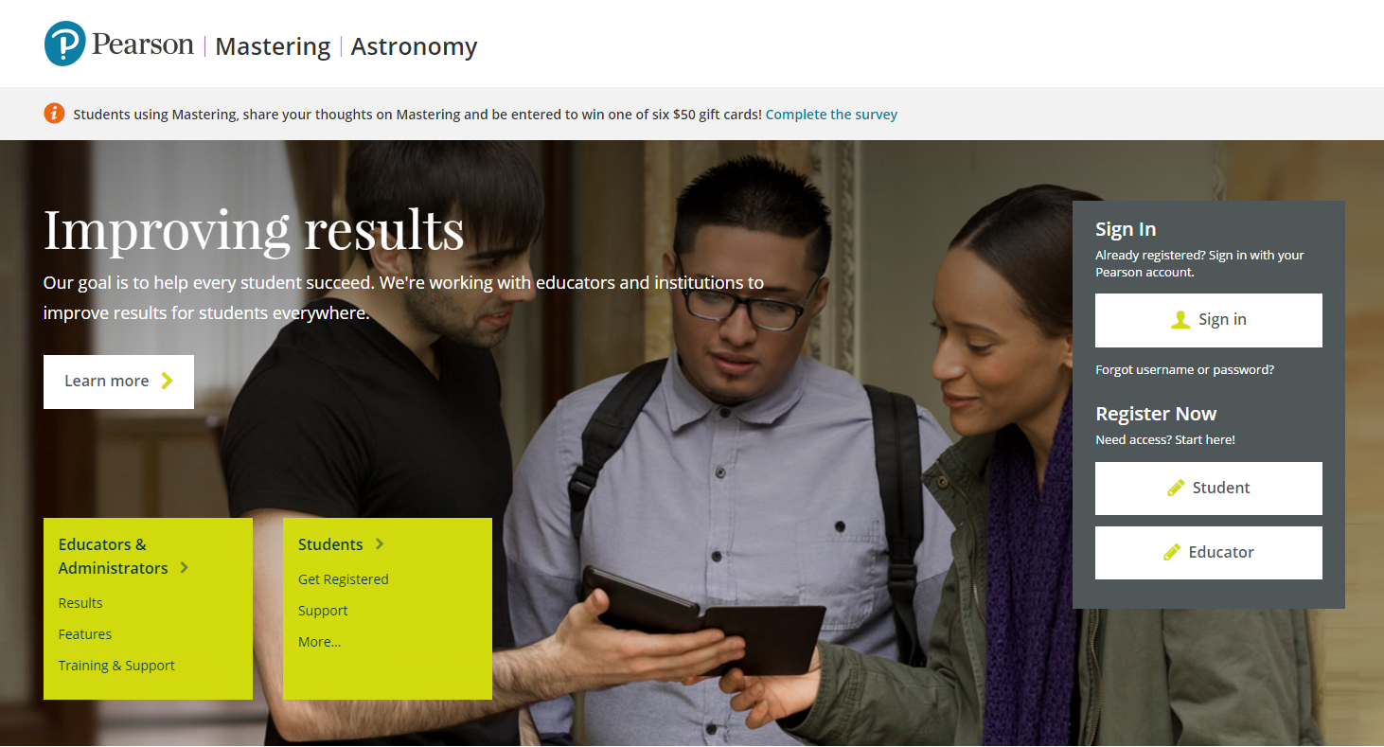
Step 1:
Users who purchased MasteringAstronomy WITH etext, go to: www.masteringastronomy.com and follow the instructions below
Users who bought an access card WITHOUT etext, go to:
https://register.pearsoncmg.com/reg/include/consent.jsp?originalDest=/reg/register/reg1.jsp
Select Student-Register
(We recommend you using Chrome or Firefox)

Slide 3
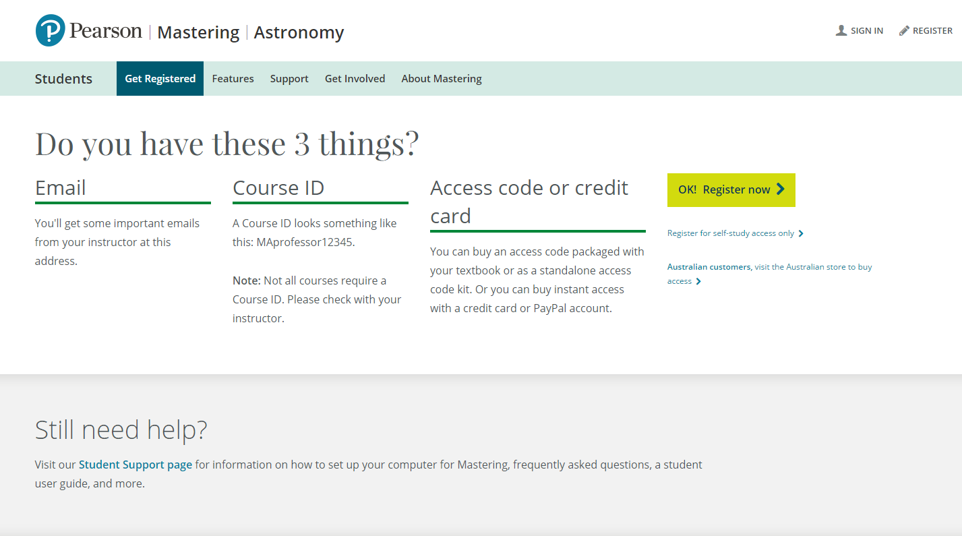
Step 2: Confirm you have…
a valid email address
Course ID MAELLISON87855
Access Code OR Credit Card

Slide 4
Step 3: Enter course ID MAELLISON87855

Slide 5
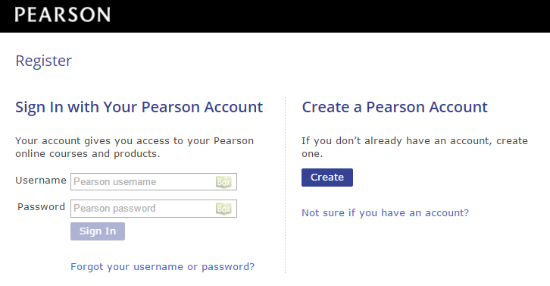
Step 4: Create an account or sign into existing account
The FIRST time you attempt to access your Mastering course, you will be asked to register.
Read and Accept the End-User License Agreement and Privacy Policy
On the next page, you will be asked to CREATE a Pearson account or sign into an EXISTING Pearson account.
If this is your first time registering for a Pearson product, click Create to and fill out the necessary information.
If you already have a Pearson Account (if you have used a Pearson product in one of your other courses) you should Sign In with Your Pearson account by entering your Username and Password into the fields provided.

Slide 6
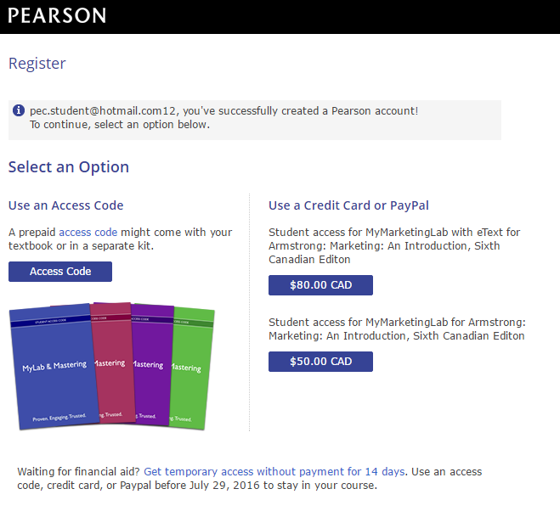
Step 5: Select Your Access Option
You will have the following choices:
Enter the Access Code (usually purchased at the bookstore).
Purchase Access – you will need a credit card to do this.
Temporary Access (14 days).

Slide 7
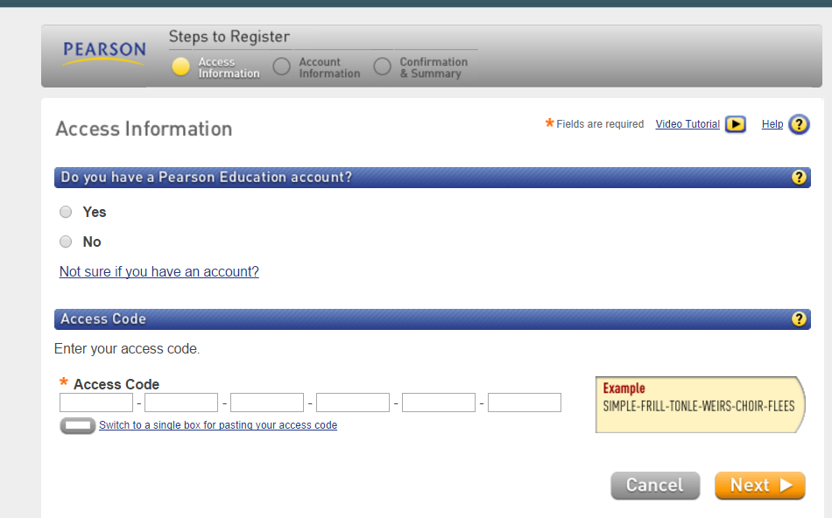
Follow the instructions to add an account and enter your code

Slide 8
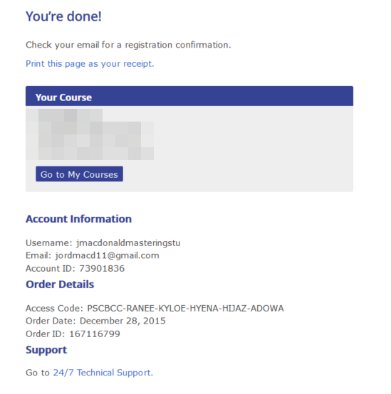
Step 6: Registration Confirmation
Congratulations, you are now registered in Mastering! One last step to make sure you are registered into your professor’s course.

Slide 9
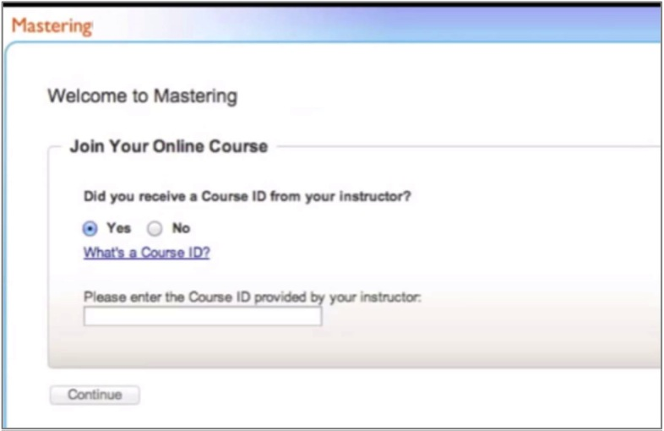
Step 7: Join Your Course
If your professor has given you a course ID, select ‘Yes’
Congratulations, you are now registered into your professor’s course!

Slide 10
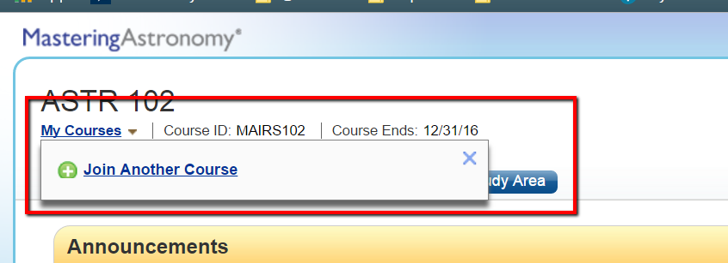
Make sure you are in the right course id

Slide 11
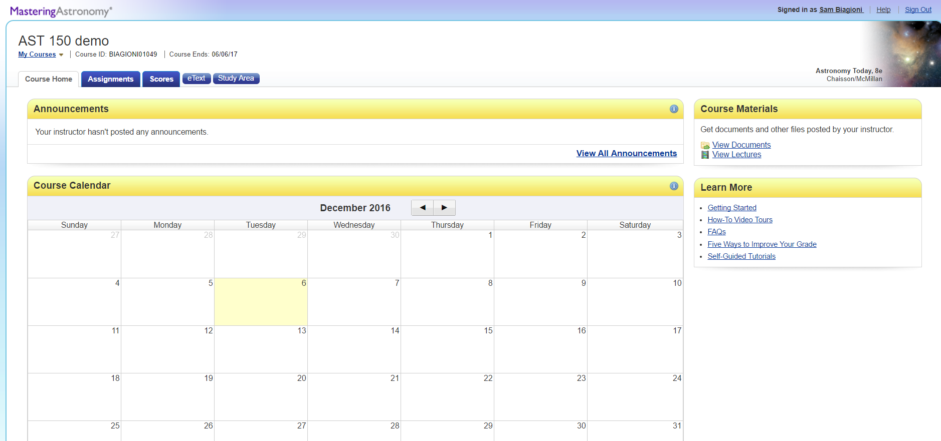
Step 8: Start Learning
Click etext to access online book (for those who purchased the book package
Click Study Area to access online resources
Use the Assignment Calendar to access assignments your instructor has assigned.

Slide 12
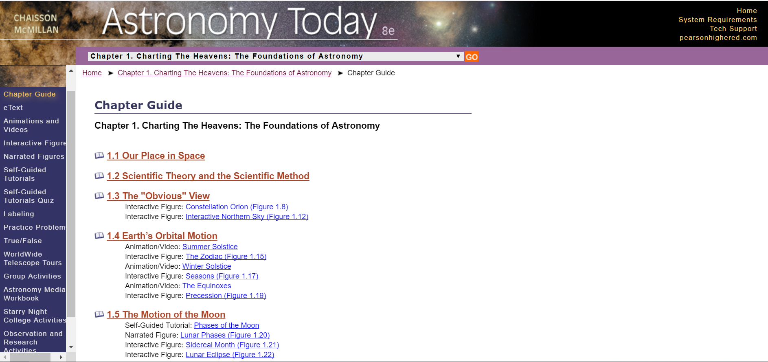
Study Area Features:
Self-guided tutorials with follow-up quizzes
Interactive Figures
Solo and Group activities
Practice problems
More…

Slide 13
Need Help?
Contact Pearson 24/7 Support:
https://support.pearson.com/getsupport
Watch this video to see how to register
Check out the PearsonStudents YouTube channel for tips on how MyLab and Mastering can help you
Stay in touch with us! Bookmark the Pearson Students Website http://pearsonstudents.com

