Slide 1
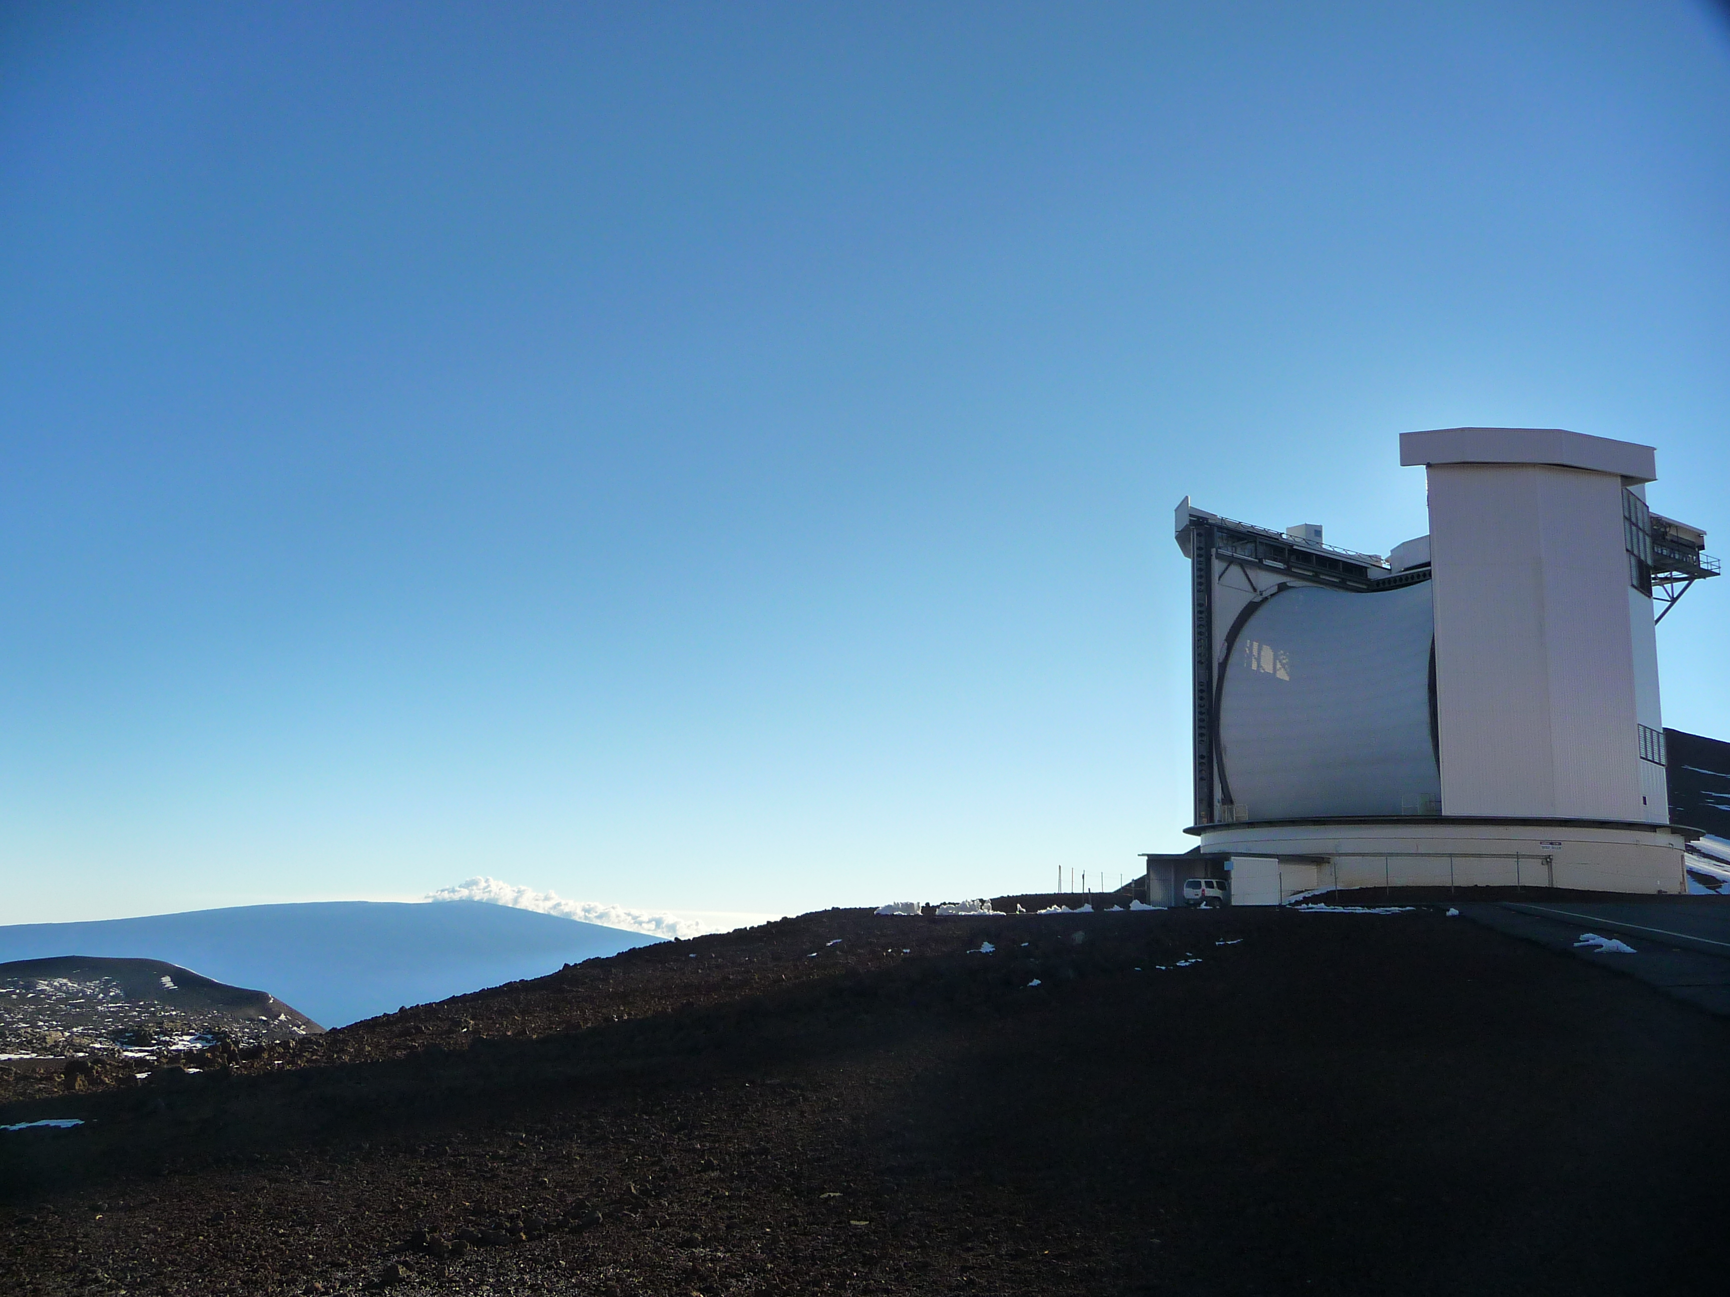
SCUBA-2: σ Orionis Star Cluster Deep Imaging
σ Orionis estimated age 0.5 Myr.
0.5º field contains 297 young stars.
8 proto-planetary disks detected.
- masses 5-16 M_{jup}
3 non-stellar sources, likely SMGs.
Stacking up all non-detections reveals excess emission.
- mean mass
~ 0.5 M_{jup}
Comparison with much younger Taurus star cluster indicates significant disk mass evolution.
SCUBA-2
850
31hrs –> 2.9 mJy/bm
Williams et al. 2013, ApJ.

Slide 2
SCUBA-2: Cosmology Legacy Survey Blank Field
SCUBA-2
450
Herschel
500
140 arcmin² HST-Candles Blank Field, observed to 1.3 mJy at 450 μm.
60 SMGs identified with > 3.75σ -> directly resolve 16±7 percent of CIB.
Statistical stacking of 24μm emitters recovers an additional ~40 percent.
Average redshift of emitters is estimated to be <z> = 1.3.
Geach et al. 2013, MNRAS.

Slide 3
SCUBA-2: Mapping in the Perseus Molecular Cloud (B1)
Part of the Gould Belt JCMT Legacy Survey.
Images reveal importance of spatial resolution.
Disentangling dust properties (T_{d}, κ_{d}) requires both JCMT and Herschel observations.
Emissivity power-law, β, found to vary with density in region.
- β~2, moderate density
- β ~ 1.6, high density
Herschel: 160 , 500 μm.
SCUBA-2: 450 ,850 μm.
Sadavoy et al. 2013, ApJ

Slide 4
RxA: Correlating In-fall and Fractionation in Pre-Stellar Cores
Kinematic HCO⁺ (3-2) 267.6 GHz survey of 26 dense cores with previous [D/H] measurements.
Five exhibit inward motion, eleven outward motion, and nine ambiguous.
Comparing motion against [D/H] reveals that [D/H] >1 correlates well with infall (likely an evolutionary effect).
Strong correlation of infall with gravitational (in)stability of cores (Jeans mass comparison).
Schnee et al. 2013, ApJ

Slide 5
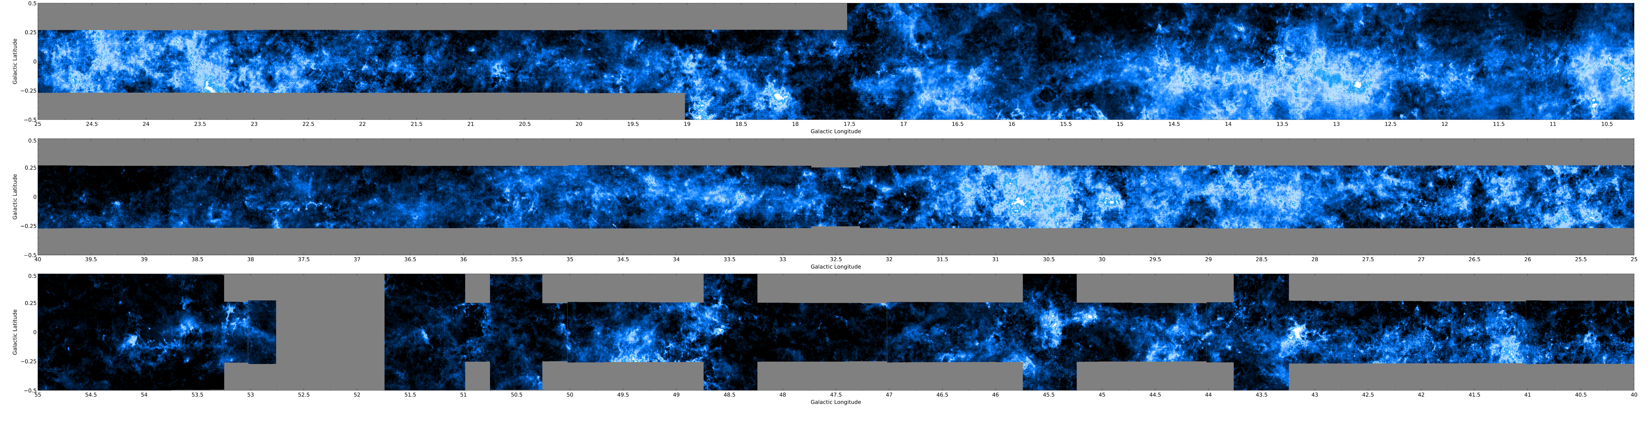
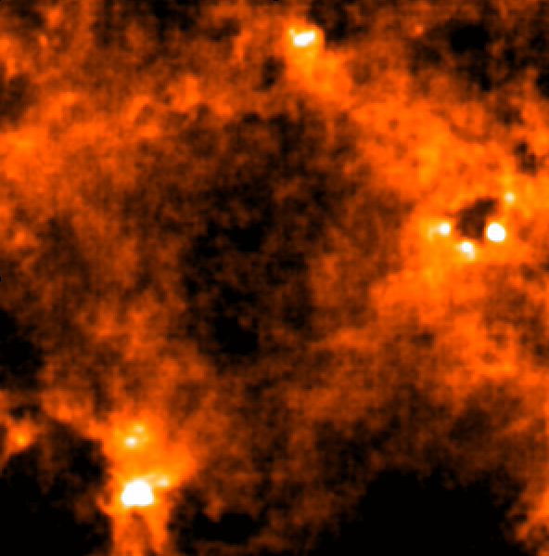
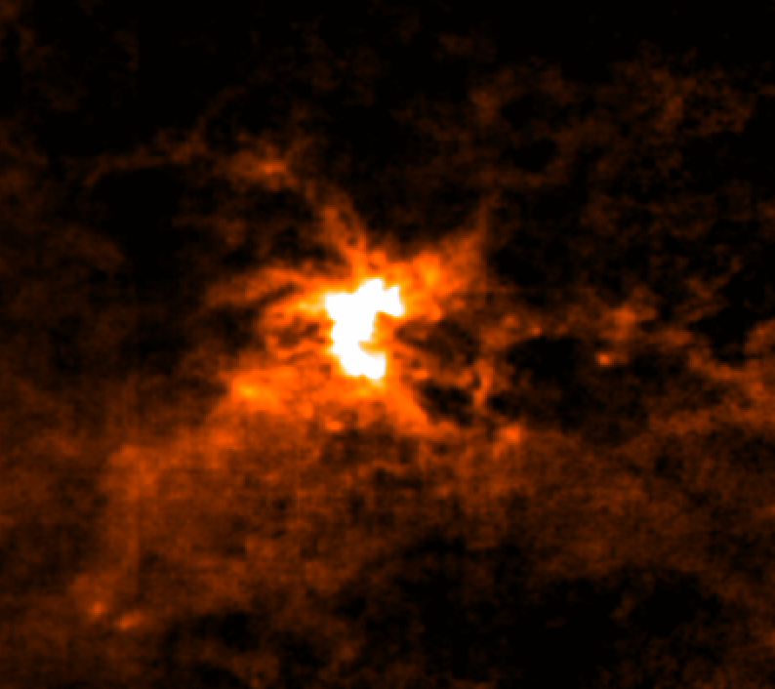
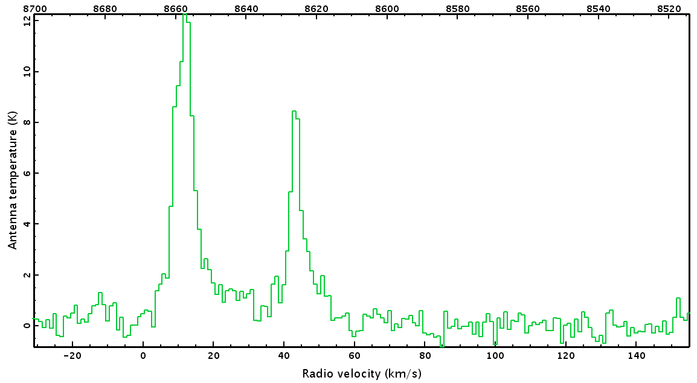
HARP: CO High Resolution Survey of Galactic Plane (COHRS)
Map of ¹²CO (3-2) covering over 25 square degrees of the Galactic Plane (10º < l < 55º).
Reduced data products are publicly available through VO-Space at CADC as 0.5º tiles :
- PPV data cubes smoothed to 1km/s resolution
- Integrated intensity maps, clipped at 3σ
- L-V maps (cubes collapsed over latitude)
Dempsey et al. 2013, ApJS

Slide 6
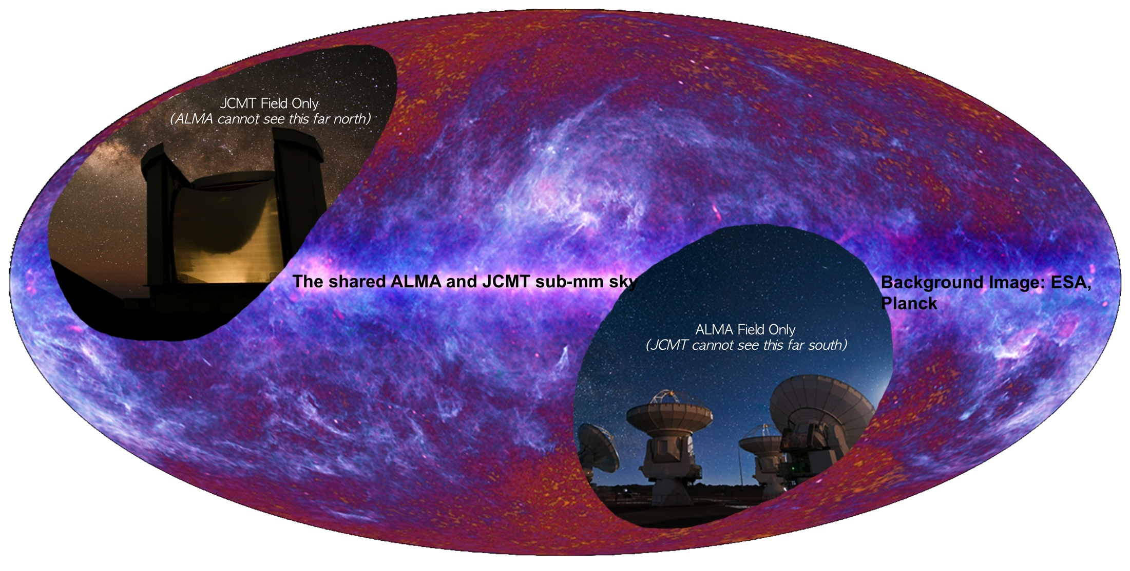
The JCMT in an ALMA Era
Portion of the Universe accessible to both ALMA and the JCMT.
Fields of View: ALMA (yellow) JCMT: SCUBA-2 (red)

Slide 7
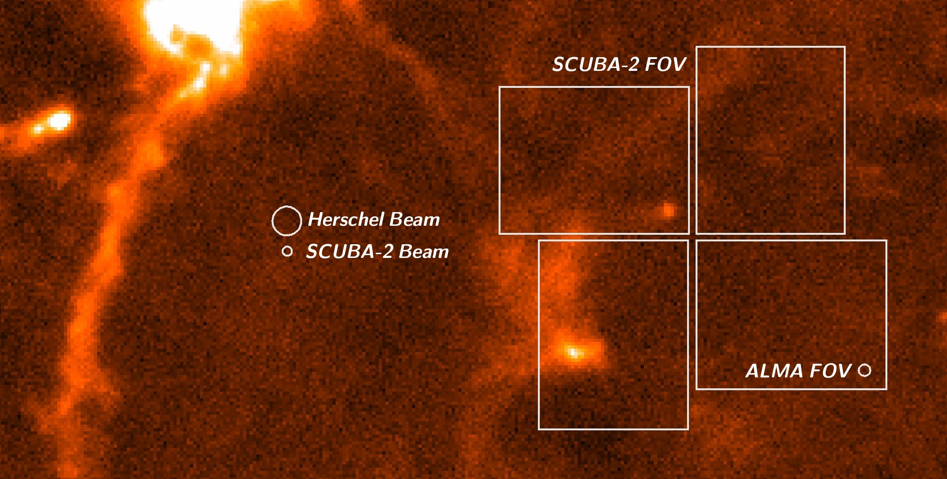
The JCMT in an ALMA Era
Beam size and Field of View for JCMT:SCUBA-2 and Herschel 500 micron
Fields of View: ALMA (yellow) JCMT: SCUBA-2 (red)

