Slide 1
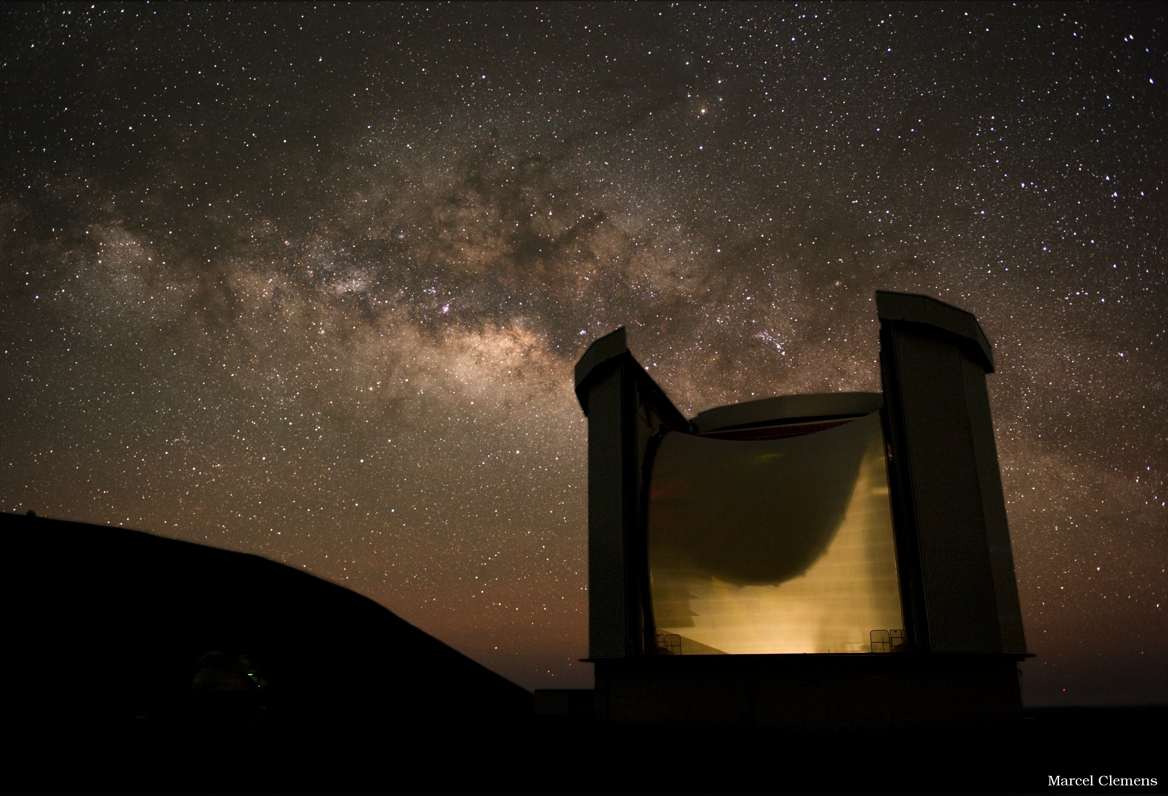
The Future of the
James Clerk Maxwell Telescope
Observing the Present and the Past
Doug Johnstone:
-Associate Director, JCMT
-Senior Astronomer, NRC-Herzberg
-Associate Professer, U. Victoria, Canada

Slide 2
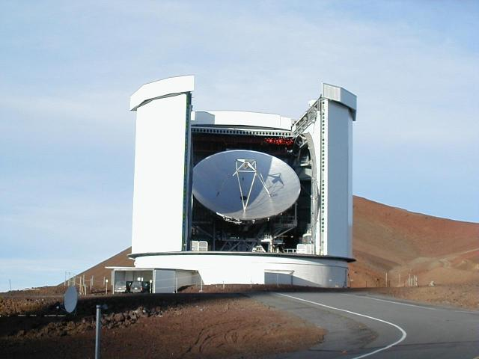
Early Scientific Success

Slide 3
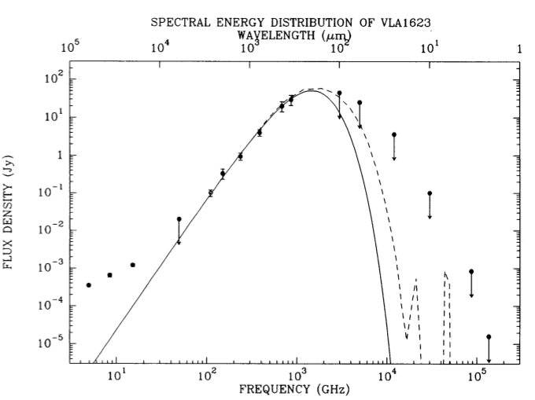
Deeply Embedded Protostars:
The earliest stage (Class 0) of star formation
VLA 1623 SED by
Andre et al. 1993
- UKT14 (single bolometer)

Slide 4
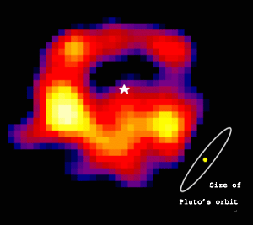
Dusty Debris Disks:
The connection between disks and planets
Epsilon Eridani by
Greaves et al. 1998
- SCUBA (128 bolometers, 450/850μm)

Slide 5
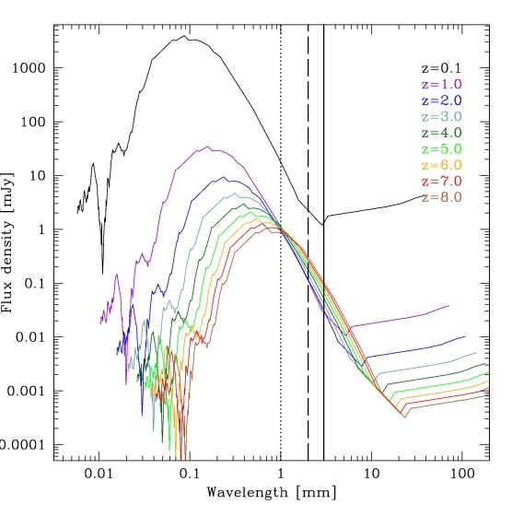
Sub-Millimeter Galaxies (SMGs):
The Source of the Cosmic Infrared Background
Hubble Deep Field by
Hughes et al. 1999
SCUBA (128 bolometers, 450/850μm)
Over 1000 citations!

Slide 6
The Role of Filaments:
From Clouds to Pre/Proto-stellar cores
Orion A: OMC 1,2,3, and 4 by
Johnstone & Bally 1999
- SCUBA (128 bolometers, 450/850μm)

Slide 7
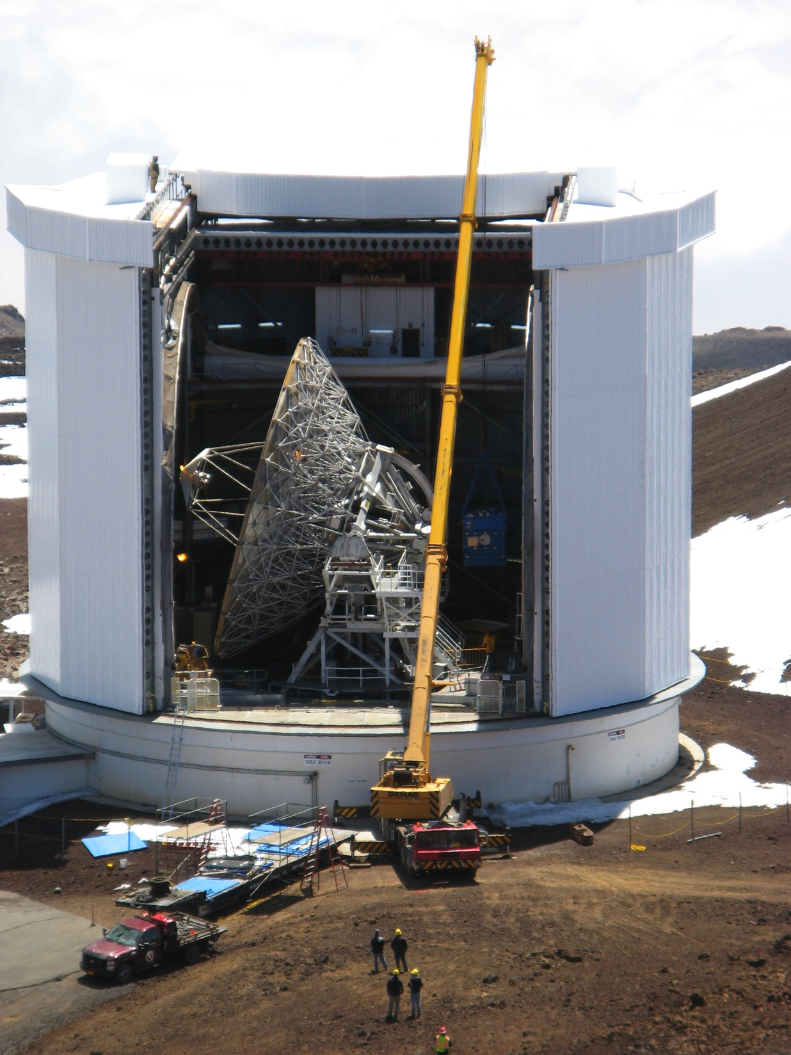
Transformation: Instrument Advances
Upgrades to both continuum and heterodyne instruments
SCUBA-2 (850 and 450 microns)
  Larger arrays
  increased field of view
  greater sensitivity
HARP (325-375 GHz Receiver)
  Many more spectral channels
  16 receptors (4x4 grid)

Slide 8
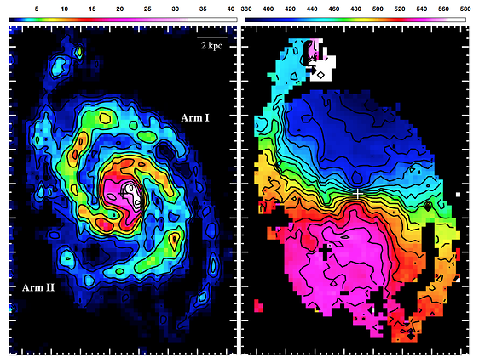
Molecular line strength and Galaxy Kinematics
M51 – CO 3-2 map by
Vlahakis et al 2013
HARP (16-receptors)

Slide 9
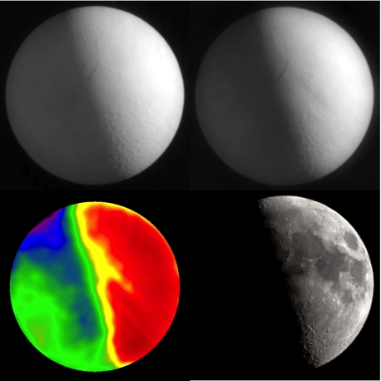
SCUBA-2 Test Observations
Temperature of Lunar Surface
Top: Left 450μm; Right 850μm
Bottom: Left Temp map; Visible Image
- SCUBA-2 (10,000 pixels, 450/850μm)

Slide 10
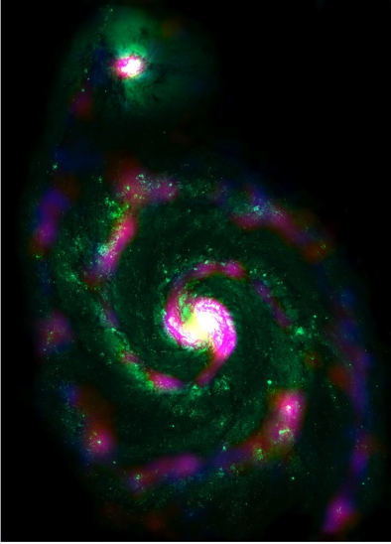
Dust temperature and location
Nearby Galaxies Survey – M51
Wilson, Israel, and the NGLS 2012
- SCUBA-2 (red: 850μm, blue: 450μm)
- HST (green)

Slide 11
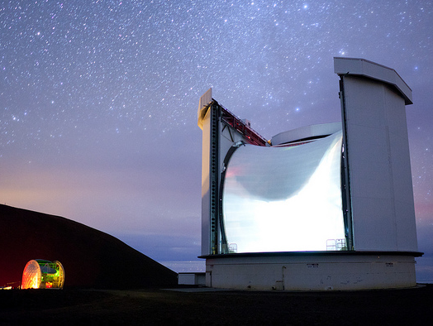
Recent Scientific Success

Slide 12
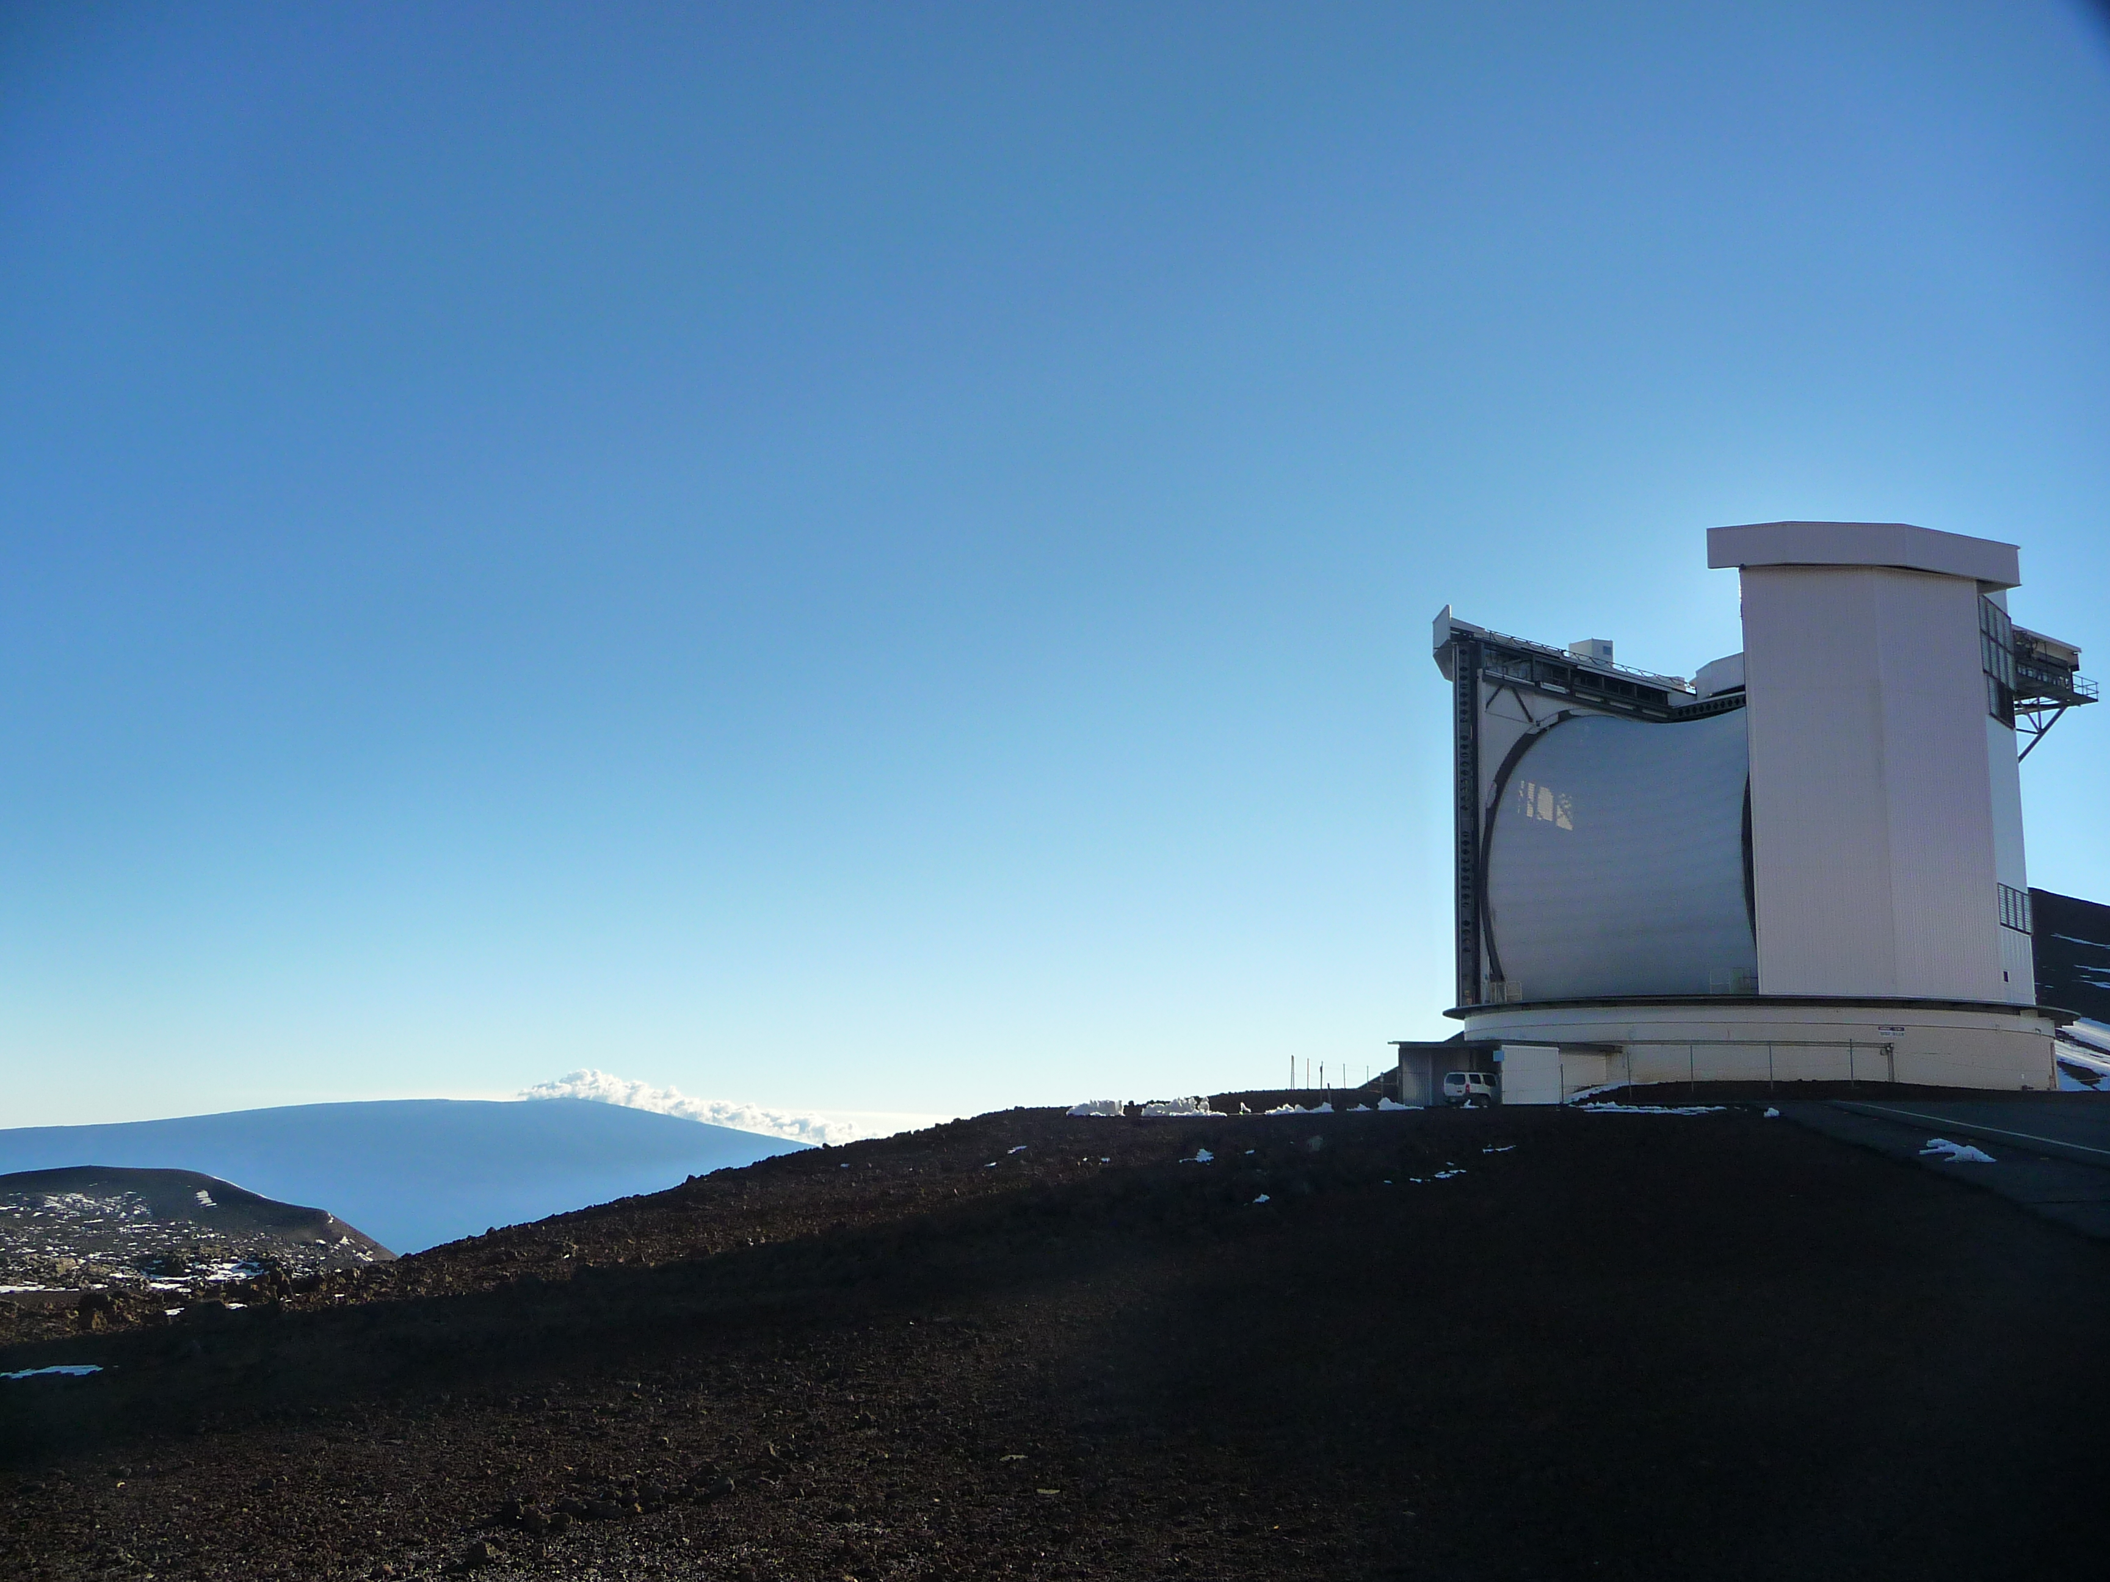
SCUBA-2: σ Orionis Star Cluster Deep Imaging
σ Orionis estimated age 0.5 Myr.
0.5º field contains 297 young stars.
8 proto-planetary disks detected.
- masses 5-16 M_{jup}
3 non-stellar sources, likely SMGs.
Stacking up all non-detections reveals excess emission.
- mean mass
~ 0.5 M_{jup}
Comparison with much younger Taurus star cluster indicates significant disk mass evolution.
SCUBA-2
850
31hrs –> 2.9 mJy/bm
Williams et al. 2013, ApJ.

Slide 13
SCUBA-2: Cosmology Legacy Survey Blank Field
SCUBA-2
450
Herschel
500
140 arcmin² HST-Candles Blank Field, observed to 1.3 mJy at 450 μm.
60 SMGs identified with > 3.75σ -> directly resolve 16±7 percent of CIB.
Statistical stacking of 24μm emitters recovers an additional ~40 percent.
Average redshift of emitters is estimated to be <z> = 1.3.
Geach et al. 2013, MNRAS.

Slide 14
SCUBA-2: Mapping in the Perseus Molecular Cloud (B1)
Part of the Gould Belt JCMT Legacy Survey.
Images reveal importance of spatial resolution.
Disentangling dust properties (T_{d}, κ_{d}) requires both JCMT and Herschel observations.
Emissivity power-law, β, found to vary with density in region.
- β~2, moderate density
- β ~ 1.6, high density
Herschel: 160 , 500 μm.
SCUBA-2: 450 ,850 μm.
Sadavoy et al. 2013, ApJ

Slide 15
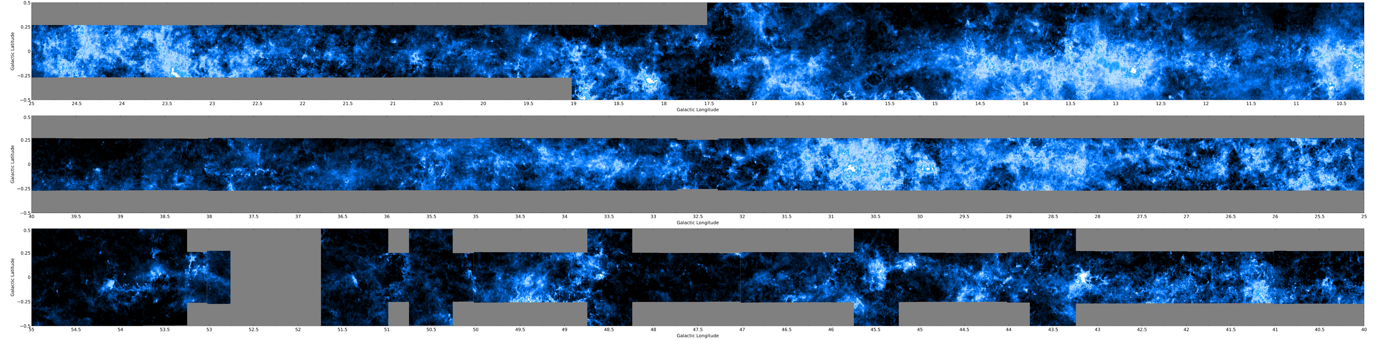
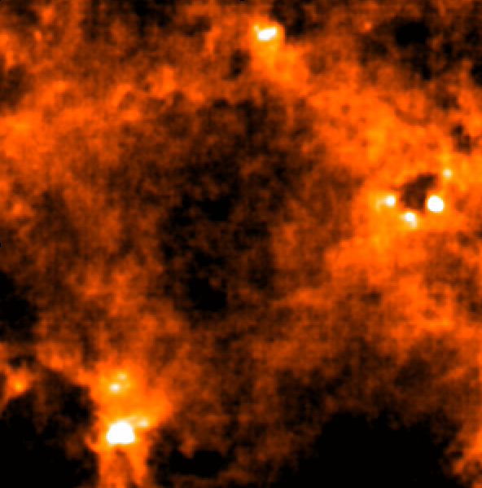
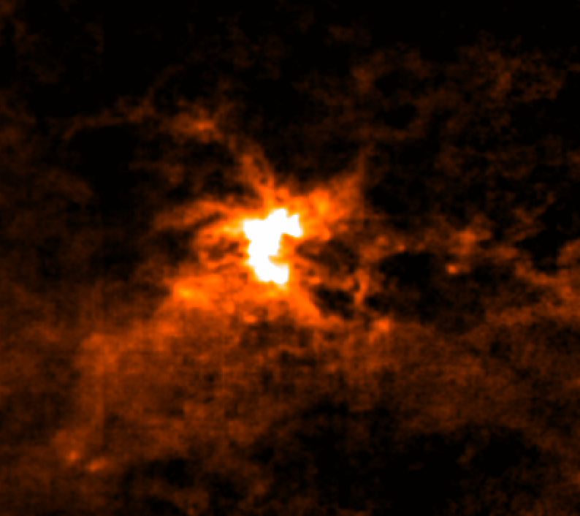
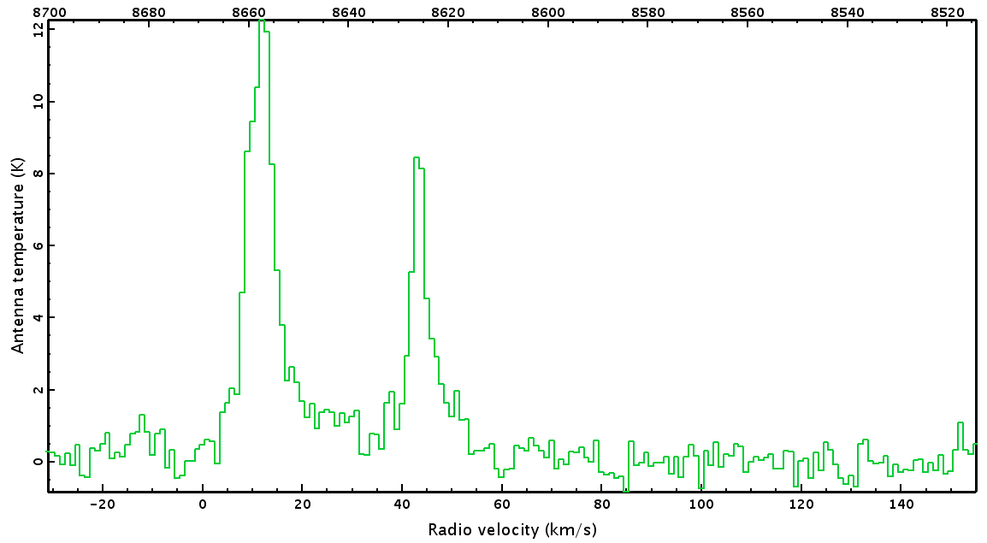
HARP: CO High Resolution Survey of Galactic Plane (COHRS)
Map of ¹²CO (3-2) covering over 25 square degrees of the Galactic Plane (10º < l < 55º).
Reduced data products are publicly available through VO-Space at CADC as 0.5º tiles :
- PPV data cubes smoothed to 1km/s resolution
- Integrated intensity maps, clipped at 3σ
- L-V maps (cubes collapsed over latitude)
Dempsey et al. 2013, ApJS

Slide 16
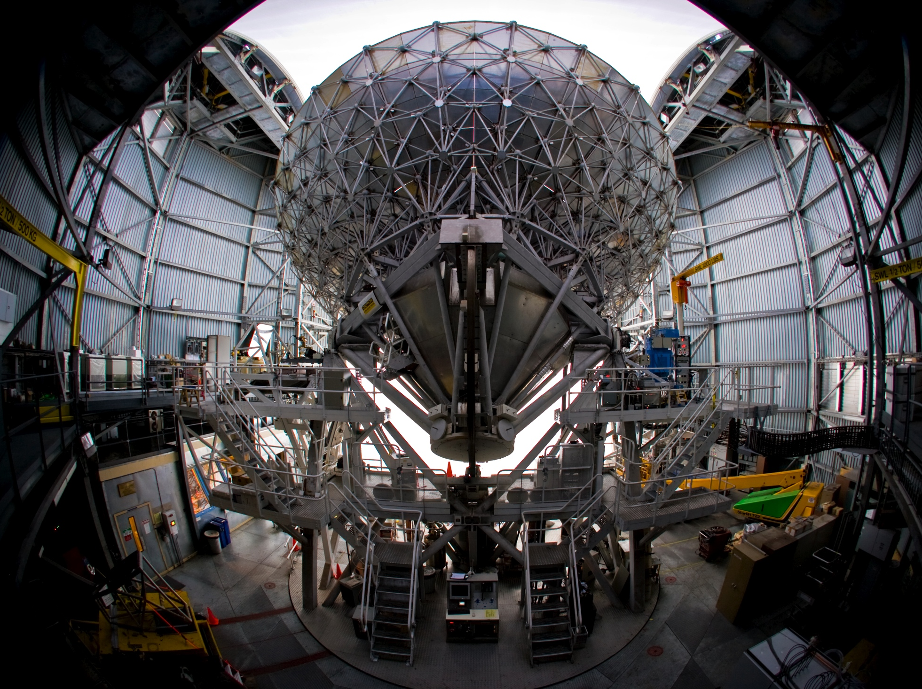
Future Directions

Slide 17
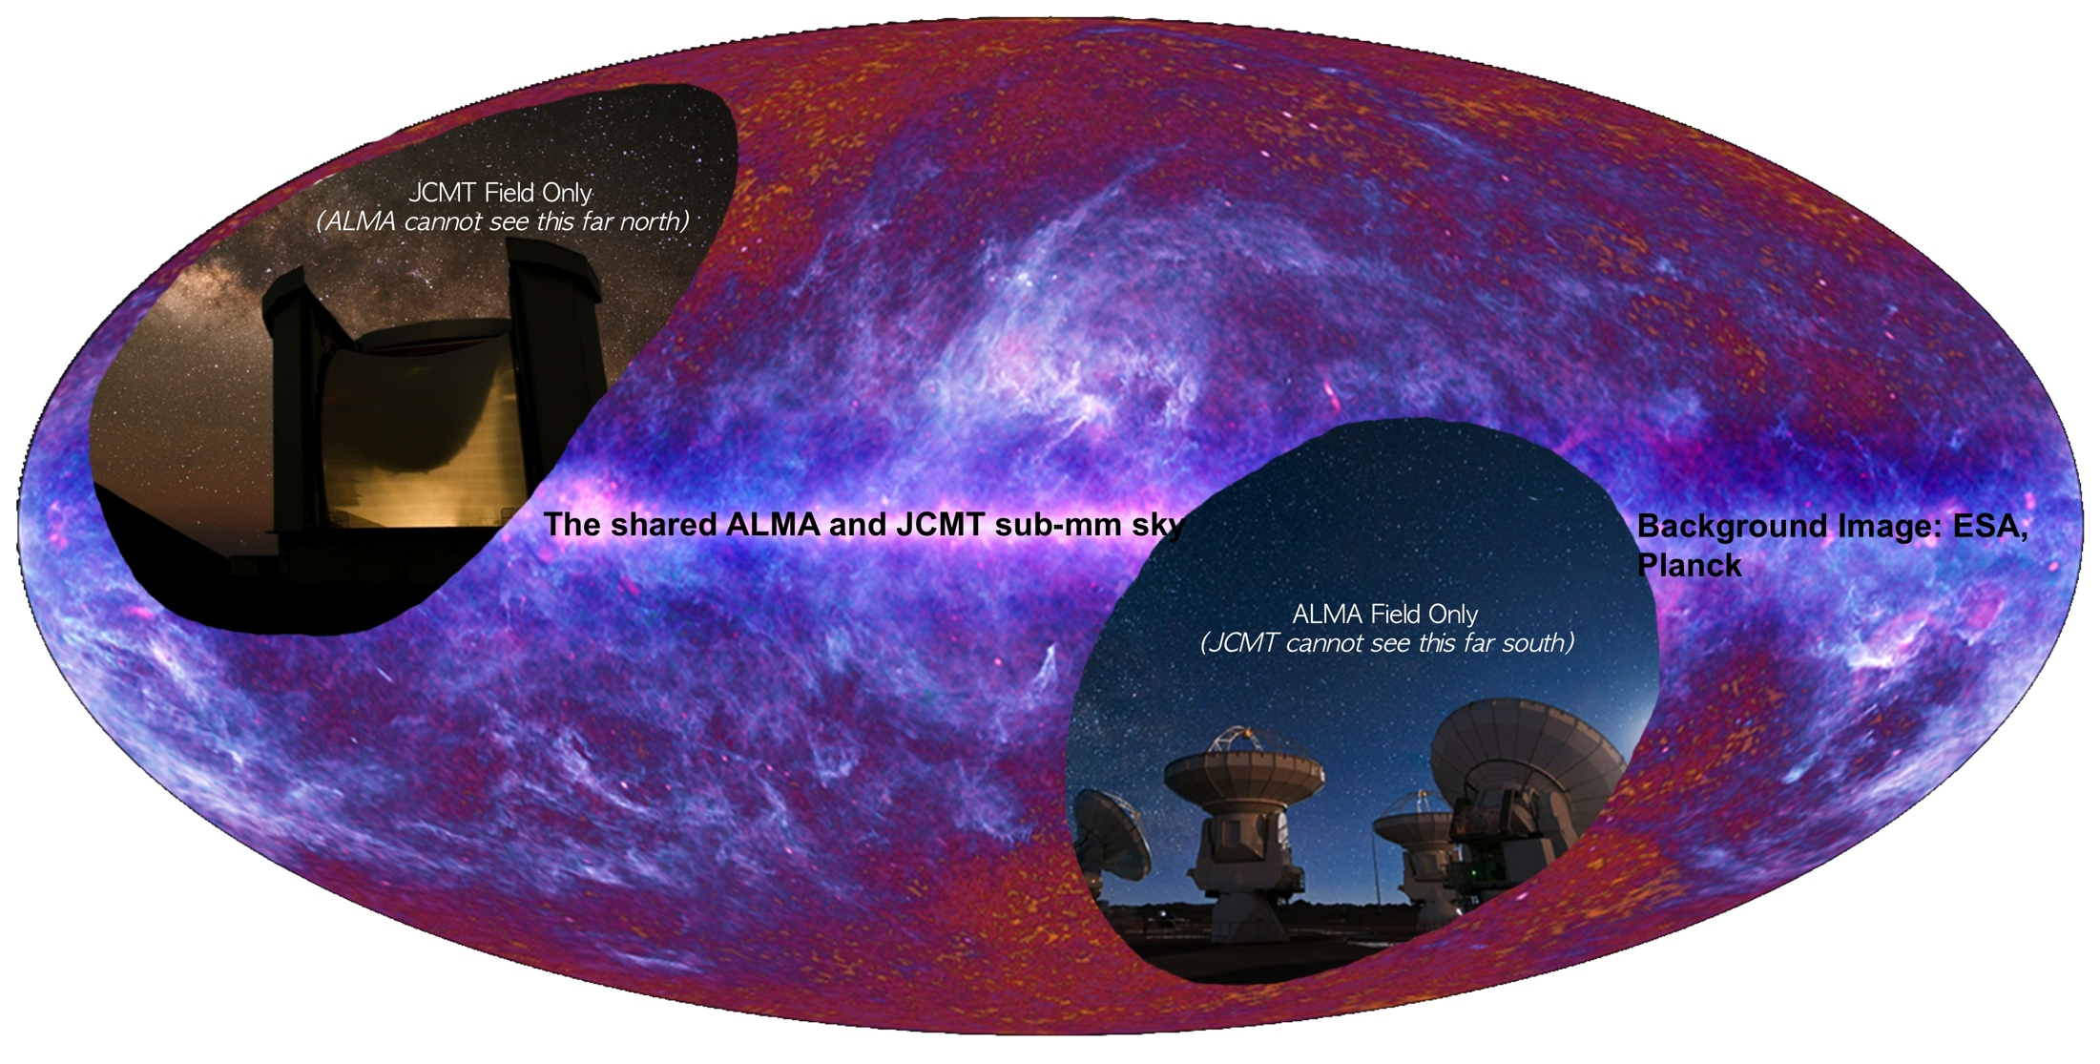
The JCMT in an ALMA Era
Portion of the Universe accessible to both ALMA and the JCMT.
Fields of View: ALMA (yellow) JCMT: SCUBA-2 (red)

Slide 18
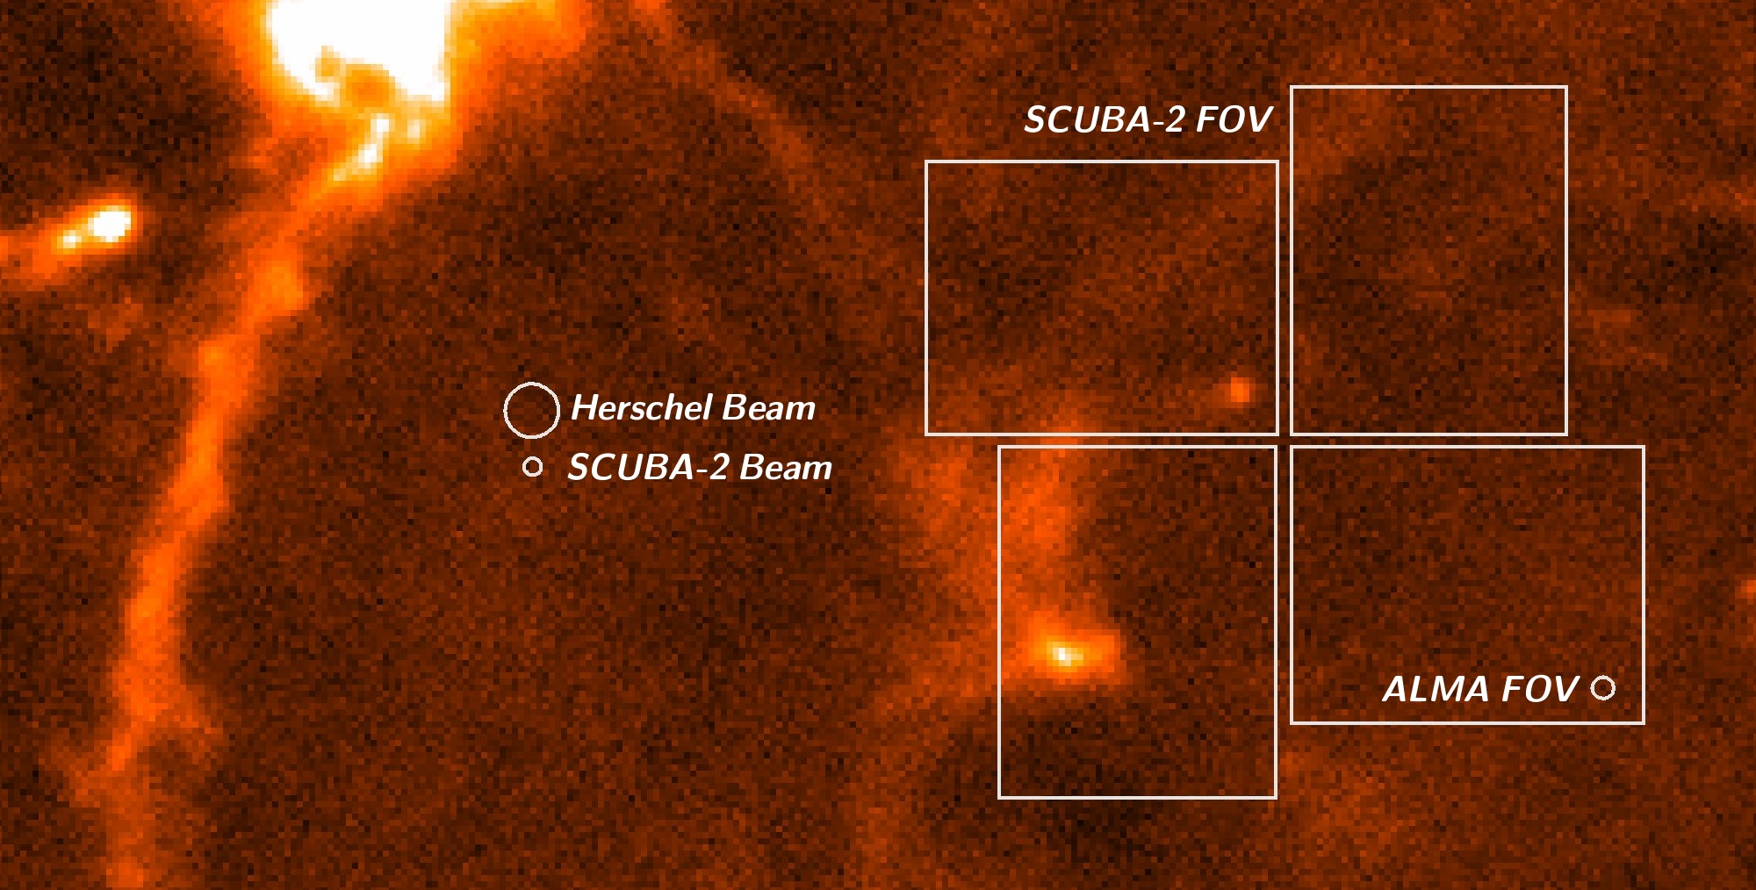
The JCMT in an ALMA Era
Beam size and Field of View for JCMT:SCUBA-2 and Herschel 500 micron
Fields of View: ALMA (yellow) JCMT: SCUBA-2 (red)

Slide 19
Enhanced Legacy Surveys
All of the Legacy Surveys planned for 5 years of operations rather than 2 years.
Only significantly scaled back science goals will have been completed by September 2014.
Legacy teams in Canada and UK hope to complete these surveys through participation in continued operations.
With knowledge gained from Herschel and the start-up of ALMA, these surveys should undoubtedly be augmented by a new round of submissions.
There is also a great deal of room for new and improved instrumentation influencing science.
Plenty of opportunity for scientific
collaboration within a new JCMT partnership.

Slide 20
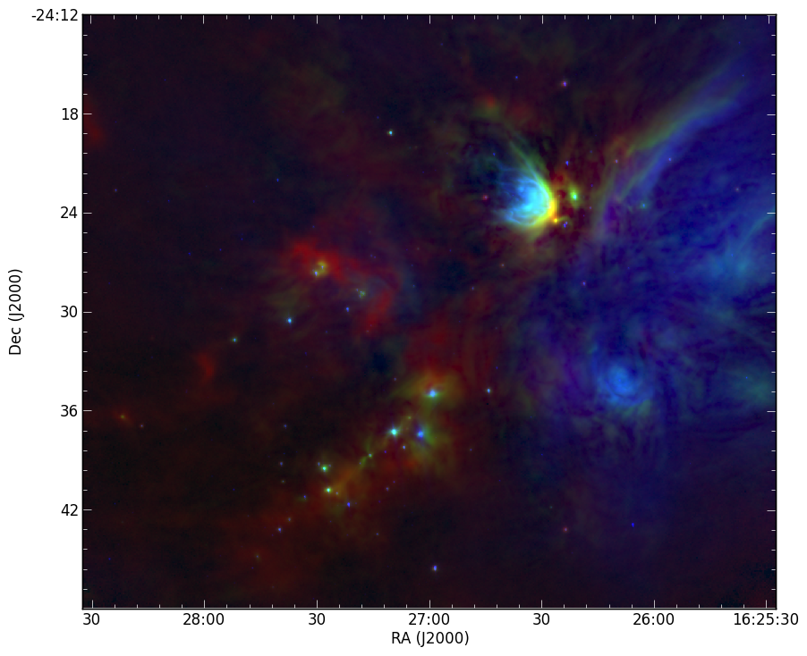

Slide 21
Fin

Slide 22
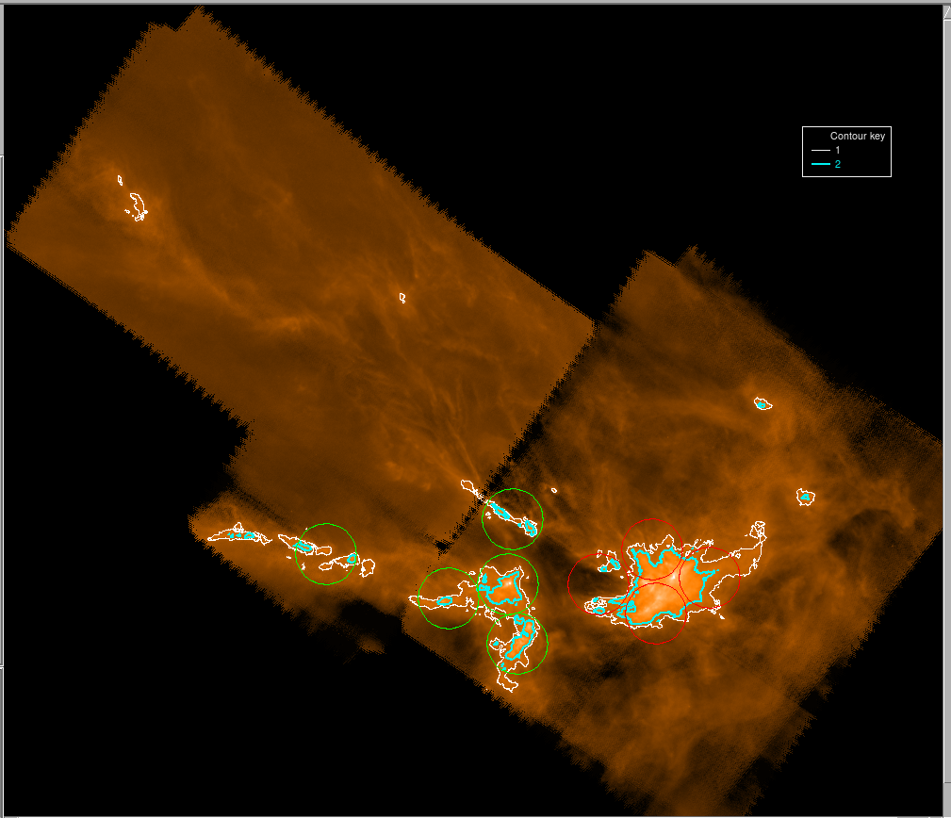

Slide 23
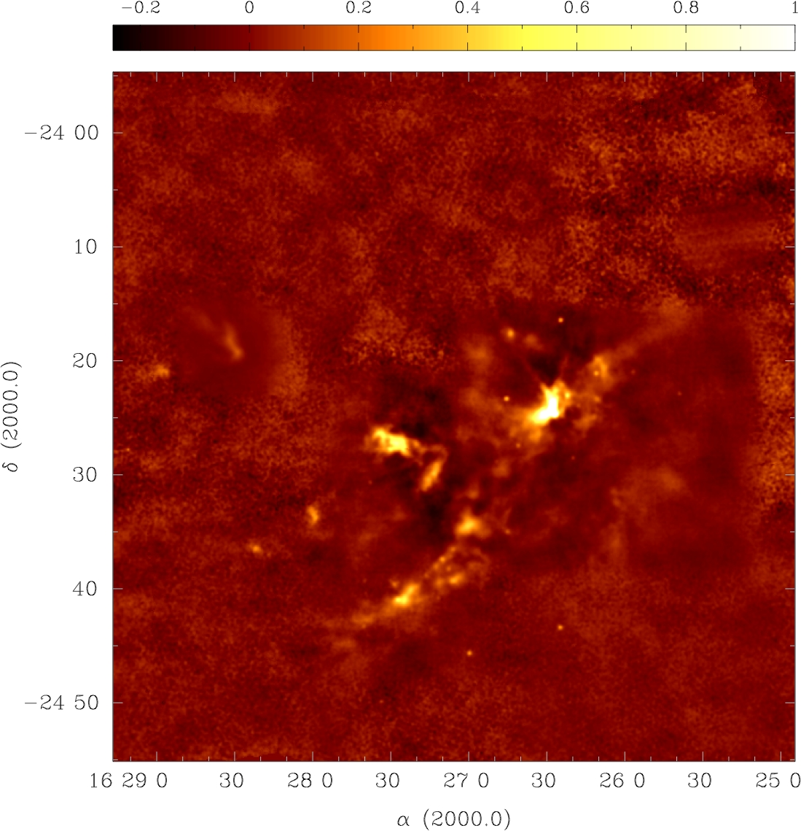
Surveys of Star Forming Regions:
The location and extent of star formation
Ophiuchus – 1 sq. degree field
From the Legacy Catalogue by
Di Francesco, Johnstone et al 2008
- SCUBA (128 bolometers, 450/850μm)

Slide 24
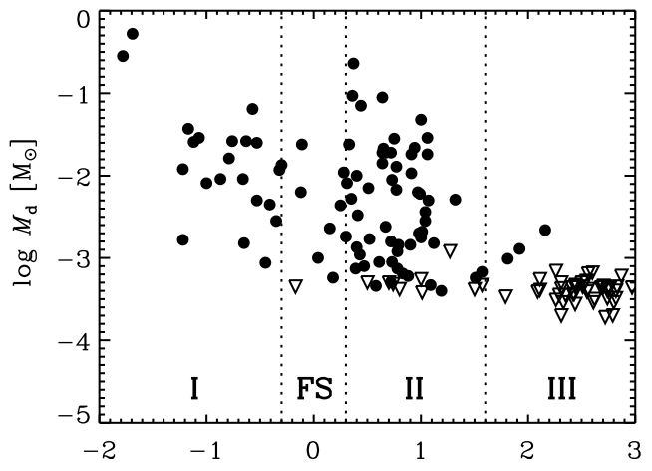
Surveys of stellar Disks:
Timescale for disk dispersal (planet formation)
Disk Mass Evolution in Taurus-Auriga by Andrews and Williams 2005
- SCUBA (450/850μm)

Slide 25
Surveys of Deep Cosmological Fields:
Source density and clustering
Deep Map – 1/4 sq. degree
From the SHADES Consortium
Coppin et al 2006
- SCUBA (128 bolometers, 450/850μm)

Slide 26
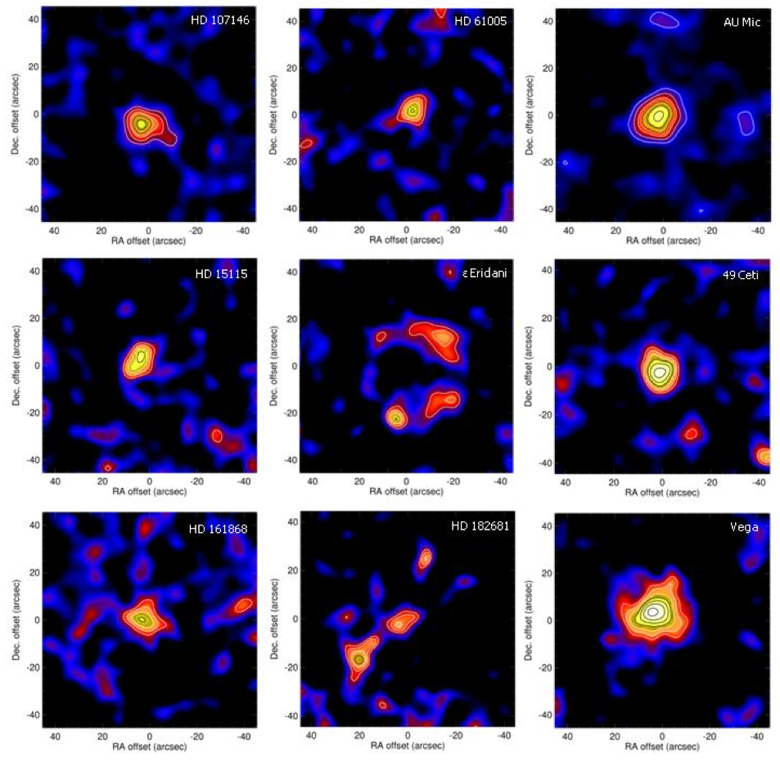
Legacy Surveys of Dusty Debris Disks
Rogues Gallery from SONS
Holland, Matthews, Greaves and the SONS Team, 2012
- SCUBA-2

Slide 27
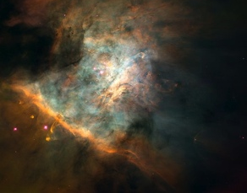
Probing Astrochemistry and Physical Conditions
H₂CO
Orion Bar as part of the Spectral Line Survey
HARP
SO
C₂H

Slide 28
RxA: Correlating In-fall and Fractionation in Pre-Stellar Cores
Kinematic HCO⁺ (3-2) 267.6 GHz survey of 26 dense cores with previous [D/H] measurements.
Five exhibit inward motion, eleven outward motion, and nine ambiguous.
Comparing motion against [D/H] reveals that [D/H] >1 correlates well with infall (likely an evolutionary effect).
Strong correlation of infall with gravitational (in)stability of cores (Jeans mass comparison).
Schnee et al. 2013, ApJ

