Slide 1
Dust to Disks to Planets with the JCMT
Doug Johnstone – Associate Director JCMT

Slide 2
JCMT Vital Statistics
First light 1987
Primary diameter 15m
Surface accuracy 22μm
Gore-Tex Membrane
Partnership (as of April 1, 2013)
Netherlands has withdrawn
Canada 25%
UK 75%
Over 100 Refereed Papers in 2012

Slide 3
Deeply Embedded (Class O) Protostars
VLA 1623 SED by
Andre et al. 1993
- UKT14 (single bolometer)

Slide 4
Surveys of Star Forming Regions
Ophiuchus Map – 1 sq. degree
From the Legacy Catalogue by
Di Francesco, Johnstone et al 2008
- SCUBA (128 bolometers, 450/850μm)

Slide 5
Legacy Surveys of Star Forming Regions
NGC1333 at 450/850μm + Sp. Index by
Hatchell and the GBS Team 2012
- SCUBA-2 (10240 bolometers, 450/850μm)

Slide 6
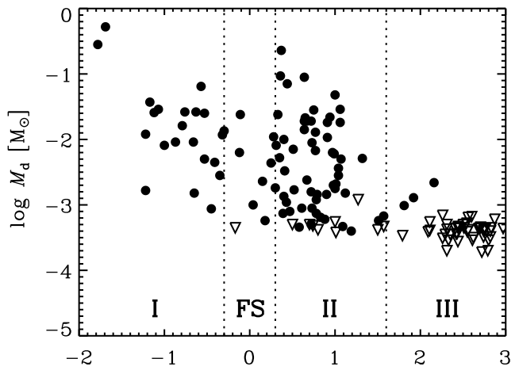
Surveys of YSO Disks
Disk Mass Evolution in Taurus-Auriga by Andrews and Williams 2005
- SCUBA

Slide 7
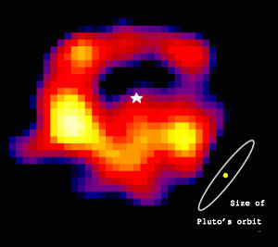
Images of Dusty Debris Disks
Epsilon Eridani by
Greaves et al. 1998
- SCUBA

Slide 8
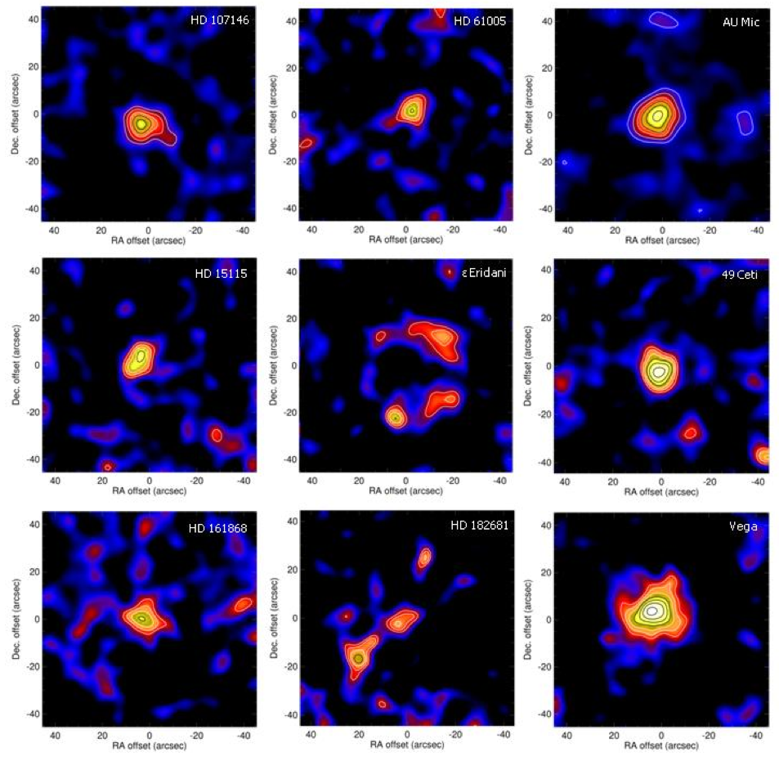
Legacy Surveys of Dusty Debris Disks
Rogues Gallery from SONS
Holland, Matthews, Greaves and the SONS Team, 2012
- SCUBA-2

Slide 9
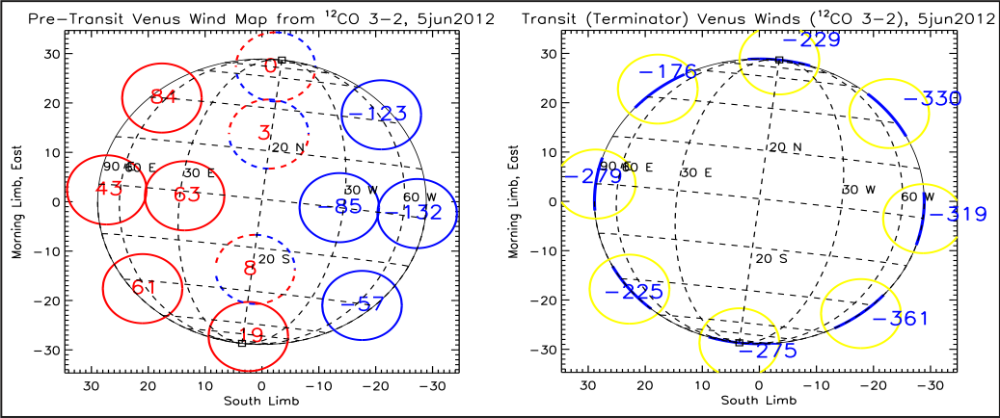
Planetary Atmospheres
Wind Speeds on Venus by
Sandor et al 2012
- HARP: 16 element 350 GHz heterodyne array
The JCMT has observed:
Atmospheres of many planets
Venus, Mars, Jupiter, Saturn, Uranus, Neptune, Pluto
Chemistry (SO, SO₂, CO, etc)
detection of CO in Neptune’s atmosphere (1993)
Temperatures, Phase Variations (day/night)

Slide 10
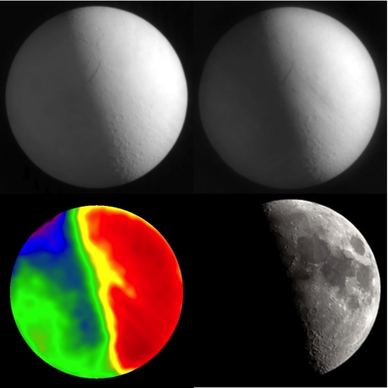
Lunar Surface
Temperature of Lunar Surface
Top: Left 450μm; Right 850μm
Bottom: Left Temp map; Visible Image
- SCUBA-2 Commissioning

Slide 11
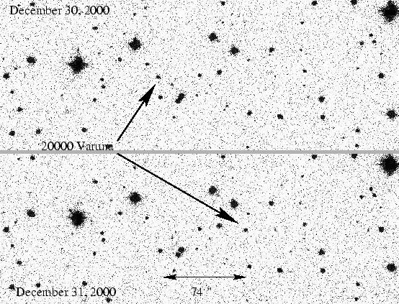
Kuiper Belt Object Sizes
R-band Image of KBO 20000 Varuna ~ 900km diameter
Aussel & Jewitt 2001
- SCUBA photometry estimate of size

Slide 12
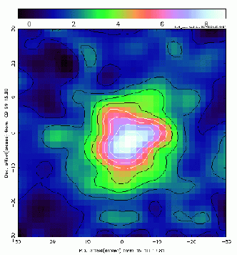
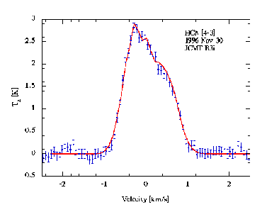
Comets
Left: HCN 4-3 map of Hale-Bopp
Right: HCN line profile fit with an outgassing model in which the rate of day to night emission is 3:1

Slide 13
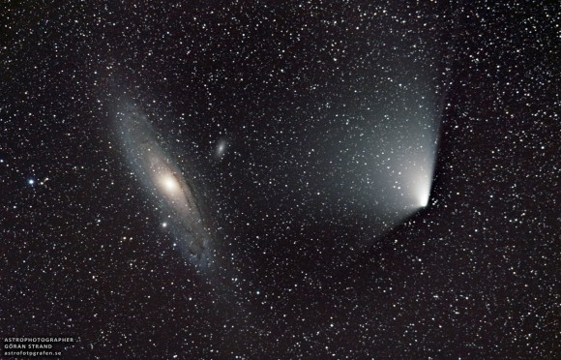
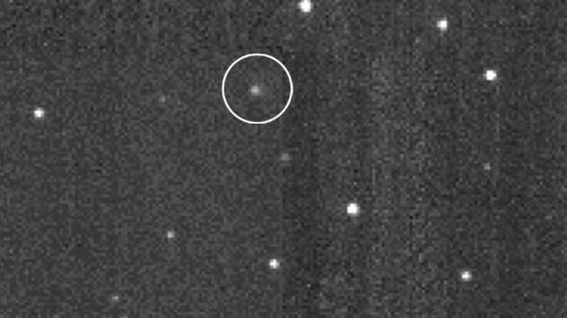
Comets Right Now
Observing L4 PanStarrs and anticipating the arrival of ISON ….
“Comets are like cats: they have tails and do whatever they want."

Slide 14
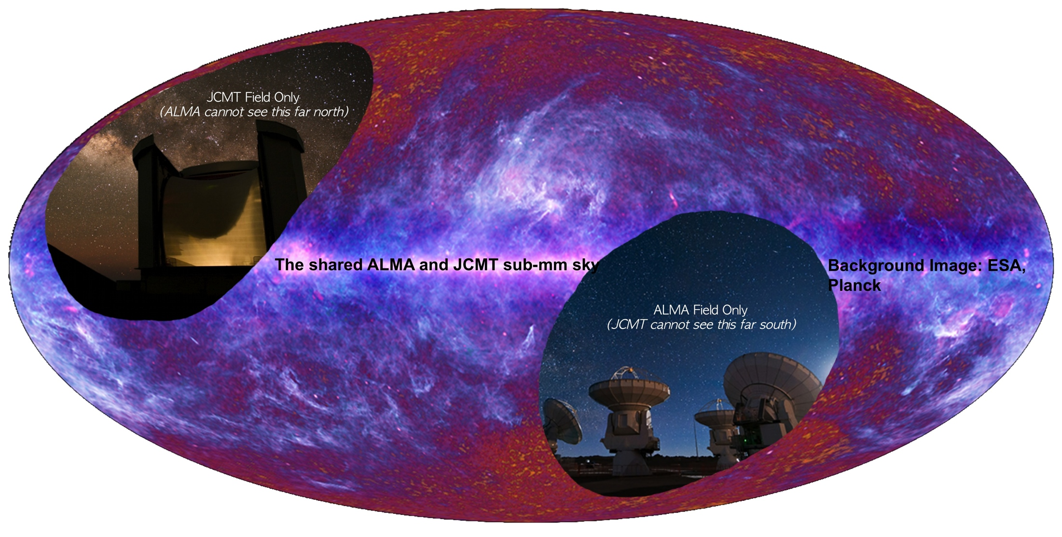
The JCMT in an ALMA Era
Portion of the Universe accessible to both ALMA and the JCMT.
Fields of View: ALMA (yellow) JCMT (red)

Slide 15
Location, Location, Location
one careful owner!
only driven at night, in benign conditions!
owner leaving town, must sell!
bargain price!
call for details …

