Slide 1
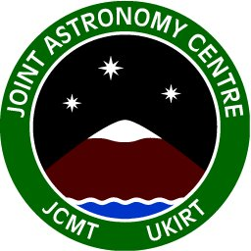
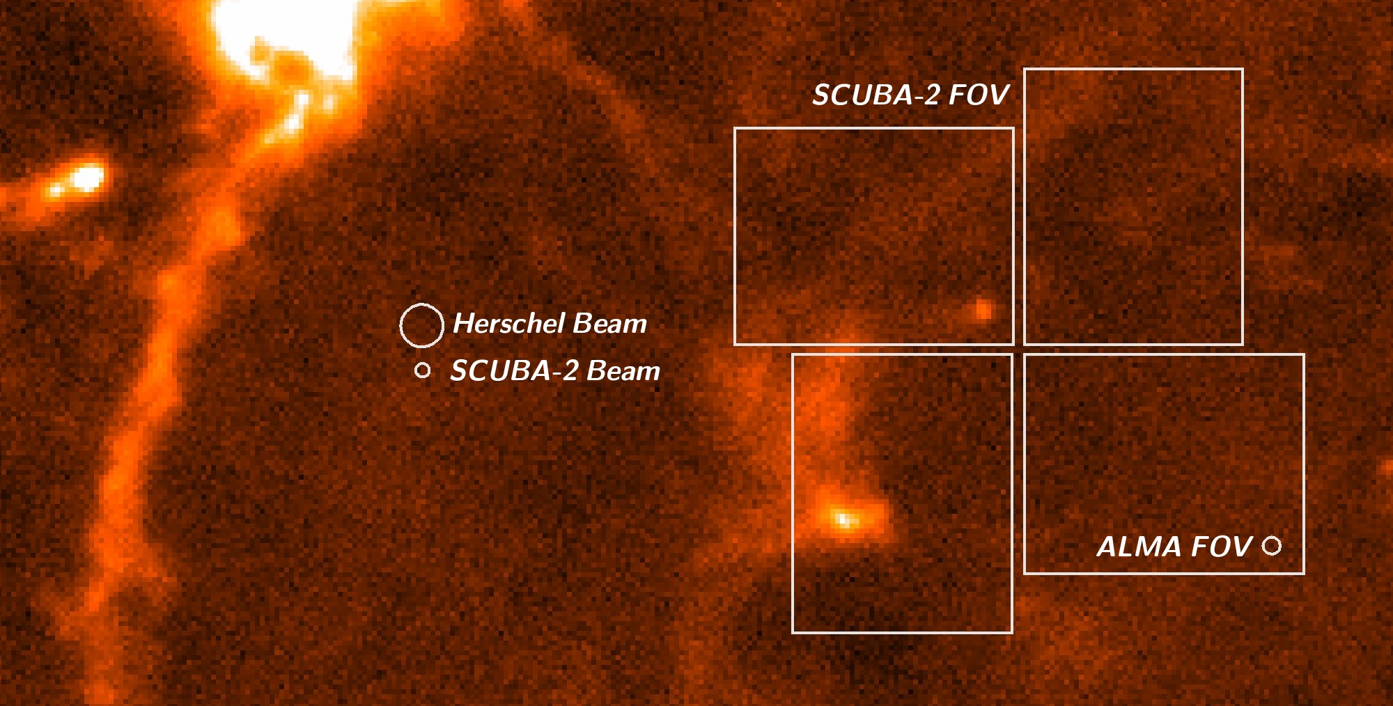
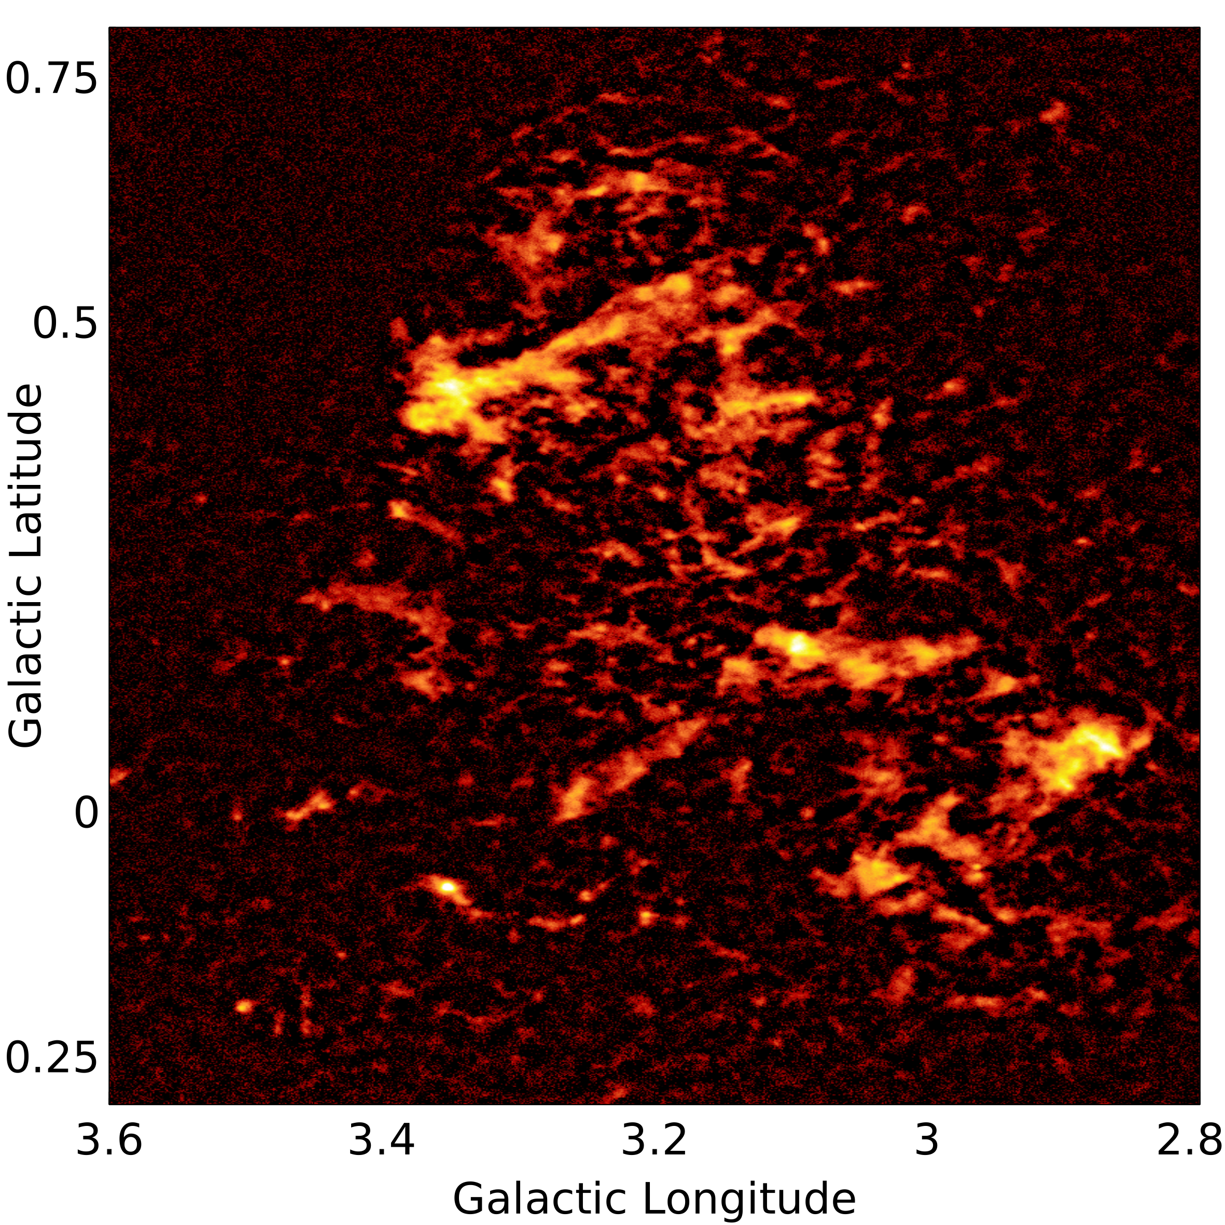
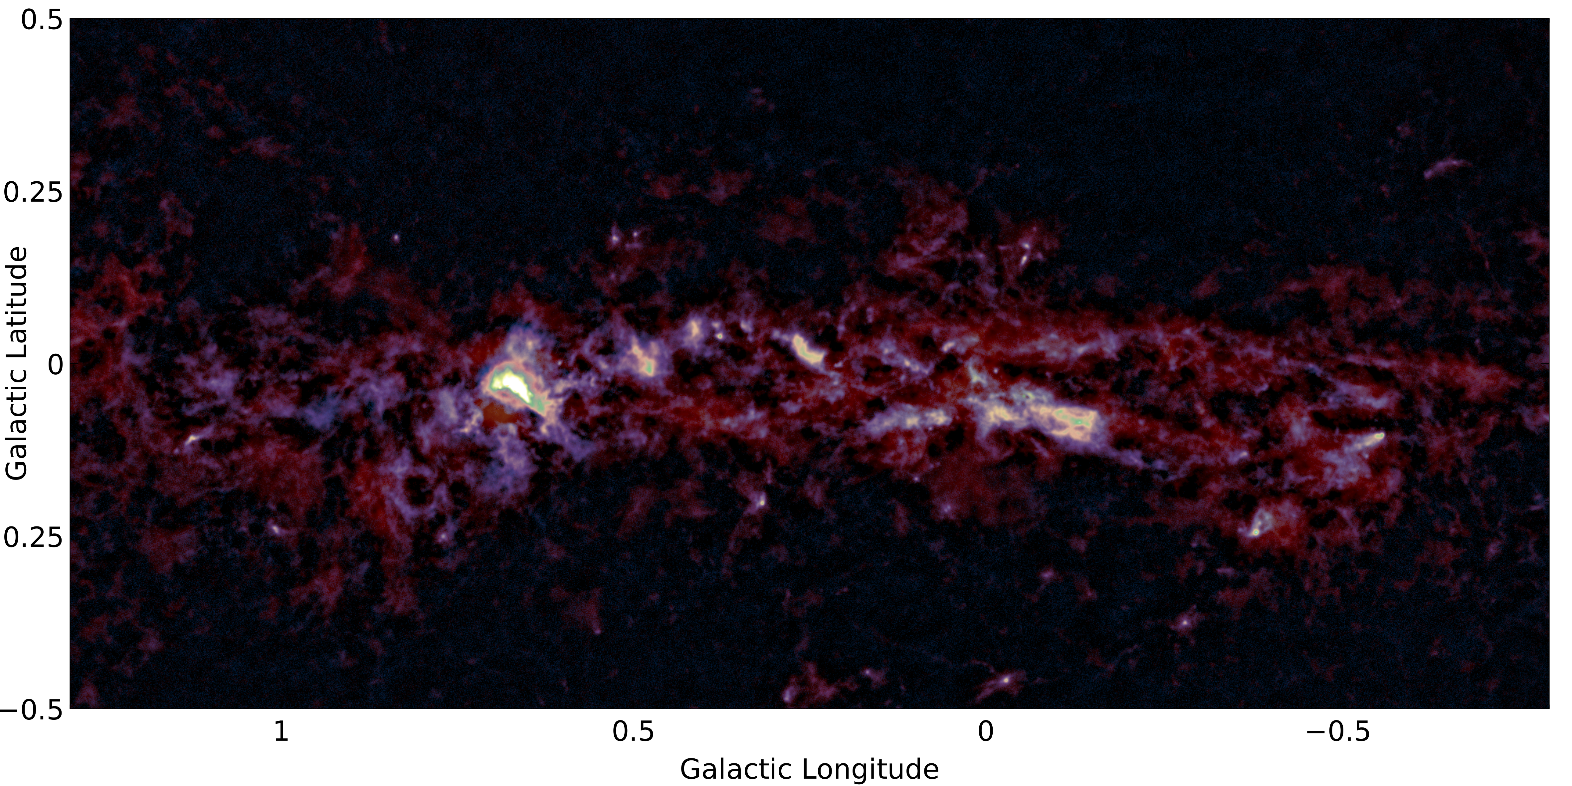
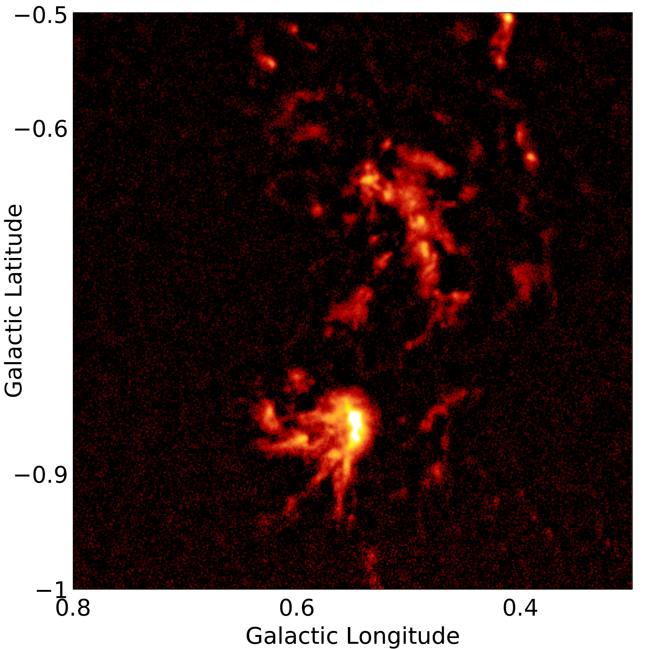
JCMT in the post-Herschel era of ALMA
The James Clerk Maxwell Telescope (JCMT), with a 15m dish, is the largest single-dish astronomical telescope in the world designed specifically to operate in the sub-mm wavelength regime. The JMT is located close to the summit of Mauna Kea, Hawaii, at an altitude of 4092m.
The most recent addition to the JCMT suite of instruments is the 10,000 bolometer sub-mm continuum instrument: SCUBA-2. SCUBA-2 operates simultaneously with 7’ x 7’ footprint sub-arrays at both 450 and 850-microns. The spatial resolution at 450-microns is 8 arcsec, matching well the field of view of ALMA and significantly smaller than the Herschel 500-micron beam size. SCUBA-2’s wide field surveying potential, combined with a 65% shared view from both sites (see figure directly below), makes it the ideal instrument to provide complementary data for the ALMA Project in this post-Hershel era.
The Cold Dust Galactic Centre as Seen by SCUBA-2. A 10 x 2 degree map of the Galactic Centre has been observed by astronomers at the JAC using SCUBA-2 at both 450 and 850-microns. The images are created by stitching together individual circular observations, each a degree in diameter. The final depth of the survey will be of the order of 15mJy at 850-microns.
Below: Two colour image of the central region of the Galactic Centre observed at 450-micron (blue) and 850-micron (red).
Right: 850-micron half degree images of two regions within the Galactic Centre obtained using SCUBA-2.
Above: The HARP spectral imaging instrument on JCMT is undertaking a high resolution (14”) CO (3-2) survey of the Galactic Plane (COHRs). This ambitious project is being observed during “poor” weather (Tau_{225GHz} > 0.12) and will include longitudes of 10-65 degrees to a depth of 1K. Currently the survey covers 25 square degrees and has taken 120 hours. Dempsey and Thomas (submitted 2013)

