Slide 1
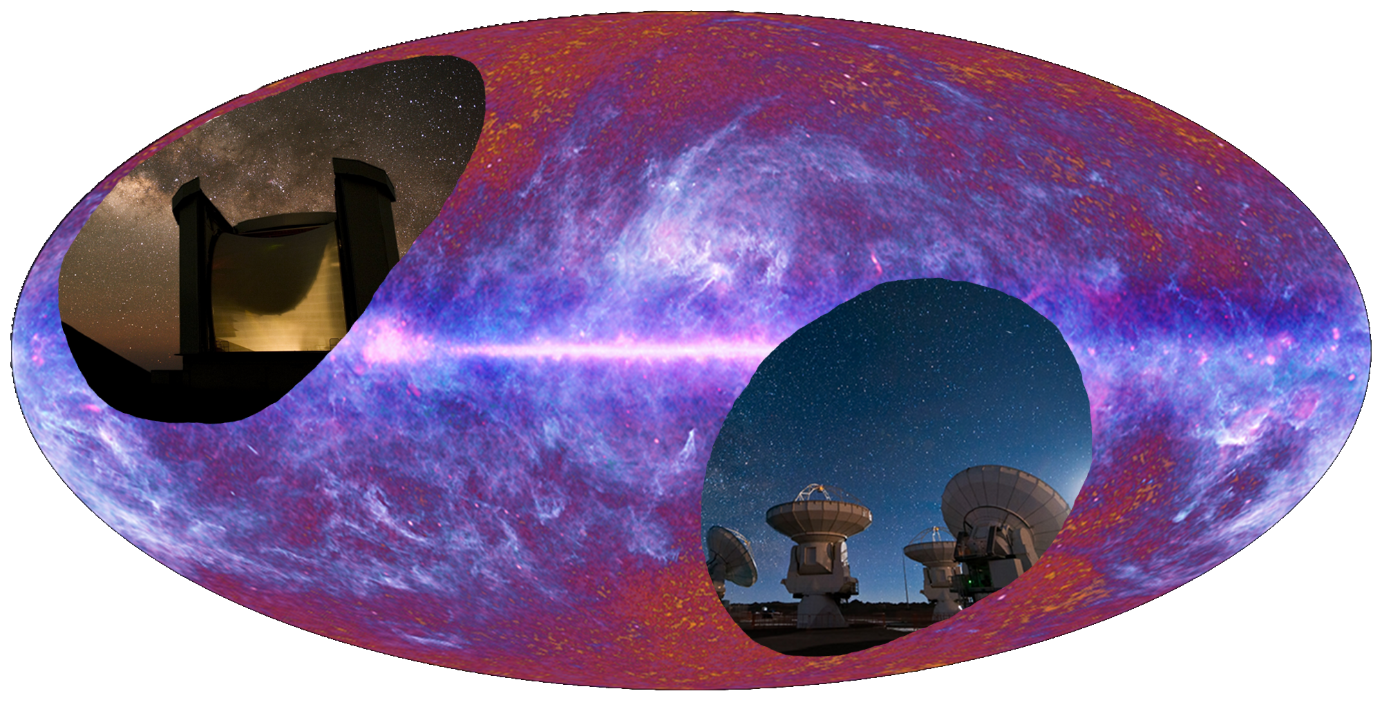
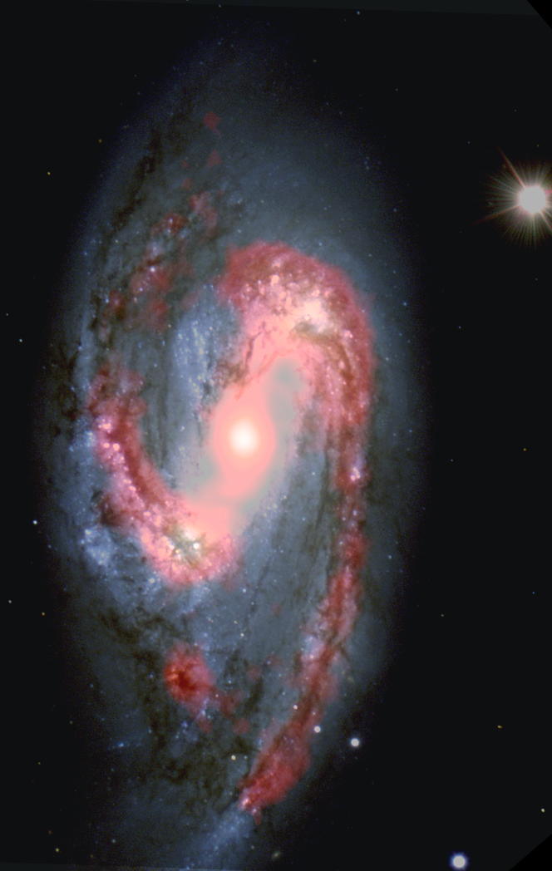
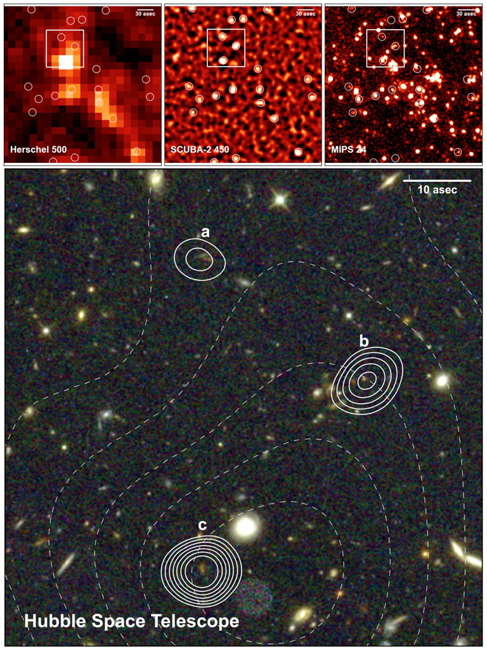
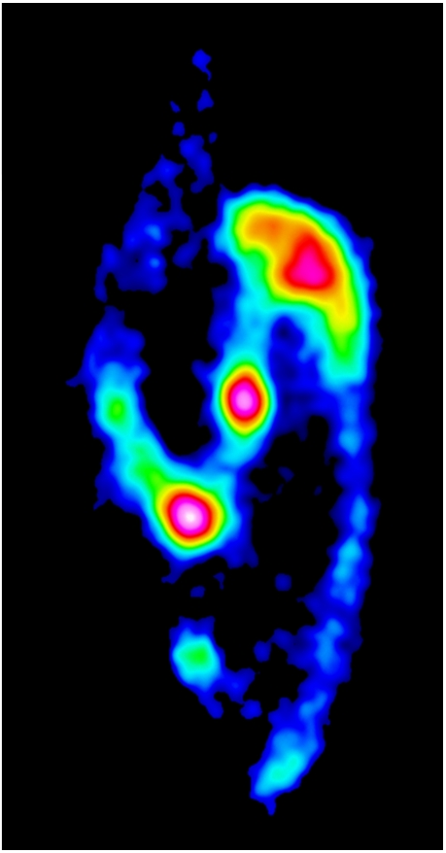
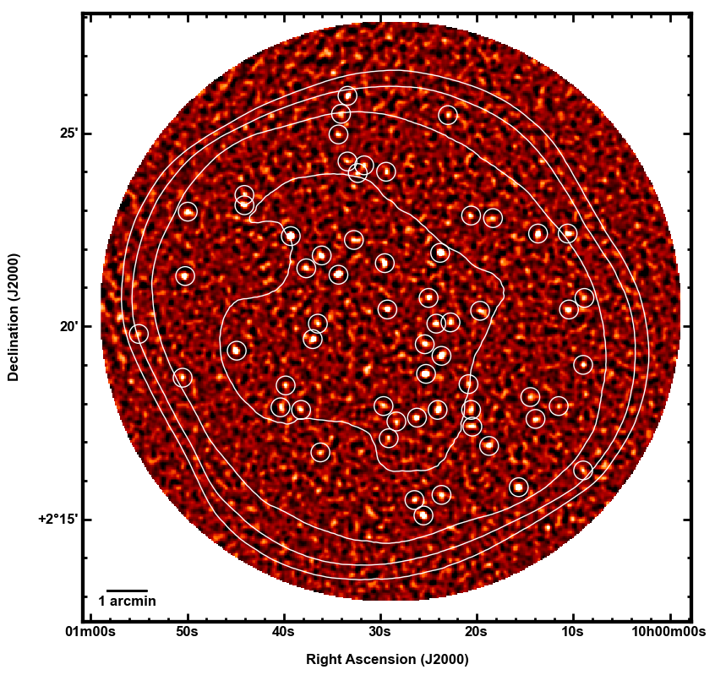
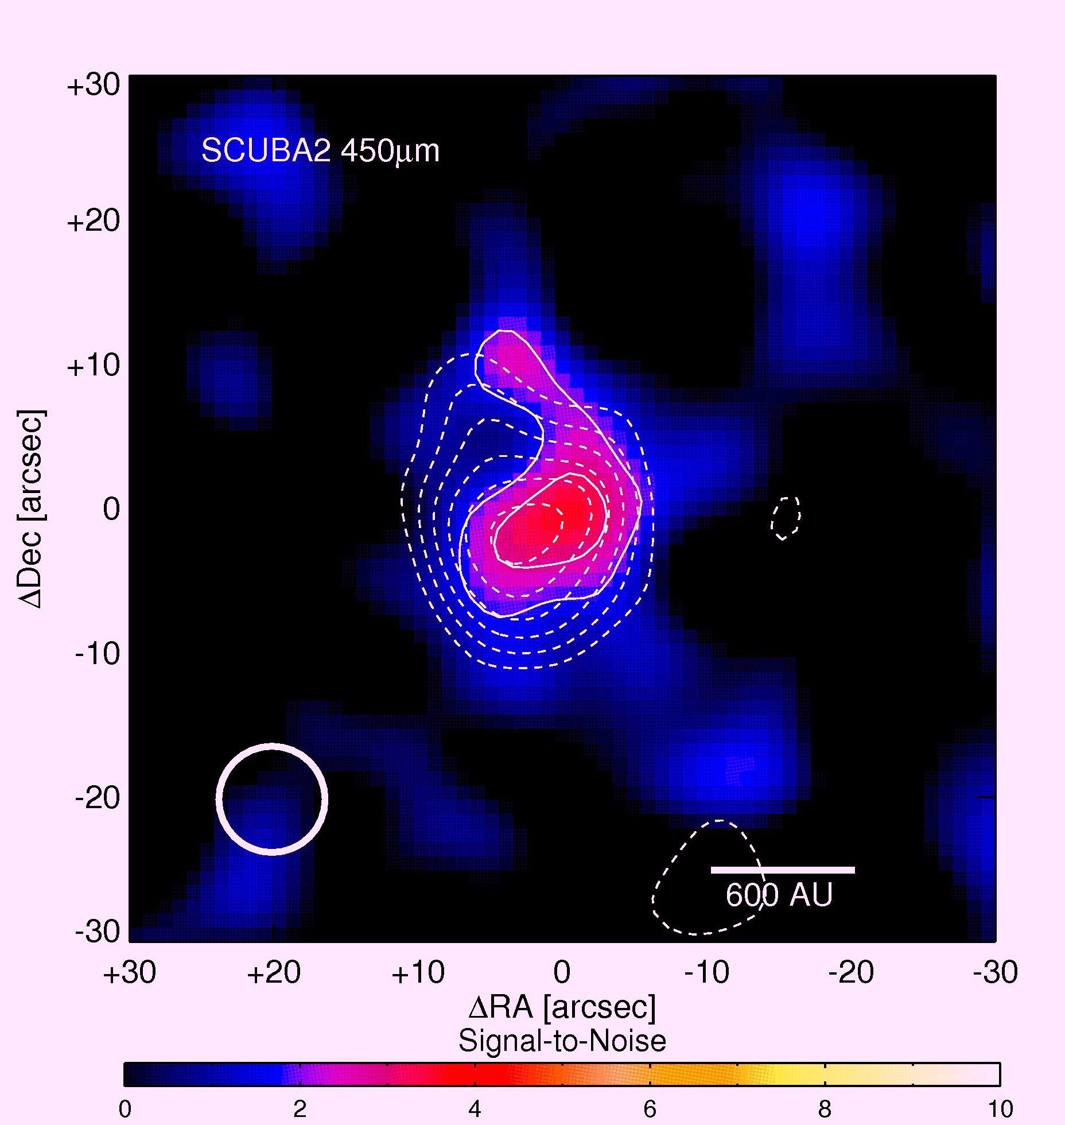
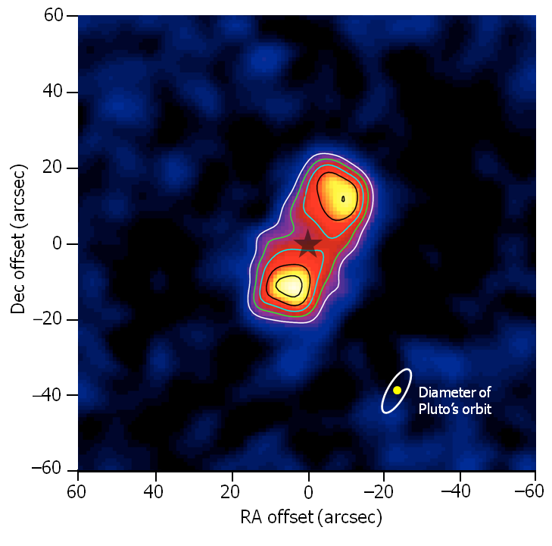
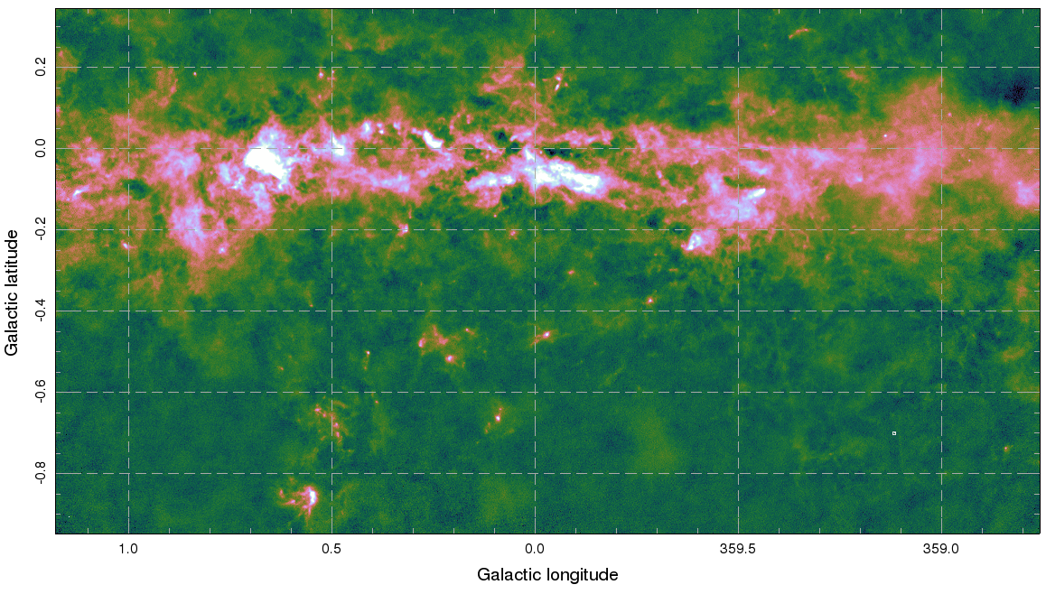
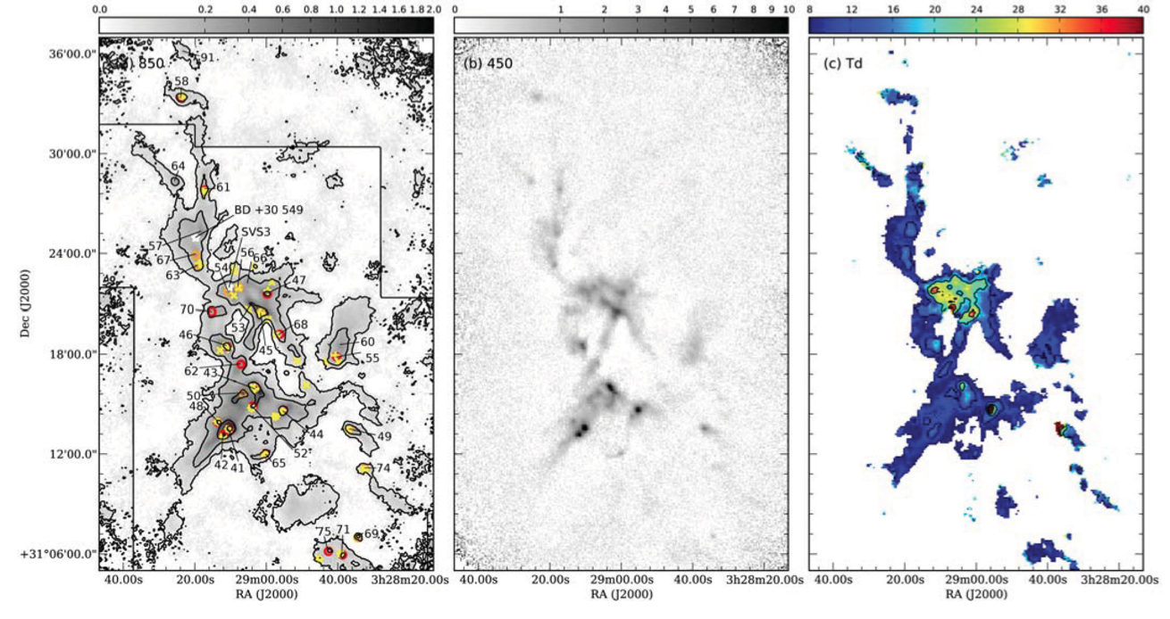
www.jach.hawaii.edu/JCMT/
www.jach.hawaii.edu/JCMT/
JCMT in the era of ALMA
The James Clerk Maxwell Telescope (JCMT), with a 15m dish, is the largest astronomical telescope in the world designed specifically to operate in the sub-mm wavelength regime. The JCMT is located close to the summit of Mauna Kea, Hawaii, at an altitude of 4092m.
The most recent addition to the JCMT’s suite of instruments is the 10,000 bolometer sub-mm continuum instrument: SCUBA-2. SCUBA-2 operates simultaneously with 7’ x7’ foot print sub-arrays at both 450 and 850-microns. SCUBA-2’s wide field surveying potential, combined with a 65% shared view of the sky from both sites (see figure directly below), makes it the ideal instrument to provide complementary data for the ALMA Project.
JCMT Field Only
(ALMA cannot see this far north)
The shared ALMA and SCUBA-2 sub-mm sky
Background Image: ESA, Planck
ALMA Field Only
(JCMT cannot see this far south)
Over 100 hours are being spent observing 100 spiral galaxies down to an rms of ~1.5mJy. Above left: M66 at 850-microns overlaid on the optical. Above right 850-micron emission. Credit NGLS team.
Imaging 115 stars in 135 hours SCUBA-2 seeks to search for evidence of debris disks. Above left: The Formalhaut debris disk at 850-microns. Above right: 49 Ceti debris disk at 450-microns.
Credit: SONS team.
Above left: cosmology survey field observed to a depth of 1.2mJy (at 450-microns) with sub-mm sources identified. Above right: zoom in to the central sources at various wavelengths with counterparts identified. Credit: CLS team/ ROE.
SCUBA-2 is imaging sections of the Galactic plane at 850-microns building up exposure time by stitching together observations of a degree in diameter. Final depth will be on the order of 10-15mJy.
Credit: JCMT.
Image of NGC 1333 taken as part of the Gould Belt Survey.
Above left: CO-subtracted SCUBA-2 850-micron map. Middle: 450-micron map. Right: dust temperature map in Kelvin.
Credit: Hatchell et al. (2012).
The HARP spectral imaging instrument on JCMT is undertaking a high resolution (14”) CO (3-2) survey of the Galactic plane. This ambitious project is being under taken during “poor” weather (Tau_{225GHz} > 0.12) and will cover longitudes of 10-65°to a depth of 1K. Currently covers 25 square degrees in 120 hours.
Credit: Thomas & Dempsey
www.jach.hawaii.edu/JCMT/
Poster Credit: Harriet Parsons & Holly Thomas

